Slide 1
Timeseries Forecast
Case of Study : Production Gas Rate

Slide 2
Agenda
Introduction and problem statement
Question
Data source
Data preparation
Data cleaning
Tools we used
Solution Method
Result

Slide 3
Introduction
Time series data is touching everything in our lives. For example: stocks price, weather data, sales data, house price, sensors data etc.
Difference between forecast and prediction:
Forecasting problems are a subset of prediction problems wherein both use the historical data and talk about the future events. The only difference between forecasting and prediction is the explicit addition of temporal dimension in forecasting.

Slide 4
Problem Statement
To forecast production gas rate from drilling dataset
Reframed the Problem`
Train, Test, Split
(Expanding Windows)
No
Walk Forward Validation (MAE)
Yes
Final Model

Slide 5
Forecasting method using Sliding Window Method
Reframed the data to supervised learning
X
t | var1 | var2
0 | 1 | 10
1 | 2 | 11
2 | 3 | 12
3 | 4 | 13
t | Var1(t-1) | Var2(t-1) | Var1(t) | Var2(t)
0 | ? | ? | 1 | 10
1 | 1 | 10 | 2 | 11
2 | 2 | 11 | 3 | 12
3 | 3 | 12 | 4 | 13
Used the previous data, X (t-1) to predict the data, y at (t)
y

Slide 6

Train Test Split
Traditional approach ML cannot be use to split the dataset into train and test samples, as it has to capture the time sequence. Instead, the to split the data at certain point in time, where the older data is used to train the model while the newer data used to test the model.

Slide 7
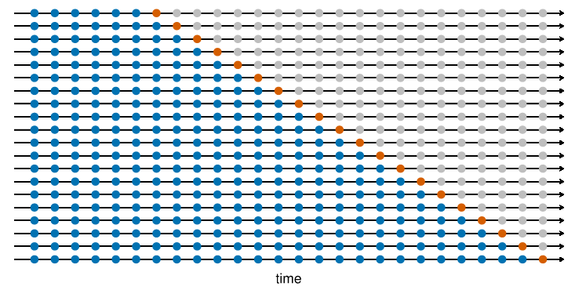
Model Validation
Walk forward validation method is used to verify the model that is developed (expanding windows).
The predicted value are compared with the actual value (red dot)
The results are stored and MAE (Mean Absolute Error) is used to evaluate the accuracy of the model
Forecasting: Principles and Practice
Rob J Hyndman and George Athanasopoulos

Slide 9
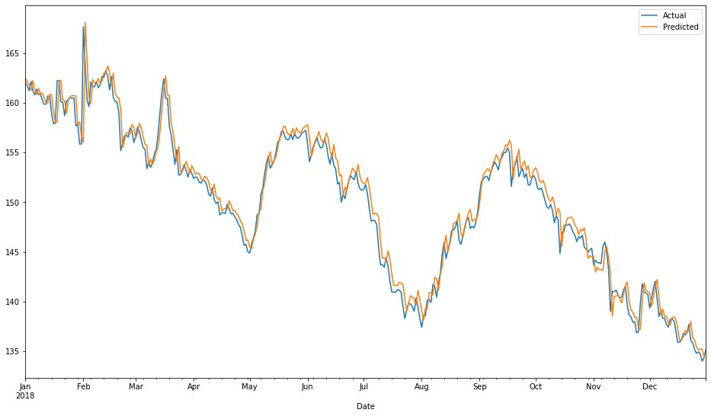
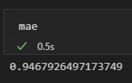
Results
Train dataset:
2014-2017
Test Dataset
2018
MAE

