Slide 1
Timeseries Forecasting
Case Study : Production Gas Rate
BY:
Ahmad Makintha
Rajesh Nair

Slide 2
INTRODUCTION

Slide 3
BACKGROUND
Forecasting future oil and gas production for a well is one of the most important tasks of a production engineer.
These production forecasts are used for estimating remaining reserves, optimizing production operations and business planning, among other tasks.
Similar technique can be implemented in various fields which involved time series data to do the short term forecasting from previous time series data.
Time series data is touching everything in our lives. For example: stocks price, weather data, sales data, house price, sensors data etc.
Difference between forecast and prediction:
Forecasting problems are a subset of prediction problems wherein both use the historical data and talk about the future events. The only difference between forecasting and prediction is the explicit addition of temporal dimension in forecasting.

Slide 4
DATA SOURCE
Petroleum Exploration Society of Australia (PESA).
This dataset contains Gas rate production from 2014 to 2018.
Production data of gas rate at different wells.
Feature:
Water Rate
Casing head pressure
Turbine head pressure
Pump speed
Torque
Gas Rate

Slide 5
TOOLS USED
Python Pandas
Matplotlib
HTML/CSS/Bootstrap
Java script Plotly
SQLite Database
Flask
Heroku
ML libraries like Scikit-learn, TensorFlow, Keras

Slide 6
Forecasting Methods
Multivariate
A multivariate times series has more than one time dependent variable. This dependency is used for forecasting future values.
Linear regression model
Random Forest model
Univariate
A univariate times series has only one variable.
RNN using LSTM

Slide 7
Multi Variate
Reframed the Problem`
Train, Test, Split
(Expanding Windows)
To forecast the next day production gas rate from historical drilling dataset
No
Walk Forward Validation (MAE)
Yes
Final Model

Slide 8
Forecasting method using Sliding Window Method
Reframed the data to supervised learning
X
t | var1 | var2
0 | 1 | 10
1 | 2 | 11
2 | 3 | 12
3 | 4 | 13
t | Var1(t-1) | Var2(t-1) | Var1(t) | Var2(t)
0 | ? | ? | 1 | 10
1 | 1 | 10 | 2 | 11
2 | 2 | 11 | 3 | 12
3 | 3 | 12 | 4 | 13
Used the previous data, X (t-1) to predict the data, y at (t)
y

Slide 9

Train Test Split
Traditional approach ML cannot be use to split the dataset into train and test samples, as it has to capture the time sequence. Instead, the to split the data at certain point in time, where the older data is used to train the model while the newer data used to test the model.

Slide 10
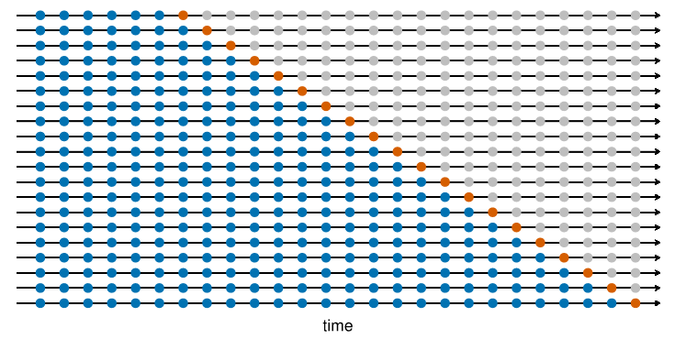
Model Validation
Walk forward validation method is used to verify the model that is developed (expanding windows).
The predicted value are compared with the actual value (red dot)
The results are stored and MAE (Mean Absolute Error) is used to evaluate the accuracy of the model
Forecasting: Principles and Practice
Rob J Hyndman and George Athanasopoulos

Slide 11
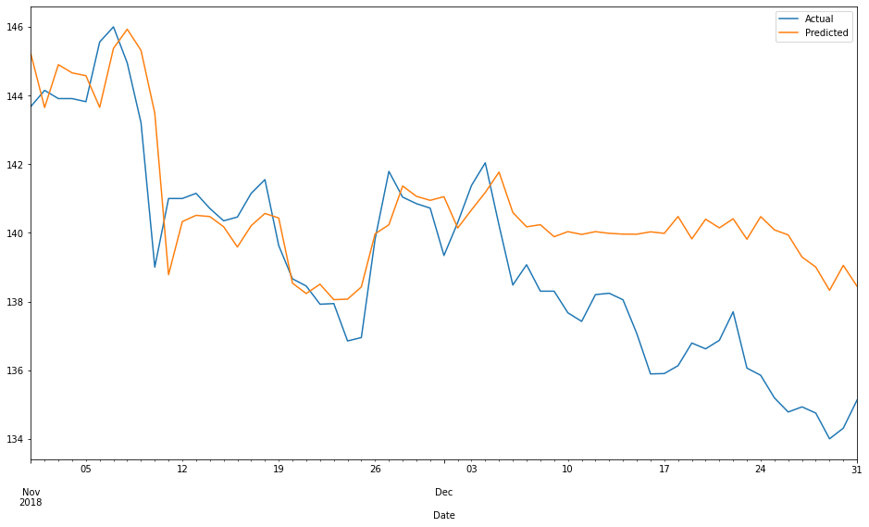
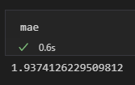
Random Forest Model
Train dataset:
2014-Oct 2018
Test Dataset
Nov – Dec 2018
MAE (Mean Absolute Error)

Slide 12
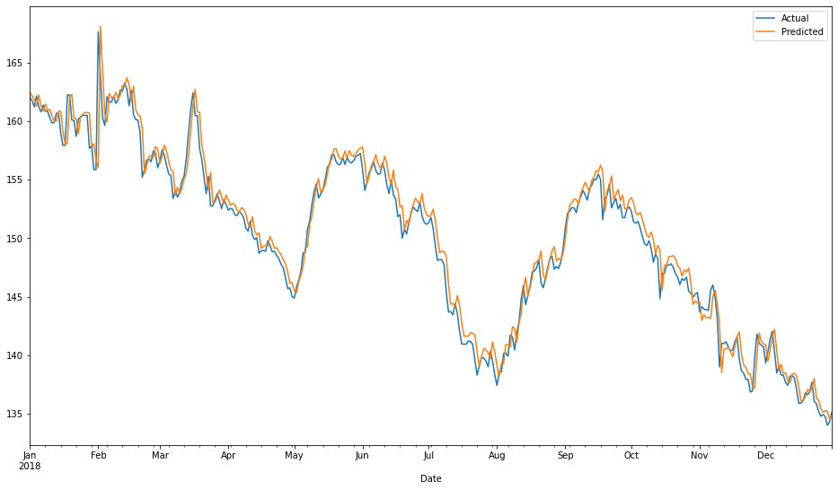
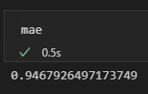
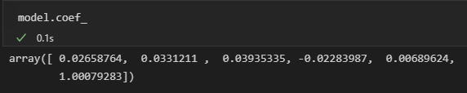
Linear Regression Model
Train dataset:
2014-2017
Test Dataset
2018
MAE (Mean Absolute Error)

Slide 13
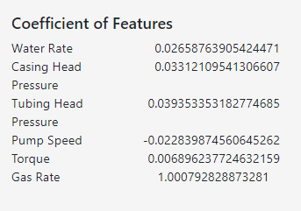
Coefficient of features

Slide 14
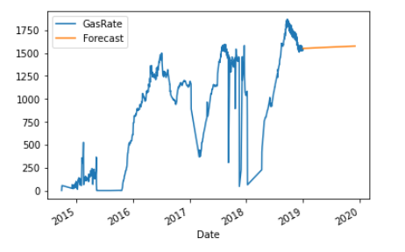
Univariate forecasting using RNN with LSTM
Manually split the data as train and test.As we don’t want machine to split randomly.
Scale the data using MinMaxScaler.
Create the model.
Evaluate the model.
Forecast new data.

Slide 15
CONCLUSION
Multivariate analysis is the analysis of three or more variables. There are many ways to perform multivariate analysis depending on your goals.
Univariate analysis is the simplest form of data analysis where the data being analyzed contains only one variable.

Slide 16
Limitation and Further Study
Correlation of features to target variable is very low in this data set, in this scenario it is better to go with univariate analysis.
Consultation with domain expert need to done for further analysis.

