Slide 1

A Project Review Meeting on Credit Score & Financial Eligibility Prediction System
By
Name P. Meghana roll 2520030461
Name M. Bhavya roll 2520030005
Team Number: 10
Under the guidance of
Dr. D. Pavithra
Assistant Professor
Department of Computer Science and Engineering
Koneru Lakshmaiah Education Foundation (Deemed to be University estd. u/s. 3 of the UGC Act, 1956) Off-Campus: Bachupally-Gandimaisamma Road, Bowrampet, Hyderabad, Telangana - 500 043. Phone No: 7815926816, www.klh.edu.in

Slide 2
Outline of the Presentation
Abstract
Introduction
Problem Statement
Project Flow Diagram
Objectives with Justification
Modules[Frontend web pages]
Expected Outcomes of the Proposed Work
Conclusion
References

Slide 3
Abstract
The Credit Score & Financial Eligibility Prediction System is a web-based application designed to help users analyze their financial health and predict their creditworthiness. The system evaluates financial parameters such as income, expenses, savings, debts, and repayment history to estimate a credit score and determine loan eligibility. It provides interactive dashboards, financial analytics, and personalized recommendations that help users improve their credit profile and make informed financial decisions.

Slide 4
Introduction
Credit scoring plays a crucial role in determining an individual's eligibility for loans and financial services. Traditional methods of evaluating creditworthiness are often complex and lack transparency. This project aims to develop a user-friendly platform that simplifies credit assessment by providing insights into financial behavior, spending patterns, and loan eligibility. The system enables users to understand the factors influencing their credit score and supports better financial planning.

Slide 5
Problem Statement
Many individuals face difficulties in understanding their financial standing and the factors affecting their credit score. Existing systems provide limited transparency and often require manual analysis. There is a need for a smart and accessible platform that can:
Evaluate financial health.
Predict credit scores.
Determine loan eligibility.
Provide personalized financial recommendations.
Improve financial awareness and planning.

Slide 6
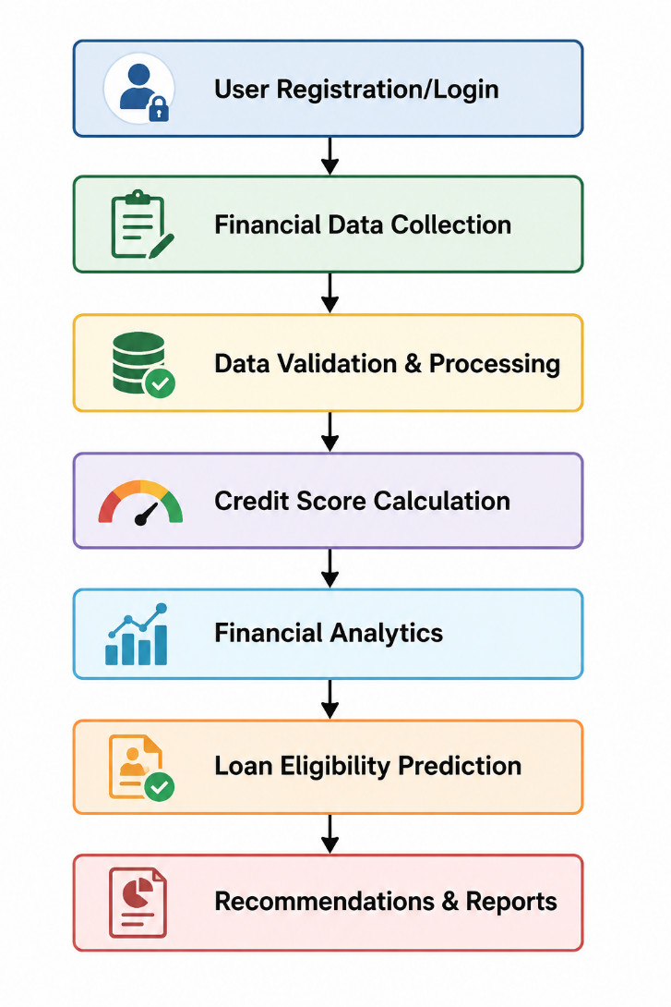
Project Flow Diagram

Slide 7
Objectives with Justification
Objectives:
The main objective of this project is to develop a user-friendly system that analyzes financial data and predicts credit scores and loan eligibility. The application helps users understand their financial health through analytics, reports, and personalized recommendations. By providing transparent insights into credit evaluation, the system supports better financial planning, improves decision-making, and increases awareness of factors that influence creditworthiness. This makes financial assessment simpler, faster, and more accessible for users.

Slide 8
Modules [Frontend web pages]
Module 1: Login & Registration Module
User authentication and account creation.
Secure access to the system.
Module 2: Dashboard Page
Overview of financial metrics.
Credit score display and insights.
Module 3: Analytics Module
Spending and savings analysis.
Visual representation of financial trends.

Slide 9
Modules [Frontend web pages]
Module 4: Credit Score Simulator
Simulates changes in credit score based on financial activities.
Helps users understand score improvement strategies.
Module 5: Loan Eligibility
Evaluates eligibility for loans.
Displays approval probability and criteria.
Module 6: Reports Module
Spending and savings analysis.
Visual representation of financial trends.

Slide 10
Modules [Frontend web pages]
Module 7: Profile Management Module
Manage personal and financial information.
Update user preferences.

Slide 11
Expected Outcomes of the Proposed Work
Accurate estimation of credit scores.
Better understanding of financial health.
Improved financial planning and budgeting.
Loan eligibility prediction with greater transparency.
Personalized recommendations for credit improvement.
Enhanced user awareness of financial behavior.

Slide 12
Conclusion and Future Scope
The proposed system provides a comprehensive platform for analyzing financial health, predicting credit scores, and assessing loan eligibility. It enables users to make informed financial decisions through data-driven insights and interactive analytics.

Slide 13
References
References:
React.js Official Documentation.
Vite Official Documentation.
Research Papers on Credit Scoring and Financial Risk Assessment.
Financial Analytics and Loan Eligibility Prediction Studies.
Artificial Intelligence Applications in Finance Journals.

Slide 14
CO’S Concepts Used
CO | Concepts Used in Project
CO1 | Component Architecture, Virtual DOM, State-driven UI
CO2 | ES6, Async/Await, Promises, Modules
CO3 | Components, Props, State, Hooks, Forms
CO4 | State Management, Data Processing, Async Operations
CO5 | Routing, Form Validation, Accessibility
CO6 | Vite, Deployment, Optimization, Scalability

Slide 15
References
References:
React.js Official Documentation.
Vite Official Documentation.
Research Papers on Credit Scoring and Financial Risk Assessment.
Financial Analytics and Loan Eligibility Prediction Studies.
Artificial Intelligence Applications in Finance Journals.

Slide 16
Thank you

