Slide 1


A Cutting Edge App and Website Bringing AI to the Automatic Detection of Multi purpose Blood Diseases For Diagnosis, and Treatment

Slide 2

The Team
Eng. Mohammad Makki
Dr. Amira Zaylaa
Notes:
The team was divided into two parts backend and frontend and a leader that guided the team and made sure everything goes as planned

Slide 3


Introduction
The diagnosis of blood-based diseases often involves identifying and characterizing patient blood samples.
Automated methods to detect and classify blood cell subtypes have important medical applications.
Automated biomedical image processing and analysis offers a powerful tool for medical diagnosis.

Slide 4
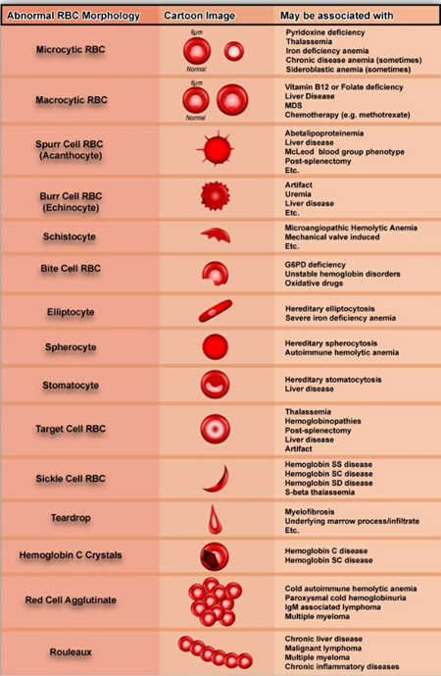
Problem Statement
In this work we tackle the problem of abnormal red blood cell classification based on the morphological characteristics of the cell. The work explores a set of preprocessing algorithms and Deep Learning Convolutional Neural Networks with a set of feature extraction techniques that can recognize, measure, count and classify the region of interest.

Slide 5
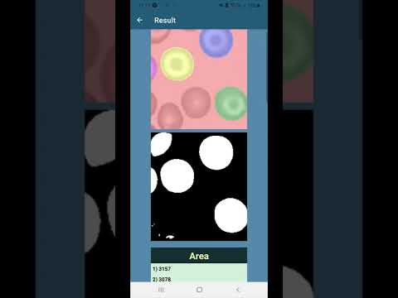
Video of Prototype

Slide 6
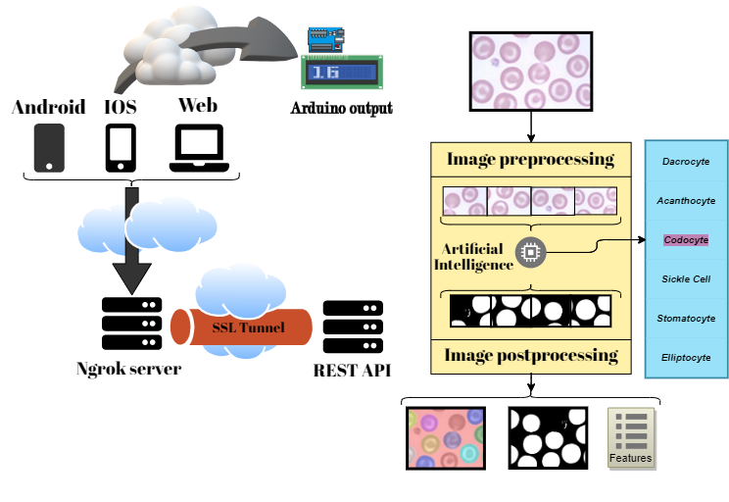
Block Diagram

Slide 7
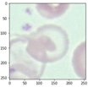
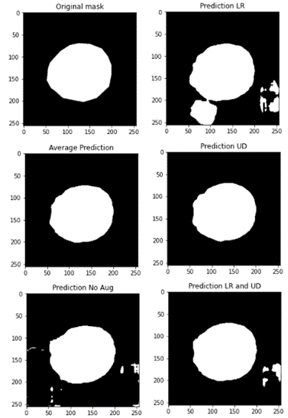
Outcome Benefits
The outcome of this work can be used as a framework by medical doctors or researchers for automated blood cell classification and feature extraction, it can aid in the diagnosis and treatment process of related blood diseases.

Slide 8
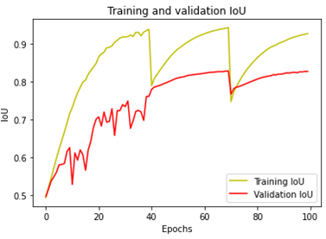
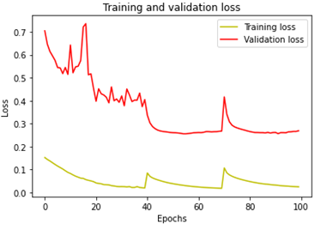
Results
All models had an IoU score above 0.942 on the training dataset and an IoU score above 0.828 on the validation dataset.
Lastly with Prediction Time Augmentation predicted on the dataset all models achieved a mean IoU score above 0.882

Slide 9
Technical Summary
The application is built in React Native to provide cross platform functionality across Android, IOS and Web platforms. The application communicates with a REST API, built in Python (Flask) hosting the Artificial Intelligence through a secure tunnel. Once it receives an image it applies different preprocessing techniques to identify the appropriate patch size to crop the image into patches suitable for the AI to process. These patches are then passed to the chosen AI models to predict on them. Each AI is a binary semantic image segmentation model with Residual and Attention Unet architecture. The models are ensembled to perform as a single multiclass model, this process pipeline enables customization, helps in maintaining high accuracy rates for each class and provides an efficient way for scaling up the system. Prediction time augmentation is applied to get a more accurate prediction. Then the resulting prediction for each patch are reassembled into the full-sized image by applying smooth blending. The server then proceeds to extract features from the prediction (Area, Equivalent Diameter, Perimeter, Eccentricity, Orientation and Hu moments up to the sixth order ). Finally, the API packs the results in a JSON format and sends it back to the application. Upon receiving the results, the application opens a new page displaying them. It also provides an option to download the images as PNG and the extracted features as a CSV file. Lastly, The application interacts with an Arduino system if available via Bluetooth.

Slide 10
Thank you

