Slide 1

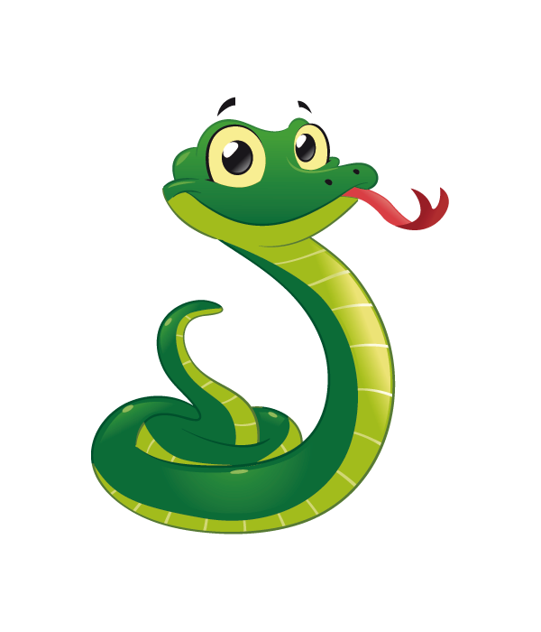
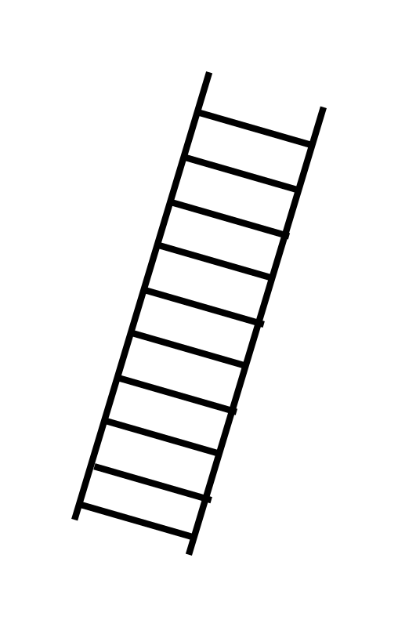
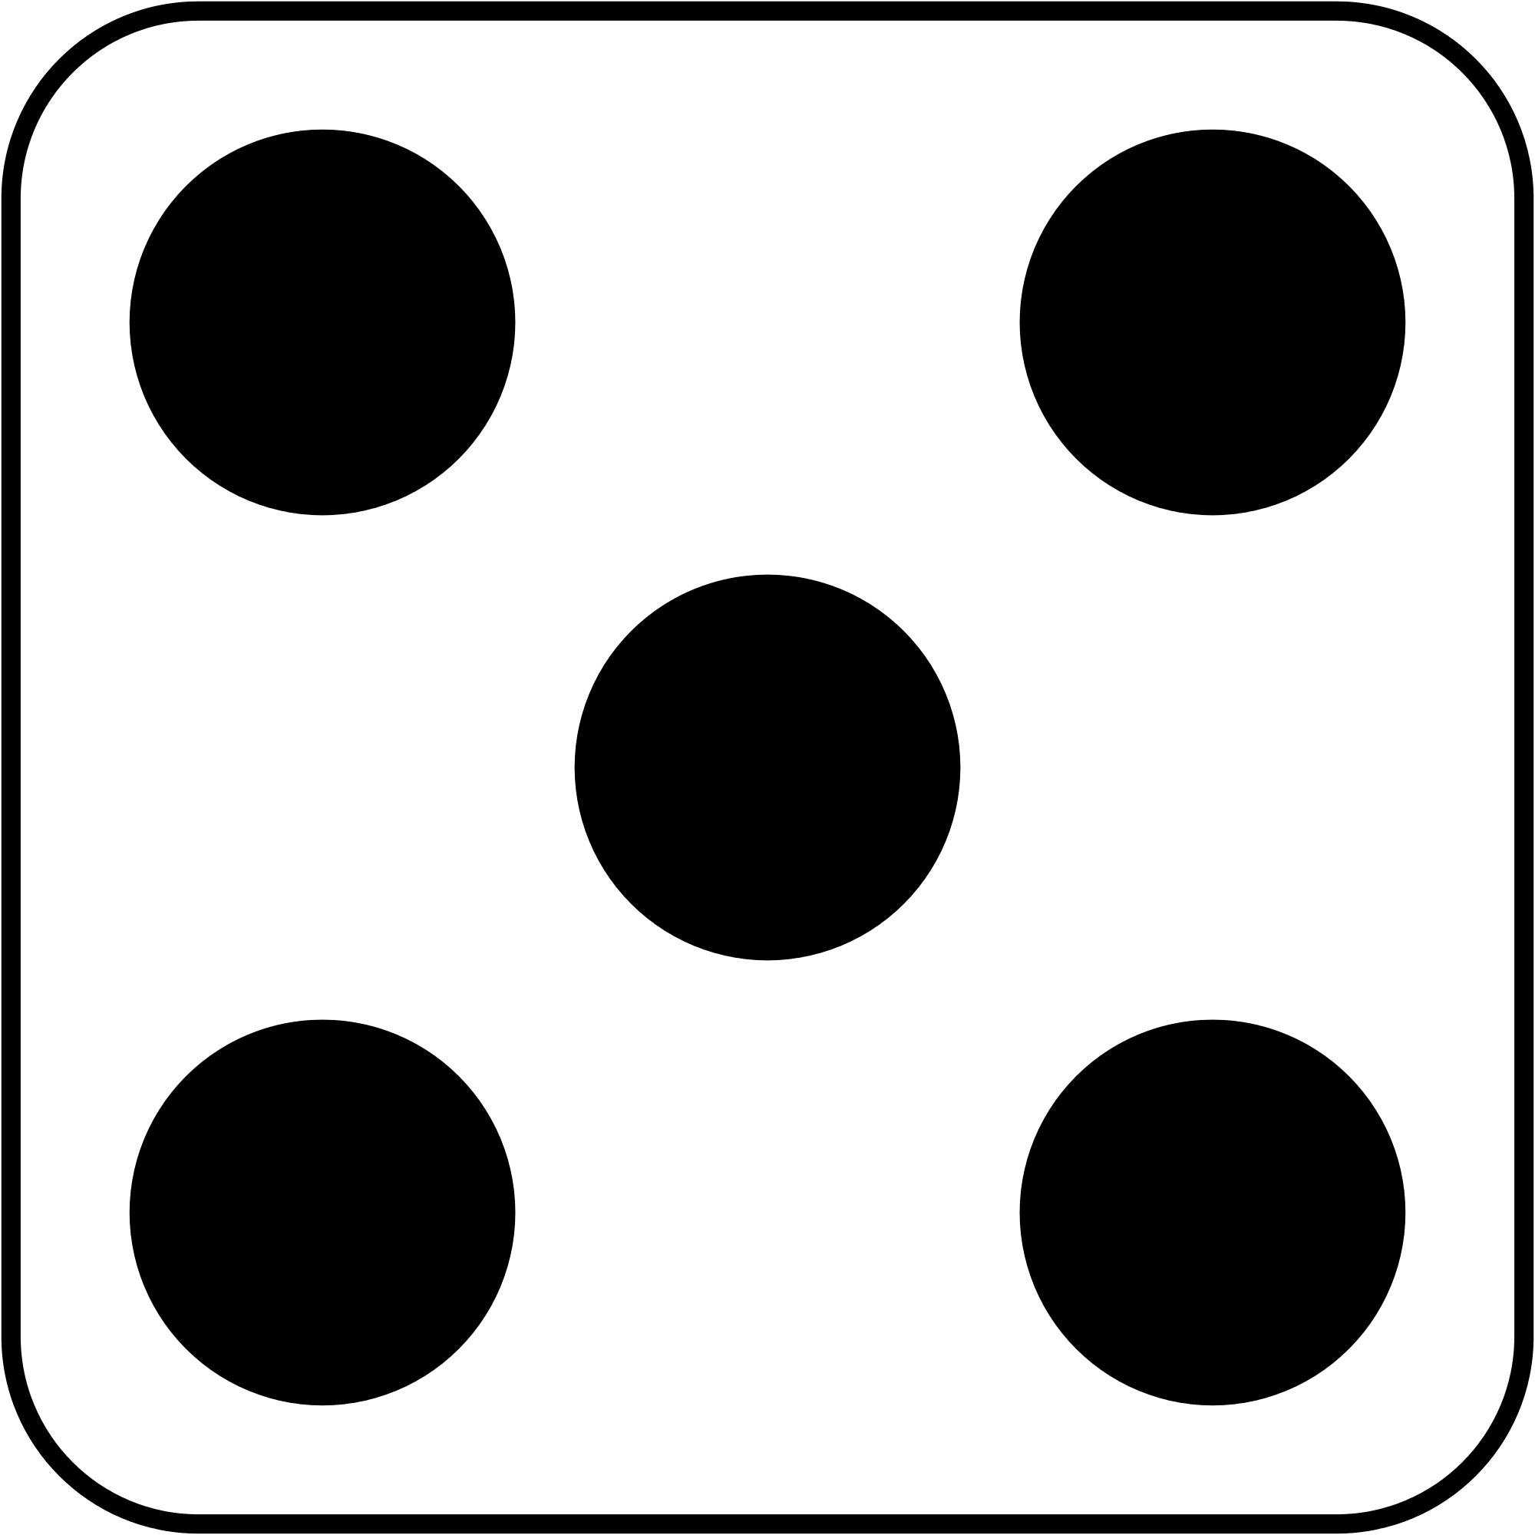
Software Project Lab-1
Project Proposal
Project Name –
LUDO AND SNAKE-LADDER

Slide 2

INTRODUCTION
Ludo and Snake-ladder game are two difference classical game which combined in one board. These are desktop based application with Multiplayer options. In the game there are hundred indexes for Snake-Ladder. In Ludo Game, Ludo is a board game for two to four players, in which the players race their four tokens from start to finish according to dice rolls.

Slide 3
OBJECTIVES
This project involves the demonstration of snake-ladder and ludo game board, on which user can play the game with other players.
In Ludo, move all four of the player's pieces clockwise once around the board, up the home column, and into the home triangle.
To begin, a player must roll a six to move a piece out of the base and onto the start position.
Ludo can be played by 2-4 players, with each player choosing a different types of token.
In Snake-Ladder, only the location of current player is shown on the board, the location of other player is mentioned below the board.

Slide 4
TARGET CUSTOMERS
Children.
Students.
Idle People.
Young People.
Old Age People.

Slide 5
PROJECT GOAL
To incorporate modern game design elements
Provide a fun and engaging gaming experience
To provide different game modes
Developed to played on multiple platforms.

Slide 6
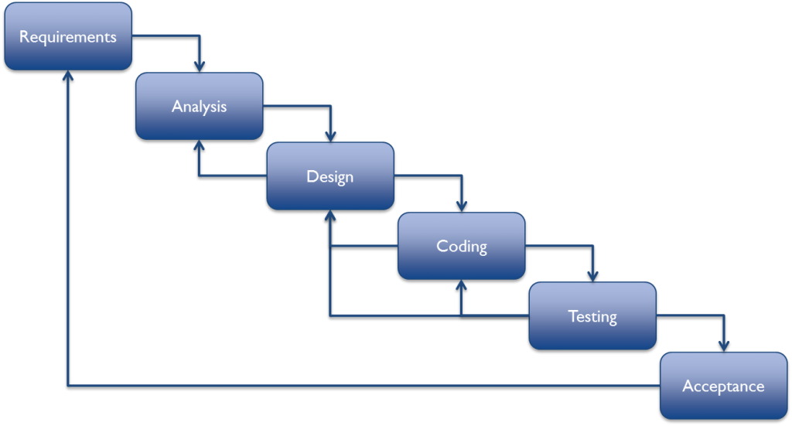

MODEL & LANGUAGES
Water Fall Model

Slide 7
TIMELINE
Submission
Integration & Testing
Implementation
System Design
Requirements Gathering
Project Proposal
02 April 10 May 1 June 28 June 30 July 20 August

Slide 8
Deliveries
1.
Source Code.
2.
Documents
3.
JAR File

Slide 9
CHALLENGES
Limited graphics capabilities.
No support of images and animations.
Multiplayer functionality.
Testing and debugging.

Slide 10

ANY QUESTION

Slide 11
That's it! Have fun playing Ludo!
THANK YOU!

