Slide 1
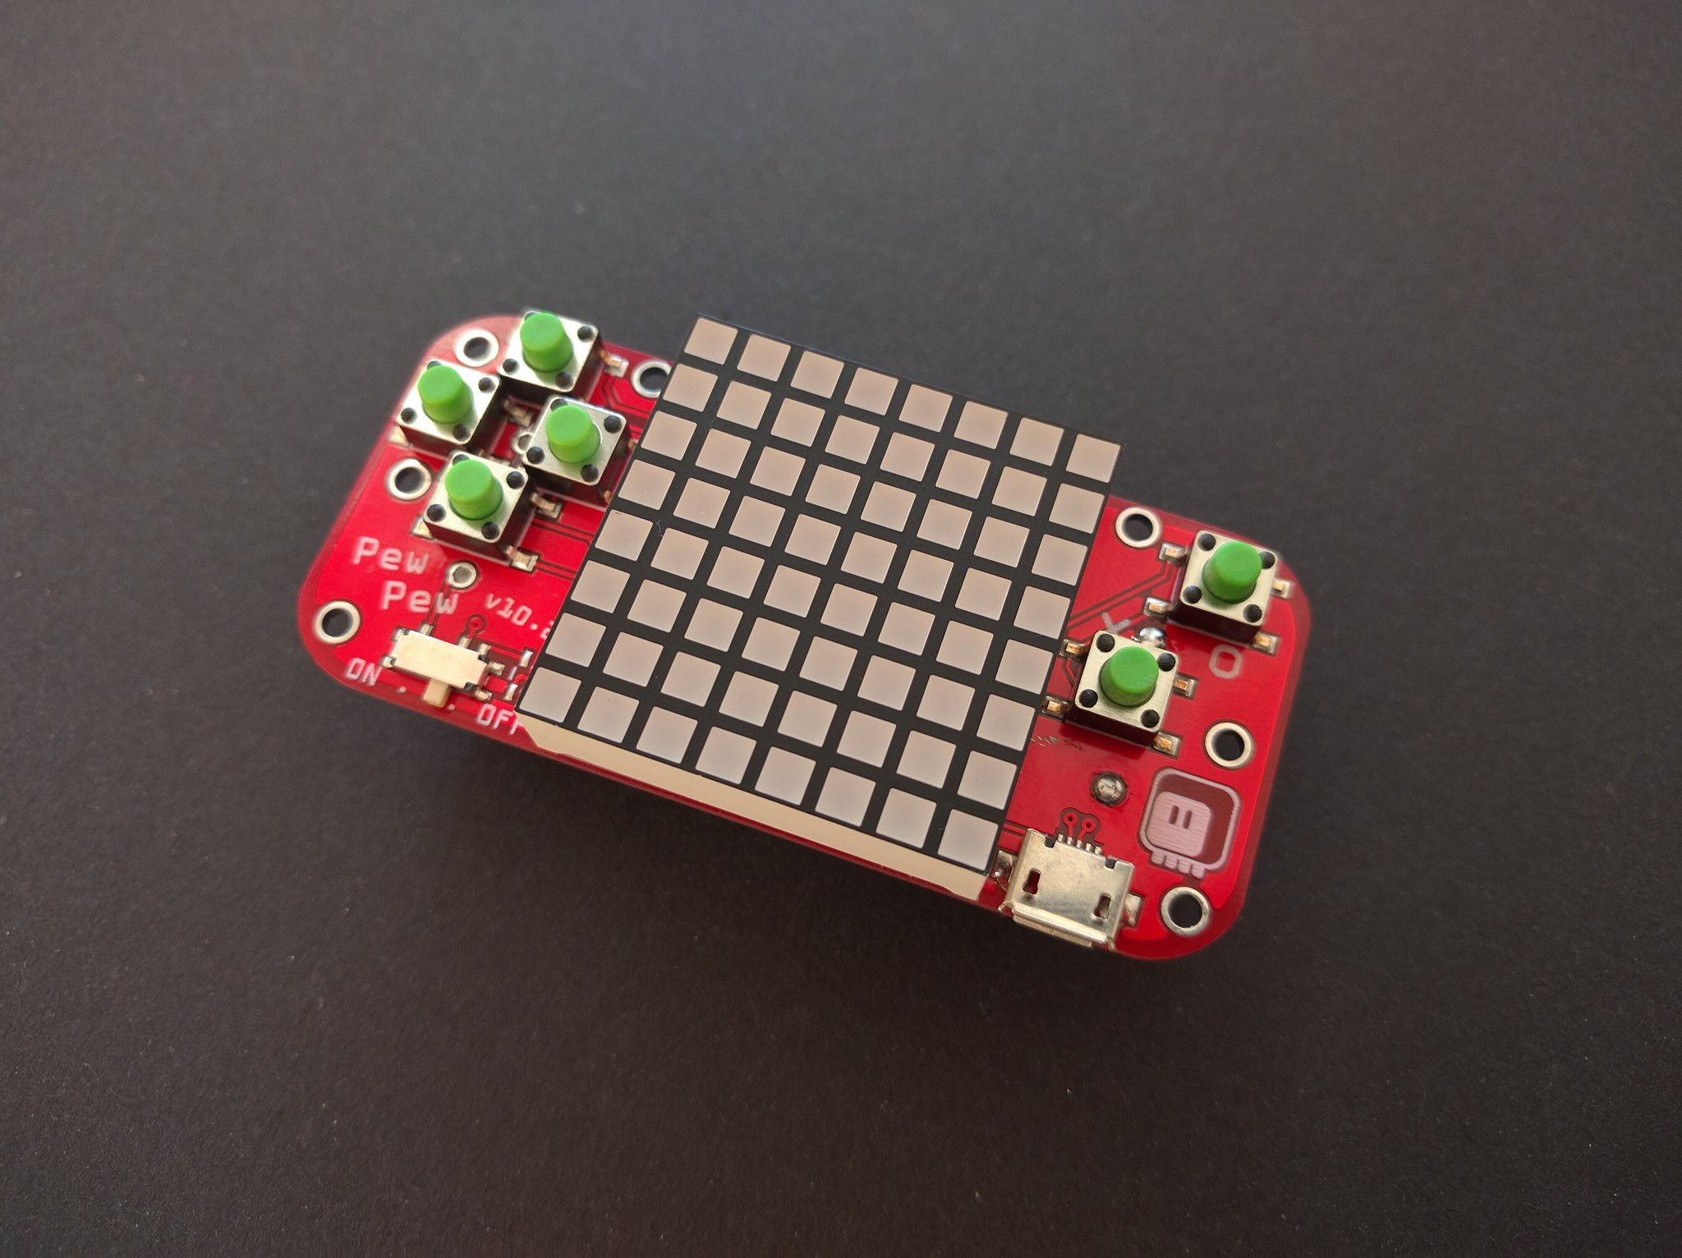
PewPew-Qube
An educational quantum Rubik’s cube for the PewPew!

Slide 2
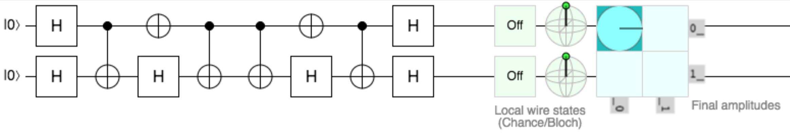
Goal: Invert unknown random circuit
?

Slide 3


Representation: level 1-3
00 | 01
10 | 11

Slide 4
Representation: level 4
0
1/2
1/√2
1

