Slide 2
Man In The Middle Attack Disclaimer
https://www.linkedin.com/company/wocsa/ https://www.youtube.com/@WOCSA-rx2mn/
Disclaimer
The following demonstration is for educational purposes only.
We do not promote or encourage illegal activities.
Knowing your enemy is a half-won battle
La connaissance n'est réellement profitable que lorsqu'elle est partagée
https://github.com/wocsa

Slide 3
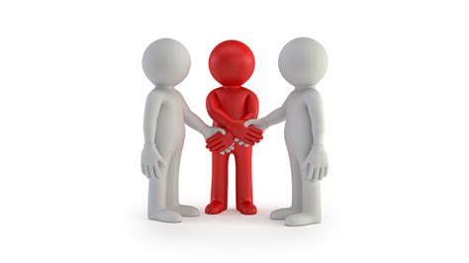
Man In The Middle Attack Agenda
https://www.linkedin.com/company/wocsa/ https://www.youtube.com/@WOCSA-rx2mn/
What is a Man In The Middle (MITM)?
How works a MITM?
Why attackers make MITM attacks?
How to protect yourself from MITM attacks?
https://github.com/wocsa

Slide 4
What is a Man In The Middle (MITM)?
10/06/2024

Slide 5
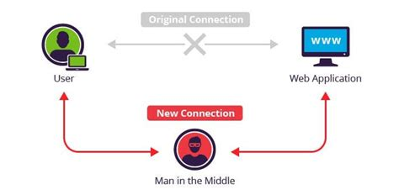
Man In The Middle Attack What is a Man In The Middle (MITM)?
https://www.linkedin.com/company/wocsa/ https://www.youtube.com/@WOCSA-rx2mn/
“Cyberattack where the attacker secretly relays and possibly alters the communications between two parties who believe that they are directly communicating with each other, as the attacker has inserted themselves between the two parties”
Wikipedia
https://github.com/wocsa

Slide 6
How works a MITM?
10/06/2024

Slide 7
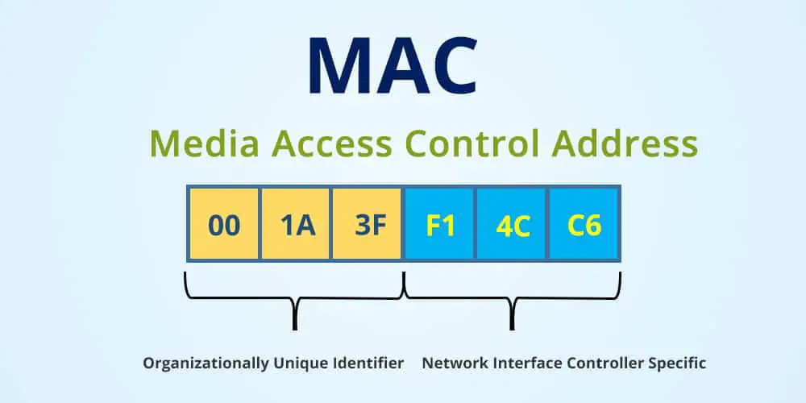
Man In The Middle Attack How works a MITM?
https://www.linkedin.com/company/wocsa/ https://www.youtube.com/@WOCSA-rx2mn/
“A media access control address (MAC address) is a unique identifier assigned to a network interface controller (NIC) for use as a network address in communications within a network segment.”
Wikipedia
https://github.com/wocsa

Slide 8
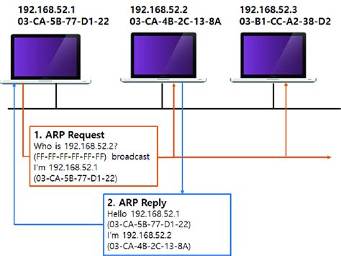
Man In The Middle Attack How works a MITM?
https://www.linkedin.com/company/wocsa/ https://www.youtube.com/@WOCSA-rx2mn/
Address Resolution Protocol (ARP)
“Communication protocol used for discovering the link layer address, such as a MAC address, associated with a given internet layer address, typically an IPv4 address.”
Wikipedia
Basically, it is a mapping between a MAC address and an IPv4 address
https://github.com/wocsa

Slide 9
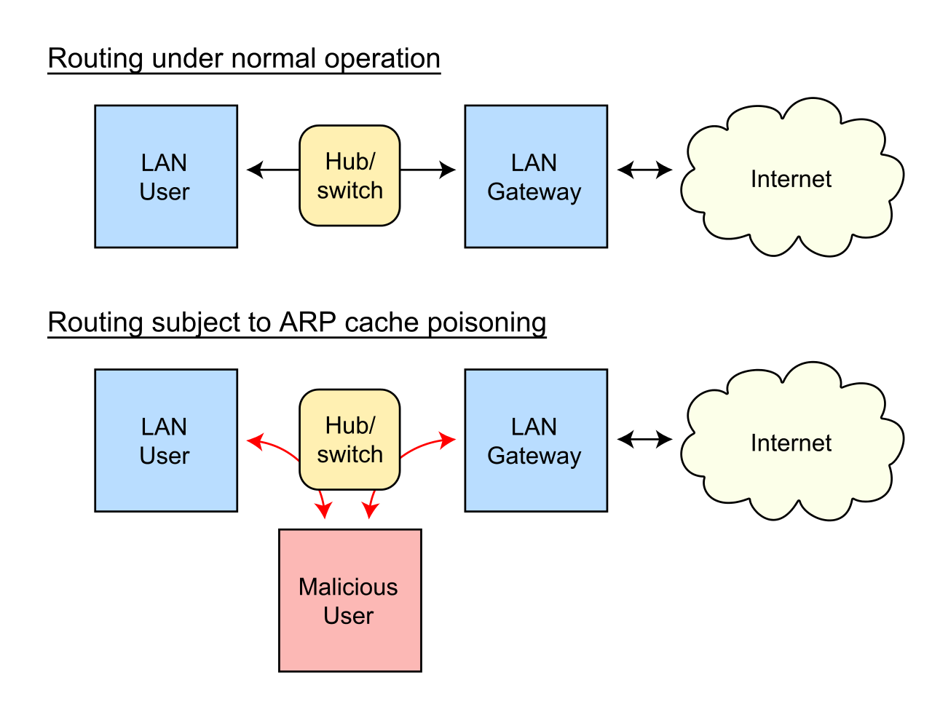
Man In The Middle Attack How works a MITM?
https://www.linkedin.com/company/wocsa/ https://www.youtube.com/@WOCSA-rx2mn/
ARP does not provide methods for authenticating ARP replies on a network
ARP replies can come from systems other than the one with the required Layer 2 address
https://github.com/wocsa

Slide 10
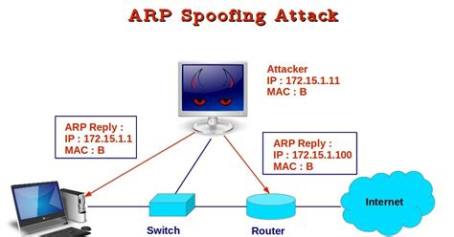
Man In The Middle Attack How works a MITM?
https://www.linkedin.com/company/wocsa/ https://www.youtube.com/@WOCSA-rx2mn/
Associate the attacker's host MAC address with the IP address of a target host
The victim will associate the attacker's host MAC address with the router’s IP address using ARP Reply
The router will associate the attacker's host MAC address with the victim’s IP address using ARP Reply
https://github.com/wocsa

Slide 11
Why attackers make MITM attacks?
10/06/2024

Slide 12
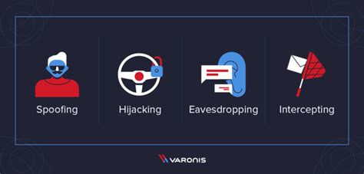
Man In The Middle Attack Why attackers make MITM attacks?
https://www.linkedin.com/company/wocsa/ https://www.youtube.com/@WOCSA-rx2mn/
Common examples of MITM attack
Network sniffing
HTTPS spoofing
DNS spoofing
DNS poisoning
JavaScript injection
Session Hijacking
And a lot of more…
With bad configurations, an attacker can steal a lot of your data and in the worst-case scenario get some of your passwords
It is very important to prevent it!
https://github.com/wocsa

Slide 13
How to protect yourself from MITM attacks?
10/06/2024

Slide 14
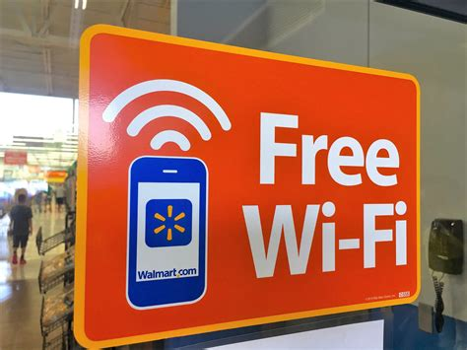
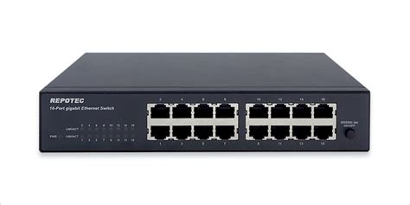
Man In The Middle Attack How to protect yourself from MITM attacks?
https://www.linkedin.com/company/wocsa/ https://www.youtube.com/@WOCSA-rx2mn/
Where can ARP spoofing be done ?
On a Wi-Fi network
On a switch/hub
You must protect yourself on networks that are not trusted!
Coffee shop Wi-Fi
Airport Wi-Fi
Public Wi-Fi in general
Weird friend’s Wi-Fi
Etc.
https://github.com/wocsa

Slide 15
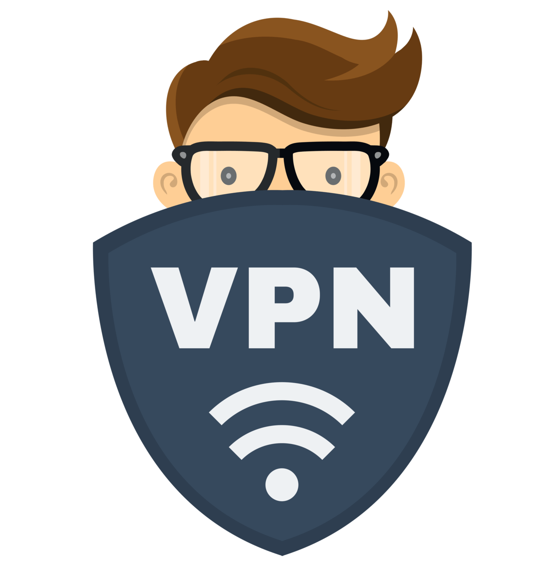
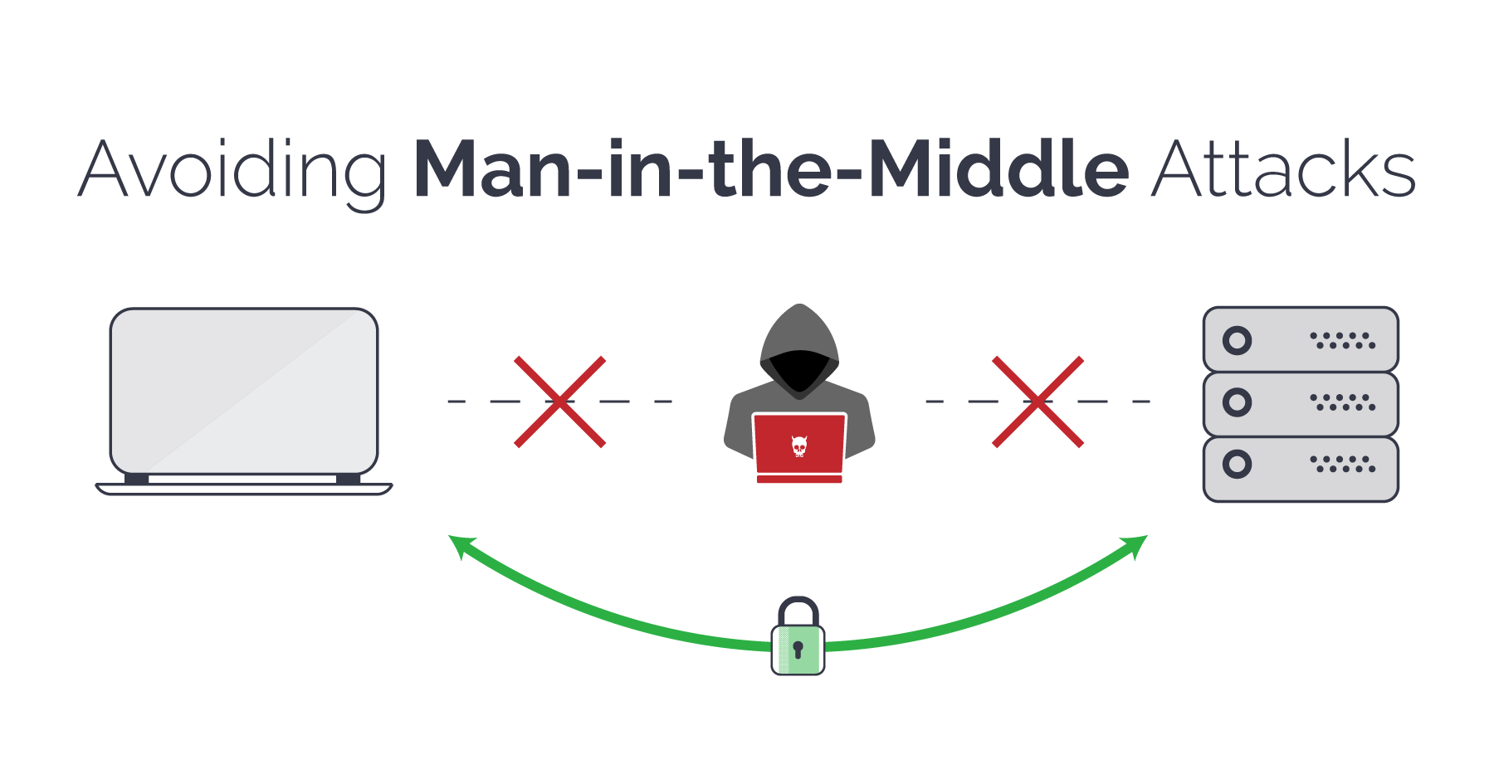
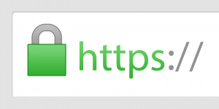
Man In The Middle Attack How to protect yourself from MITM attacks?
https://www.linkedin.com/company/wocsa/ https://www.youtube.com/@WOCSA-rx2mn/
But how ?
Use an encrypted connection
HTTPS
On websites
Your DNS still in plain text
VPN
For all of your traffic
You have to trust your VPN server
https://github.com/wocsa

Slide 16
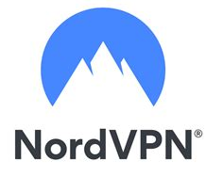
Man In The Middle Attack How to protect yourself from MITM attacks?
https://www.linkedin.com/company/wocsa/ https://www.youtube.com/@WOCSA-rx2mn/
Use our HOSTYOURSELF coupon
to get a 100% discount at NordVPN
WARNING
Nowadays VPN are mostly used as proxy. They are able to protect you against phishing websites, ads, virus, etc…
That means that your VPN provider can see your unencrypted data!
Such as MITM…
You have to trust your VPN server.
https://github.com/wocsa

Slide 17







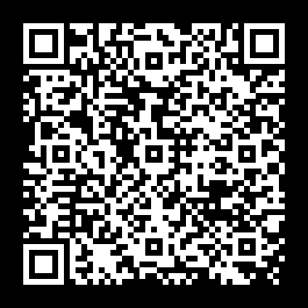


Join us to change the digital world: https://www.helloasso.com/associations/wocsa/adhesions/bulletin-d-adhesion-2 Please provide your feedback for our quality check process: https://www.wocsa.org/qcheck.php
10/06/2024
www.wocsa.org
@wocsa
@wocsa_asso
@wocsa
contact@wocsa.org
Join Us!
@WOCSA-rx2mn
https://discord.gg/pDunje3tpb

