Slide 1

Child Sleep Detection
Tomasz Makowski
Enrico Maria Marinelli
Wojciech Neuman

Slide 2

Introduction
The machine learning problem
of Child Sleep State Detection delivered by Child Mind Institute has been provided in the form of a challenge on the renown web platform Kaggle.

Slide 3


Introduction – Target variables
ONSET
WAKEUP

Slide 4
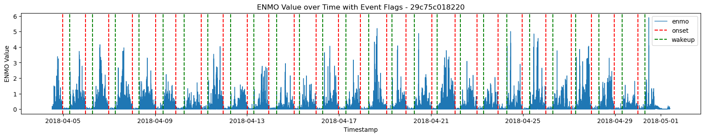
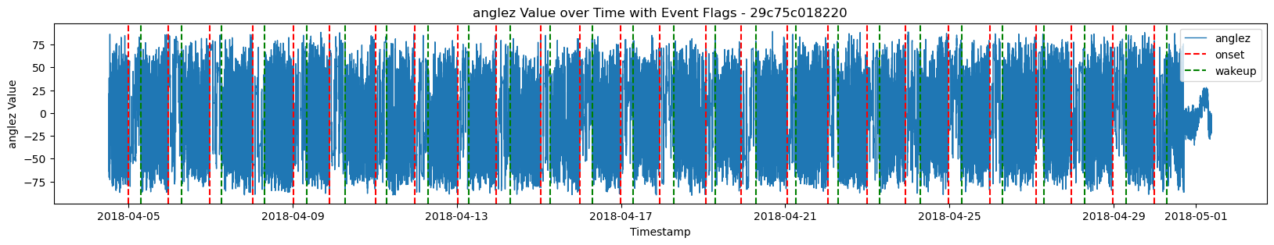
Data visualization
Visualization of 'enmo' and 'anglez' for a well-recorded series

Slide 5
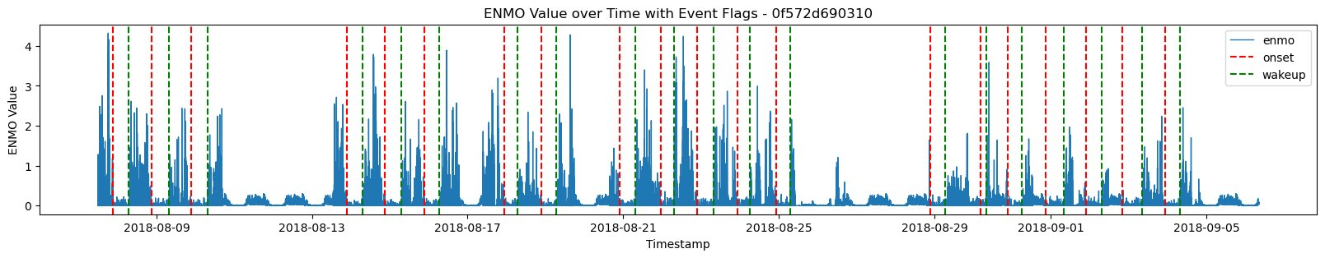
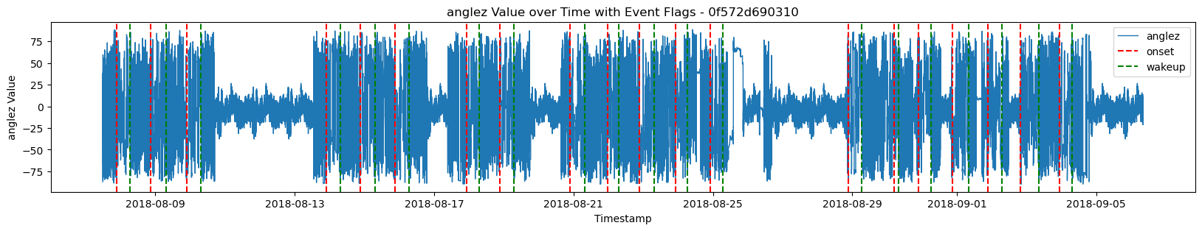
Incomplete series
47%
Poor Data Quality series

Slide 6
Dataset size
127 946 340
Even after removing poor-quality data we still
got huge dataset size with 39 308 249 rows.
Size of the initial train_series

Slide 7
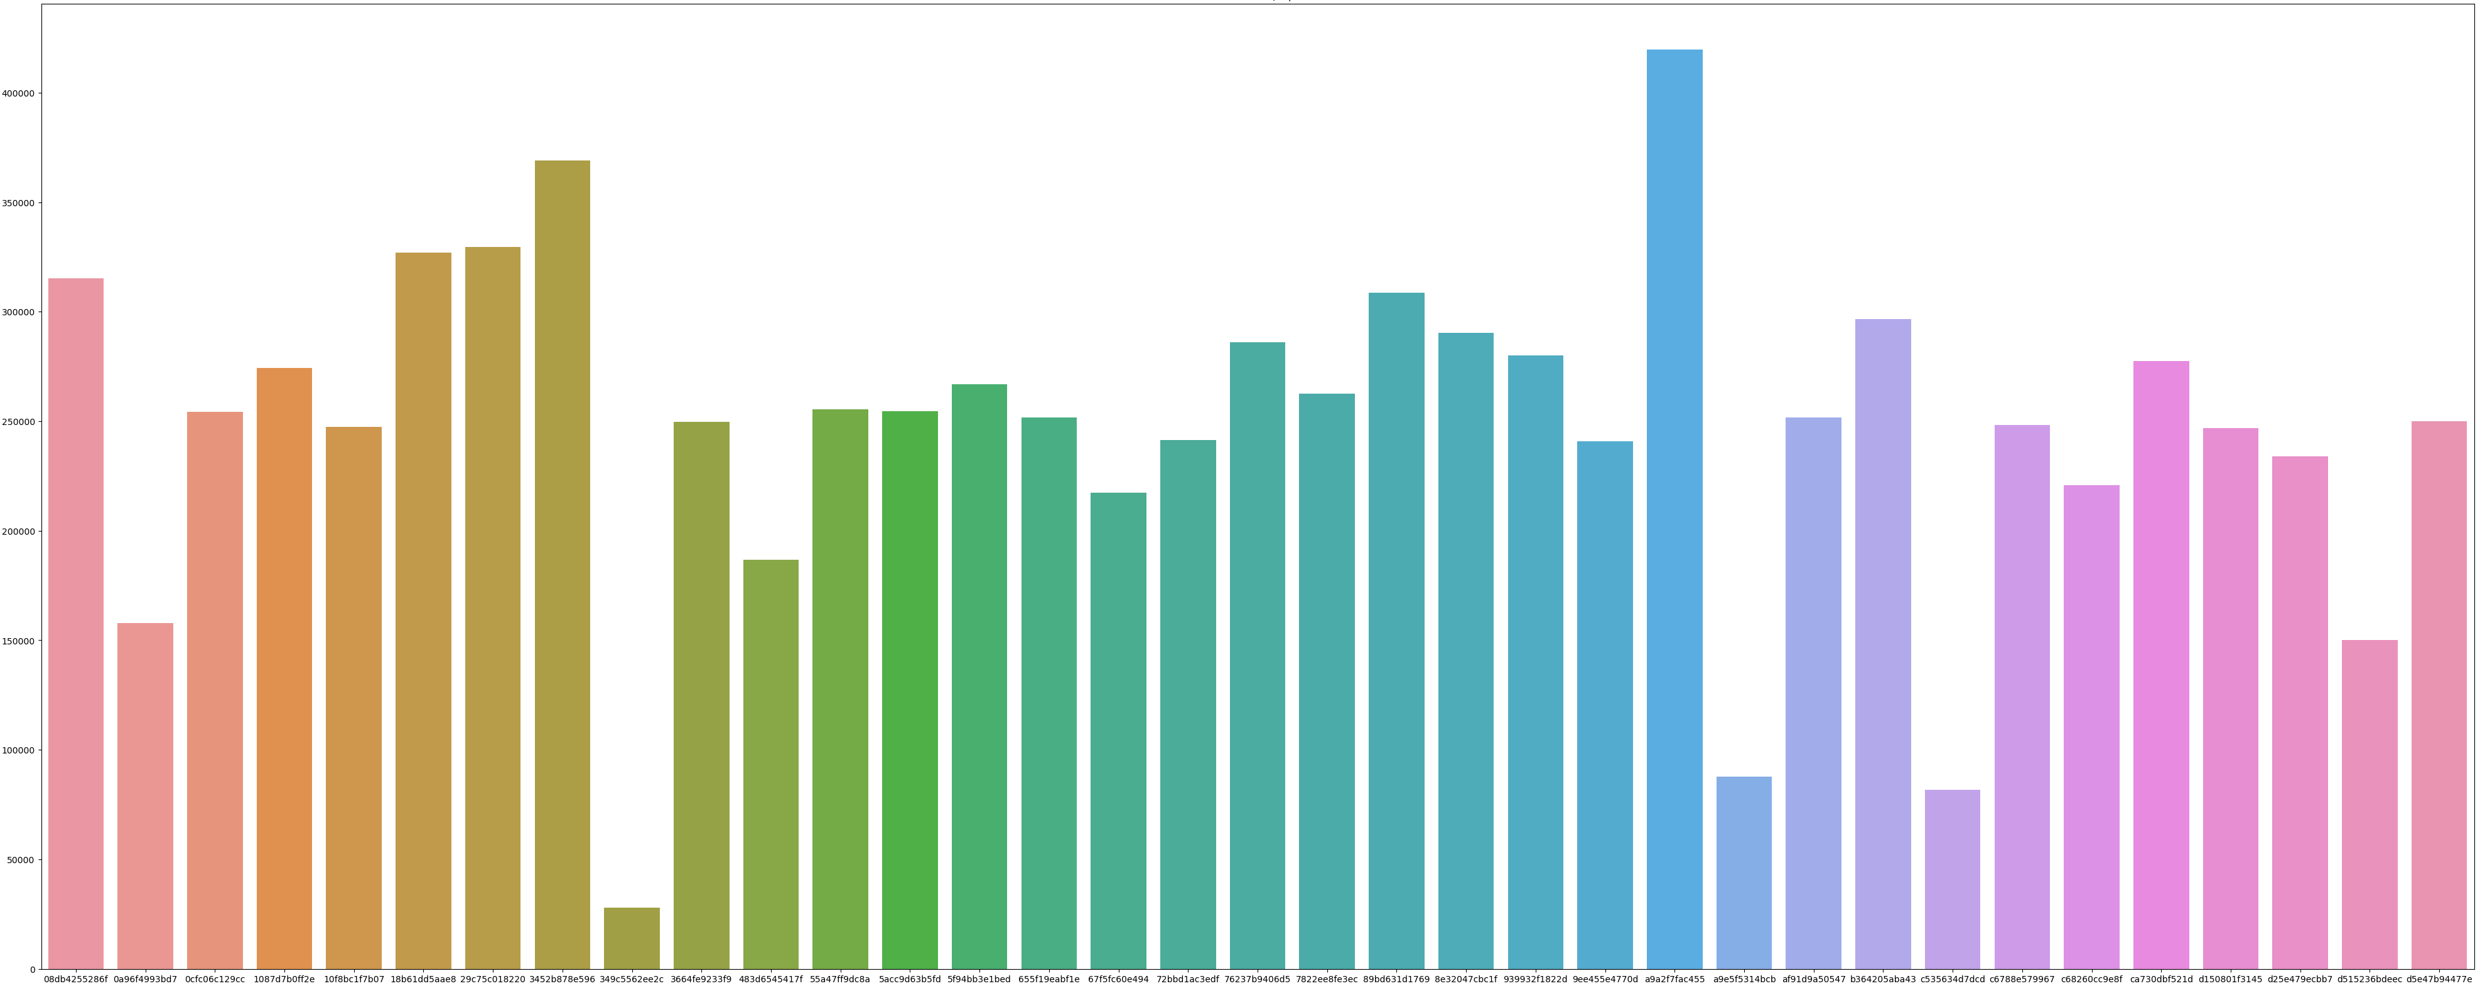
Dataset series distribution
4•10^5
3•10^5
Time-steps
2•10^5
1•10^5
Series ID
Is clear to see that not all the series are equally distributed

Slide 8
Feature Engineering
0.098
Model that used only two features that are obtained from the accelerometer performed poorly.
We need to introduce new features.
Score of model where only features are anglez & enmo.

Slide 9
Operations done during feature engineering
Anglez and enmo interaction
Temporal difference
Rolling statistic

Slide 10

Build Sequences
Window

Slide 11
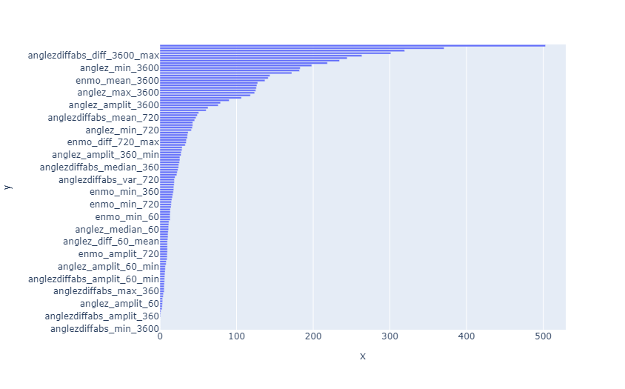
Feature importance (from Ensemble)
Features
Importance

Slide 12
Neural Network Model
LSTM block
First Conv + Residual block
Last Conv + Residual block + GAP

Slide 13
ENSEMBLE MODEL
Random Forest Classifier
XGBoost
Classifier
Ensemble Probability Average Classifier
Gradient Boosting Classifier
LGBoost
Classifier

Slide 14
Evaluation
Difference (in minutes) | Score
[0; 1) | 1
[1; 3) | 0.9
[3; 5) | 0.8
[5; 7.5) | 0.7
[7.5; 10) | 0.6
[10; 12.5) | 0.5
[12.5; 15) | 0.4
[15; 20) | 0.3
[20; 25) | 0.2
[25;30) | 0.1
>=30 | 0
Metric based on the Average Precision.
Evaluation in 3 stages:
Assignment,
Scoring,
Reduction.

Slide 15
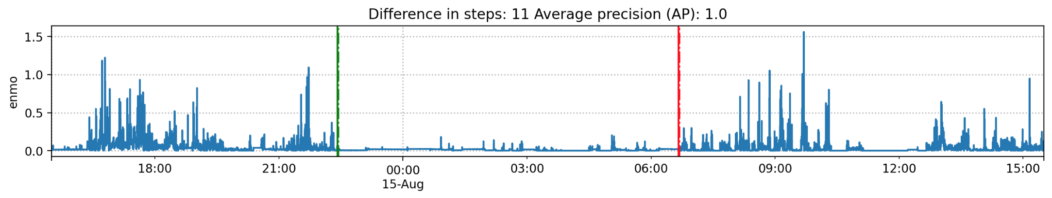


Example
Score 0.53
Notes:
Let's assume we had to detect only three events.
The threshold table in minutes: {1, 3, 5, 7.5, 10, 12.5, 15, 20, 25, 30}
The threshold table in steps: {12, 36, 60, 90, 120, 150, 180. 240, 300, 360}

Slide 16
Models Performance
Random Forest Classifier
Gradient Boosting Classifier
XGB Classifier
LGB Classifier
0.499
0.514
0.502
0.493

Slide 17
Ensemble Model Performance
Ensemble Probability Average Classifier
0.535

Slide 18
Questions

