Slide 1
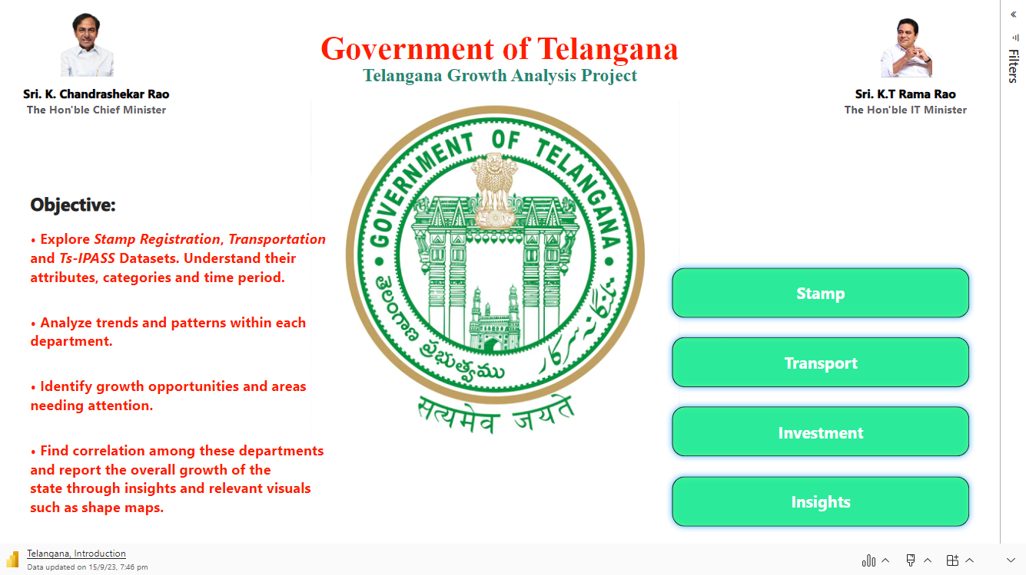

Slide 2


Primary Questions: Stamp Registration
1. How does the revenue generated from document registration vary across districts in Telangana? List down the top 5 districts that showed the highest document registration revenue growth between FY 2019 and 2022.
2. How does the revenue generated from document registration compare to the revenue generated from e-stamp challans across districts? List down the top 5 districts where e-stamps revenue contributes significantly more to the revenue than the documents in FY 2022?
3. Is there any alteration of e-Stamp challan count and document registration count pattern since the implementation of e-Stamp challan? If so, what suggestions would you propose to the government?
4. Categorize districts into three segments based on their stamp registration revenue generation during the fiscal year 2021 to 2022.

Slide 3
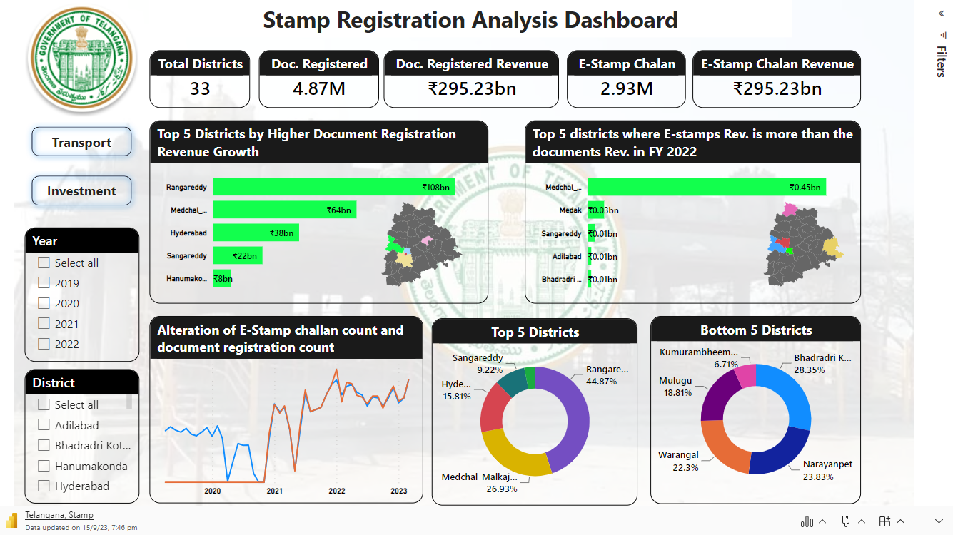

Slide 4
Primary Questions: Stamp Registration
How does the revenue generated from document registration vary across districts in Telangana? List down the top 5 districts that showed the highest document registration revenue growth between FY 2019 and 2022.
How does the revenue generated from document registration compare to the revenue generated from e-stamp challans across districts? List down the top 5 districts where e-stamps revenue contributes significantly more to the revenue than the documents in FY 2022?
Is there any alteration of e-Stamp challan count and document registration count pattern since the implementation of e-Stamp challan? If so, what suggestions would you propose to the government?
Categorize districts into three segments based on their stamp registration revenue generation during the fiscal year 2021 to 2022.

Slide 5
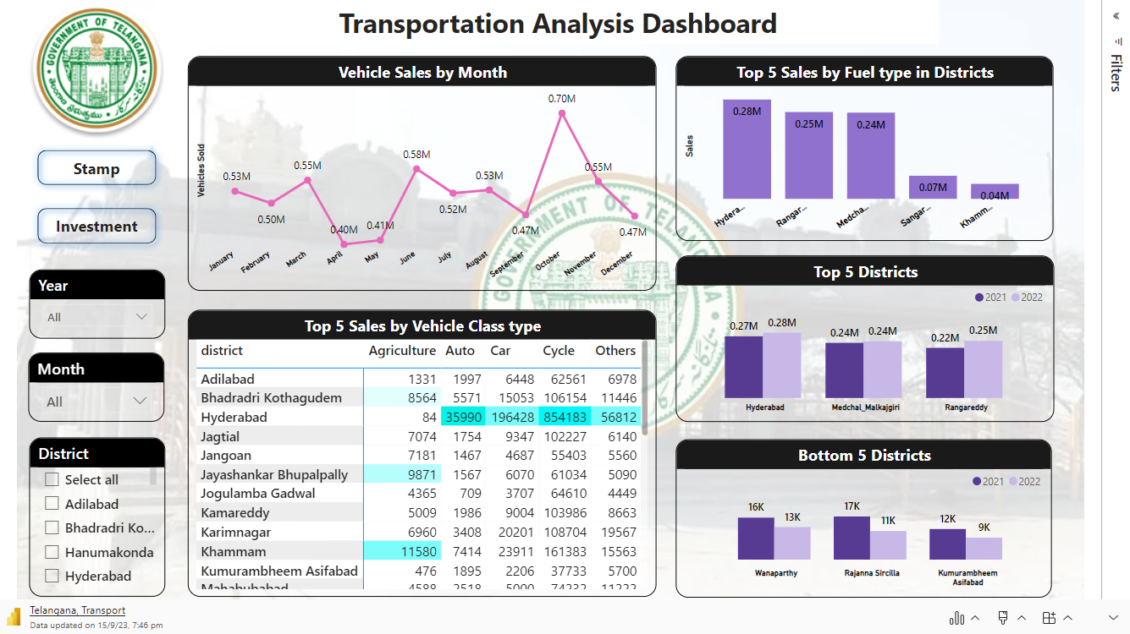

Slide 6
Primary Questions: Ts-IPass
List down the top 5 sectors that have witnessed the most significant investments in FY 2022.
List down the top 3 districts that have attracted the most significant sector investments during FY 2019 to 2022? What factors could have led to the substantial investments in these particular districts?
Is there any relationship between district investments, vehicles sales and stamps revenue within the same district between FY 2021 and 2022?
Are there any particular sectors that have shown substantialinvestment in multiple districts between FY 2021 and 2022?
Can we identify any seasonal patterns or cyclicality in the investment trends for specific sectors? Do certain sectors experience higher investments during particular months?

Slide 7
