Slide 1
Estimation of Actuation Configuration for a Multi-Actuated Blimp
Semester Thesis
Students: Matthias Krebs Advisors: Kostas Alexis
Simon Laube Markus Achtelik

Slide 2
Context / General Description

Slide 3
Problem Formulation
Nonlinear Least Squares Optimization
: Angular acceleration from gyro measurement : Nonlinear function depending on inputs and parameters
Parametrization
Quaternion
No Singularities
Constrained
Quadratic model
Gibbs-Rodriguez
Singularity at
Unconstrained
Nonlinear model

Slide 4
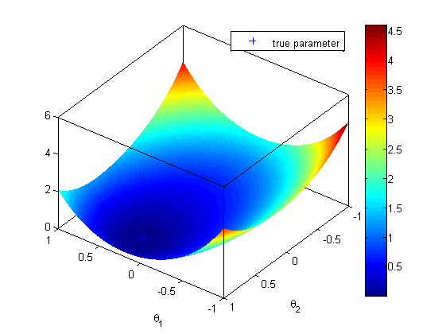
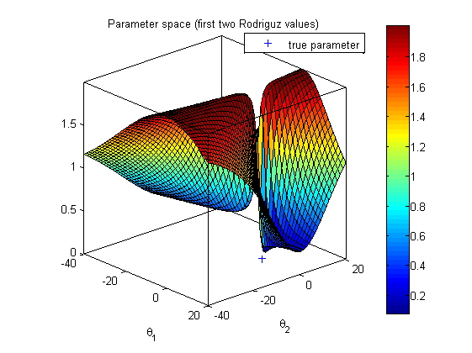
Problem Formulation
Quaternion
No Singularities
Constrained
Quadratic model
Gibbs-Rodriguez
Singularity at
Unconstrained
Nonlinear model

Slide 5
Example
Video?

Slide 6
Outlook
Inputs bla bla …
Text Cases …
Estimate Accuracy of Result ...

