Slide 1
Estimation of Actuation Configuration for a Multi-Actuated Blimp
Semester Thesis
Students: Matthias Krebs Advisors: Kostas Alexis
Simon Laube Markus Achtelik

Slide 2
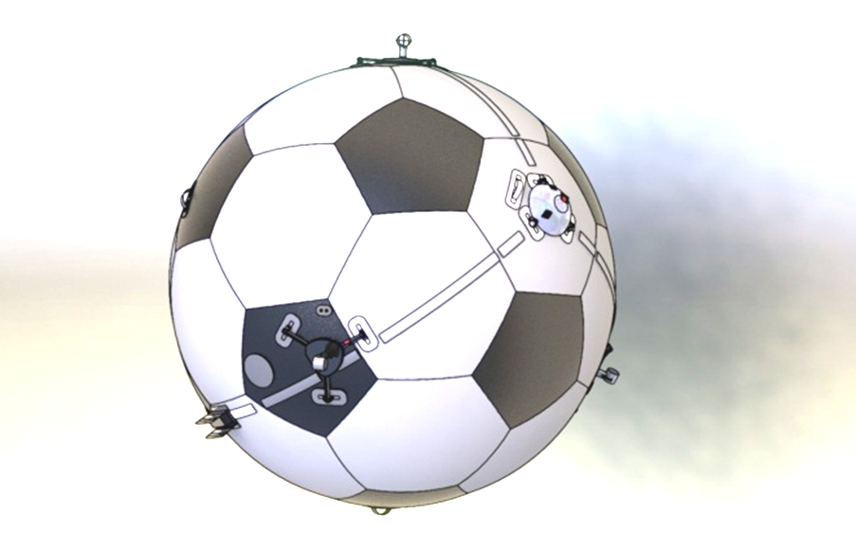
Overview
Problem: Motor to Blimp transformation is essential part of controller
Idea: Create blimp model from Motor transformations and fit this model to the system
How: Actuate blimp and compare measurements with model output
Notes:
Position of motors is essential for control, but uncertain / unknown

Slide 3
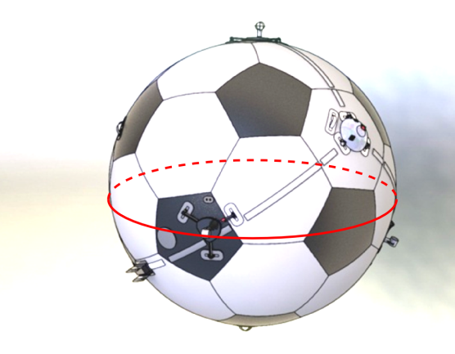
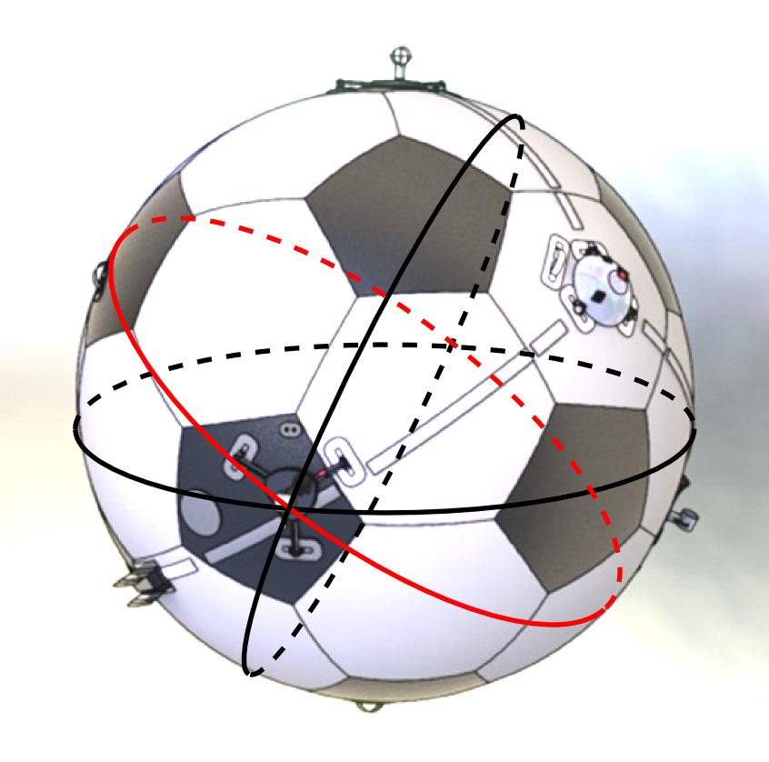
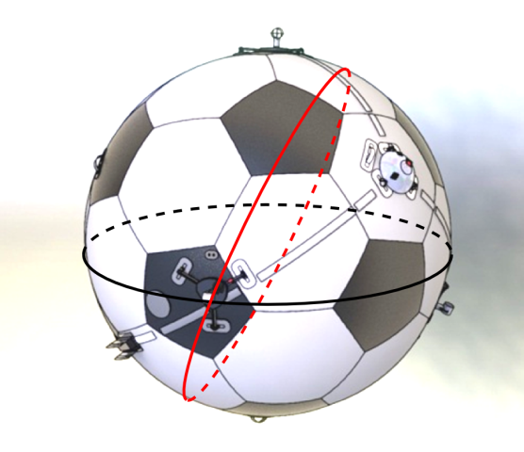
Concept

Slide 4
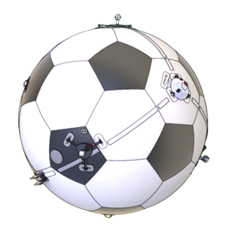
Batch Optimization Process
IMU Data
Actuator Input Pattern .
Parameters
Optimization Algorithm
Model
Model Output

Slide 5






Model Function
Thrust force transformation
Thrust force (input)
Angular velocity
Angular acceleration
Radius
Inertia tensor
Parameterization
Gibbs-Rodriguez (3)
Quaternionen (4)
Notes:
To optimize the model with respect to the actuation configuration we need to make the model dependent on the actuation configuration.
For a spherical blimp the configuration of an actuator is described with a position on the hull surface and a rotation which tells us in which direction the x axis of the actuator is pointing.
It turns out that this actuator configuration can be expressed with a rotation against the blimps center.
For rotations there are a few parameterisations each of them having advantages and disadvantages. This basically boils down to one trade-off: either you use minimal representation of a rotation and you have to deal with singularities or you use a non-minimal representation and you have to deal with constraints on these parameters.
We decided to use one parameterization which is minimal in the number of parameters and one which does not have the issue of singularities.
we choose the gibbs-rodriguez and quaternion parameterisation, because gibbs-rodriguez are minimal parameters

Slide 6
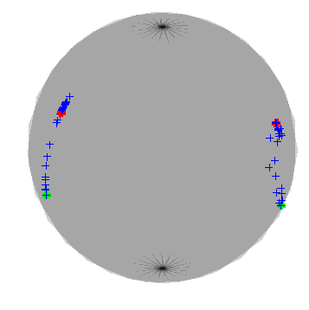
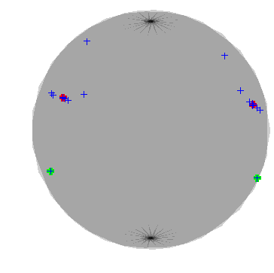
Current Results
Iterative parameter optimization (2 actuation units)
Rodriquez
Quaternions
init position
true position
Notes:
results based on simulator data

Slide 7
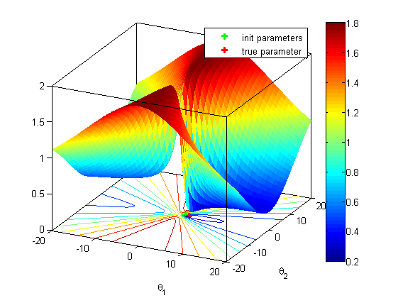
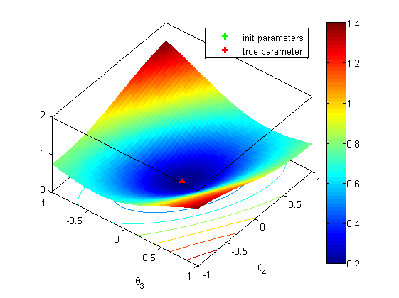
Current Results
Residual grid plots
Rodriquez
Quaternions

Slide 8
Outlook
Parameterization for radius, inertia tensor
Actuator input patterns
Varied simulation data from modular simulation model
Convergence analysis

Slide 10
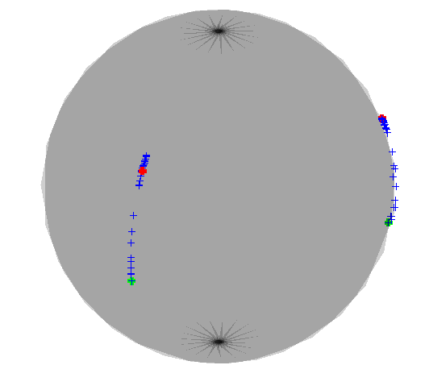
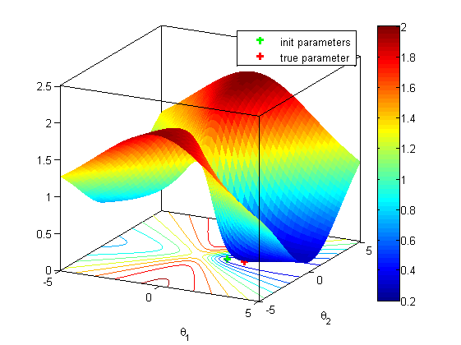
Current Results
Gibbs-Rodriguez Parameters
init position
Residual plot in parameter space
true position
Notes:
results based on simulator data

Slide 11
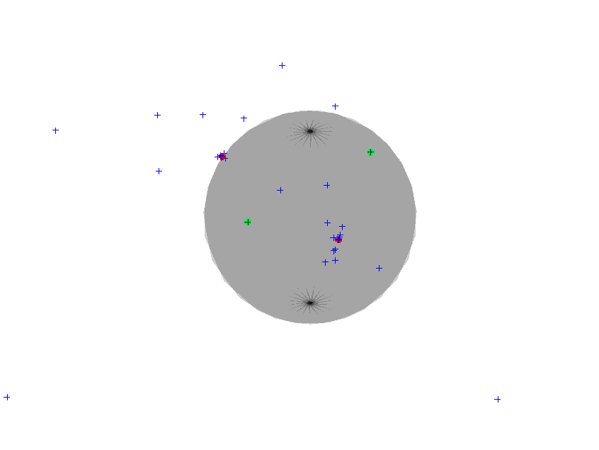
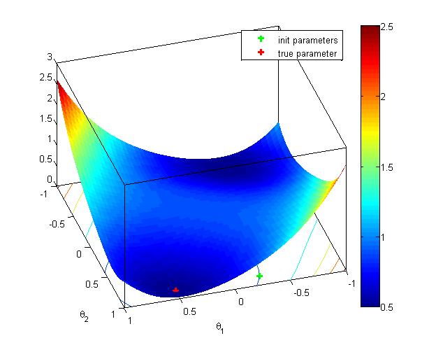
Current Results
Quaternion Parameters
init position
Residual plot in parameter space
true position

Slide 12
Context / General Description
Control depends on simplified model of blimp
Fit paramteres of simplified model s.t. it best fits real system

Slide 13
Problem Formulation
Nonlinear Least Squares Optimization
: Angular acceleration from gyro measurement : Nonlinear function depending on inputs and parameters
Parametrization
Quaternion
No Singularities
Constrained
Quadratic model
Gibbs-Rodriguez
Singularity at
Unconstrained
Nonlinear model

Slide 14
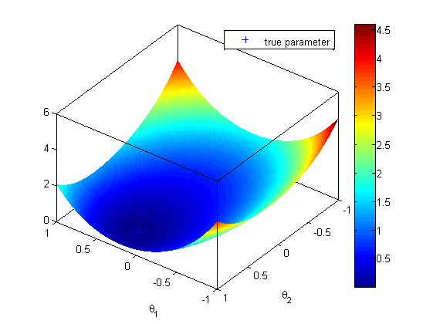
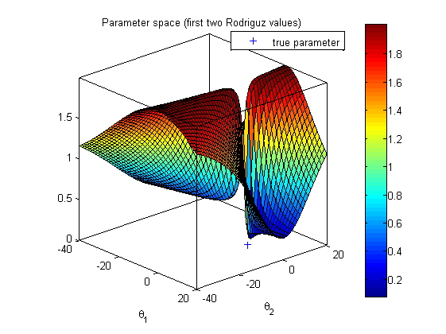
Problem Formulation
Quaternion
No Singularities
Constrained
Quadratic model
Gibbs-Rodriguez
Singularity at
Unconstrained
Nonlinear model

Slide 15
Example
Video?

Slide 16
Outlook
Inputs bla bla …
Text Cases …
Estimate Accuracy of Result ...

