Slide 1
Estimation of Actuation Configuration for a Multi-Actuated Blimp
Semester Thesis
Students: Matthias Krebs Advisors: Kostas Alexis
Simon Laube Markus Achtelik

Slide 2
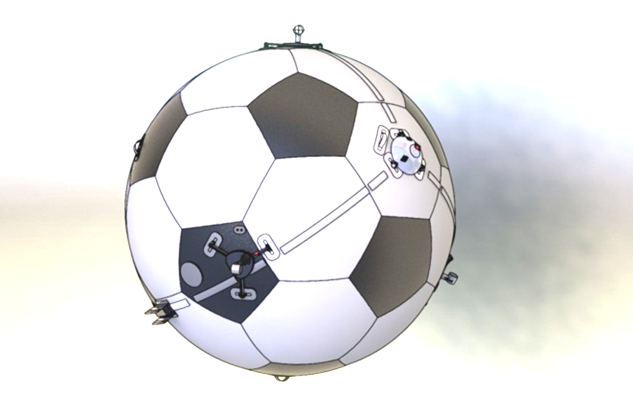
Overview
Problem: Motor to Blimp transformation is essential part of controller
Idea: Create blimp model from Motor transformations and fit this model to the system
How: Actuate blimp and compare measurements with model output
Notes:
-Skye is a helium blimp with actuators attached to it to stabilize it in the air.
-Each actuator has two degrees of freedom: rotating around one axis and applying a force into the current direction it is pointing. (show AU from skye)
-The actuator configuration is an essential part of the control system.
-the control system uses the actuator configuration to derive a simplified model.
-The better the control system knows the actuator configuration, the better it can control the system
-we want to find the actual actuator configuration by observing the system when it is excited by test inputs

Slide 3
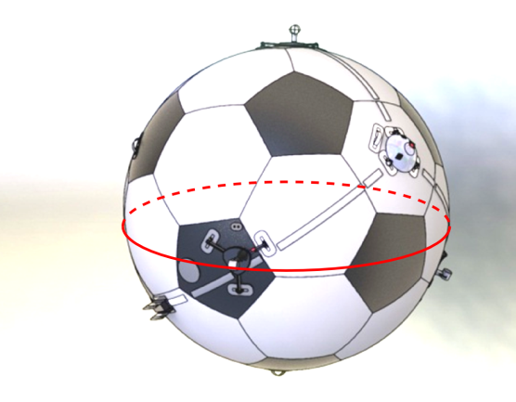
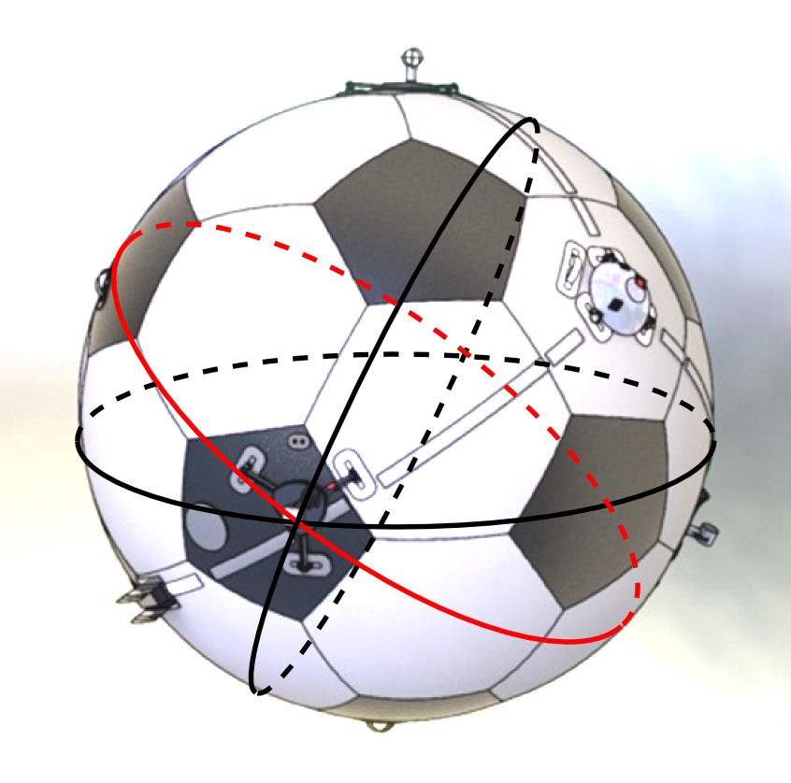
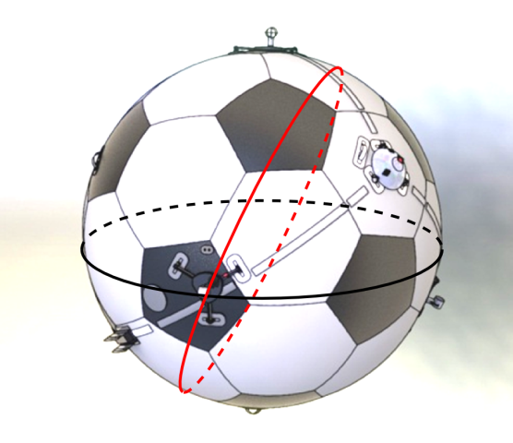
Concept
Notes:
-here is the general idea of the process of finding the actuator configuration
-if we turn the actuator on in the indicated direction, the blimp will start to rotate along the red circle
-after this step we know that the actuator must lie somewhere on that circle
-we then can repeat the process with other directions and will get additional circles which intersect with each other at the position of the actuator.
-it turns out that since we know in which direction we rotated the actuator when generating these circles, we can eliminate the wrong candidate position.

Slide 4
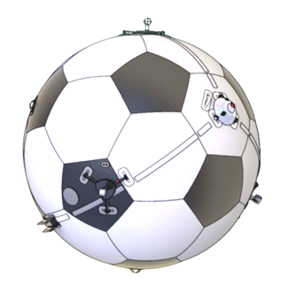
Batch Optimization Process
IMU Data
Actuator Input Pattern .
Parameters
Optimization Algorithm
Model
Model Output
Notes:
-now, intersection circles looks like a good idea, however we can do better with batch optimization
-here is how this works:
-we first record a dataset with the IMU by applying a series of actuator inputs to the system.
-then we start with initial guesses about the parameters for the actuator configuration and feed our simplified system model with the same actuator inputs.
-when the parameters are correct the data from the model will match with the measured dataset.
-here comes the batch optimization algorithm (any Nonlinear LeastSquares Solver, e.g. using a Levenberg-Marquardt Algorithm), into play:
-in each iteration it compares the model output with the measured IMU dataset and adjusts the parameters accordingly to improve the model output.
-this process repeats until the model reproduces the measured dataset best.

Slide 5







Model Function
Thrust force transformation
Thrust force (input)
Angular velocity
Angular acceleration
Radius
Inertia tensor
Parameterization
Gibbs-Rodriguez (3)
Quaternions (4)
Notes:
-here is the model function we use to optimize the parameters.
-the important part is that the matrix C depends on the actuator configuration.
-C maps the forces u which are in the coordinate systems of the actuators to the resulting moment that acts on the system.
-for a spherical blimp the configuration of an actuator is described with a position on the hull and the direction its x axis points.
-one way to describe this is by using a rotation against the blimps center.
-for rotations there are several parameterisations each of them with their own advantages and disadvantages.
-the main trade-off is that either you use minimal representation of the rotation and have to deal with singularities
-or you use non-minimal representation and you have to deal with constraints in the optimization problem
-in this work we are evaluating two different types of parameters:
-Gibbs-Rodriguez which is a minimal parametrisation and
-Quaternions which is a non-minimal parametrisation
-to describe the actuator configuration we need one set of rotation parameters for each actuator.

Slide 6
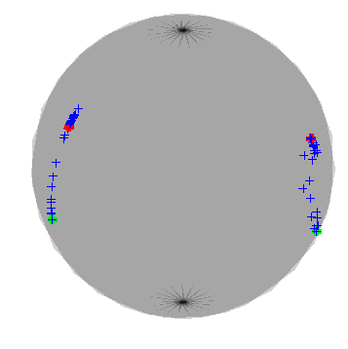
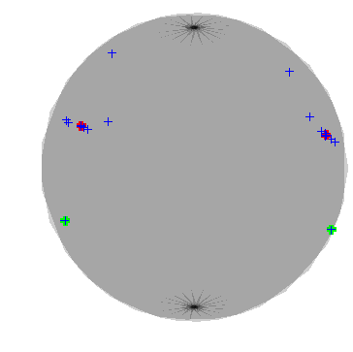
Current Results
Iterative parameter optimization (2 actuation units)
Rodriquez
Quaternions
init position
true position
Notes:
-currently we use a modular simulator we built to create different datasets for testing the optimization algorithms
-it allows us to gradually introduce non ideal effects the real system has and additionally we are also able to create systems with a different number of actuators and actuator configurations to test the algorithms.
-what we can see in the plots here is a typical optimization process with two actuators on the blimp
-the initial guess of the algorithm is the green dot and it works its way up to the true position which is the red dot.
-what we can see (in this example) is that the quaternion parameterization converges faster than the Rodriguez parameterization

Slide 7
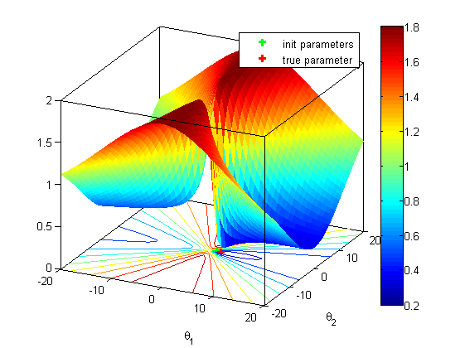
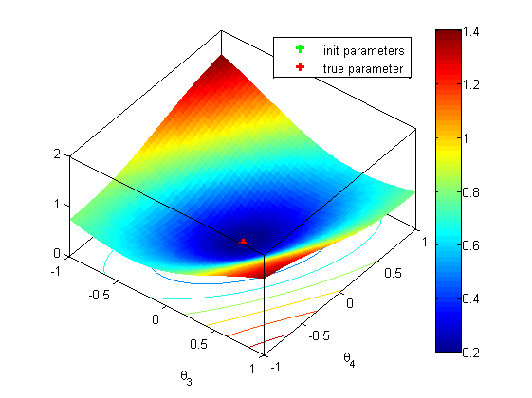
Current Results
Residual grid plots
Rodriquez
Quaternions
Notes:
-here we can see plots of the parameter space around the true parameter value for one actuator.
-what we see here is that the error function in the quaternion parameter space has a much nicer shape than the rodriguez parametrisation
-this explains the faster convergence

Slide 8
Outlook
Parameterization for radius, inertia tensor
Actuator input patterns
Varied simulation data from modular simulation model
Convergence analysis
Notes:
-for the next steps of this thesis we will try to parameterize the radius and inertial tensor in a similar way
-another important topic will be to analyze which input patterns guarantee a fast, accurate, and robust convergence of the algorithm
-we will evaluate the performance for different initial parameter guesses, system measurement noise and actuator configurations
-and more convergence analysis of the optimization problem

