Slide 1
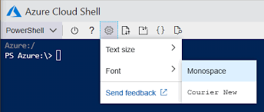




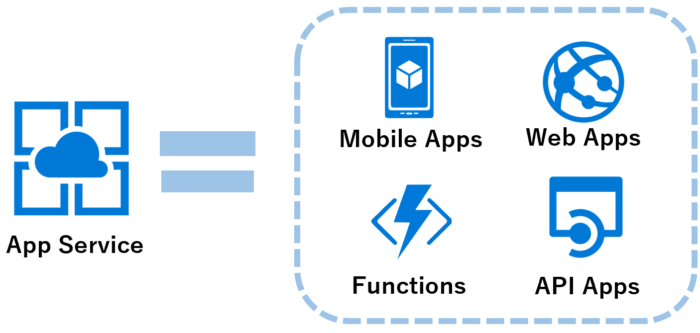
GitHub
GitHub Actions
Azure Pipeline
WebApp
Users

