Slide 1
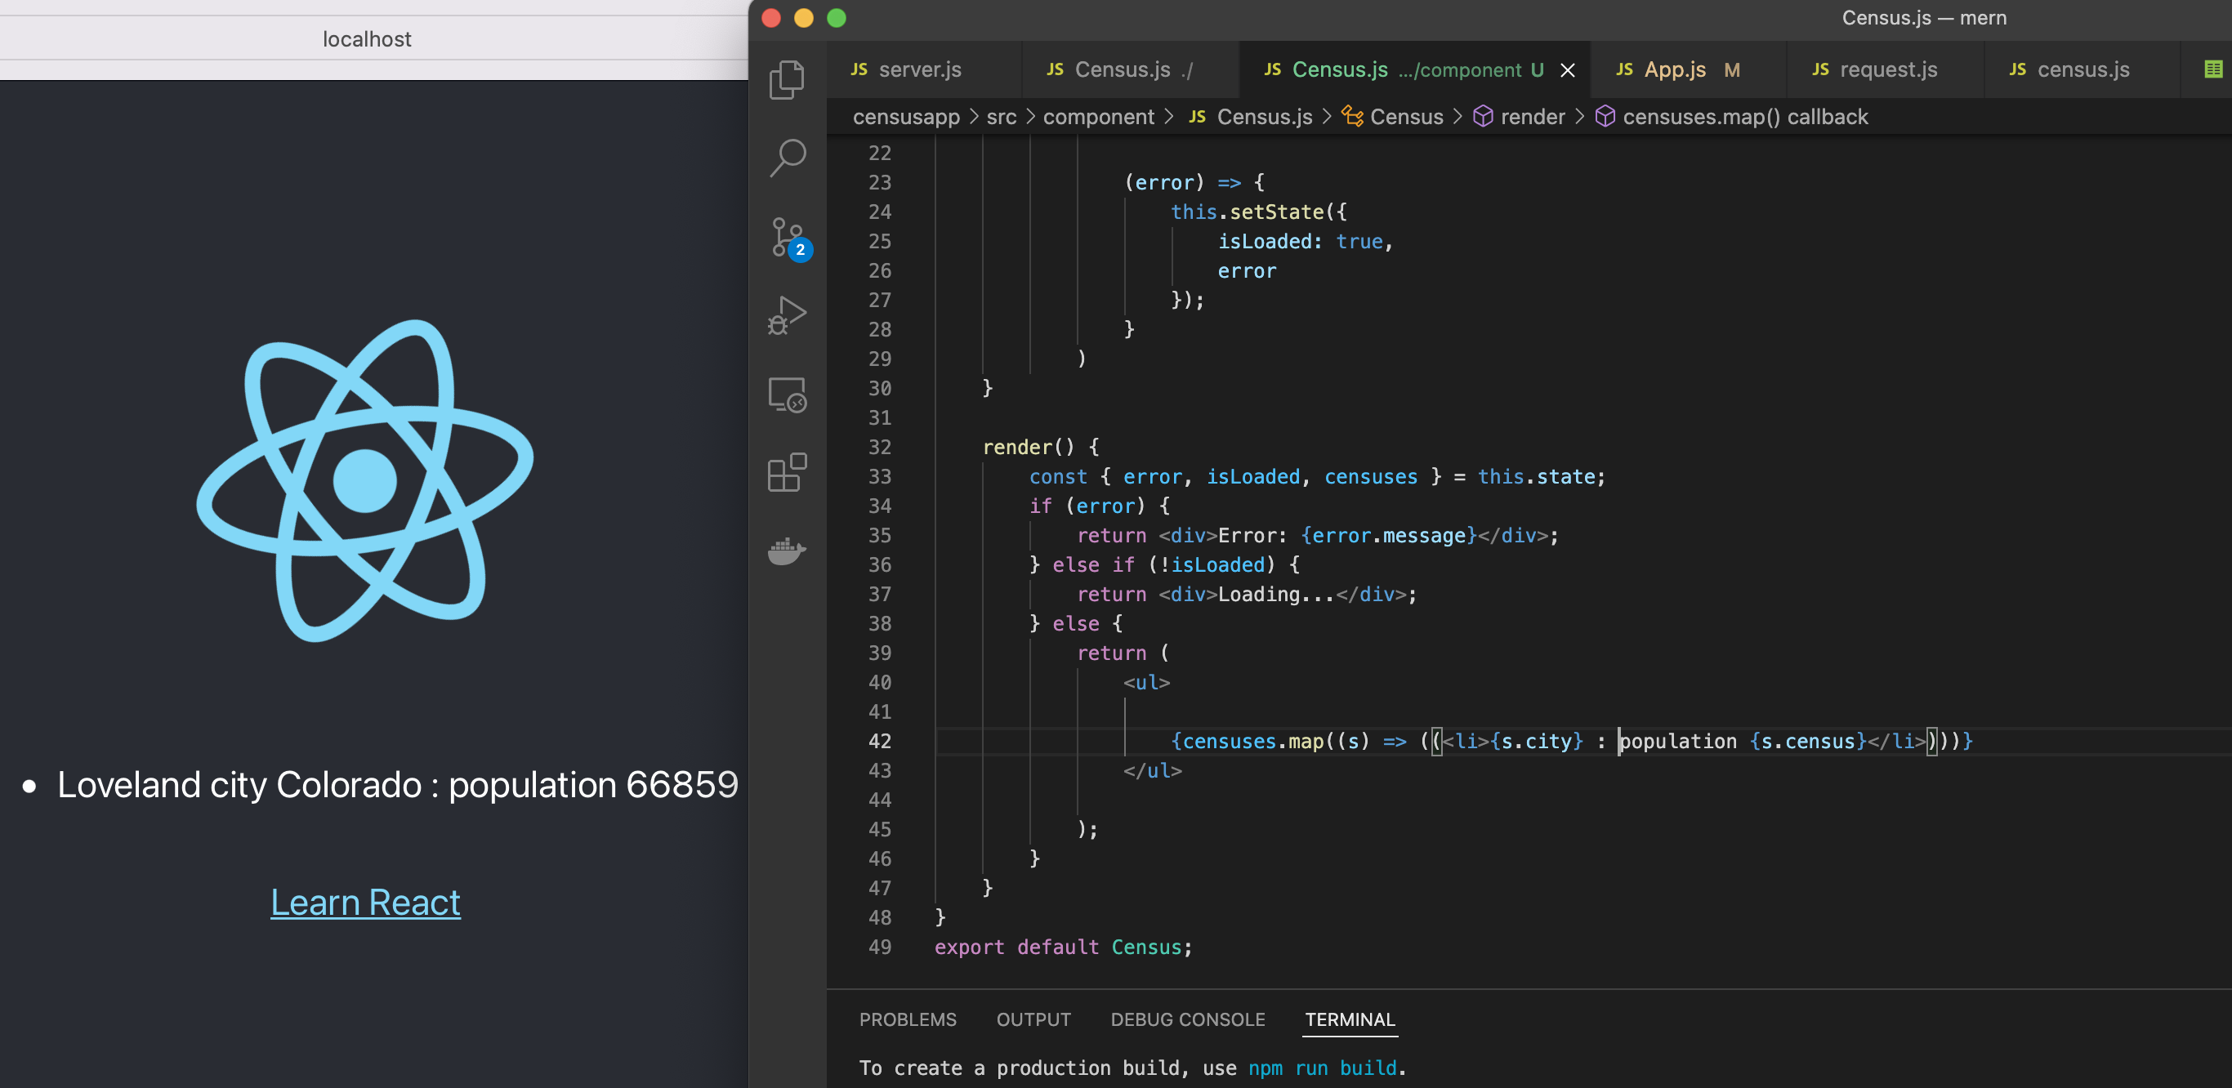

Build a Full Stack App using React and Express.
Dave Dalsveen

Slide 2
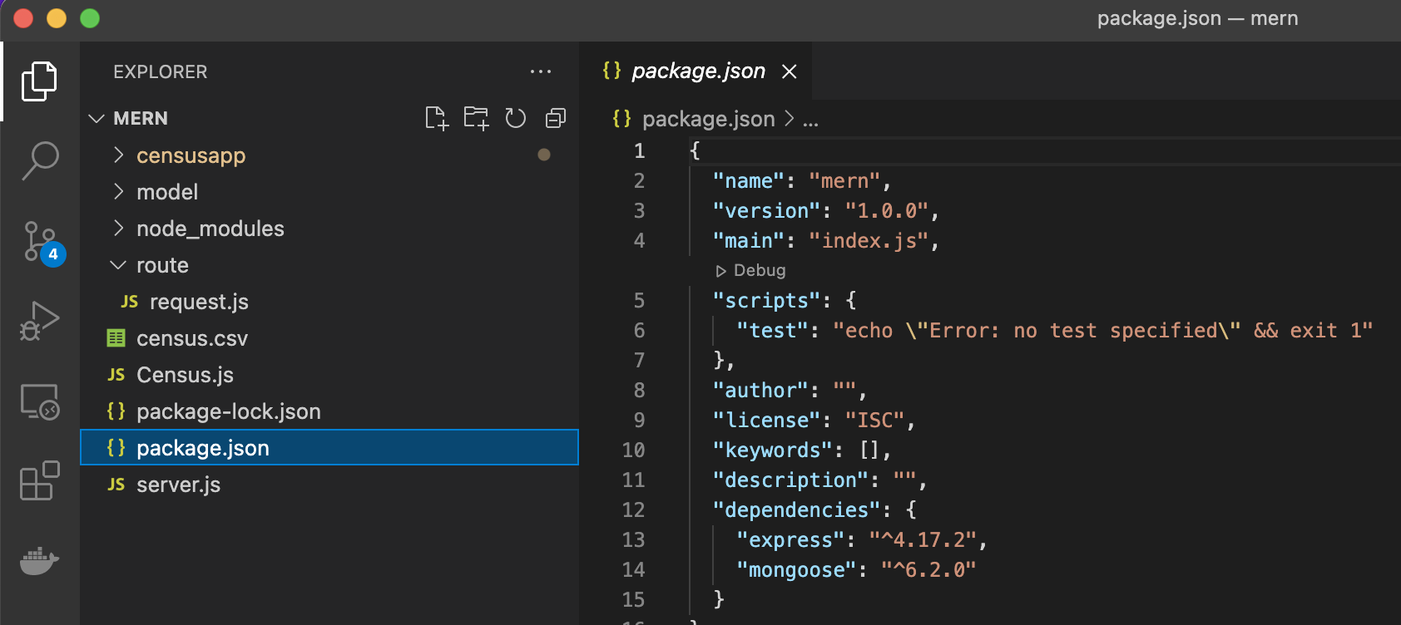
Task1: Create the React app structure and Express backend structure.
Use npm (node package manager) init to create the package.json file.
Install express, which includes the Node.js server files.
Install Mongoose to interface with the MongoDB database.
Install the React App front end structure.

Slide 3
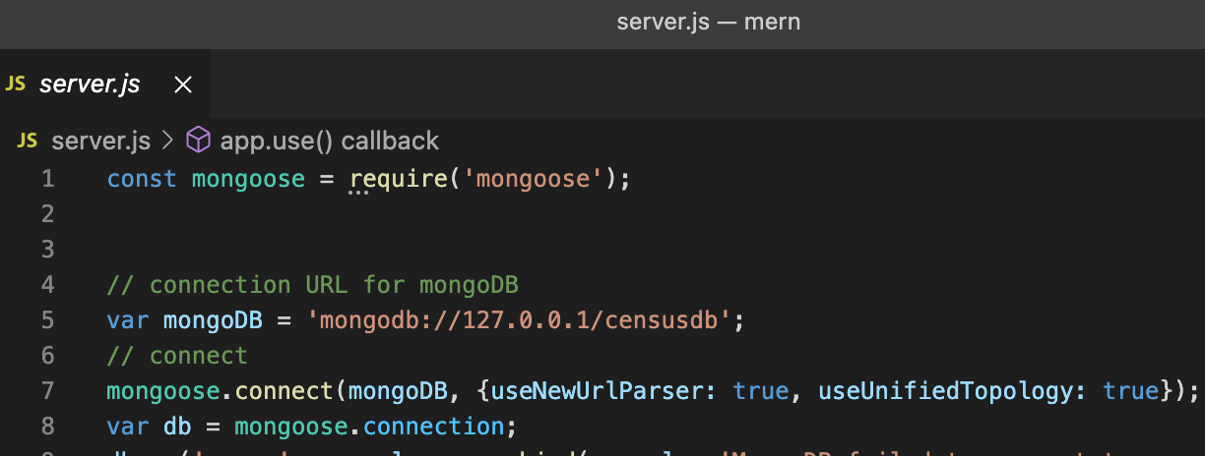
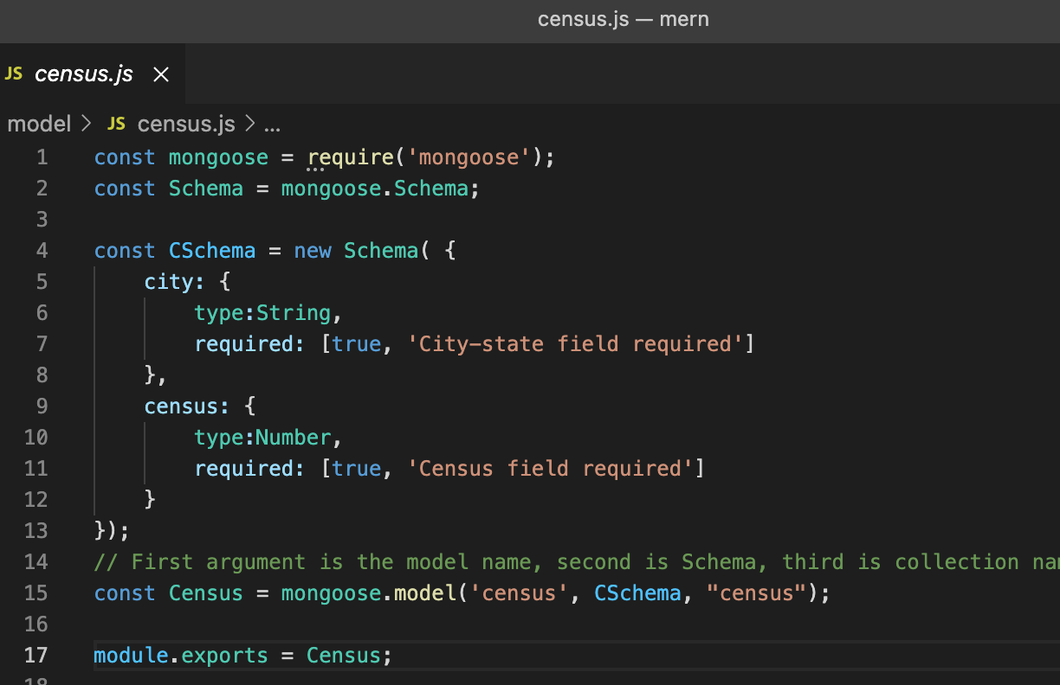
Task2: Import the CSV file data into MongoDB.
Observe the data in the CSV file.
Import the data using a MongoDB tool.
Create a MongoDB connection using Mongoose.
Create a Data Model for Census data.

Slide 4
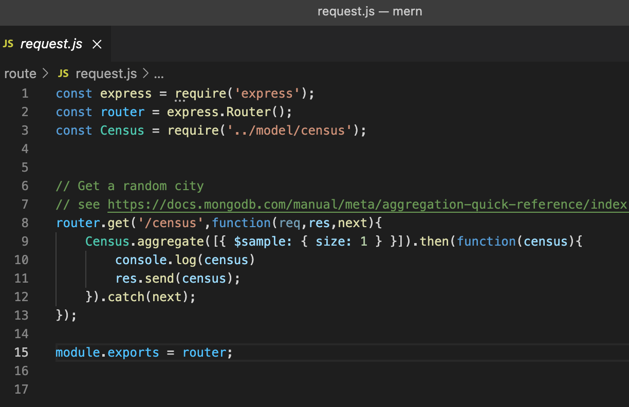
Task3: Add code for Express routing and Mongoose middleware.
Add code to check the MongoDB connection using Mongoose.
Create an express module in server.js.
Create an express route module to handle incoming requests and instantiate the Data Model.

Slide 5
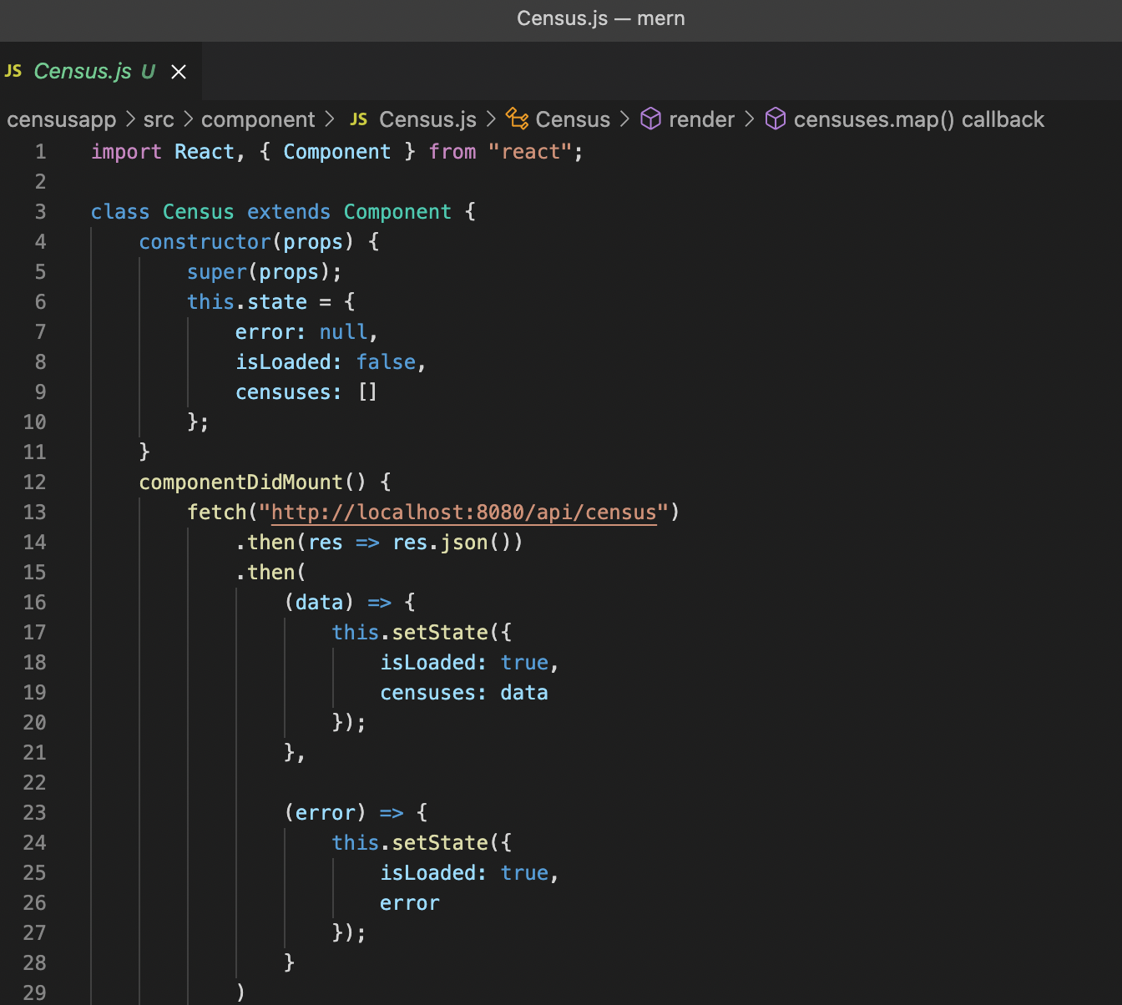
Task4: Create the React Front end.
In server.js, Enable cross origin resource sharing (CORS) reference.
Create a component directory to organize components.
Use a Component template to create the Census Component.
The Census Component is used to define the Census tag in the app.

Slide 6
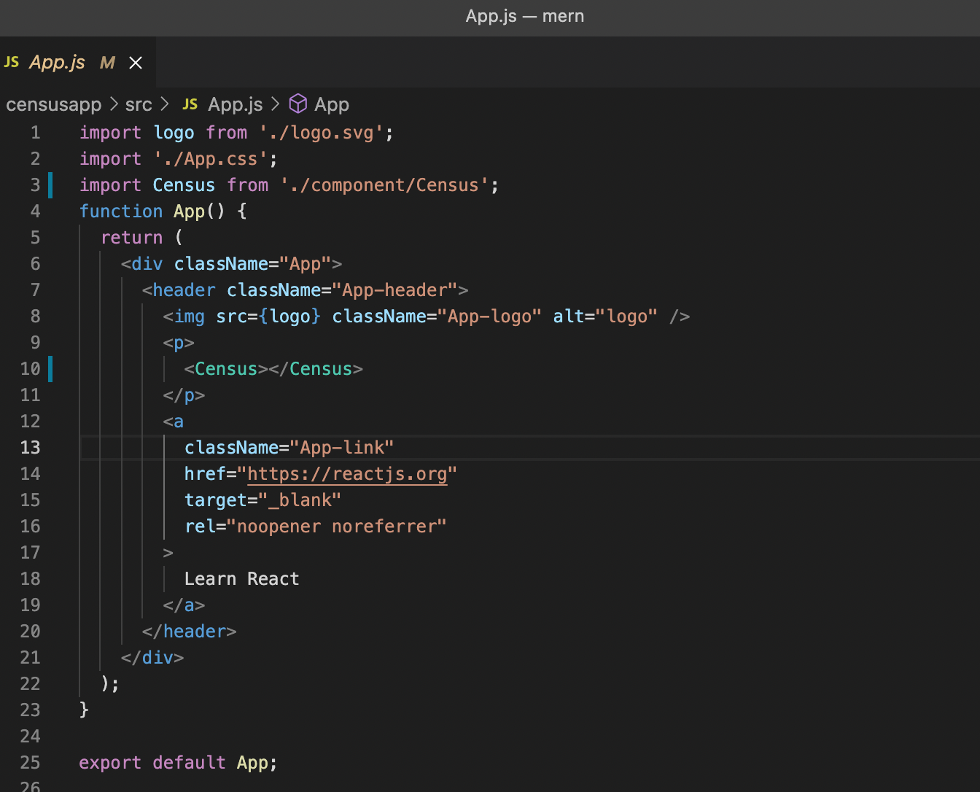
Task5: Run the Full Stack React and Express Application.
Import the Census component into the React app.js.
Add the Census tag to the App.
Start the React App.
Locate and modify the App styling.

