Slide 1

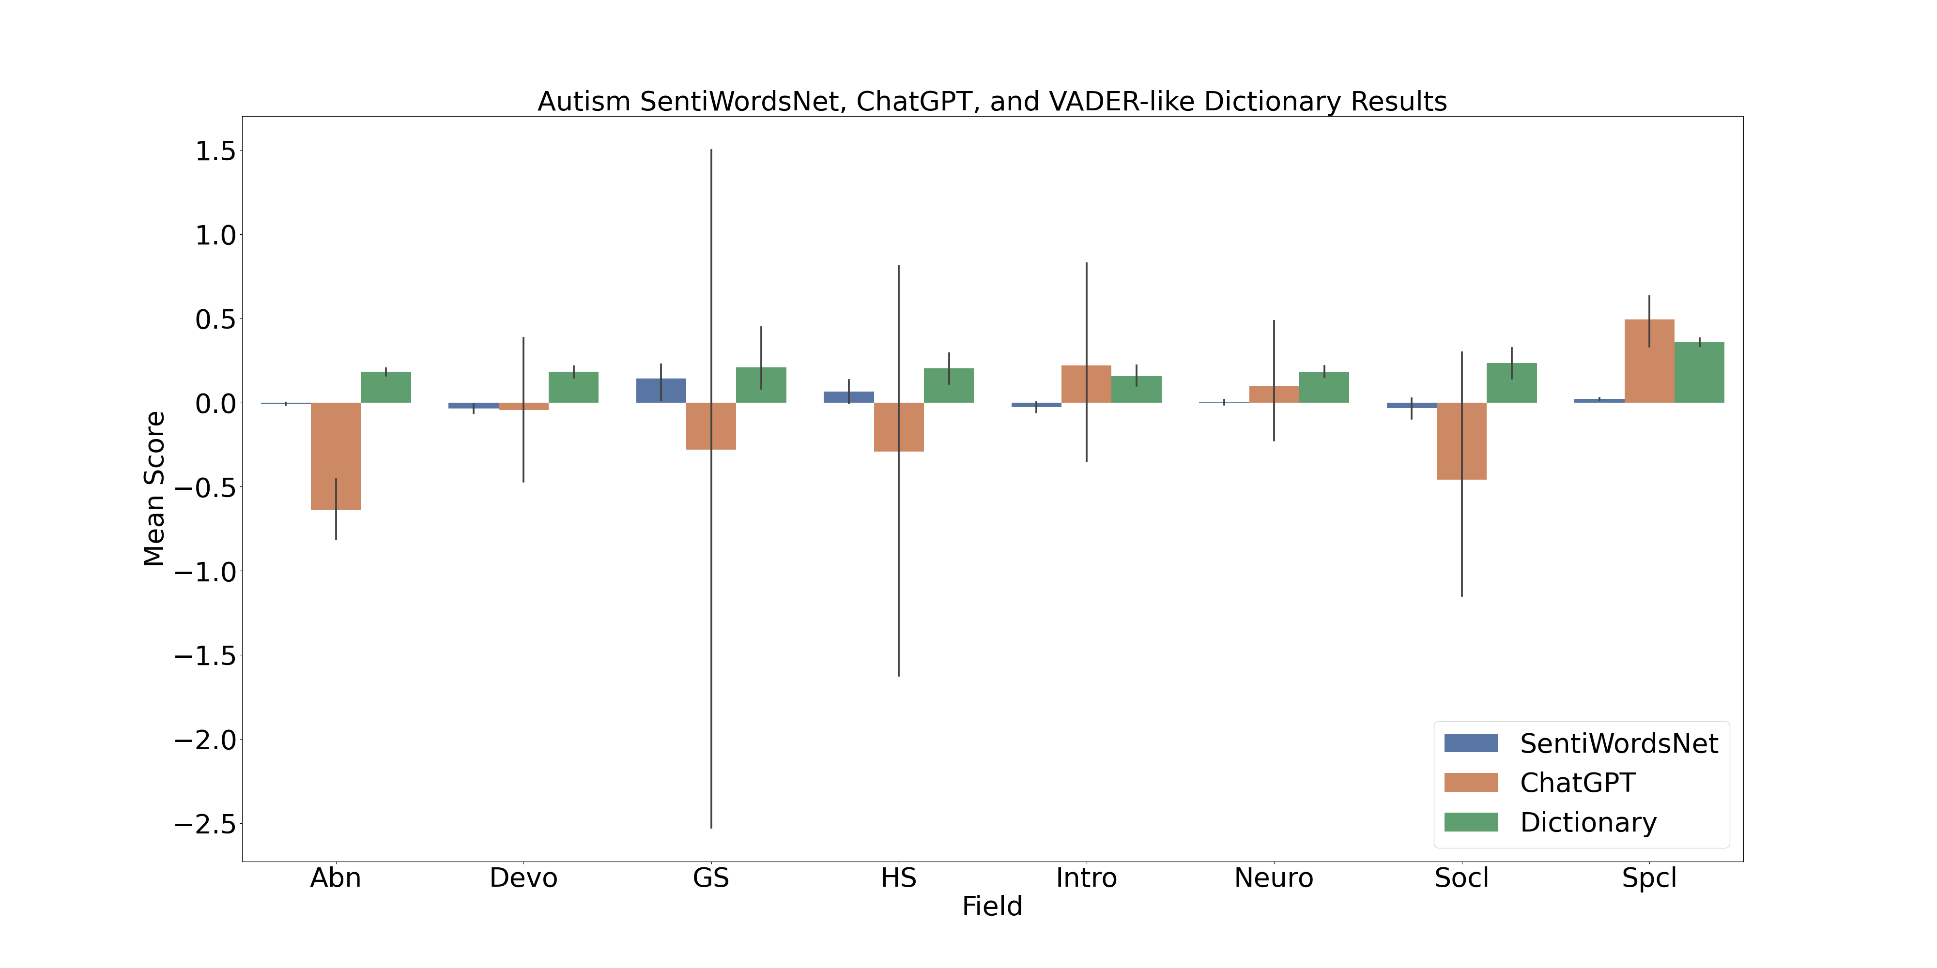
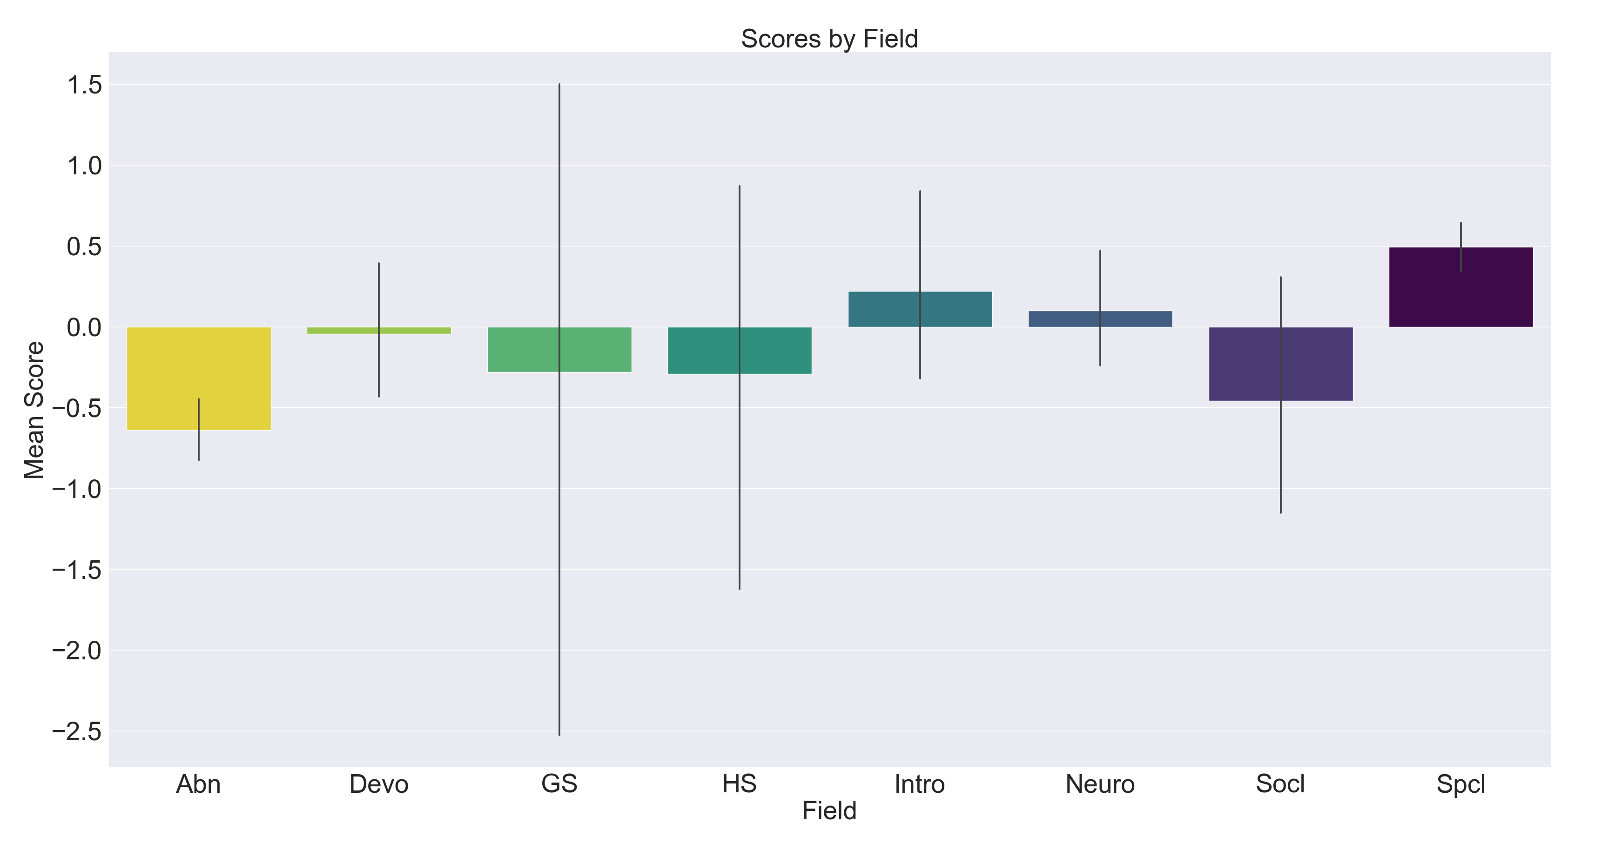
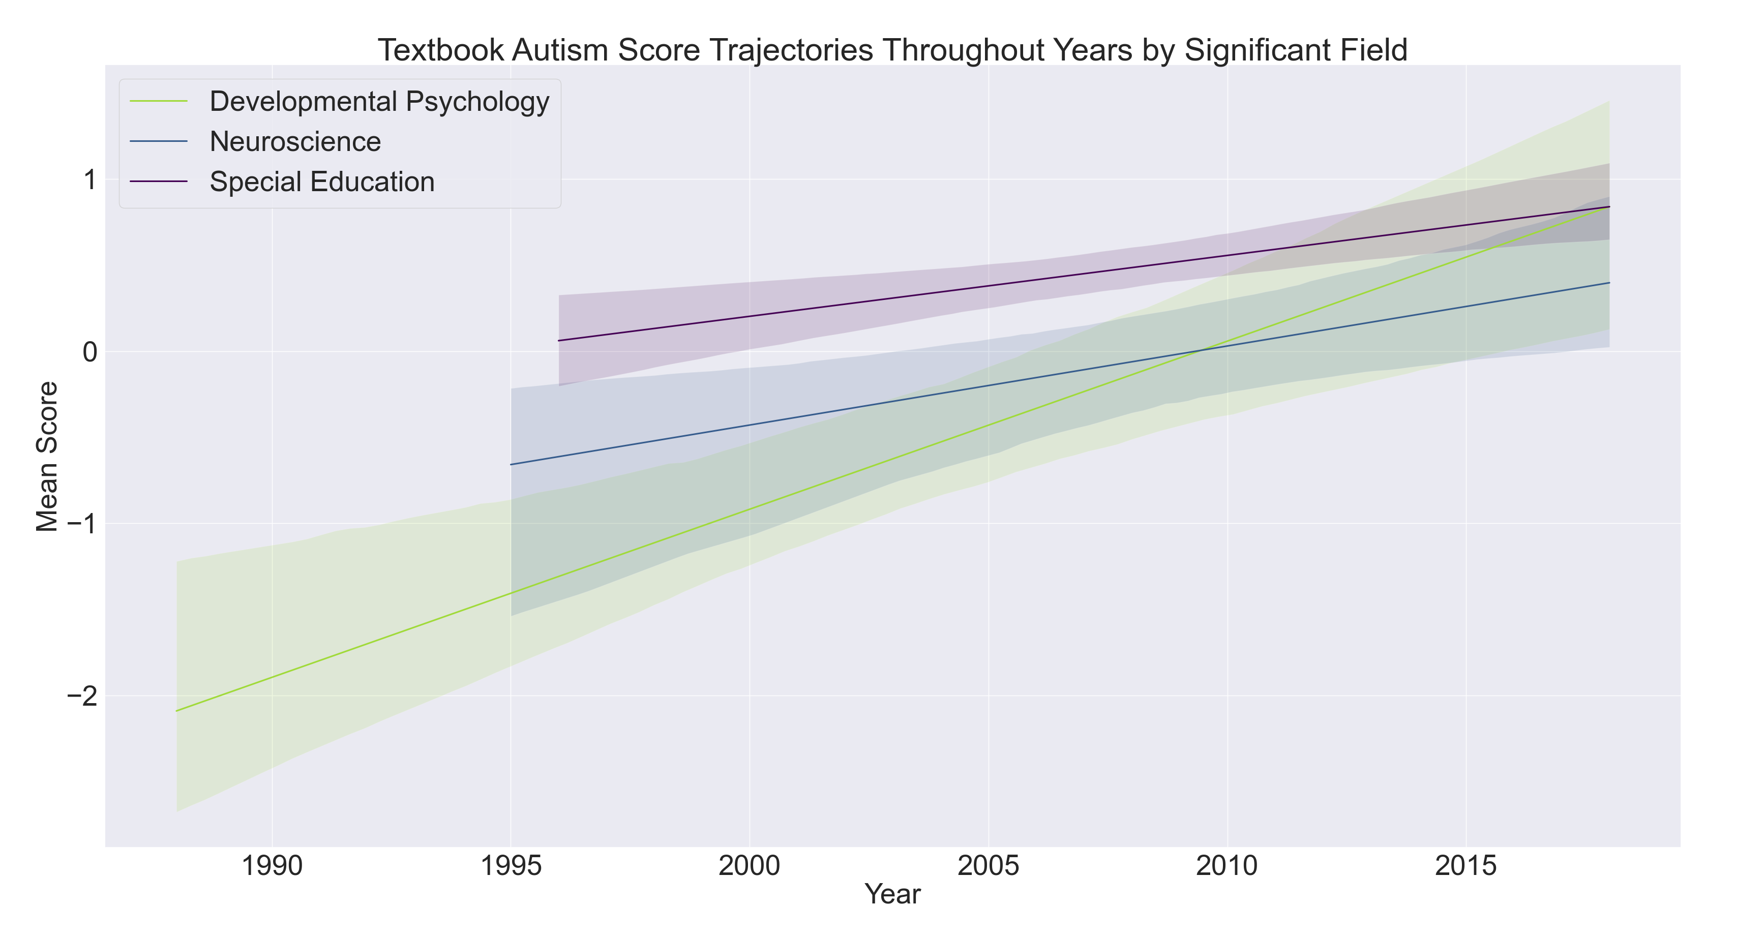
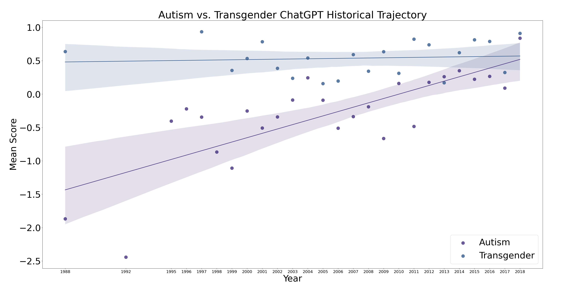
Textbooks Write More Positively About Autism Over Time
Student: Alexander Maksiaev
Primary Advisor: Dr. Vikram Jaswal
Introduction
Both autistic and transgender people are heavily stigmatized in society.
Sentiment is how positive or negative one views a subject.
Educational textbooks reflect societal sentiments, and have the power to affect the sentiments of future professionals working with these populations.
Sentiment analysis is a computational method used to systematically determine the sentiment of a text.
Using sentiment analysis, we explored textbook sentiment regarding autistic and transgender people, both by subfield and across time.
Method
The sentiment analysis method used matters. VADER-like dictionary results differ significantly from SentiWordsNet and ChatGPT.
Sentiment was rated from -4 (most negative) to +4 (most positive).
ChatGPT was chosen for further analysis because it is the only method which accounted for context.
Results: Fields (Autism)
Abnormal psychology textbooks spoke about autism most negatively.
Special education textbooks spoke about autism most positively.
Results: Fields (Autism)
Across time, most fields did not show a significant change.
However, developmental psychology, neuroscience, and special education all showed a significant increase in sentiment.
Results: Autism vs. Transgender
Overall, across all fields:
Sentiment regarding transgender people stayed the same.
Sentiment regarding autistic people improved.
Conclusion
Textbooks write more positively about autistic people over time, while textbook sentiment regarding transgender people has not significantly changed.

