Slide 1


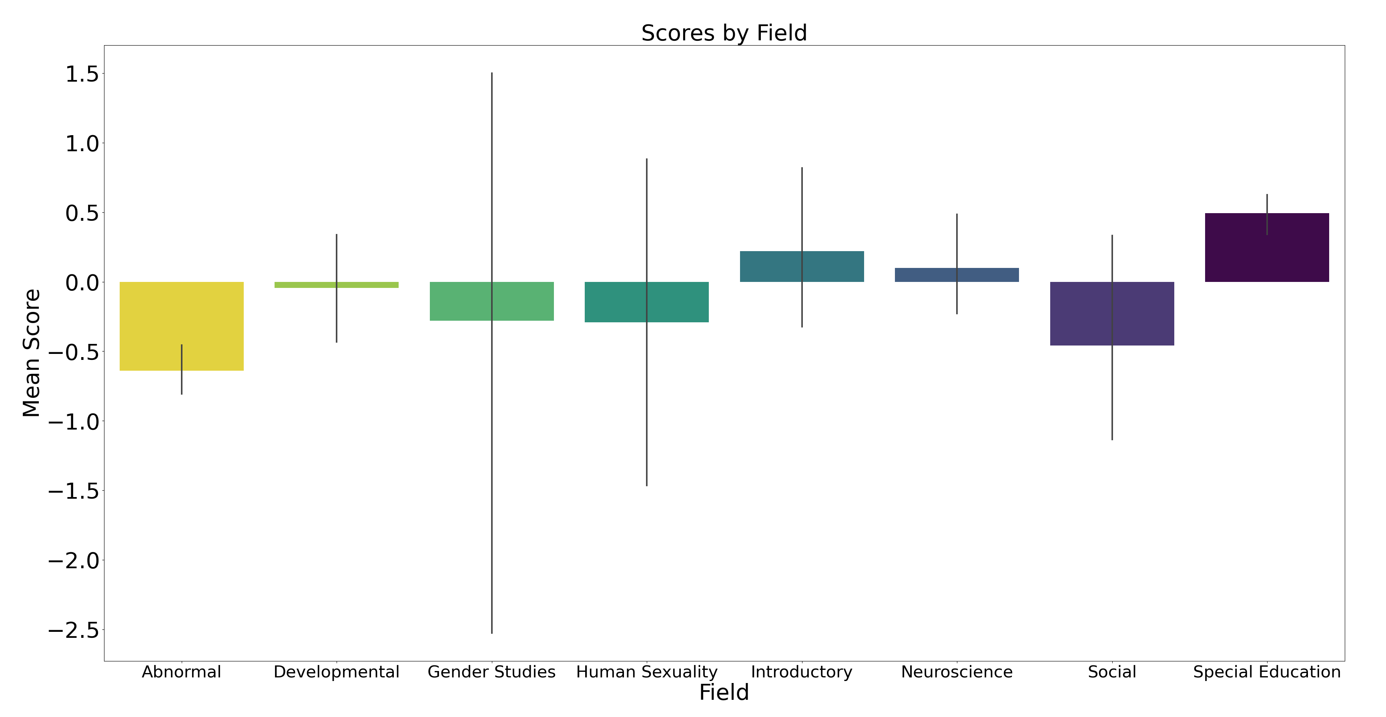
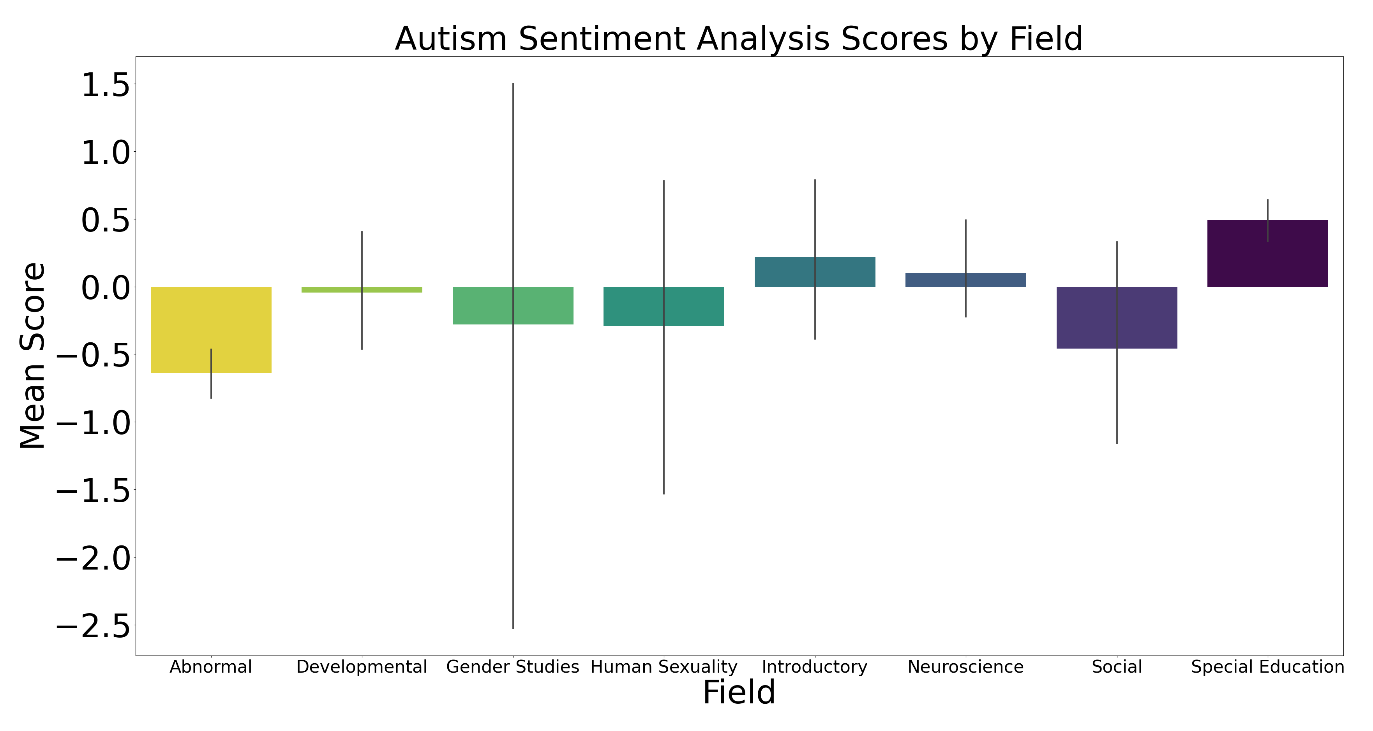
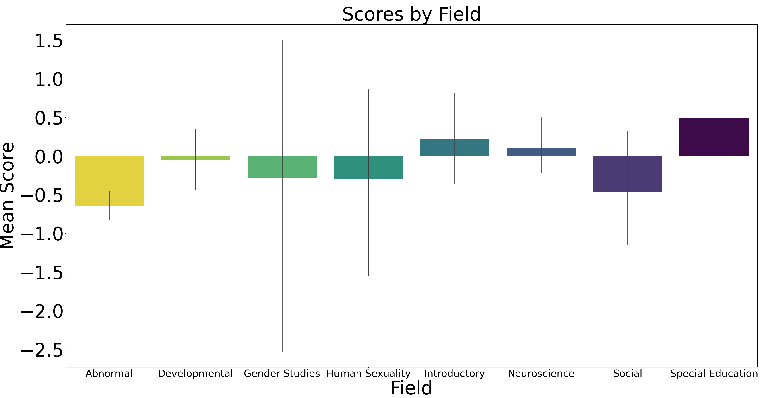
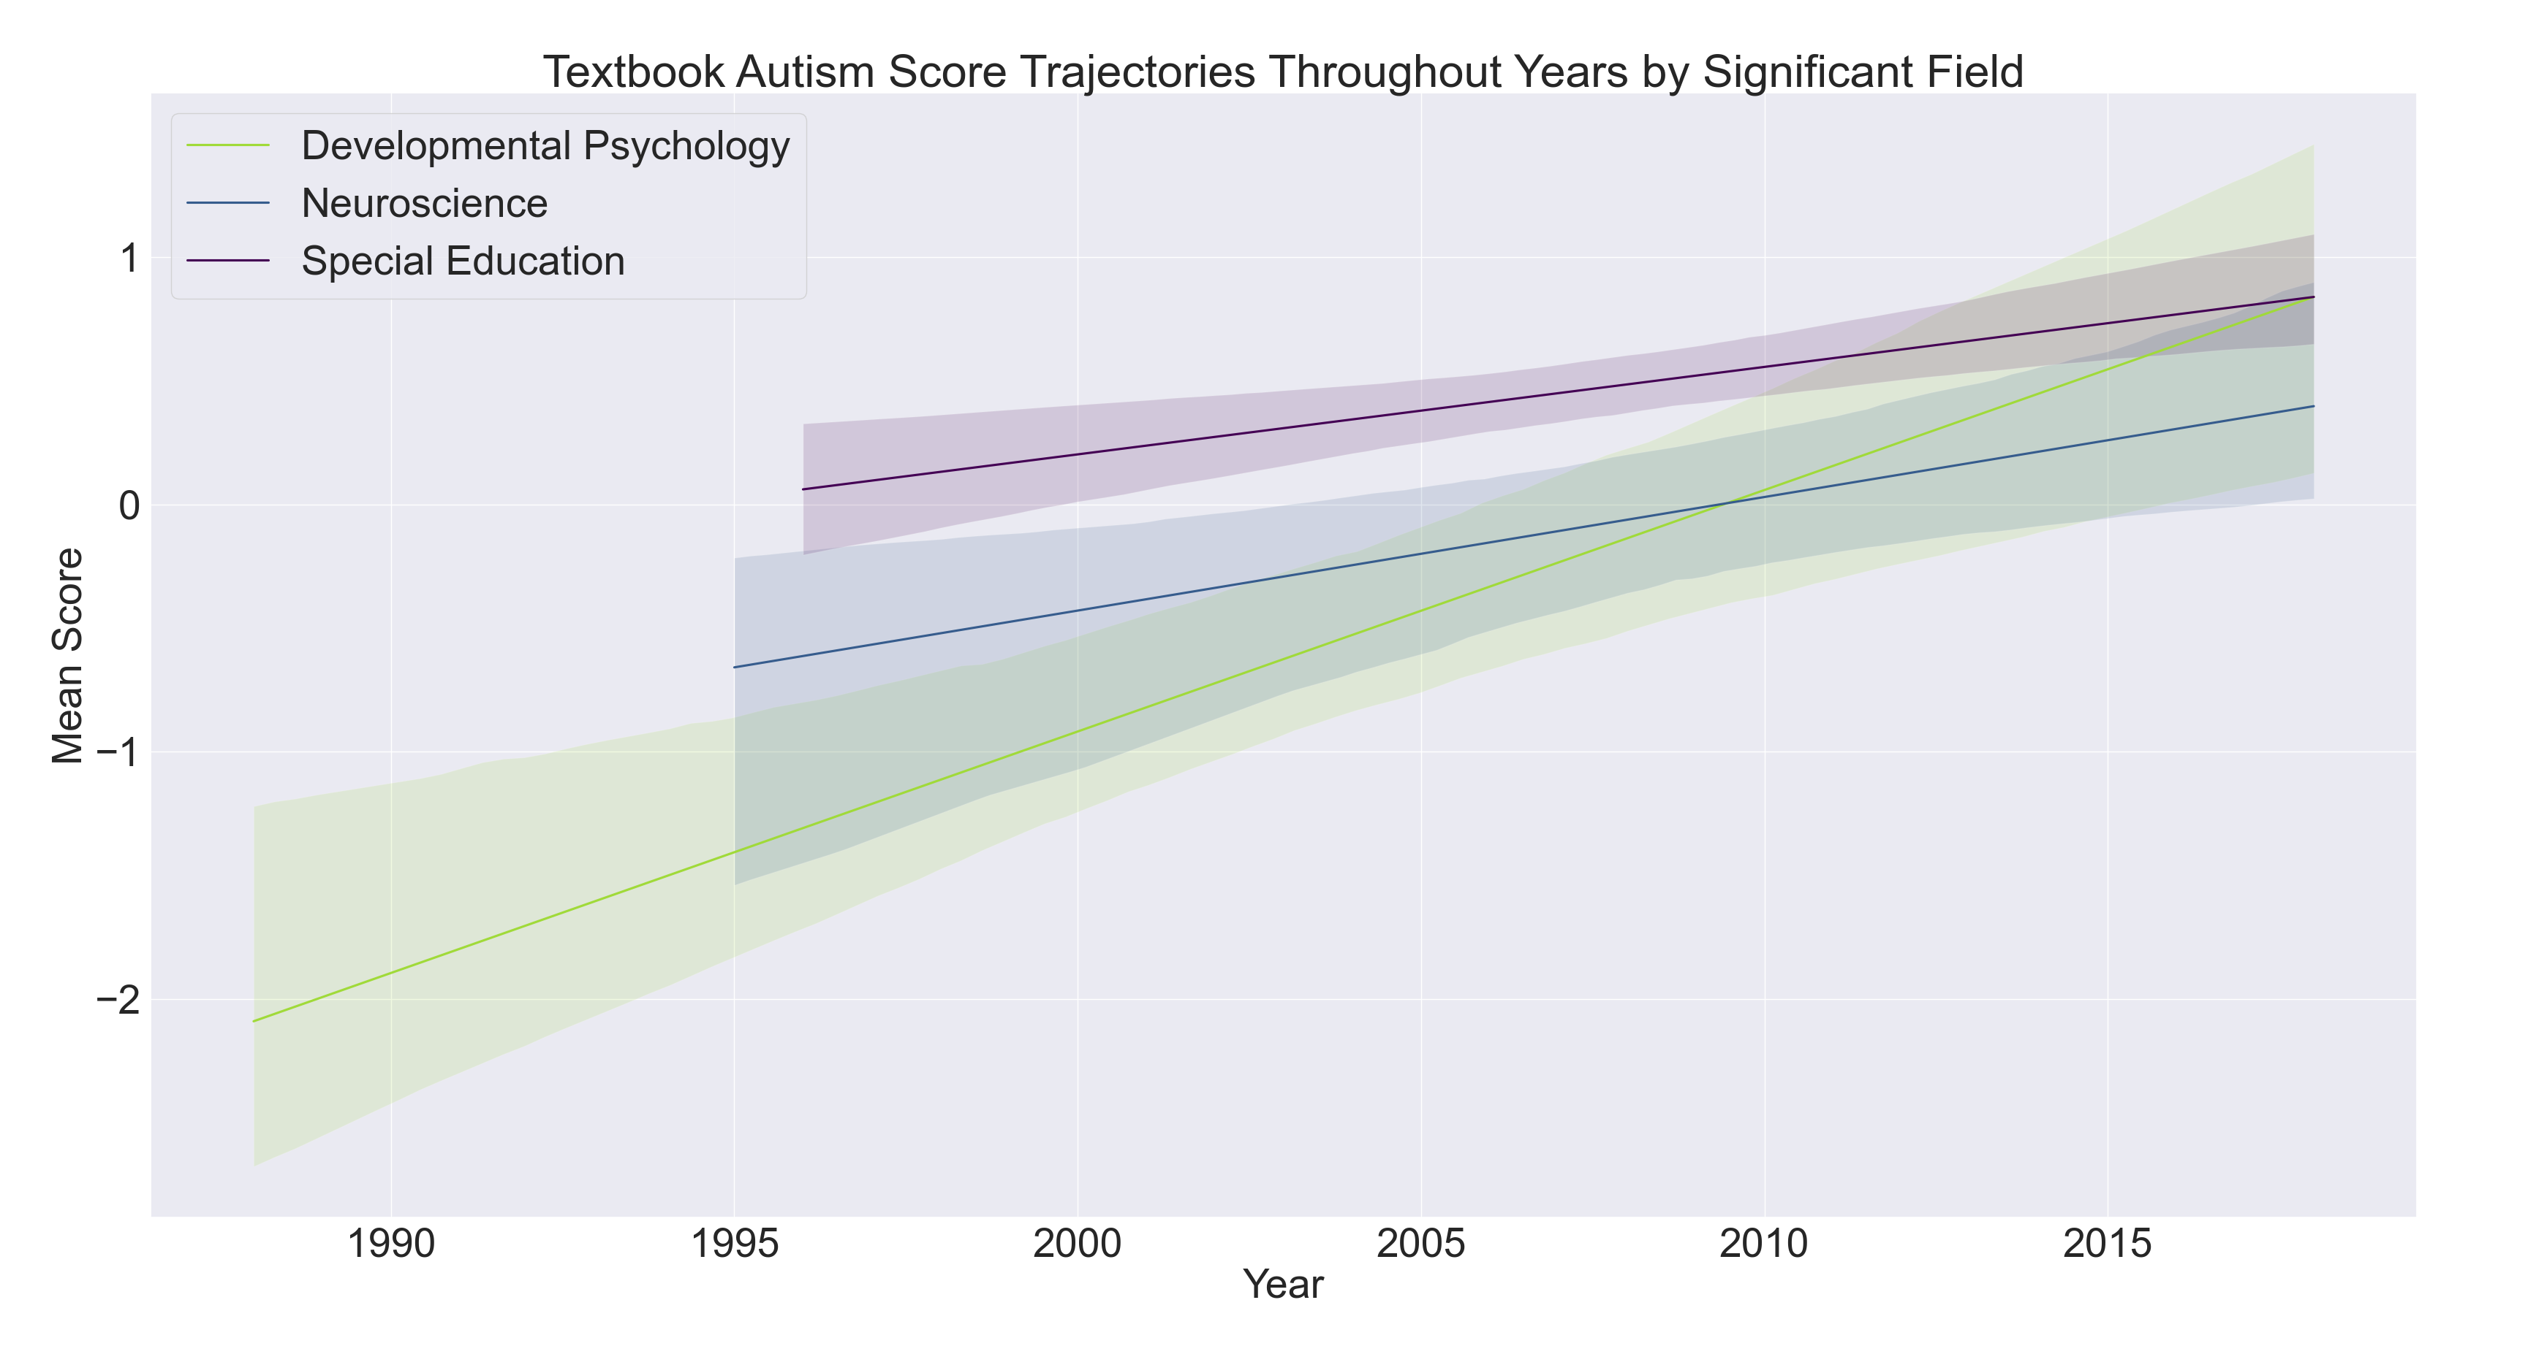
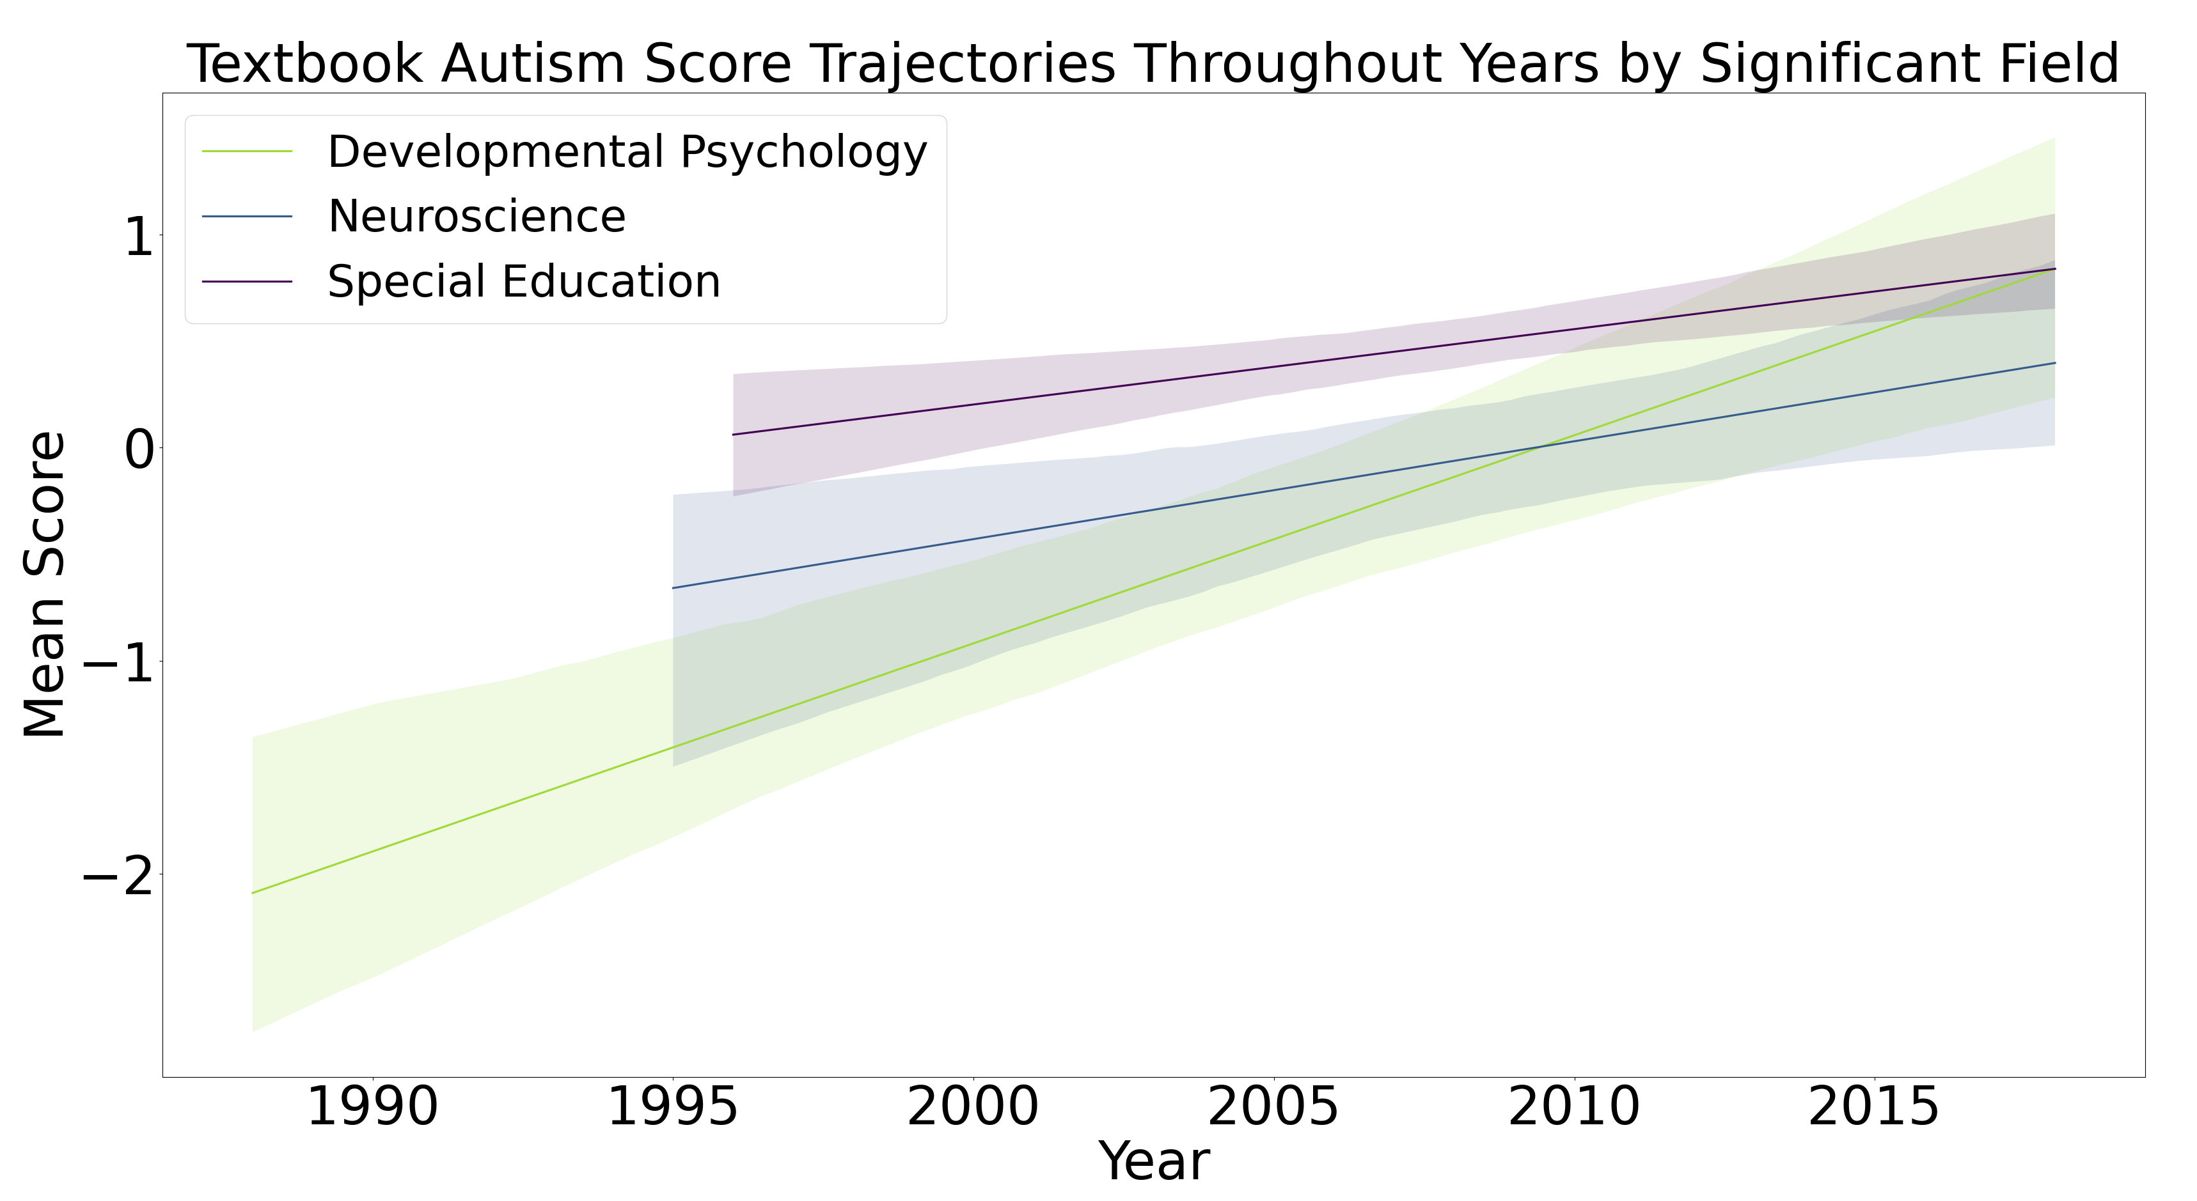
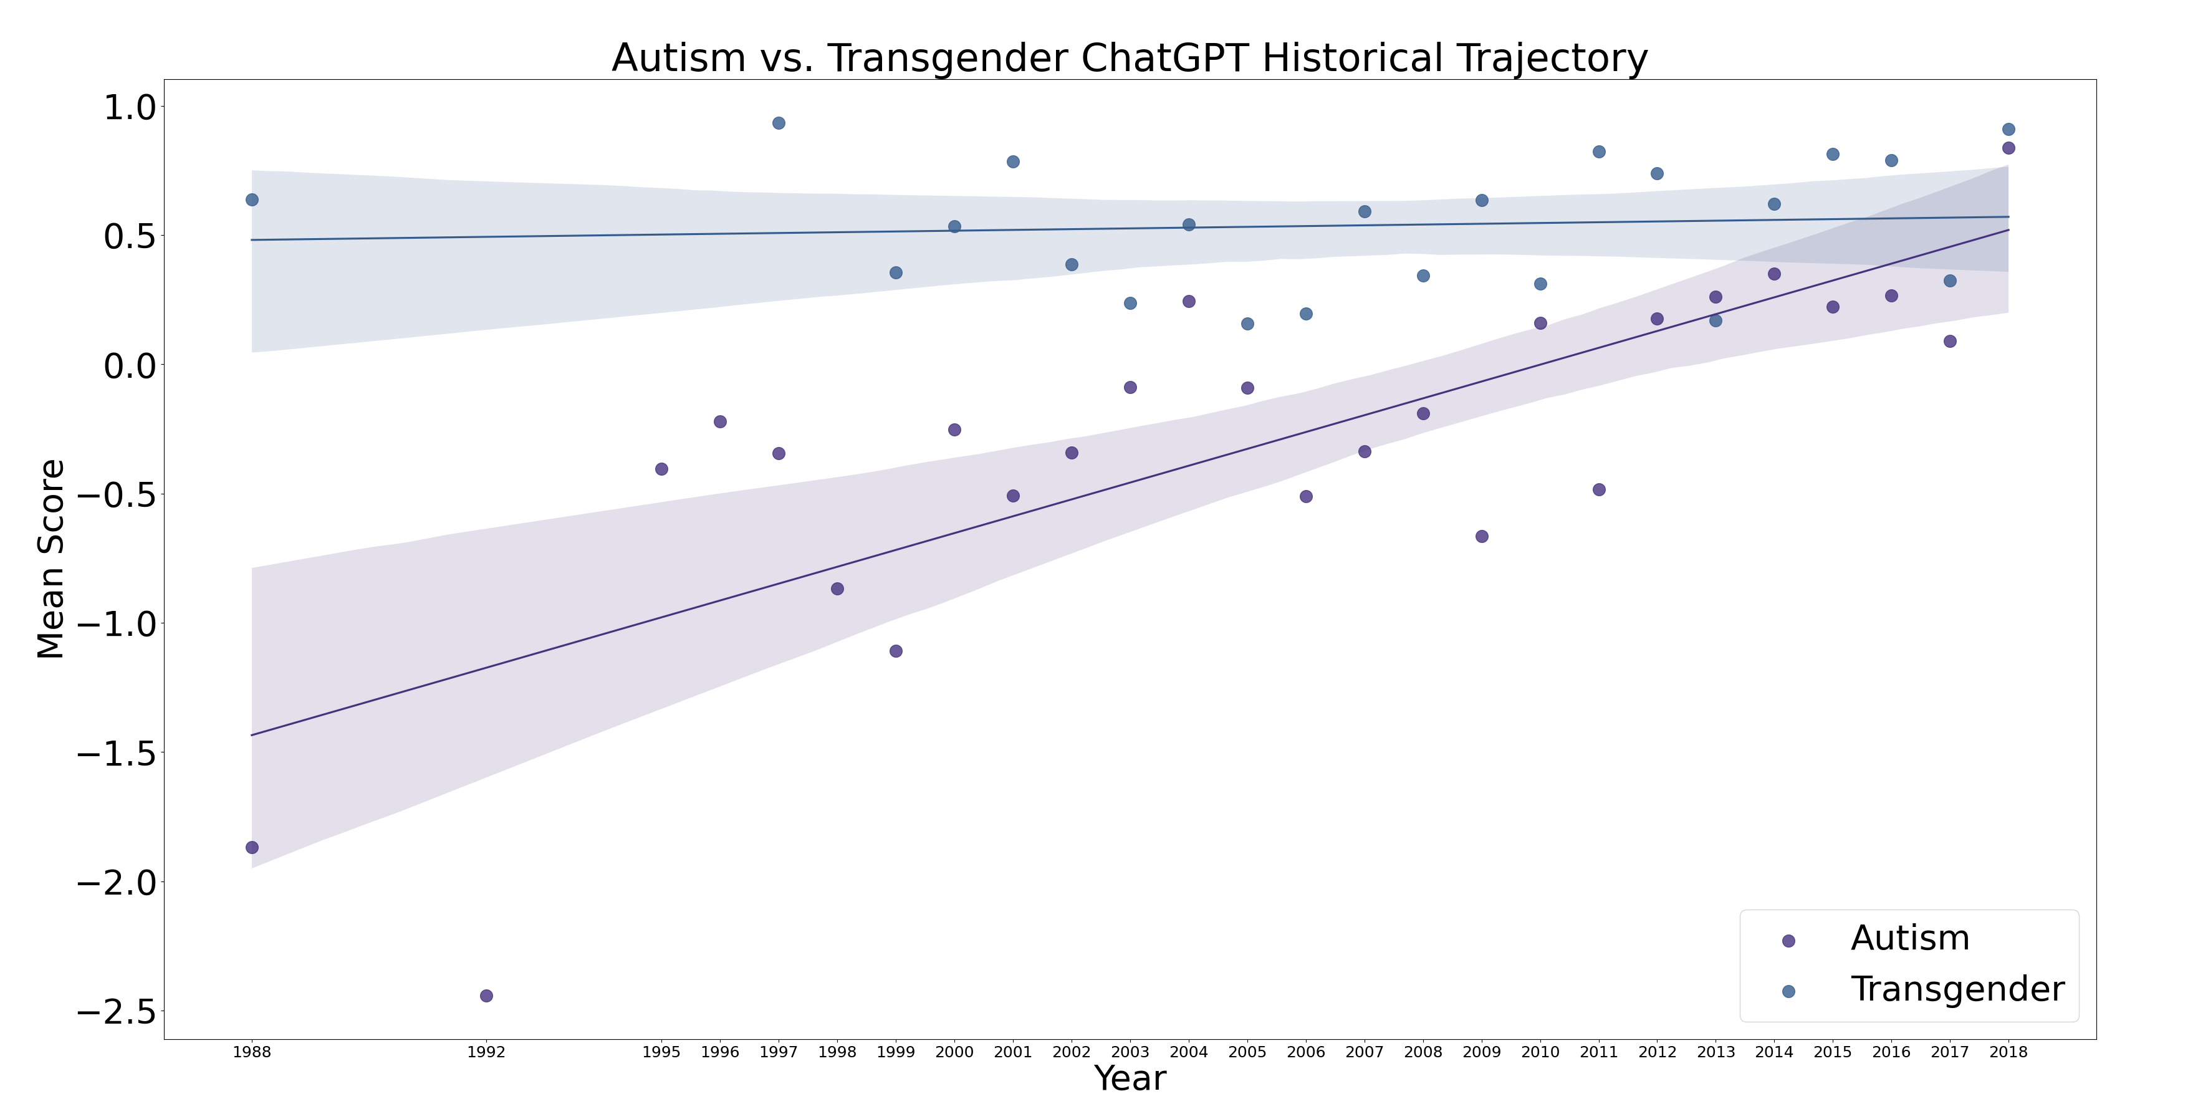
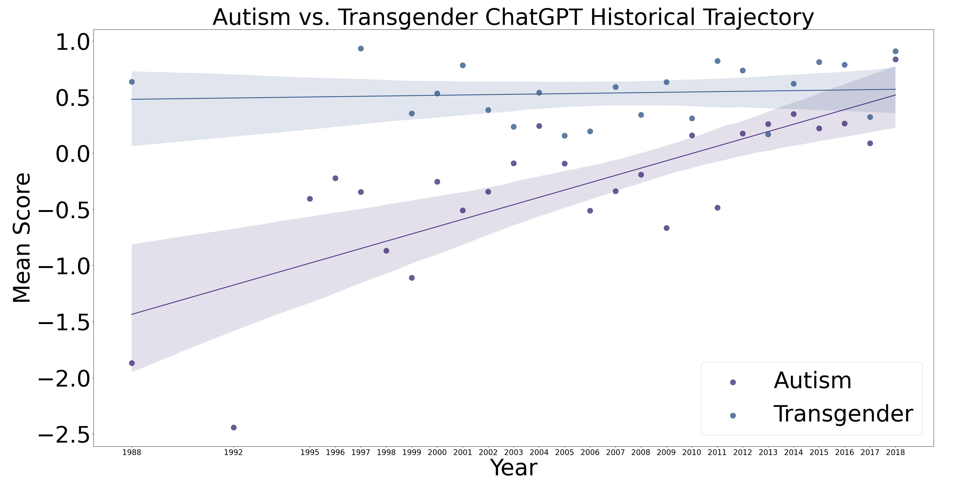
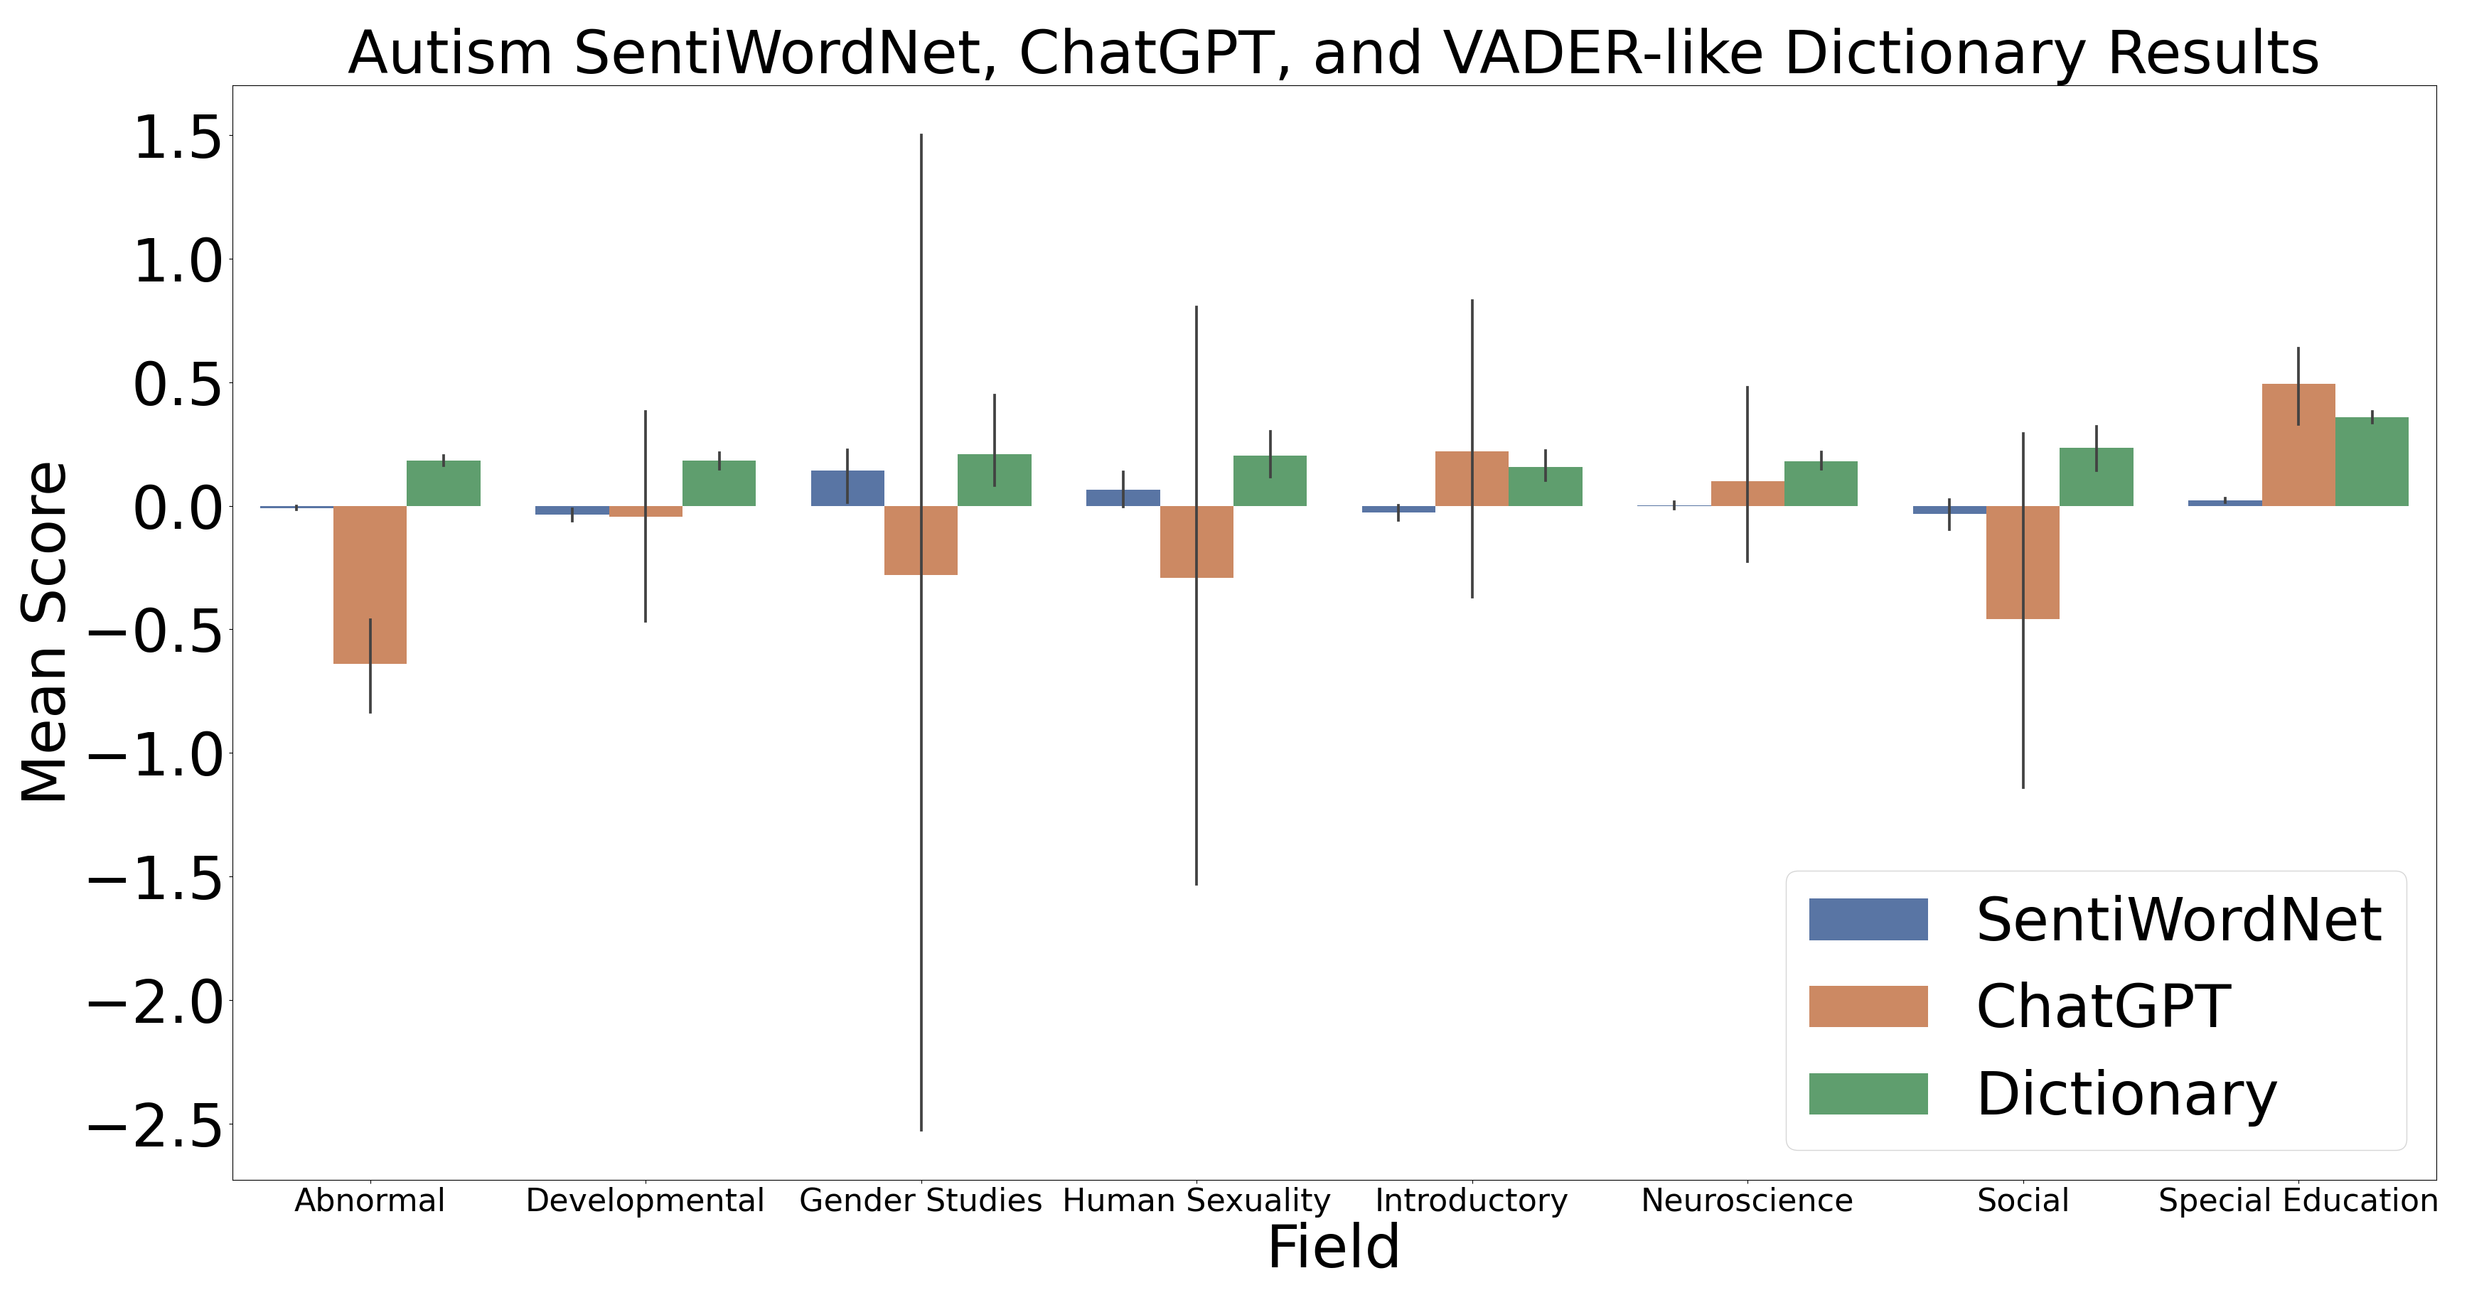

Textbooks Write More Positively About Autism Over Time
Alexander Maksiaev & Dr. Vikram Jaswal
Introduction
Both autistic and transgender people are heavily stigmatized in society.
Textbooks reflect current societal sentiments, and have the power to affect future societal sentiments through education.
Sentiment analysis is a computational method used to systematically determine the sentiment of a text (Wankhade et al., 2022).
Several sentiment analysis methods exist:
SentiWordNet (Baccianella et al., 2010)
VADER and other VADER-like dictionaries (Hutto & Gilbert, 2014)
ChatGPT (OpenAI, 2024)
Using sentiment analysis, we explored textbook sentiment regarding autistic and transgender people, both by subfield and across time.
Results
Special education textbooks wrote about autism most positively.
Abnormal psychology textbooks wrote about autism most negatively.
Across time, most fields did not show a significant change.
However, developmental psychology, neuroscience, and special education all showed a significant improvement in sentiment.
Overall, across all fields:
Sentiment regarding transgender people stayed the same.
Sentiment regarding autistic people improved.
Positive sentiment | Negative sentiment
“Neurodiversity is the concept that autism, as well as other disabilities, are normal variations of functioning of the human mind, not pathological conditions or deficits” (Friend, 2018). | “[Autism] is a developmental disorder that involves a wide range of problematic behaviors including deficits in language, and perceptual and motor development; defective reality testing; and an inability to function in social situations” (Hooley, 2006).
Method
296 textbooks from 8 different subfields from 1988 – 2018 were excerpted for “autism” and “transgender” search terms.
Sentiment was rated from -4 (most negative) to 4 (most positive).
Sentiment analysis method used matters. VADER-like dictionary results differ significantly from SentiWordNet and ChatGPT.
ChatGPT was chosen for further analysis because it is the only method which accounted for context.
Conclusion
Textbooks write more positively about autistic people over time, while textbook sentiment regarding transgender people has not significantly changed.

