Slide 1
Ado.Net

Slide 2
Ado.net
ADO.NET is a set of classes that expose data access services for .NET Framework programmers. ADO.NET provides a rich set of components for creating distributed, data-sharing applications. It is an integral part of the .NET Framework, providing access to relational, XML, and application data. ADO.NET supports a variety of development needs, including the creation of front-end database clients and middle-tier business objects used by applications, tools, languages, or Internet browsers.

Slide 3
Ado.net approaches
Connected
Disconnected
Entity Framework

Slide 4
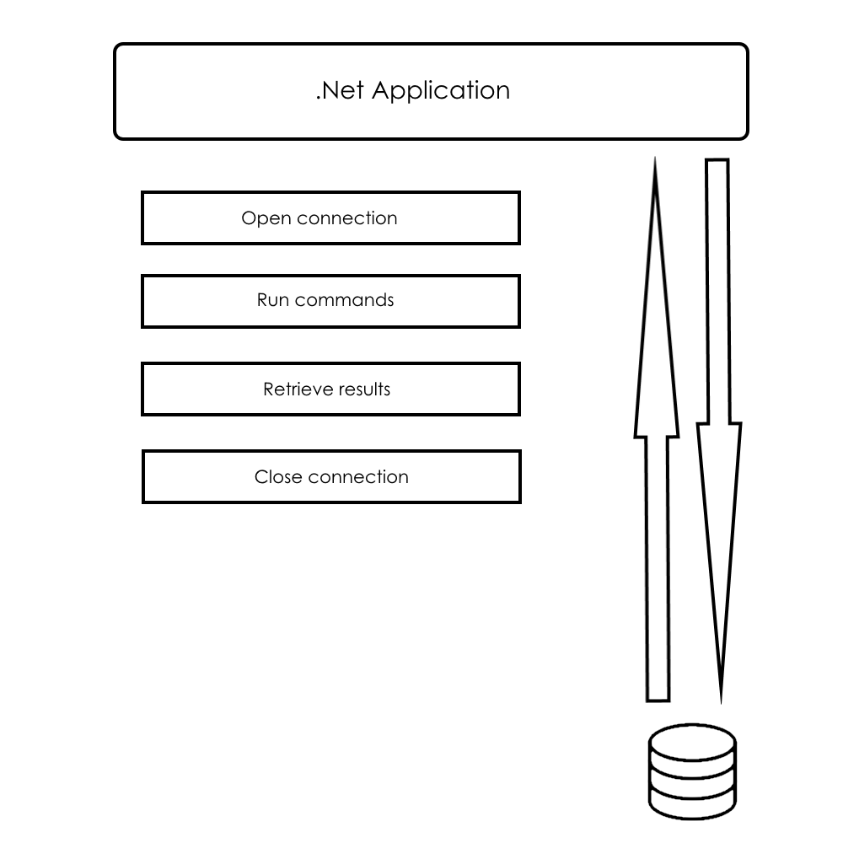
Connected approach

Slide 5
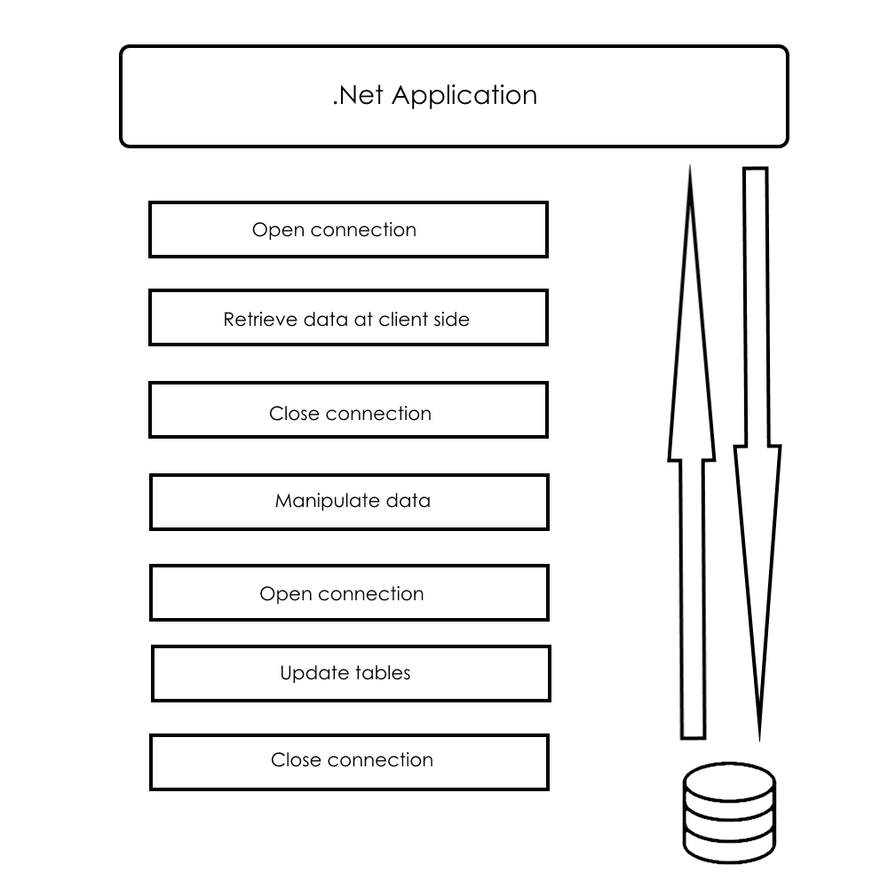
Disconnected approach

Slide 6
Ado.net key objects
DbConnection
DbCommand
DbDataReader
DbParameter
DbTransaction

Slide 7
DbConnection
ConnectionString
ConnectionTimeout
Open
Close

Slide 8
DbCommand
CommandType
ExecuteScalar
ExecuteNonQuery
ExecuteReader

Slide 9
DbDataReader
Read
NextResult
Batch of Get<Type> methods

Slide 10
DbParameter
Name
SourceColumn
DbType

Slide 11
DbTransaction
Commit
Rollback
IsolationLevel

Slide 12
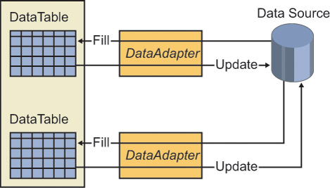
DbDataAdapter
Fill
Update
CRUD-Commands

Slide 13
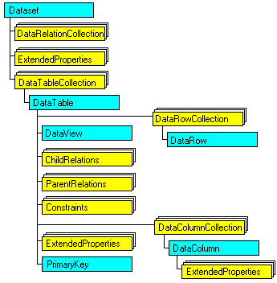
DataSet

Slide 14
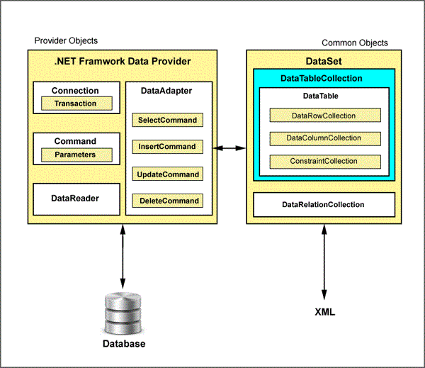
Ado.net architecture

Slide 15
Time for demo

Slide 16
Transient fault handling
Transient Fault Handling Application Block

Slide 17
Retry strategies
Fixed interval
Incremental interval
Exponential back off

Slide 18
Detection strategies
SqlDatabaseTransientErrorDetectionStrategy
StorageTransientErrorDetectionStrategy
CacheTransientErrorDetectionStrategy
ServiceBusTransientErrorDetectionStrategy
SqlAzureTransientErrorDetectionStrategy

Slide 19
Questions

