Slide 1
Ado.net and micro orm

Slide 2
Ado.net
ADO.NET is a set of classes that expose data access services for .NET Framework programmers. ADO.NET provides a rich set of components for creating distributed, data-sharing applications. It is an integral part of the .NET Framework, providing access to relational, XML, and application data. ADO.NET supports a variety of development needs, including the creation of front-end database clients and middle-tier business objects used by applications, tools, languages, or Internet browsers.

Slide 3
Ado.net approaches
Connected
Disconnected
Entity Framework

Slide 4
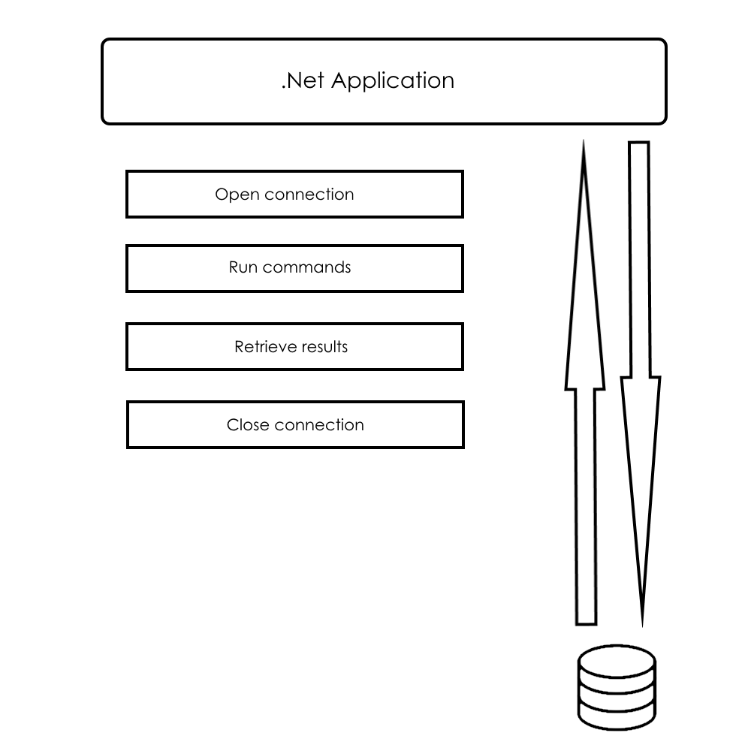
Connected approach

Slide 5
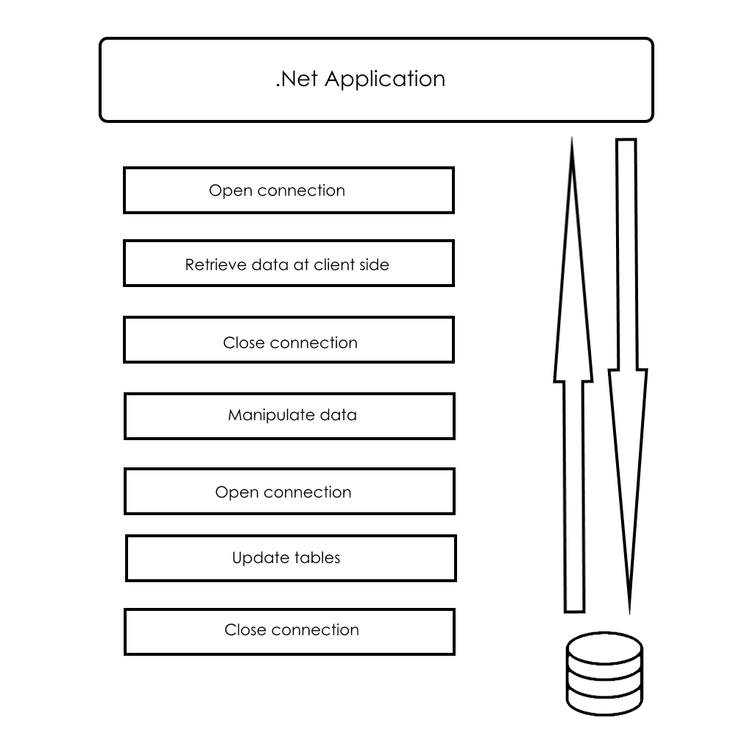
Disconnected approach

Slide 6
Ado.net key objects
DbConnection
DbCommand
DbDataReader
DbParameter

Slide 7
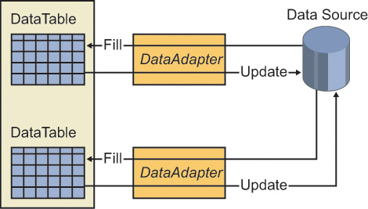
Data adapter

Slide 8
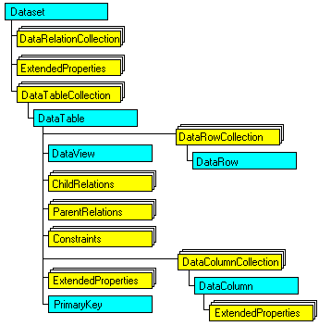
Data set

Slide 9
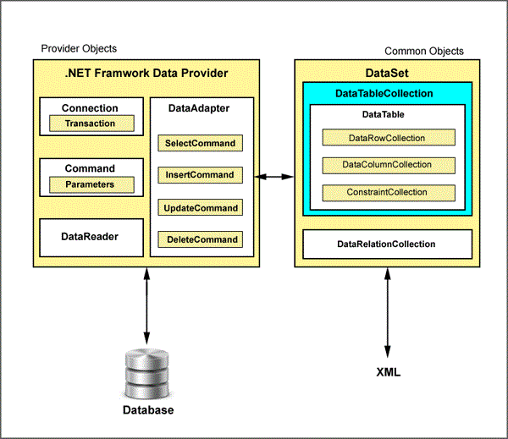
Ado.net architecture

Slide 10
Time for demo

Slide 11
Micro orm
Dapper.Net

Slide 12
Dapper helpers
Execute a query and map the results to a strongly typed List
Execute a query and map it to a list of dynamic objects
Execute a Command that returns no result

Slide 13
Limitations of dapper
Many features that ORM ship with are stripped out, there is no identity map, there are no helpers for update/insert and so on.
Dapper does not manage your connection’s life cycle, it assumes the connection it gets is open.

Slide 14
Time for demo

Slide 15
Transient fault handling
Transient Fault Handling Application Block

Slide 16
Retry strategies
Fixed interval
Incremental interval
Exponential back off

Slide 17
Detection strategies
SqlDatabaseTransientErrorDetectionStrategy
StorageTransientErrorDetectionStrategy
CacheTransientErrorDetectionStrategy
ServiceBusTransientErrorDetectionStrategy
SqlAzureTransientErrorDetectionStrategy

Slide 18
questions

