Slide 1
Ado.net and micro orm

Slide 2
Ado.net
ADO.NET is a set of classes that expose data access services for .NET Framework programmers. ADO.NET provides a rich set of components for creating distributed, data-sharing applications. It is an integral part of the .NET Framework, providing access to relational, XML, and application data. ADO.NET supports a variety of development needs, including the creation of front-end database clients and middle-tier business objects used by applications, tools, languages, or Internet browsers.

Slide 3
Ado.net approaches
Connected
Disconnected
Entity Framework

Slide 4
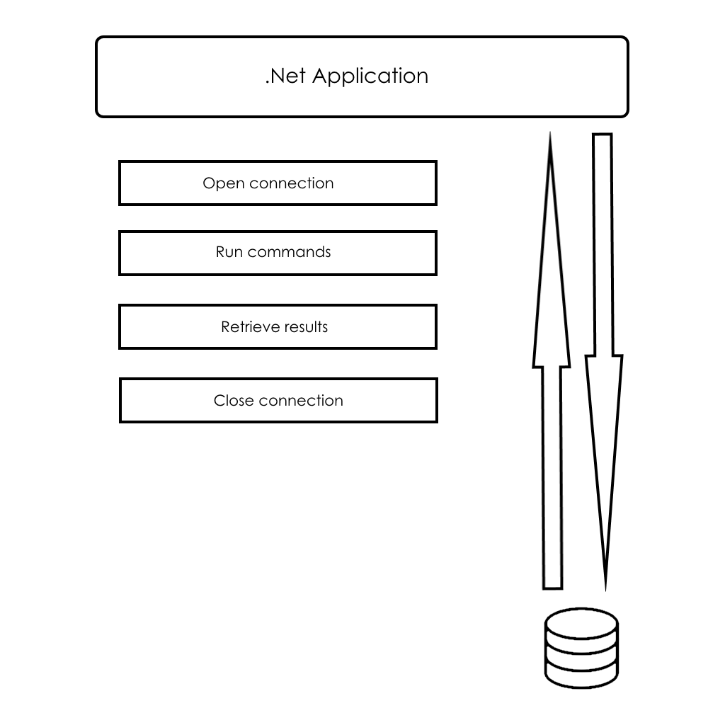
Connected approach

Slide 5
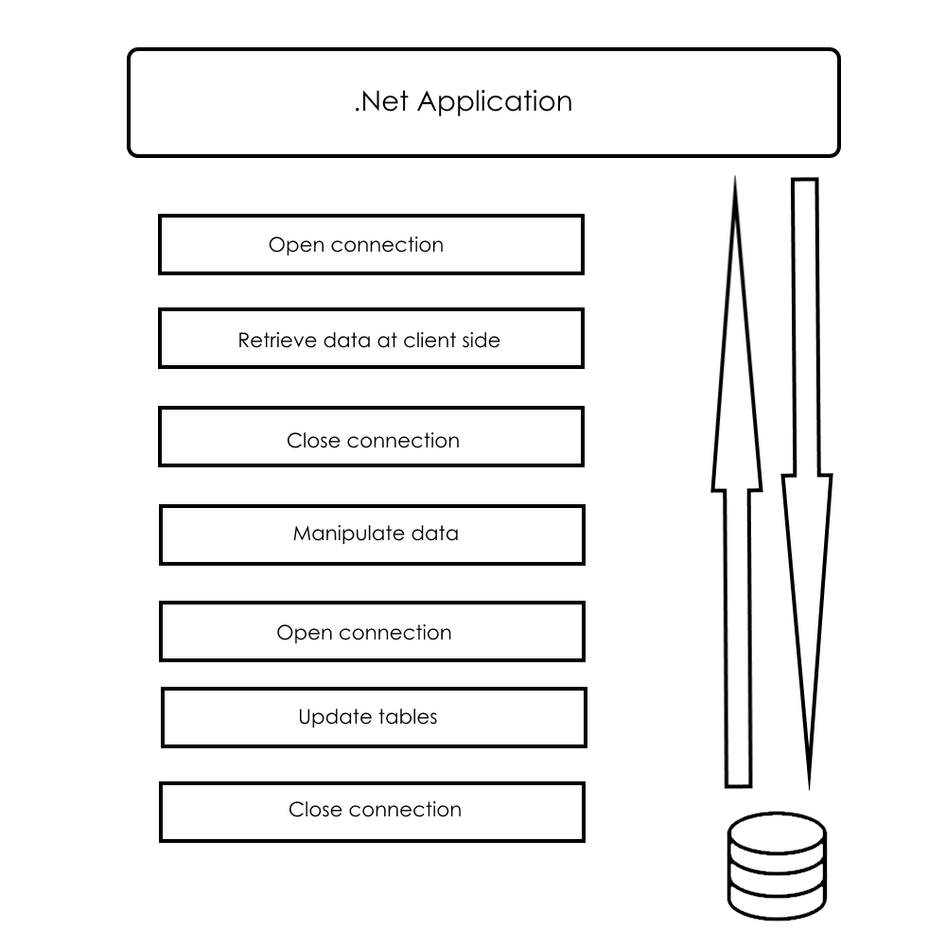
Disconnected approach

Slide 6
Ado.net key objects
DbConnection
DbCommand
DbDataReader
DbParameter

Slide 7
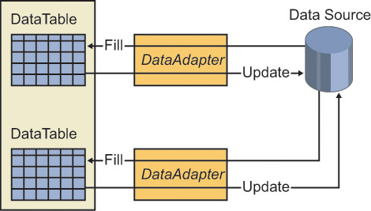
Data adapter

Slide 8
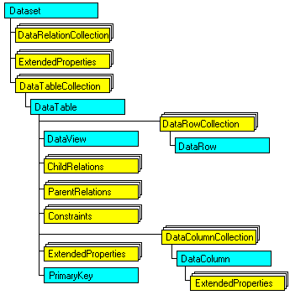
Data set

Slide 9
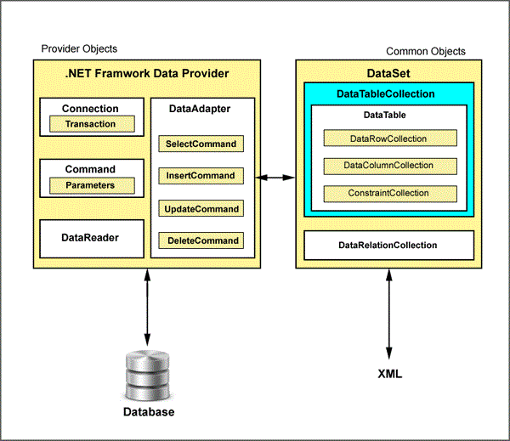
Ado.net architecture

Slide 10
Time for demo

Slide 11
Micro orm
Dapper.Net

Slide 12
Dapper helpers
Execute a query and map the results to a strongly typed List
Execute a query and map it to a list of dynamic objects
Execute a Command that returns no result

Slide 13
Limitations of dapper
Many features that ORM ship with are stripped out, there is no identity map, there are no helpers for update/insert and so on.
Dapper does not manage your connection’s life cycle, it assumes the connection it gets is open.

Slide 14
Time for demo

