Slide 1


Logging
Mykyta Bakirov
JANUARY 17, 2017

Slide 2
AGENDA
1
Logs Purpose and Value
2
Log levels
3
Considerations
4
.Net logging libraries overview
5
Structured logging
6
ELK stack
7
Azure application insights
8
Best practices & Project logging review checklist

Slide 3

Logs Purpose and value

Slide 4
Logs purpose and value
Purpose of the logging framework is to answer questions what happened to the system.
The questions depends on who is asking.
Parties that are interesting in information from logs can be:
Development team
Maintenance team
Business

Slide 5
Development team questions
Did the application logic work as expected?
How long it took to make an operation?
Did a call to external system occur? Where the parameters correct?
How long it took to get response from external system?

Slide 6
Maintenance team questions
How healthy the application is?
Application does not work after network outage. Why? How this can be fixed?
Is the application in a middle of something? How safe it is to restart or shutdown it right now?
Why the system is slow?

Slide 7
Business questions
Why a business transaction failed?
Why this user could not do the operation?
What did a user do in a specific period of time?
Did this user do what he or she claims?
Why the system is slow?

Slide 8
Log levels
OCTOBER 7, 2015

Slide 9






Log level
VERBOSE
DEBUG
INFO
WARNING
ERROR
FATAL
Very low-level debugging/internal information
Low level, control logic, diagnostic information
Non “internals” information / black box
Information about possible problems
Information about an unexpected failure
Information about critical systems failures

Slide 10
Log level - VERBOSE
Very low-level debugging/internal information.
Usually enabled to troubleshoot severe problem with application. On this level application usually produce large amount of information.
Information is internal and mostly can be understood having correspondent code besides.
Should not be enabled by default.
Target Audience: Developers.

Slide 11
Log level - DEBUG
Low level, control logic, diagnostic information.
Not quire low level as verbose. Write down logical branches that was used within application. The info that will be helpful to know what part of application was actually in work and where the failure happened.
This level logs “how” application is doing stuff.
As a verbose it reveals “internal” application information.
Target Audience: Developers, rarely Maintenance team

Slide 12
Log level - INFO
Non “internals” information / black box.
Ability to logs events that are of some interest to external parties. This level logs mostly “what” the application is doing, not “how”.
That a level where some kind of raw audit happens. When the project is in maintenance phase, making information from this level easy to query can make troubleshooting much easier.
Target Audience: mostly Maintenance team, Business.

Slide 13
Log level - WARNING
Information about possible problems.
Application logs messages about things that might potentially breaks in the future. Events that produces warning might cause system slowness, alternative communication approaches, etc. Users and their data are not affected by this level events.
Messages on that level might be included to notification system for Maintenance team. Can be used for retrospective analysis for application improvements by development team.
Target Audience: Maintenance team, Developers

Slide 14
Log level - ERROR
Information about an unexpected failure.
Error occurred, however the system still able run. Error messages are logged in result of some business transaction failure, so some users are affected by the event.
Message on that level must be included to notification system for Maintenance team. Analysis of the message might help in resolving custom issue in advance.
Target Audience: Maintenance team, Developers

Slide 15
Log level - FATAL
Information about critical systems failures.
System is not able to work. Underlying system are down, strict dependencies are not made. System does not produce business value.
Message on that level must be included to notification system for Maintenance team. Information from this messages should be as clear as possible for maintenance team, so they can fix the issue as soon as possible.
Target Audience: Maintenance team

Slide 16
considerations

Slide 17
Audit/Legal Requirements
What needs to be logged? Events or data or both?
Sensitive data should not be logged, such as Credit Card Ids, user passwords, personal info?
Does logs info correspond to required compliance?

Slide 18
Logs Security
What is logged?
Who has access to logs?

Slide 19
.net logging libraries overview

Slide 20
Features of a logging library
or why not to build own logging library…
Various log formatters
Asynchronous and reliable logs writing
Extreme robustness
High performance

Slide 21
log4net
https://logging.apache.org/log4net/
PM>Install-Package log4net
AdoNetAppender
AnsiColorTerminalAppender
AspNetTraceAppender
BufferingForwardingAppender
ColoredConsoleAppender
ConsoleAppender
DebugAppender
EventLogAppender
FileAppender
ForwardingAppender
LocalSyslogAppender
ManagedColoredConsoleAppender
MemoryAppender
NetSendAppender
OutputDebugStringAppender
RemoteSyslogAppender
RemotingAppender
RollingFileAppender
SmtpAppender
SmtpPickupDirAppender
TelnetAppender
TraceAppender
UdpAppender

Slide 22
NLog
http://nlog-project.org/
PM>Install-Package NLog.Config
Interesting notes:
http://deep-depth.blogspot.com/2014/01/net-low-latency-logging-part-2-nlog.html
Files
Console
Event Log
E-mail
Database
ASP.NET trace
…

Slide 23
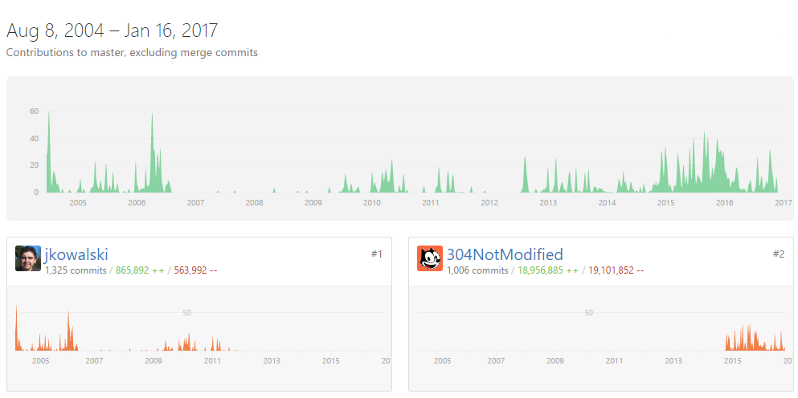
NLog

Slide 24
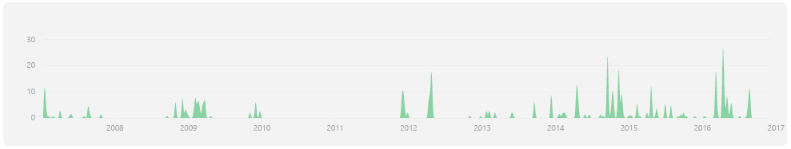
Common Logging
Provides a simple logging abstraction to switch between different logging implementations. There is current support for log4net, NLog and Enterprise Library logging.
PM> Install-Package Common.Logging
Common.Logging 3.3.1 (latest stable) |  | Saturday, November 14, 2015

Slide 25
Structured logging

Slide 26


Log Message Consumers
Humans
Machines

Slide 27
Messages as arbitrary string (char[])
Example:
2012:11:24T17:32:23.3435 INFO gps@mozilla.com successfully logged in
Humans are main consumers
Text-only searching (regular expressions, text tools)
Files might be spread over different locations
Text is queryable only for info it got when it was written

Slide 28
Structured Logging
Example:
[1354317157.034534, "INFO", "sucessful_login", {"who": "gps@mozilla.com", “user_id”: 17}]
Both for Humans and Machines
Goal is to eliminate parsing problem
Emit machine readable messages to logs
Preserve more info for further querying

Slide 29
Serilog – Structured Logging
http://serilog.net/
PM>Install-Package Serilog
Console
File
Observers (Rx)
TextWriter
Trace
Amazon Kinesis
Application Insights
Azure DocumentDB
Azure Event Hubs
Azure Table Storage
CouchDB
CouchBase
DataDog
Elasticsearch
elmah.io
Email
Exceptionless
Glimpse
Literate Console
log4net
Logentries
Loggly
Loggr
MongoDB
NLog
Seq
SignalR
Splunk
SQL Server
RavenDB
Raygun
RethinkDB
Windows Event Log
Xamarin
XSockets.NET

Slide 30

Serilog – ELK
PM>Install-Package Serilog.Sinks.Elasticsearch
Elasticsearch is a distributed, JSON-based search and analytics engine designed for horizontal scalability, maximum reliability, and easy management.
Logstash is a dynamic data collection pipeline with an extensible plugin ecosystem and strong Elasticsearch synergy.
Kibana gives shape to your data and is the extensible user interface for configuring and managing all aspects of the Elastic Stack.

Slide 31
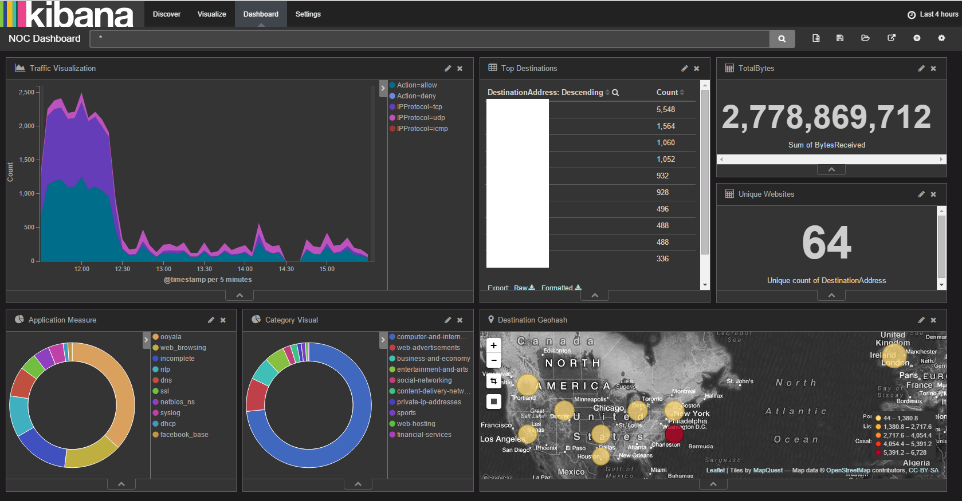

Slide 32
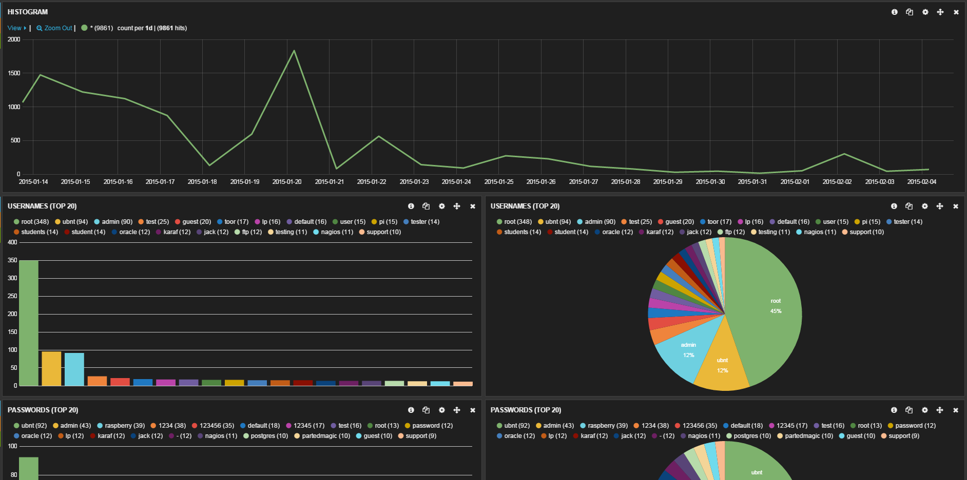

Slide 33
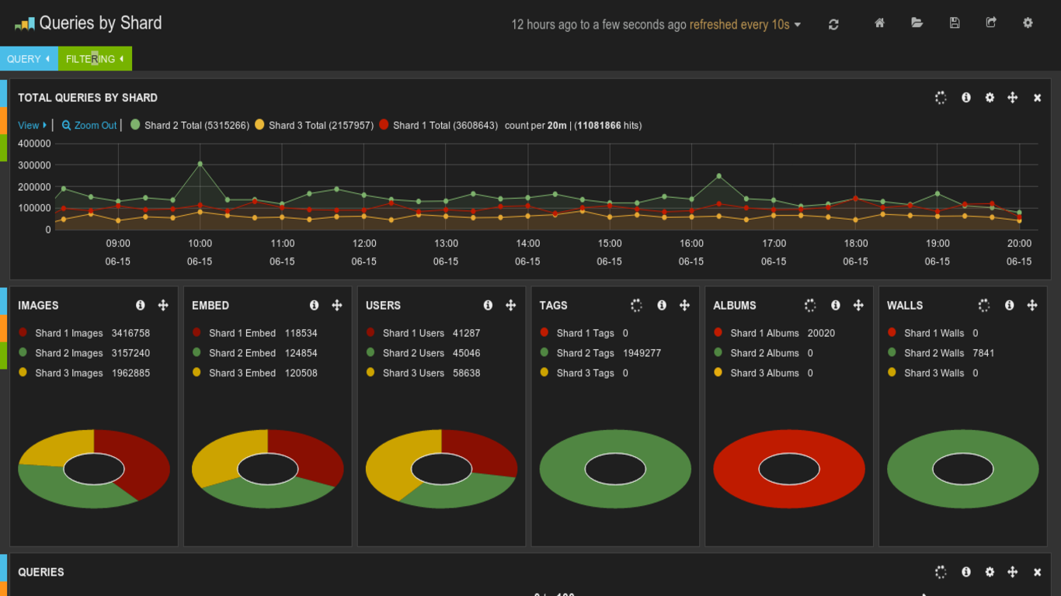

Slide 34
AZURE APP INSIGHtS

Slide 35
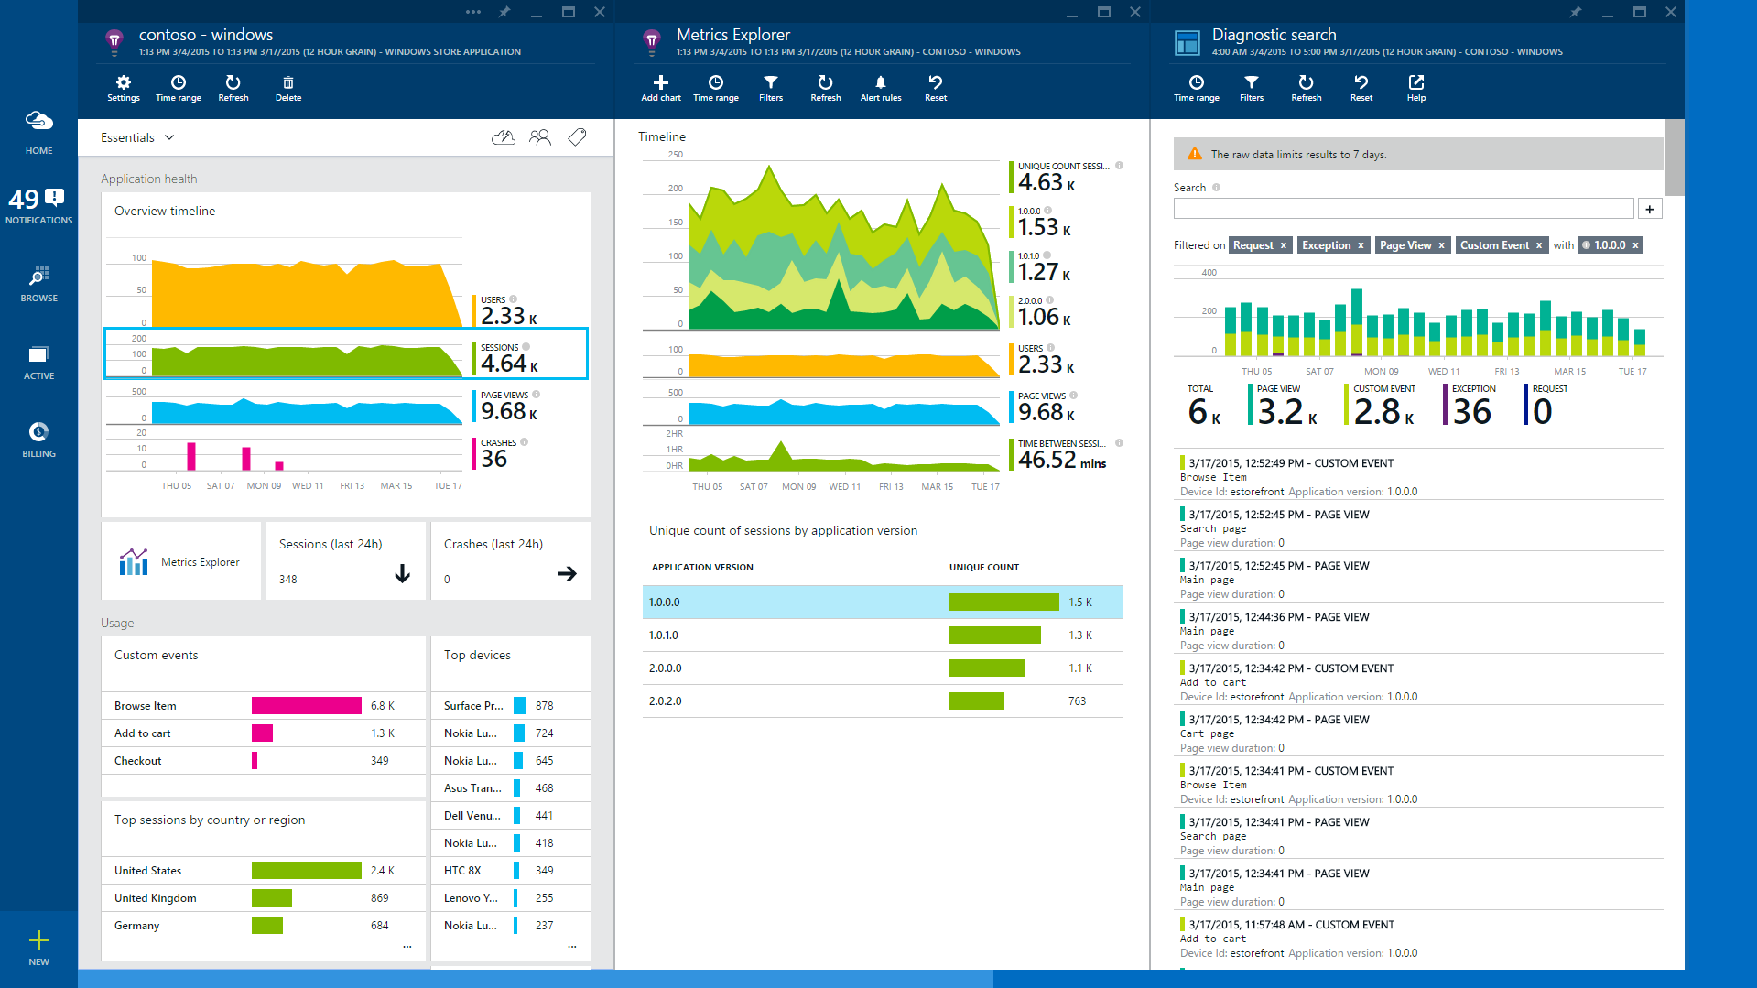

Slide 36
Best practices

Slide 37
Best Practices – Error Token
On error generate unique id (e.g. GUID), log the id and show id with the error message to user. That will extremely speed up search for the error in logs. Also, it would guarantee that logs are not missing.

Slide 38
Best Practices – Test Logs
Test Logs – As a developer you should always test that your logging approach works. Not only it does not break the whole application, but actually logs what should be logged. Make sure that object info won’t be logged as “ClassName”. In some cases even bring QA to test logs modification, if it makes value for business or/and is developed as separate story.

Slide 39
Best Practices – Error Handling
Error Handling – On root level you must log all unhandled exceptions. On lower levels, think logging will make investigations easier and log correspondently.

Slide 40
using (LogContext.PushProperty("A", 1))
{
_appLogger.Info("Carries property A = 1");
using (LogContext.PushProperty("A", 2))
using (LogContext.PushProperty("B", 1))
{
_appLogger.Info("Carries A = 2 and B = 1");
}
_appLogger.Info("Carries property A = 1, again");
}
Best Practices – LogContext

Slide 41
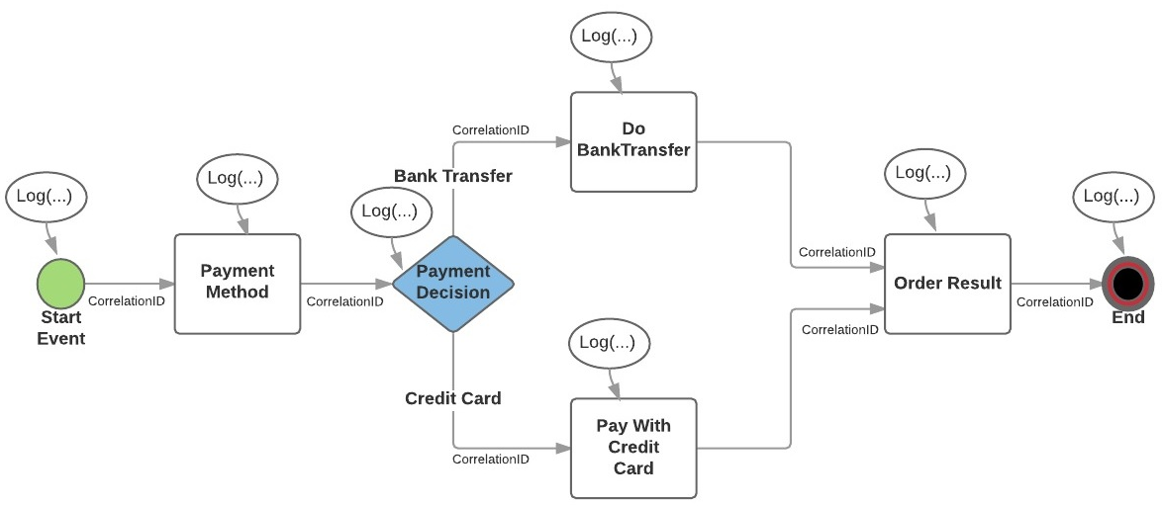
Best Practices – microservices

Slide 42
Project logging review checklist

Slide 43
Project Logging Review Checklist
Can you say what application is doing now from logs?
How long in takes you to get that info from logs?
Can you say what did user do yesterday from logs?
Is there try catch without logging?
Is logger configured correctly balancing performance and reliability?
How long does it take to get trace of one business operation? (If more than 20 minutes, the application is not ready for maintenance)

Slide 44
Thank you!

