Slide 1
Security
Describe what it is.
And show the direction.

Slide 2
Agenda
Identification
Authentication
Authorization
STRIDE Threat Model
Cross-site scripting
Cross-site request forgery
Demo

Slide 3
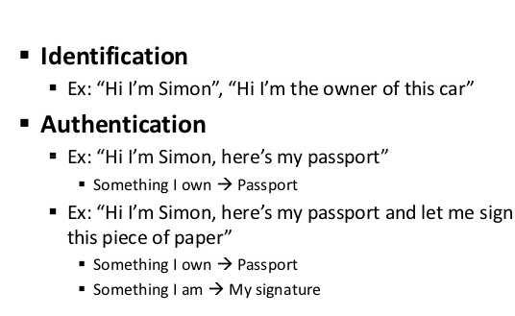
Identification vs Authentication

Slide 4
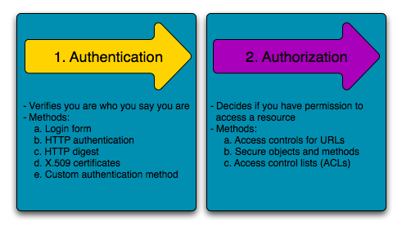
Authentication vs Authorization

Slide 5
Threat Types – STRIDE
Spoofing – falsify identity
Tampering – unauthorized changes of something
Repudiation – deny responsibility
Information Disclosure – stealing information
Denial of Service – component does not respond as expected
Elevation of Privilege – ability to raise user’s permissions
T
t

Slide 6
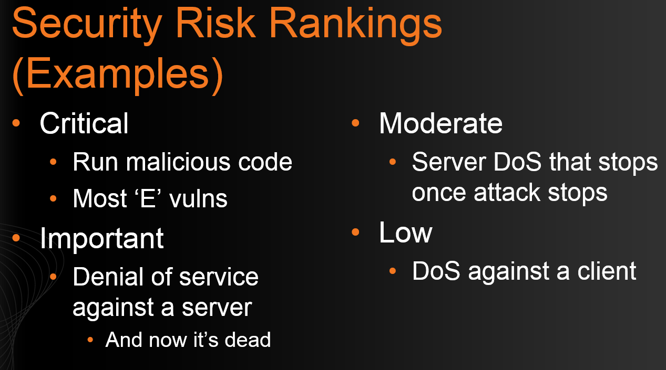
Threat Ranking
T
t

Slide 7
Possible Actions
Do Nothing
Mitigate with Technology
Remove functionality
Warn a User
T
t

Slide 8
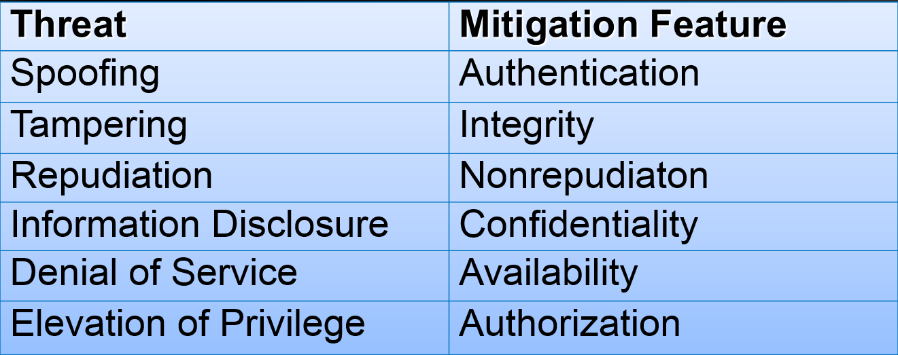
Mitigation Techniques
T
t

Slide 9
Mitigations – External Entity
Spoofing
Authentication: Login/Password, NTLM/Kerberos, Certificates, Tags, Fingerprints etc
Repudiation
Logs/Audit – security, business etc.
T
t

Slide 10
Mitigations – Processes 1/5
Important: we CANNOT protect the Process if we do not control environment. All mitigations are just Defense-in-Depth
Spoofing
Authentication – SSL/TLS, certificates, SPN, shared secrets
Tampering
Privacy for classes, Strong Naming, Code Signing, Code Access Security (CAS), Code Permissions
Keeping Secrets in Memory – avoid keeping, clear memory, keep manipulation short, encrypt if possible
Config files – ACLs, encryption (DPAPI), do not put sensitive info, do not trust them
T
t

Slide 11
Mitigations – Processes 2/5
Information Disclosure
UI, Code, config, memory, dumps
Proper exception handling and UI error messages
Obfuscation, assembly encoding, config encryption (Data Protection API – DPAPI)
Do not store sensitive data
If you do – encrypt it (symmetric/asymmetric), minimize amount of time when unencrypted, clear down memory, do not use strings (arrays of bytes instead).
Think where to store encryption keys
T
t

Slide 12
Mitigations – Processes 3/5
Denial of Service (Client/Server, Permanent/Temporary, Amplifying or not etc)
Client – malicious input, corrupted environment
Code consistency
Do not trust user input or resources/environment (configs, environment variables etc), isolate work with resources, expect/handle problems
T
t

Slide 13
Mitigations – Processes 4/5
Denial of Service (Client/Server, Permanent/Temporary, Amplifying or not etc)
Server
Infrastructure
Quotas (number of connections, amount of memory, size of requests, timeouts etc), Health Monitoring (performance counters)
Application
Use parsers carefully (Deserializers/RegExp), set quotas (number of nodes, max size etc)
Fuzz Testing
T
t

Slide 14
Mitigations – Processes 5/5
Elevation of Privilege
Bypass authentication/authorization
Authorize on both client/server; Do not trust client authorization (security context can be tampered with)
Use strong authentication protocols (Kerberos/NTLM, WS-Federation, OpenID Connect etc)
Execute arbitrary code
Execute under Least Privileges, code permissions
Protect against Injections (e.g. SQL Injection)
ACLs on all resources (databases, files, certificates, etc)
T
t

Slide 15
Mitigations – Data Flows
Tampering
Changing messages – digital signing (SSL/TLS or Message based)
Replay attacks – replay detection, WCF/WIF support, secure conversations
Information Disclosure
Sniffing – encryption (SSL/TLS or Message based)
Denial of Service
Correct handling of network outage scenarios
Control of message sequence (secure conversations)
T
t

Slide 16
Mitigations – Data Stores (1/2)
Databases, File System, Registry etc.
Physical access, Access via Application
Tampering/Repudiation (for logs/audit)
Access Authorization, do not use Administrative accounts, protect credentials
ACLs, use least privileges for the job
Digital Signing – does not protect, just helps to detect Tampering
Key Management (e.g. PKI)
Protect against SQL Injection
Architectural patterns – DMZ, GateKeeper
T
t

Slide 17
Mitigations – Data Stores (2/2)
Databases, File System, Registry etc.
Information Disclosure
Authorization, ACLs, account protection
Encryption of sensitive data (SQL Encryption, manual encryption)
Denial of Service
Monitor and profile long queries
Handle connections (connection pool)
Limit number of simultaneous connections
Use Paging, no unlimited resultsets
T
t

Slide 18
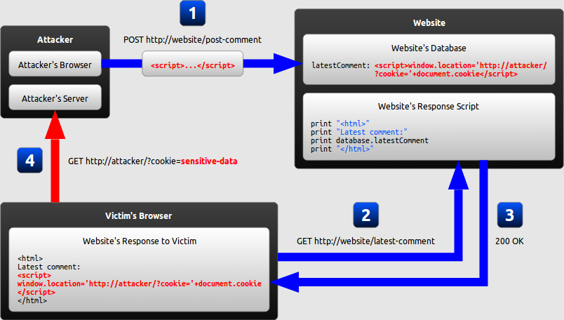
Cross-site scripting

Slide 19
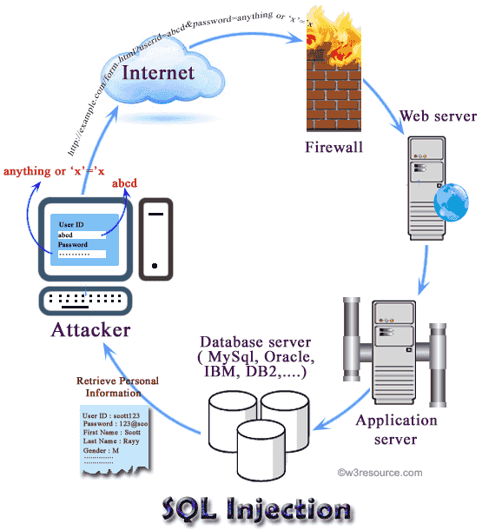
SQL Injection

Slide 20
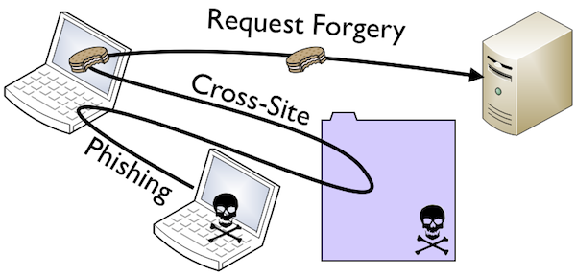
Cross-site request forgery

