Slide 1
Caching

Slide 2
Agenda
What is caching
Design patterns
Memcached
Redis
Amazon ElastiCache
Demo

Slide 3
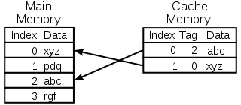
What is cache

Slide 4
History And Facts
1967 IBM Systems Journal
High-speed buffer
1968 IBM Award
Fr Cacher – “hide”
Notes:
Редактор журнала Лайл Джонсон

Slide 5
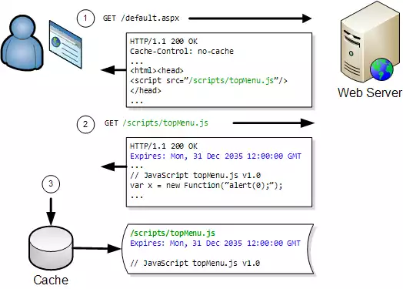
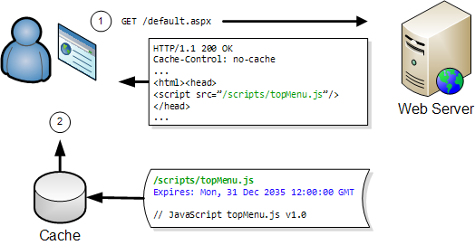
Caching Example

Slide 6
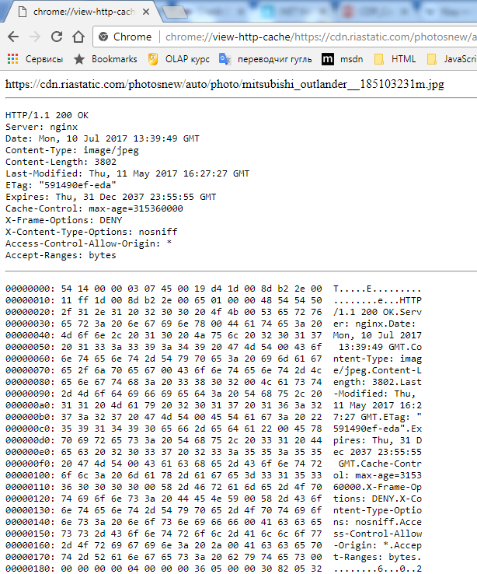
Caching Example
chrome://cache/
C:\Users\<UserName>\AppData\Local\Google\Chrome\User Data\Default\Cache

Slide 7
Patterns
Lazy Loading
Cache-Aside
Read-Through
Write-Through
Write Behind
Refresh Ahead

Slide 8
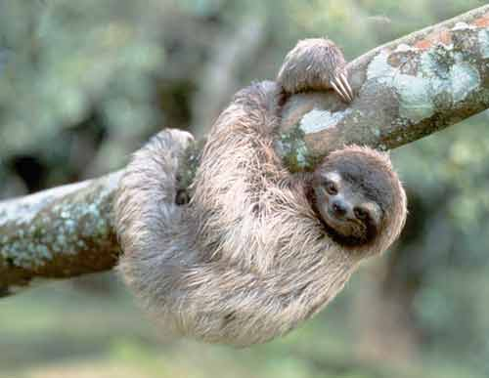
Lazy Loading

Slide 9
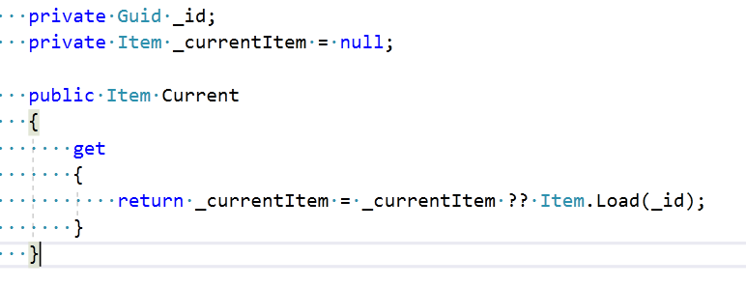
Lazy Loading

Slide 10
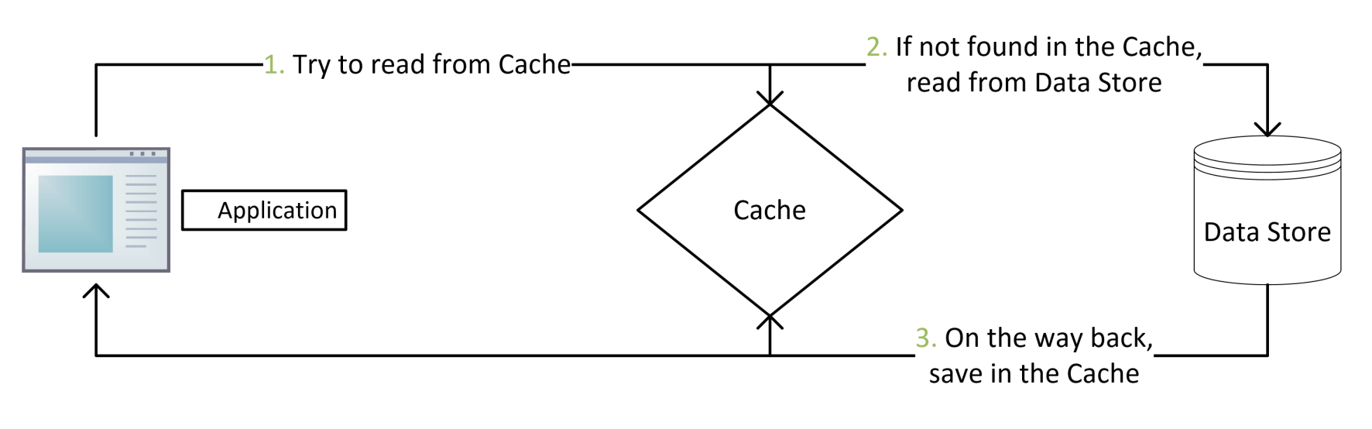
Cache-Aside
Read:
1. Check the item in the cache
2. If not, read the item from data store
3. Store a copy into the cache
Write:
1.Write data to the data store
2. Send the invalidate request to the cache

Slide 11
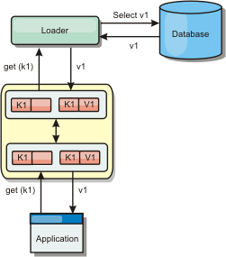
Read-Through
Application asks cache for an entry
If entry found – cache returns it. Cycle is done
If not– cache loads it from underlying data source
Cache returns entry to application
Cache stores entry to itself for future use

Slide 12
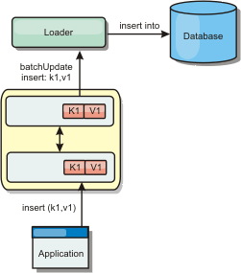
Write-Through
Application sends data insert/update request to cache
Cache stores data in data source
Cache inserts/updates entry in itself
Cache sends successful response to application

Slide 13
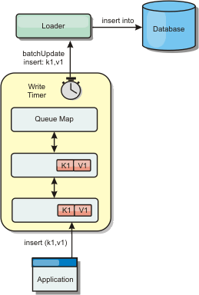
Write-Behind
Application sends data insert/update request to cache
Cache inserts/updates entry in itself
Cache releases new data to application
Cache adds or replaces entry in write-behind queue
Cache dequeues entry and saves data to store after configured write-behind delay
Important about DELETION
cache entries are removed synchronously from the data source
Notes:
Improves performance
Reduce database load
Linear scalability
Isolation from database failures

Slide 14
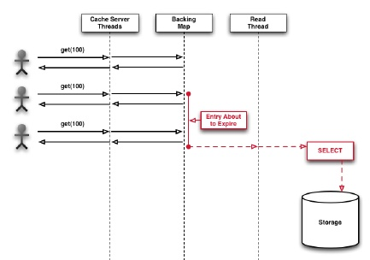
Refresh-Ahead
Automatically and asynchronously reload (refresh) item cache before its expiration
Async refresh is only triggered when an object that is sufficiently close to its expiration time
Refresh-ahead time is expressed as a percentage of the entry's expiration time

Slide 15
Cache replacement policies
First In First Out
Last In First Out
Least Recently Used (LRU)
Most Recently Used (MRU)
Least Frequently Used (LFU)
Notes:
Оптимально - отбрасывать из кэша ту информацию, которая не понадобится в будущем дольше всего. Но предвидеть не можем.
LRU - в первую очередь, вытесняется неиспользованный дольше всех. Этот алгоритм требует отслеживания того, что и когда использовалось. Нужно сохранять метку возраста для всех записей. При обращении к строке кэша необходимо обновлять возраст всех остальных строк.
MRU - первую очередь вытесняется последний использованный элемент. Это эффективно для циклического сканирования данных.
LFU – считает количество запросов к конкретной записи, в отличие от LRU – только одной.

Slide 16
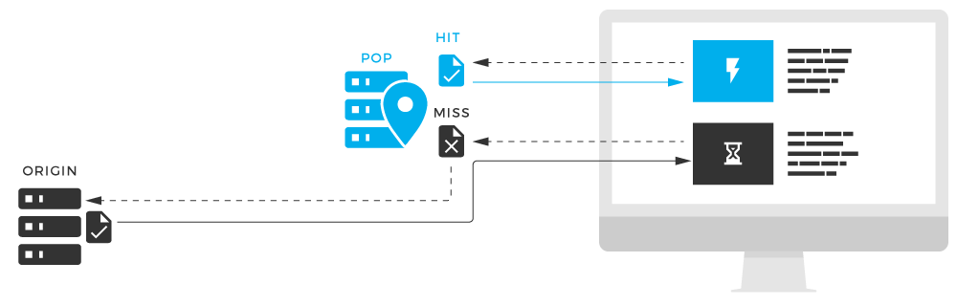
Cache Metrics
Cache hit – entry in cache can be found with a matching tag
Cache miss – cache doesn’t contain data with the desired tag
Hit ratio – the percentage of requests that result is hit

Slide 17

Memcached
Open source
In-memory caching system
Key-value store
Latest release 2017-7-4
Notes:
Memcached was originally developed by Brad Fitzpatrick for LiveJournal in 2003.

Slide 18




Memcached users

Slide 19
Supported languages
.Net
C
C++
ColdFusion
Erlang
Java
Lisp
Perl
PHP
Python
Ruby

Slide 20

Redis
Open source
In-memory
Data structure store
Database
Cache
Message broker

Slide 21




Redis users

Slide 22
Redis data types
Strings - can be at max 512 Megabytes in length
Lists - lists of strings, sorted by insertion order
Sets - unordered collection of Strings
Hashes - maps between string fields and string values
Sorted sets - non repeating collections of Strings sorted by Score

Slide 23
Supported languages
C#
C
C++
Erlang
Haskell
Javascript(Node.js)
Java
PHP
Ruby
Python
Scala
Objective-C

Slide 24


Amazon ElastiCache
Amazon ElastiCache is a web service that makes it easy to deploy, operate, and scale an in-memory data store or cache in the cloud

Slide 25
DEMO

