Slide 1
Inverted Index Construction
Adapted from Lectures by
Prabhakar Raghavan (Yahoo and Stanford) and Christopher Manning (Stanford)

Slide 2
Unstructured data in 1650
Which plays of Shakespeare contain the words Brutus AND Caesar but NOT Calpurnia?
One could grep all of Shakespeare’s plays for Brutus and Caesar, then strip out plays containing Calpurnia?
  Slow (for large corpora)
  NOT Calpurnia is non-trivial
  Other operations (e.g., find the word Romans near countrymen) not feasible
L3InvertedIndex

Slide 3
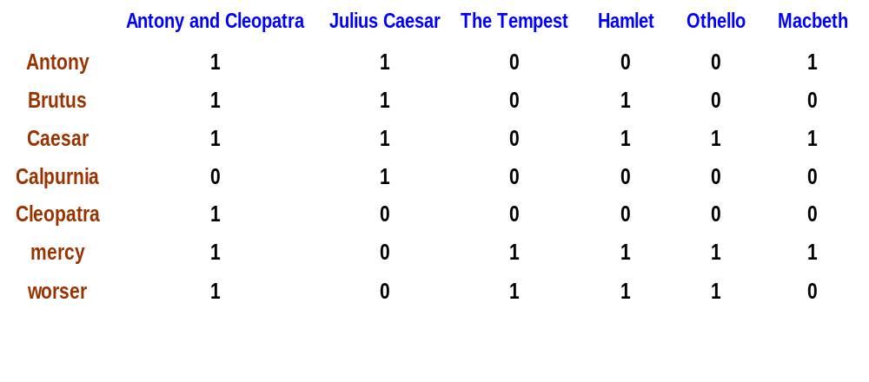
Term-document incidence
Brutus AND Caesar but NOT Calpurnia
1 if play contains word, 0 otherwise
L3InvertedIndex

Slide 4
Incidence vectors
So we have a 0/1 vector for each term.
To answer query:
take the vectors for Brutus, Caesar and Calpurnia (complemented) ➔ bitwise AND.
110100 AND 110111 AND 101111 = 100100.
L3InvertedIndex

Slide 5
Answers to query
Antony and Cleopatra, Act III, Scene ii
Agrippa [Aside to DOMITIUS ENOBARBUS]: Why, Enobarbus,
When Antony found Julius Caesar dead,
He cried almost to roaring; and he wept
When at Philippi he found Brutus slain.
Hamlet, Act III, Scene ii
Lord Polonius: I did enact Julius Caesar I was killed i' the
Capitol; Brutus killed me.
L3InvertedIndex

Slide 6
Bigger corpora
Consider N = 1M documents, each with about 1K terms.
Avg 6 bytes/term including spaces/punctuation
  6GB of data in the documents.
Say there are m = 500K distinct terms among these.
L3InvertedIndex

Slide 7
Can’t build the matrix
500K x 1M matrix has half-a-trillion 0’s and 1’s.
But it has no more than one billion 1’s.
  matrix is extremely sparse.
What’s a better representation?
  We only record the 1 positions.
Why?
L3InvertedIndex
Notes:
1 M docs each with 1K terms

Slide 8
Inverted index
For each term T, we must store a list of all documents that contain T.
Do we use an array or a list for this?
Brutus
2
4
8
16
32
64
128
Calpurnia
1
2
3
5
8
13
21
34
Caesar
13
16
What happens if the word Caesar is added to document 14?
L3InvertedIndex

Slide 9
Inverted index
Linked lists generally preferred to arrays
  Dynamic space allocation
  Insertion of terms into documents easy
  Space overhead of pointers
Posting
Brutus
2
4
8
16
32
64
128
Calpurnia
1
2
3
5
8
13
21
34
Caesar
13
16
Dictionary
Postings lists
L3InvertedIndex
Sorted by docID (more later on why).

Slide 10





Inverted index construction
Documents to
be indexed.
Friends, Romans, countrymen.
Tokenizer
Token stream.
Friends
Romans
Countrymen
More on
these later.
Linguistic modules
Modified tokens.
friend
roman
countryman
Indexer
friend
2
4
roman
1
2
Inverted index.
countryman
13
16

Slide 11
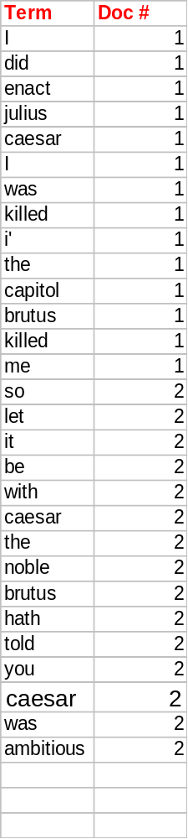
Indexer steps
Sequence of (Modified token, Document ID) pairs.
Doc 1
Doc 2
I did enact Julius
Caesar I was killed
i' the Capitol;
Brutus killed me.
So let it be with
Caesar. The noble
Brutus hath told you
Caesar was ambitious
L3InvertedIndex

Slide 12
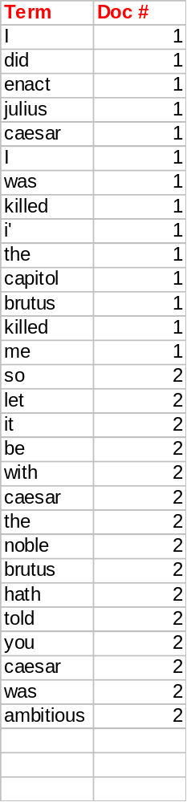
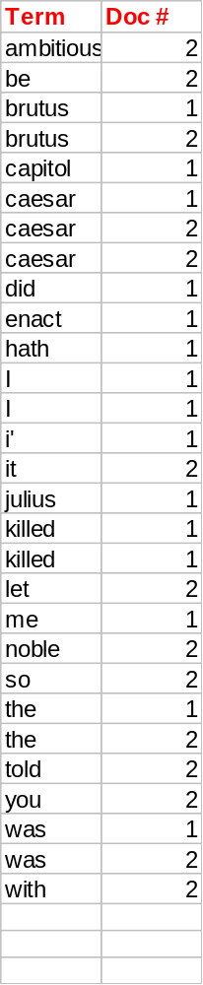
Sort by terms.
Core indexing step.
L3InvertedIndex

Slide 13
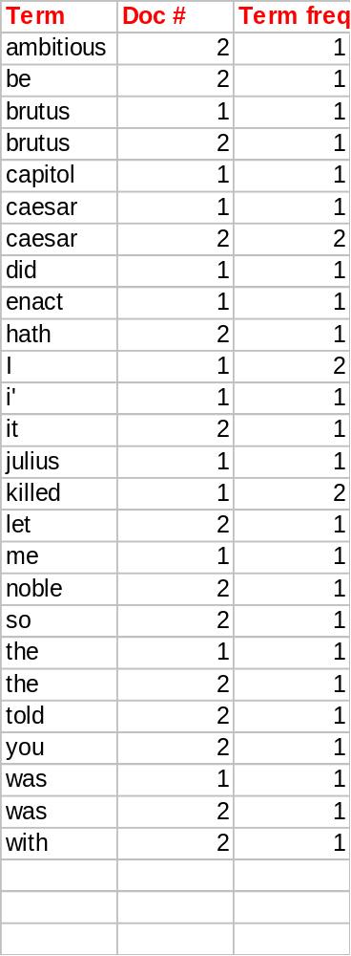
Multiple term entries in a single document are merged.
Frequency information is added.
Why frequency?
Will discuss later.
Notes:
Number of documents vs Document number
Cumulative frequency vs frequency within a document

Slide 14
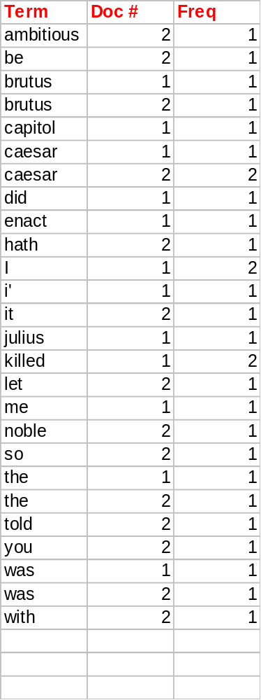
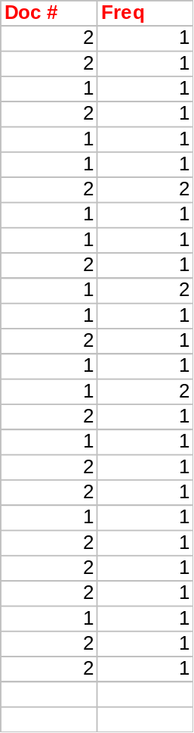
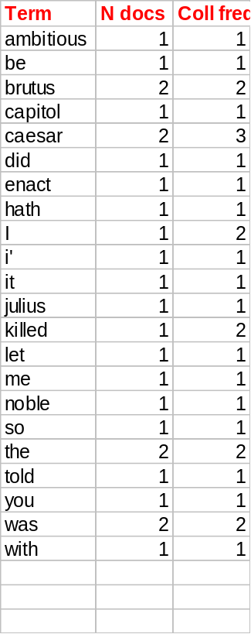
The result is split into a Dictionary file and a Postings file.
L3InvertedIndex

Slide 15
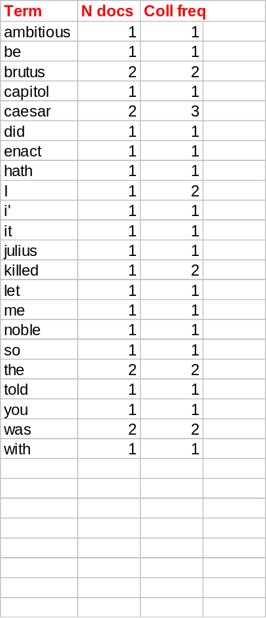
Where do we pay in storage?
Will quantify the storage, later.
Terms
Pointers

Slide 16
Query Processing
How?
What?
L3InvertedIndex

Slide 17
Query processing: AND
Consider processing the query:
  Brutus AND Caesar
  Locate Brutus in the Dictionary;
    Retrieve its postings.
  Locate Caesar in the Dictionary;
    Retrieve its postings.
  “Merge” the two postings:
2
4
8
16
32
64
128
Brutus
1
2
3
5
8
13
21
34
Caesar
L3InvertedIndex

Slide 18
The merge
Walk through the two postings simultaneously, in time linear in the total number of postings entries
2
2
4
4
8
8
16
16
32
64
128
32
64
128
Brutus
2
8
1
Caesar
1
2
2
3
5
5
8
8
13
13
21
21
34
3
34
If the list lengths are x and y, the merge takes O(x+y)
operations.
Crucial: postings sorted by docID.
L3InvertedIndex

Slide 19
Boolean queries: Exact match
Boolean Queries are queries using AND, OR and NOT to join query terms
    Views each document as a set of words
    Is precise: document matches condition or not.
Primary commercial retrieval tool for 3 decades.
Professional searchers (e.g., lawyers) still like Boolean queries:
  You know exactly what you’re getting.
L3InvertedIndex

Slide 20
Example: WestLaw http://www.westlaw.com/
Largest commercial (paying subscribers) legal search service (started 1975; ranking added 1992)
Tens of terabytes of data; 700,000 users
Majority of users still use boolean queries
Example query:
  What is the statute of limitations in cases involving the federal tort claims act?
  LIMIT! /3 STATUTE ACTION /S FEDERAL /2 TORT /3 CLAIM
/3 = within 3 words, /S = in same sentence
L3InvertedIndex
Notes:
LexisNexis locally

Slide 21
Example: WestLaw http://www.westlaw.com/
Another example query:
  Requirements for disabled people to be able to access a workplace
  disabl! /p access! /s work-site work-place (employment /3 place
Note that SPACE is disjunction, not conjunction!
Long, precise queries; proximity operators; incrementally developed; not like web search
Professional searchers often like Boolean search:
  Precision, transparency and control
But that doesn’t mean they actually work better ...
L3InvertedIndex

Slide 22
Query optimization
Consider a query that is an AND of t terms.
For each of the t terms, get its postings, then AND them together.
What is the best order for query processing?
Brutus
2
4
8
16
32
64
128
Calpurnia
1
2
3
5
8
16
21
34
Caesar
13
16
Query: Brutus AND Calpurnia AND Caesar
L3InvertedIndex

Slide 23
Query optimization example
Process in order of increasing freq:
  start with smallest set, then keep cutting further.
This is why we kept
freq in dictionary
Brutus
2
4
8
16
32
64
128
Calpurnia
1
2
3
5
8
13
21
34
Caesar
13
16
Execute the query as (Caesar AND Brutus) AND Calpurnia.
L3InvertedIndex

Slide 24
More general optimization
e.g., (madding OR crowd) AND (ignoble OR strife)
Get freq’s for all terms.
Estimate the size of each OR by the sum of its freq’s (conservative).
Process in increasing order of OR sizes.
L3InvertedIndex

Slide 25
Space Requirements
The space required for the vocabulary is rather small. According to Heaps’ law the vocabulary grows as O(n^{β}), where β is a constant between 0.4 and 0.6 in practice.
Size of inverted file as a percentage of text (all words, non-stop words)
Index
Small collection
(1Mb)
Medium collection
(200Mb)
Large collection
(2Gb)
Addressing words
Addressing documents
Addressing 256 blocks
45%
19%
18%
73%
26%
25%
36%
18%
1.7%
64%
32%
2.4%
35%
26%
0.5%
63%
47%
0.7%
L3InvertedIndex
Notes:
N^0.5 is square root of N.

Slide 26
Space Requirements
To reduce space requirements, a technique called block addressing can be used
  Advantages:
    the number of pointers is smaller than positions
    all the occurrences of a word inside a single block are collapsed to one reference
  Disadvantages:
    online (dynamic) search over the qualifying blocks necessary if exact positions are required
L3InvertedIndex

Slide 27
What’s ahead in IR?
Beyond term search
What about phrases?
  Stanford University
Proximity: Find Gates NEAR Microsoft.
  Need index to capture position information in docs. More later.
Zones in documents: Find documents with (author = Ullman) AND (text contains automata).
L3InvertedIndex

Slide 28
Other Indexing Techniques
Even though Inverted Files is the method of choice, in the face of phrase and proximity queries, the following approaches were also developed:
  Suffix arrays
  Signature files
L3InvertedIndex

