Slide 1
Modeling the Internet and the Web:
Text Analysis

Slide 2
Outline
Indexing
Lexical processing
Content-based ranking
Probabilistic retrieval
Latent semantic analysis
Text categorization
Exploiting hyperlinks
Document clustering
Information extraction

Slide 3
Information Retrieval
Analyzing the textual content of individual Web pages
  given user’s query
  determine a maximally related subset of documents
Retrieval
  index a collection of documents (access efficiency)
  rank documents by importance (accuracy)
Categorization (classification)
  assign a document to one or more categories

Slide 4
Indexing
Inverted index
  effective for very large collections of documents
  associates lexical items to their occurrences in the collection
Terms ω
  lexical items: words or expressions
Vocabulary V
  the set of terms of interest

Slide 5
Inverted Index
The simplest example
  a dictionary
    each key is a term ω ∈ V
    associated value b(ω) points to a bucket (posting list)
      a bucket is a list of pointers marking all occurrences of ω in the text collection

Slide 6
Inverted Index
Bucket entries:
  document identifier (DID)
    the ordinal number within the collection
  separate entry for each occurrence of the term
    DID
    offset (in characters) of term’s occurrence within this document
      present a user with a short context
      enables vicinity queries

Slide 7
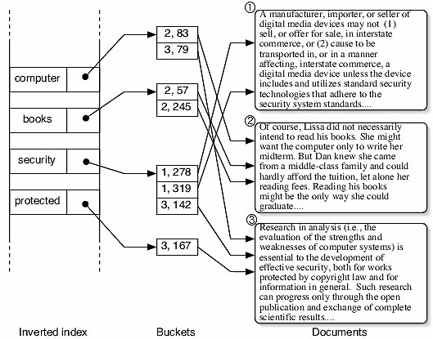
Inverted Index

Slide 8
Inverted Index Construction
Parse documents
Extract terms ω_{i}
  if ω_{i} is not present
    insert ω_{i} in the inverted index
Insert the occurrence in the bucket

Slide 9
Searching with Inverted Index
To find a term ω in an indexed collection of documents
  obtain b(ω) from the inverted index
  scan the bucket to obtain list of occurrences
To find k terms
  get k lists of occurrences
  combine lists by elementary set operations

Slide 10
Inverted Index Implementation
Size = Ω(|V|)
Implemented using a hash table
Buckets stored in memory
  construction algorithm is trivial
Buckets stored on disk
  impractical due to disk assess time
    use specialized secondary memory algorithms

Slide 11
Bucket Compression
Reduce memory for each pointer in the buckets:
  for each term sort occurrences by DID
  store as a list of gaps - the sequence of differences between successive DIDs
Advantage – significant memory saving
  frequent terms produce many small gaps
  small integers encoded by short variable-length codewords
Example:
  the sequence of DIDs: (14, 22, 38, 42, 66, 122, 131, 226 )
  a sequence of gaps: (14, 8, 16, 4, 24, 56, 9, 95)

Slide 12
Lexical Processing
Performed prior to indexing or converting documents to vector representations
  Tokenization
    extraction of terms from a document
  Text conflation and vocabulary reduction
    Stemming
      reducing words to their root forms
    Removing stop words
      common words, such as articles, prepositions, non-informative adverbs
      20-30% index size reduction

Slide 13
Tokenization
Extraction of terms from a document
  stripping out
    administrative metadata
    structural or formatting elements
Example
  removing HTML tags
  removing punctuation and special characters
  folding character case (e.g. all to lower case)

Slide 14
Stemming
Want to reduce all morphological variants of a word to a single index term
  e.g. a document containing words like fish and fisher may not be retrieved by a query containing fishing (no fishing explicitly contained in the document)
Stemming - reduce words to their root form
    e.g. fish – becomes a new index term
Porter stemming algorithm (1980)
  relies on a preconstructed suffix list with associated rules
    e.g. if suffix=IZATION and prefix contains at least one vowel followed by a consonant, replace with suffix=IZE
      BINARIZATION => BINARIZE

Slide 15
Content Based Ranking
A boolean query
  results in several matching documents
  e.g., a user query in google: ‘Web AND graphs’, results in 4,040,000 matches
Problem
  user can examine only a fraction of result
Content based ranking
  arrange results in the order of relevance to user

Slide 16
Choice of Weights
query
q | web graph
document results | text | terms
d₁ | web web graph | web graph
d₂ | graph web net graph net | graph web net
d₃ | page web complex | page web complex
 | web | graph | net | page | complex
q | wq1 | wq2
d1 | w11 | w12
d2 | w21 | w22 | w23
d3 | w31 |  |  | w34 | w35
What weights retrieve most relevant pages?

Slide 17
Vector-space Model
Text documents are mapped to a high-dimensional vector space
Each document d
  represented as a sequence of terms ω(t)
d = (ω(1), ω(2), ω(3), …, ω(|d|))
Unique terms in a set of documents
  determine the dimension of a vector space

Slide 18
Example
document | text | terms
d₁ | web web graph | web graph
d₂ | graph web net graph net | graph web net
d₃ | page web complex | page web complex
Boolean representation of vectors:
V = [ web, graph, net, page, complex ]
  V₁ = [1 1 0 0 0]
  V₂ = [1 1 1 0 0]
  V₃ = [1 0 0 1 1]

Slide 19
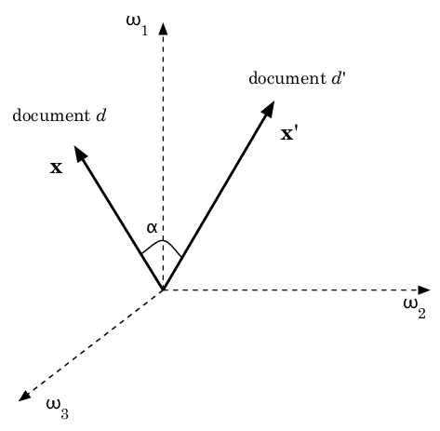
Vector-space Model
ω₁, ω₂ and ω₃ are terms in document, x and x′ are document vectors
Vector-space representations are sparse, |V| >> |d|

Slide 20
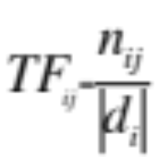
Term frequency (TF)
A term that appears many times within a document is likely to be more important than a term that appears only once
n_{ij} - Number of occurrences of a term ω_{j} in a document d_{i}
Term frequency

Slide 21
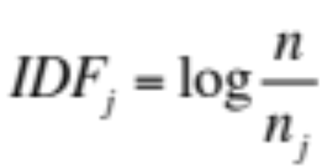
Inverse document frequency (IDF)
A term that occurs in a few documents is likely to be a better discriminator than a term that appears in most or all documents
n_{j} - Number of documents which contain the term ω_{j}
n - total number of documents in the set
Inverse document frequency

Slide 22
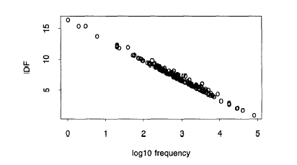
Inverse document frequency (IDF)

Slide 23
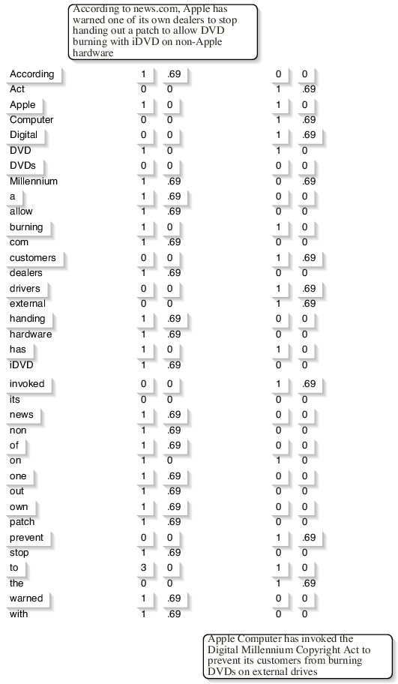
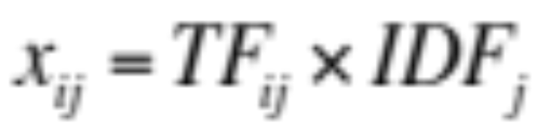
Full Weighting (TF-IDF)
The TF-IDF weight of a term ω_{j} in document d_{i} is

Slide 24
Document Similarity
Ranks documents by measuring the similarity between each document and the query
Similarity between two documents d and d′ is a function s(d, d′)∈ R
In a vector-space representation the cosine coefficient of two document vectors is a measure of similarity

Slide 25
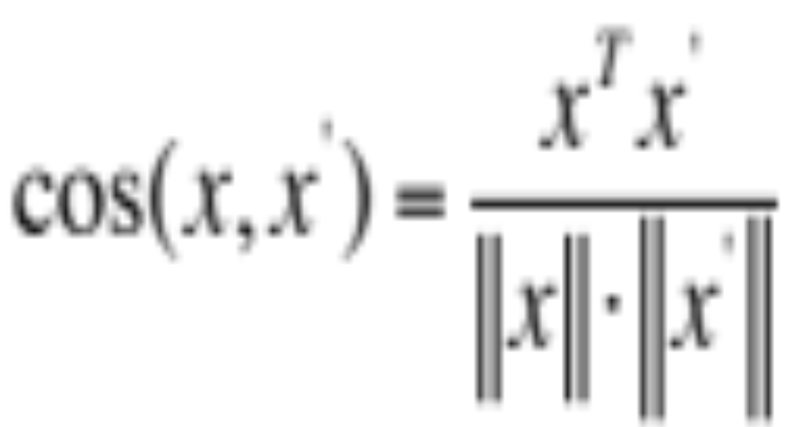
Cosine Coefficient
The cosine of the angle formed by two document vectors x and x′ is
Documents with many common terms will have vectors close to each other, than documents with fewer overlapping terms

Slide 26
Retrieval and Evaluation
Compute document vectors for a set of documents D
Find the vector associated with the user query q
Using s(x_{i}, q), I = 1, ..,n, assign a similarity score for each document
Retrieve top ranking documents R
Compare R with R* - documents actually relevant to the query

Slide 27
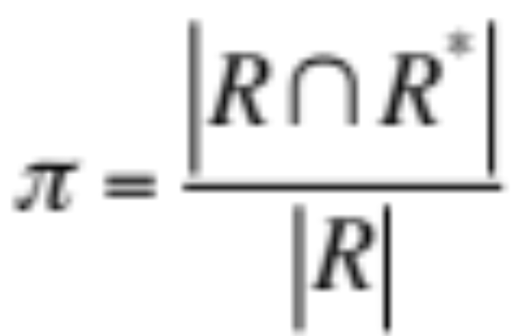

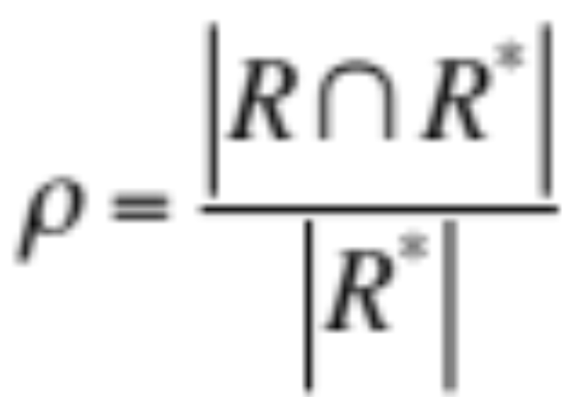
Retrieval and Evaluation Measures
Precision (π) - Fraction of retrieved documents that are actually relevant
Recall (ρ) - Fraction of relevant documents that are retrieved

Slide 28
Probabilistic Retrieval
Probabilistic Ranking Principle (PRP) (Robertson, 1977)
  ranking of the documents in the order of decreasing probability of relevance to the user query
  probabilities are estimated as accurately as possible on basis of available data
  overall effectiveness of such as system will be the best obtainable

Slide 29

Probabilistic Model
PRP can be stated by introducing a Boolean variable R (relevance) for a document d, for a given user query q as P(R | d,q)
Documents should be retrieved in order of decreasing probability
d′ - document that has not yet been retrieved

Slide 30
Latent Semantic Analysis
Why need it?
  serious problems for retrieval methods based on term matching
    vector-space similarity approach works only if the terms of the query are explicitly present in the relevant documents
  rich expressive power of natural language
    often queries contain terms that express concepts related to text to be retrieved

Slide 31
Synonymy and Polysemy
Synonymy
  the same concept can be expressed using different sets of terms
    e.g. bandit, brigand, thief
  negatively affects recall
Polysemy
  identical terms can be used in very different semantic contexts
    e.g. bank
      repository where important material is saved
      the slope beside a body of water
  negatively affects precision

Slide 32
Latent Semantic Indexing(LSI)
A statistical technique
Uses linear algebra technique called singular value decomposition (SVD)
  attempts to estimate the hidden structure
  discovers the most important associative patterns between words and concepts
Data driven

Slide 33
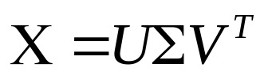

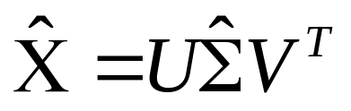
LSI and Text Documents
Let X denote a term-document matrix
X = [x₁ . . . x_{n}]^{T}
  each row is the vector-space representation of a document
  each column contains occurrences of a term in each document in the dataset
Latent semantic indexing
  compute the SVD of X:
    Σ - singular value matrix
  set to zero all but largest K singular values -
  obtain the reconstruction of X by:

Slide 34
LSI Example
A collection of documents:
d1: Indian government goes for open-source software
d2: Debian 3.0 Woody released
d3: Wine 2.0 released with fixes for Gentoo 1.4 and Debian 3.0
d4: gnuPOD released: iPOD on Linux… with GPLed software
d5: Gentoo servers running at open-source mySQL database
d6: Dolly the sheep not totally identical clone
d7: DNA news: introduced low-cost human genome DNA chip
d8: Malaria-parasite genome database on the Web
d9: UK sets up genome bank to protect rare sheep breeds
d10: Dolly’s DNA damaged

Slide 35
LSI Example
The term-document matrix X^{T}
d1 d2 d3 d4 d5 d6 d7 d8 d9 d10
open-source 1 0 0 0 1 0 0 0 0 0
software 1 0 0 1 0 0 0 0 0 0
Linux 0 0 0 1 0 0 0 0 0 0
released 0 1 1 1 0 0 0 0 0 0
Debian 0 1 1 0 0 0 0 0 0 0
Gentoo 0 0 1 0 1 0 0 0 0 0
database 0 0 0 0 1 0 0 1 0 0
Dolly 0 0 0 0 0 1 0 0 0 1
sheep 0 0 0 0 0 1 0 0 0 0
genome 0 0 0 0 0 0 1 1 1 0
DNA 0 0 0 0 0 0 2 0 0 1

Slide 36

LSI Example
The reconstructed term-document matrix after projecting on a subspace of dimension K=2
Σ = diag(2.57, 2.49, 1.99, 1.9, 1.68, 1.53, 0.94, 0.66, 0.36, 0.10)
d1 d2 d3 d4 d5 d6 d7 d8 d9 d10
open-source 0.34 0.28 0.38 0.42 0.24 0.00 0.04 0.07 0.02 0.01
software 0.44 0.37 0.50 0.55 0.31 -0.01 -0.03 0.06 0.00 -0.02
Linux 0.44 0.37 0.50 0.55 0.31 -0.01 -0.03 0.06 0.00 -0.02
released 0.63 0.53 0.72 0.79 0.45 -0.01 -0.05 0.09 -0.00 -0.04
Debian 0.39 0.33 0.44 0.48 0.28 -0.01 -0.03 0.06 0.00 -0.02
Gentoo 0.36 0.30 0.41 0.45 0.26 0.00 0.03 0.07 0.02 0.01
database 0.17 0.14 0.19 0.21 0.14 0.04 0.25 0.11 0.09 0.12
Dolly -0.01 -0.01 -0.01 -0.02 0.03 0.08 0.45 0.13 0.14 0.21
sheep -0.00 -0.00 -0.00 -0.01 0.03 0.06 0.34 0.10 0.11 0.16
genome 0.02 0.01 0.02 0.01 0.10 0.19 1.11 0.34 0.36 0.53
DNA -0.03 -0.04 -0.04 -0.06 0.11 0.30 1.70 0.51 0.55 0.81

Slide 37
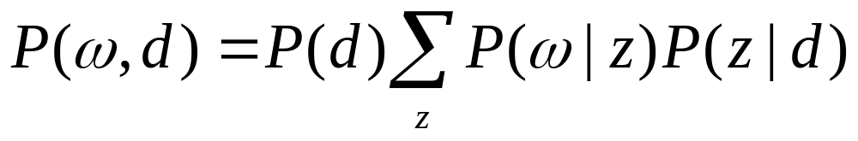
Probabilistic LSA
Aspect model (aggregate Markov model)
  let an event be the occurrence of a term ω in a document d
  let z∈{z₁, … , z_{K}} be a latent (hidden) variable associated with each event
  the probability of each event (ω, d) is
    select a document from a density P(d)
    select a latent concept z with probability P(z|d)
    choose a term ω, sampling from P(ω|z)

Slide 38

Aspect Model Interpretation
In a probabilistic latent semantic space
  each document is a vector
  uniquely determined by the mixing coordinates P(z_{k}|d), k=1,…,K
    i.e., rather than being represented through terms, a document is represented through latent variables that in tern are responsible for generating terms.

Slide 39
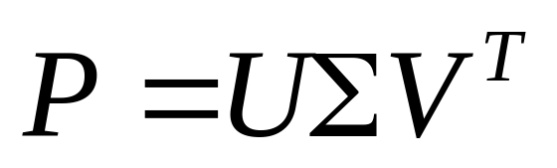
Analogy with LSI
all n x m document-term joint probabilities
  u_{ik} = P(d_{i}|z_{k})
  v_{jk} = P(ω_{j}|z_{k})
  σ_{kk} = P(z_{k})
  P is properly normalized probability distribution
  entries are nonnegative

Slide 40
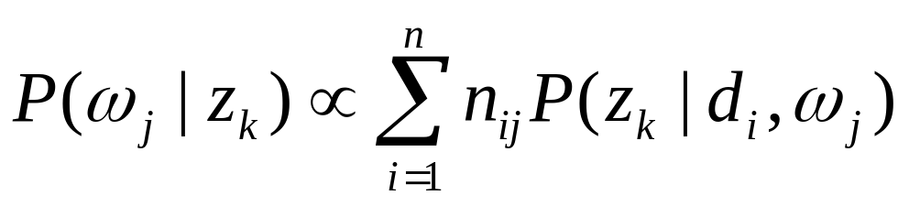

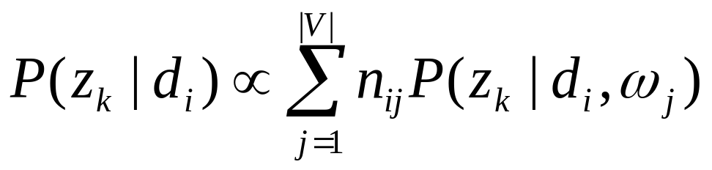
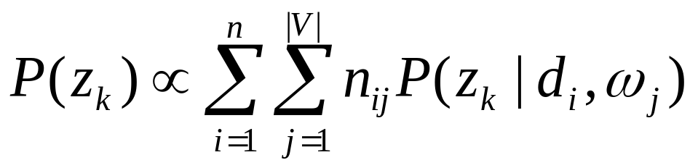
Fitting the Parameters
Parameters estimated by maximum likelihood using EM
  E step
  M step

Slide 41
Text Categorization
Grouping textual documents into different fixed classes
Examples
  predict a topic of a Web page
  decide whether a Web page is relevant with respect to the interests of a given user
Machine learning techniques
  k nearest neighbors (k-NN)
  Naïve Bayes
  support vector machines

Slide 42
k Nearest Neighbors
Memory based
  learns by memorizing all the training instances
Prediction of x’s class
  measure distances between x and all training instances
  return a set N(x,D,k) of the k points closest to x
  predict a class for x by majority voting
Performs well in many domains
  asymptotic error rate of the 1-NN classifier is always less than twice the optimal Bayes error

Slide 43
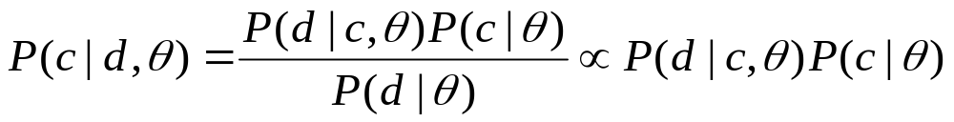
Naïve Bayes
Estimates the conditional probability of the class given the document
θ - parameters of the model
P(d) – normalization factor (Σ_{c}P(c|d)=1)
  classes are assumed to be mutually exclusive
Assumption: the terms in a document are conditionally independent given the class
  false, but often adequate
  gives reasonable approximation
    interested in discrimination among classes

Slide 44
Bernoulli Model
An event – a document as a whole
  a bag of words
  words are attributes of the event
  vocabulary term ω is a Bernoully attribute
    1, if ω is in the document
    0, otherwise
  binary attributes are mutually independent given the class
    the class is the only cause of appearance of each word in a document

Slide 45
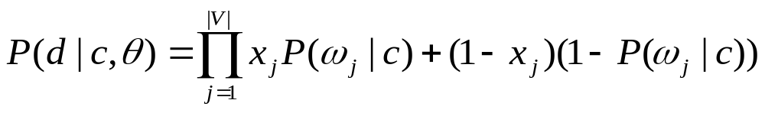
Bernoulli Model
Generating a document
  tossing |V| independent coins
  the occurrence of each word in a document is a Bernoulli event
  xj = 1[0] - ω_{j} does [does not] occur in d
  P(ω_{j}|c) – probability of observing ω_{j} in documents of class c

Slide 46
Multinomial Model
Document – a sequence of events W₁,…,W_{|d|}
Take into account
  number of occurrences of each word
  length of the document
  serial order among words
    significant (model with a Markov chain)
    assume word occurrences independent – bag-of-words representation

Slide 47
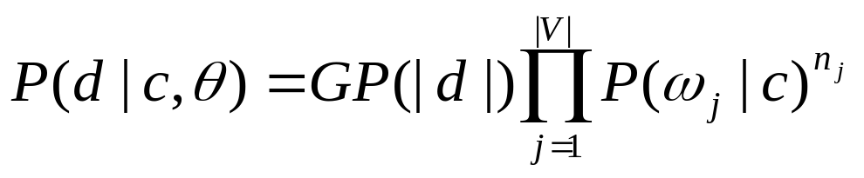
Multinomial Model
Generating a document
  throwing a die with |V| faces |d| times
  occurrence of each word is multinomial event
    n_{j} is the number of occurrences of ω_{j} in d
    P(ω_{j}|c) – probability that ω_{j} occurs at any position
    t ∈ [ 1,…,|d| ]
    G – normalization constant

Slide 48
Learning Naïve Bayes
Estimate parameters θ from the available data
Training data set is a collection of labeled documents { (d_{i}, c_{i}), i = 1,…,n }

Slide 49
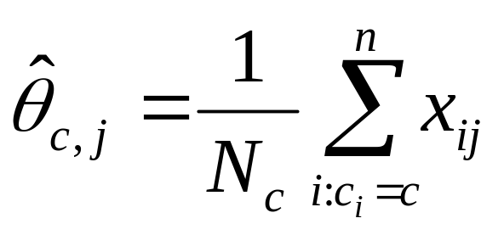
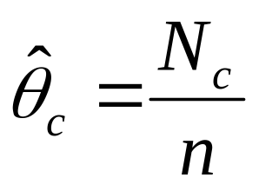
Learning Bernoulli Model
θ_{c,j} = P(ω_{j}|c), j = 1,…,|V|, c = 1,…,K
  estimated as
  N_{c} = |{ i : c_{i} =c }|
  x_{ij} = 1 if ω_{j} occurs in d_{i}
class prior probabilities θ_{c} = P(c)
  estimated as

Slide 50
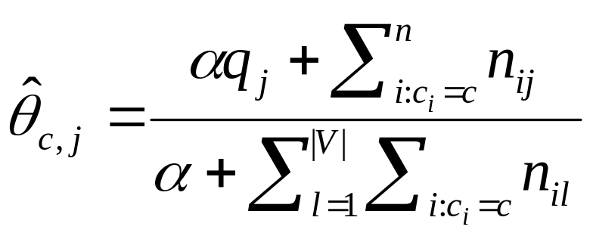

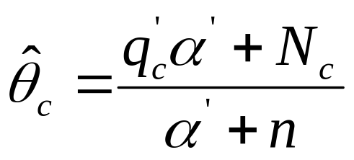
Learning Multinomial Model
Generative parameters θ_{c,j} = P(ω_{j}|c)
  must satisfy Σ_{j} θ_{c,j} = 1 for each class c
Distributions of terms given the class
  q_{j} and α are hyperparameters of Dirichlet prior
  n_{ij} is the number of occurrences of ω_{j} in d_{i}
Unconditional class probabilities

Slide 51
Support Vector Classifiers
Support vector machines
  Cortes and Vapnik (1995)
  well suited for high-dimensional data
  binary classification
Training set
  D = {(x_{i},y_{i}), i=1,…,n}, x_{i} ∈ R^{m} and y_{i} ∈ {-1,1}
Linear discriminant classifier
  Separating hyperplane
  { x : f(x) = w^{T}x + w₀ = 0 }
    model parameters: w ∈ R^{m} and w₀ ∈ R

Slide 52
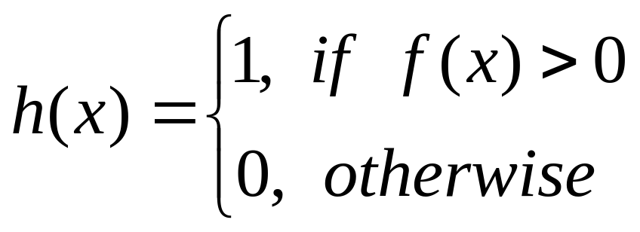
Support Vector Machines
Binary classification function
h : R^{m} → {0, 1} defined as
Training data is linearly separable:
  y_{i} f(x_{i}) > 0 for each i = 1,…,n
Sufficient condition for D to be linearly separable
  number of training examples
  n = |D| is less or equal to m + 1

Slide 53
Perceptron
  Perceptron ( D )
  w ← 0
  w₀ ← 0
  repeat
  e ← 0
  for i ← 1,…,n
  do s ← sign( y_{i}( w^{T}x_{i} + w₀ ))
  if s < 0
  then w ← w + y_{i}x_{i}
  w₀ ← w₀ +y_{i}
  e ← e + 1
  until e = 0
  return ( w, w₀ )

Slide 54
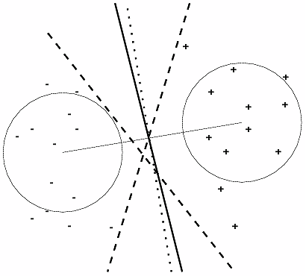
Overfitting

Slide 55
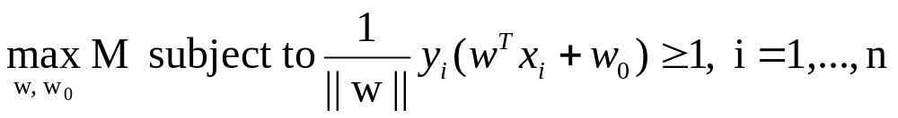
Optimal Separating Hyperplane
Unique for each linearly separable data set
Its associated risk of overfitting is smaller than for any other separating hyperplane
Margin M of the classifier
  the distance between the separating hyperplane and the closest training samples
  optimal separating hyperplane – maximum margin
Can be obtained by solving the constraint optimization problem

Slide 56
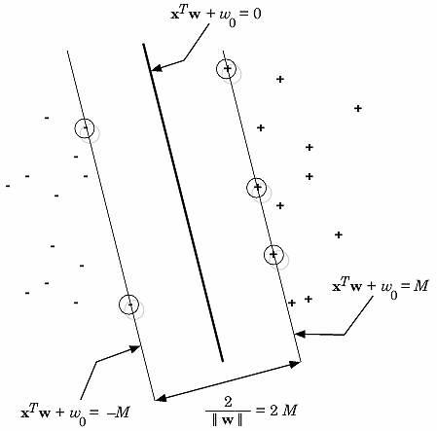
Optimal Hyperplane and Margin

Slide 57
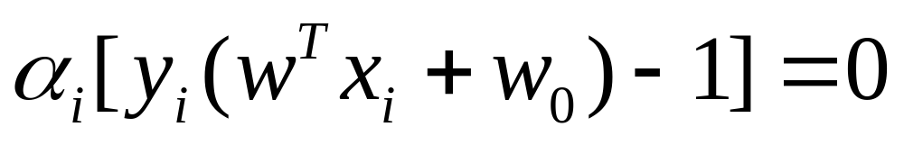
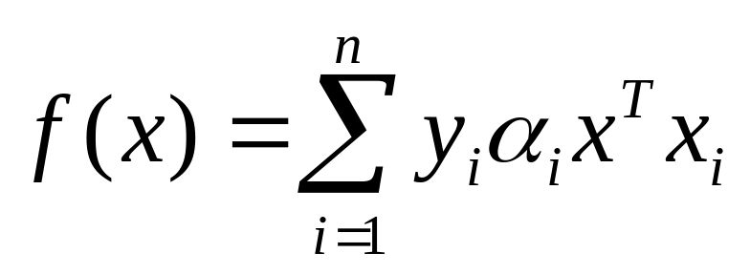
Support Vectors
Karush-Kuhn-Tucker condition for each x_{i}:
If α_{I} > 0 then the distance of x_{i} from the separating hyperplane is M
Support vectors - points with associated α_{I} > 0
The decision function h(x) computed from

Slide 58
Feature Selection
Limitations with large number of terms
  many terms can be irrelevant for class discrimination
    text categorization methods can degrade in accuracy
  time requirements for learning algorithm increases exponentially
Feature selection is a dimensionality reduction technique
  limits overfitting by identifying the irrelevant term
Categorized into two types
  filter model
  wrapper model

Slide 59
Filter Model
Feature selection is applied as a preprocessing step
  determines which features are relevant before learning takes place
For e.g., the FOCUS algorithm (Almuallim & Dietterich, 1991)
  performs exhaustive search of all vector space subsets,
  determines a minimal set of terms that can provide a consistent labeling of the training data
Information theoretic approaches perform well for filter models

Slide 60
Wrapper Model
Feature selection is based on the estimates of the generalization error
  specific learning algorithm is used to find the error estimates
  heuristic search is applied through subsets of terms
  set of terms with minimum estimated error is selected
Limitations
  can overfit the data if used with classifiers having high capacity

Slide 61
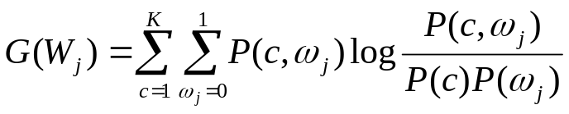
Information Gain Method
Information Gain, G – Measure of information about the class that is provided by the observation of each term
Also defined as
  mutual information l(C, Wj) between the class C and the term Wj
For feature selection
  compute the information gain for each unique term
  remove terms whose information gain is less than some predefined threshold
Limitations
  relevance assessment of each term is done separately
  effect of term co-occurrences is not considered

Slide 62
Average Relative Entropy Method
Whole sets of features are tested for relevance about the class (Koller and Sahami, 1996)
For feature selection
  determine relevance of a selected set using the average relative entropy

Slide 63
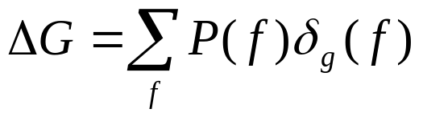
Average Relative Entropy Method
Let x ∈V, xg be the projection of x onto G ⊂ V
  to estimate quality of G measure distance between P(C|x) and P(C|xg) using average relative entropy
For optimal set of features
  ΔG should be small
Limitations
  parameters are computationally intractable
  distributions are hard to estimate accurately

Slide 64
Markov Blanket Method
M is a Markov Blanket for term Wj
    If Wj is conditionally independent of all features in V – M - {Wj}, given M ⊂ V, Wj ∉M
    class C is conditionally independent of Wj, given M
Feature selection is performed by
  removing features for which the Markov blanket is found

Slide 65
Approximate Markov Blanket
For each term Wj in G,
  compute the co-relation factor of Wj with Wi
  obtain a set M of k terms, that have highest co-relation with Wj
  find the average cross entropy Δ(Wj, Mj)
  select the term for which the average relative entropy is minimum
Repeat steps until a predefined number of terms are eliminated from the set G

Slide 66
Measures of Performance
Determines accuracy of the classification model
To estimate performance of a classification model
  compare the hypothesis function with the true classification function
For a two class problem,
  performance is characterized by the confusion matrix

Slide 67
Confusion Matrix
TN - irrelevant values not retrieved
TP - relevant values retrieved
FP - irrelevant values retrieved
FN - relevant values not retrieved
Total retrieved terms = TP + FP
Total relevant terms = TP + FN
Predicted Category | Actual Category
 | - | +
- | TN | FN
+ | FP | TP

Slide 68
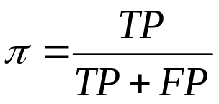
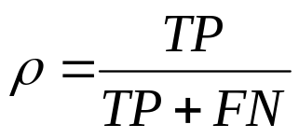
Measures of Performance
For balanced domains
  accuracy characterizes performance
A = (TP+TN) / |D|
  classification error, E = 1 - A
For unbalanced domain
  precision and recall characterize performance

Slide 69
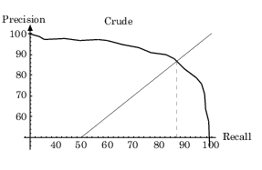
Precision-Recall Curve
Breakeven Point
At the breakeven point, π(t*) = ρ(t*)

Slide 70
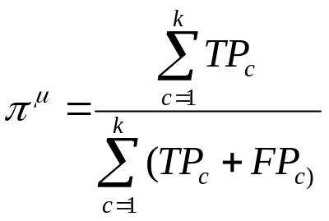
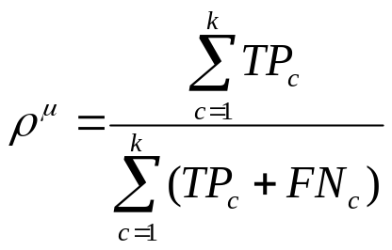
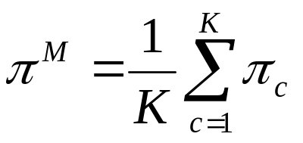
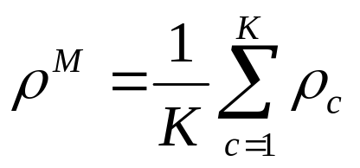
Precision-Recall Averages
Microaveraging
Macroaveraging

Slide 71
Applications
Text categorization methods use
  document vector or ‘bag of words’
Domain specific aspects of the web
  for e.g., sports, citations related to AI improves classification performance

Slide 72
Classification of Web Pages
Use of text classification to
  extract information from web documents
  automatically generate knowledge bases
Web → KB systems (Cravern et al.)
  train machine-learning subsystems
    predict about classes and relations
    populate KB from data collected from web
  provide ontolgy and training examples as inputs

Slide 73
Knowledge Extraction
Consists of two steps
  assign a new web page to one node of the class hierarchy
  fill in the class attributes by extracting relevant information from the document
Naive Bayes classifier
  discriminate between the categories
  predict the class for a web page

Slide 74
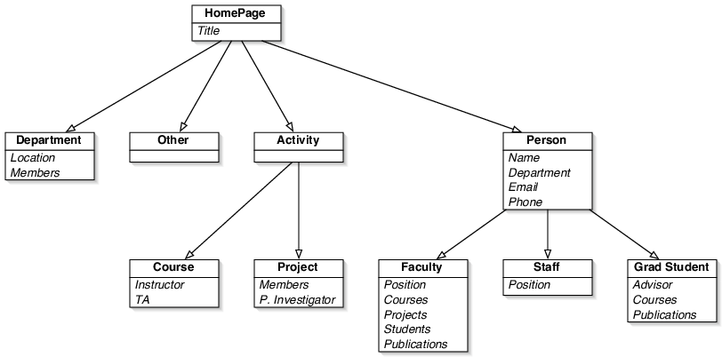
Example

Slide 75
Experimental Results
Predicted catefory | Actual Category
 | cou | stu | fac | sta | pro | dep | oth | Precision
Cou | 202 | 17 | 0 | 0 | 1 | 0 | 552 | 26.2
Stu | 0 | 421 | 14 | 17 | 2 | 0 | 519 | 43.3
Fac | 5 | 56 | 118 | 16 | 3 | 0 | 264 | 17.9
Sta | 0 | 15 | 1 | 4 | 0 | 0 | 45 | 6.2
Pro | 8 | 9 | 10 | 5 | 62 | 0 | 384 | 13.0
Dep | 10 | 8 | 3 | 1 | 5 | 4 | 209 | 1.7
Oth | 19 | 32 | 7 | 3 | 12 | 0 | 1064 | 93.6
Recall | 82.8 | 75.4 | 77.1 | 8.7 | 72.9 | 100.0 | 35.0

Slide 76
Classification of News Stories
Reuters-21578
  consists of 21578 news stories, assembled and manually labeled
  672 categories each story can belong to more than one category
Data set is split into training and test data

Slide 77
Experimental Results
ModApte split (Joachims 1998)
  9603 training data and 3299 test data, 90 categories
Prediction Method | Performance breakeven (%)
Naïve Bayes | 73.4
Rocchio | 78.7
Decision tree | 78.9
K-NN | 82.0
Rule induction | 82.0
Support vector (RBF) | 86.3
Multiple decision trees | 87.8

Slide 78
Email and News Filtering
‘Bag of words’ representation
  removes important order information
  need to hand-program terms, for e.g., ‘confidential message’, ‘urgent and personal’
Naïve Bayes classifier is applied for junk email filtering
Feature selection is performed by
  eliminating rare words
  retaining important terms, determined by mutual information

Slide 79
Example Data Set
Data set consisted of
  1578 junk messages
  211 legitimate messages
Loss of FP is higher than loss of FN
Classify a message as junk
  only if probability is greater than 99.9%

Slide 80
Supervised Learning with Unlabeled Data
Assigning labels to training set is
  expensive
  time consuming
Abundance of unlabeled data
  suggests possible use to improve learning

Slide 81
Why Unlabeled Data?
Consider positive and negative examples
  as two separate distribution
  with very large number of samples available parameters of distribution can be estimated well
  needs only few labeled points to decide which gaussian is associated with positive and negative class
In text domains
  categories can be guessed using term co-occurrences

Slide 82
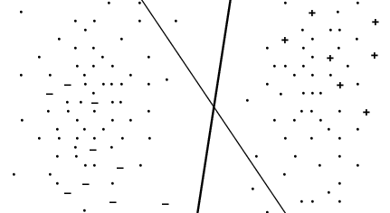
Why Unlabeled Data?

Slide 83
EM and Naïve Bayes
A class variable for unlabeled data
  is treated as a missing variable
  estimated using EM
Steps involved
  find the conditional probability, for each document
  compute statistics for parameters using the probability
  use statistics for parameter re-estimation

Slide 84
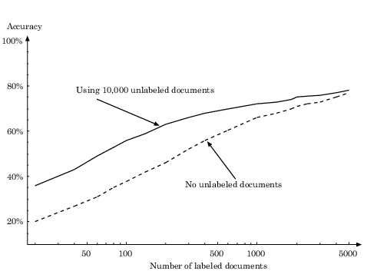
Experimental Results

Slide 85

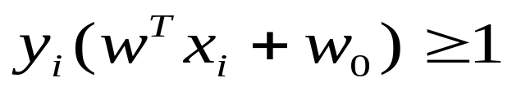
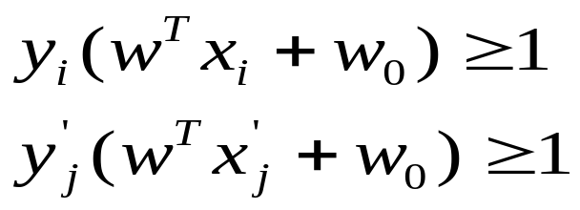
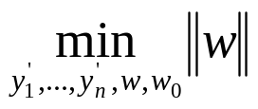
Transductive SVM
The optimization problem
  that leads to computing the optimal separating hyperplane
  becomes –
  missing values (y′1, .., y′n) are filled in using maximum margin separation
subject to
subject to

Slide 86
Exploiting Hyperlinks – Co-training
Each document instance has two sets of alternate view (Blum and Mitchell 1998)
  terms in the document, x1
  terms in the hyperlinks that point to the document, x2
Each view is sufficient to determine the class of the instance
  Labeling function that classifies examples is the same applied to x1 or x2
  x1 and x2 are conditionally independent, given the class

Slide 87
Co-training Algorithm
Labeled data are used to infer two Naïve Bayes classifiers, one for each view
Each classifier will
  examine unlabeled data
  pick the most confidently predicted positive and negative examples
  add these to the labeled examples
Classifiers are now retrained on the augmented set of labeled examples

Slide 88
Relational Learning
Data is in relational format
Learning algorithm exploits the relations among data items
Relations among web documents
  hyperlinked structure of the web
  semi-structured organization of text in HTML

Slide 89
Example of Classification Rule
FOIL algorithm (Quinlan 1990) is used
  to learn classification rules in the Web→KB domain
student(A) :- not(has_data(A)), not(has_comment(A)), link_to(B,A),
has_jane(B), has_paul(B), not(has_mail(B)).

Slide 90
Document Clustering
Process of finding natural groups in data
  training data are unsupervised
  data are represented as bags of words
Few useful applications
  automatic grouping of web pages into clusters based on their content
  grouping results of a search engine query

Slide 91
Example
User query – ‘World Cup’
Excerpt from search engine results
  http://www.fifaworldcup.com - soccer
  http://www.dubaiworldcup.com – horse racing
  http://www.wcsk8.com – robot soccer
  http://www.robocup.org - skiing
Document clustering results (www.vivisimo.com)
  FIFA world cup (44)
  Soccer (42)
  Sports (24)
  History (19)

Slide 92
Hierarchical Clustering
Generates a binary tree, called dendrogram
  does not presume a predefined number of clusters
  consider clustering n objects
    root node consists of a cluster containing all n objects
    n leaf nodes correspond to clusters, ,each containing one of the n objects

Slide 93
Hierarchical Clustering Algorithm
Given
  a set of N items to be clustered
  NxN distance (or similarity) matrix
Assign each item to its own cluster
  N items will have N clusters
Find the closest pair of clusters and merge them into a single cluster
  distances between the clusters equal the distances between the items they contain
Compute distances between the new cluster and each of the old clusters
Repeat until a single cluster of size N is formed

Slide 94
Hierarchical Clustering
Chaining-effect
  'closest' - defined as the shortest distance between clusters
  cluster shapes become elongated chains
  objects far away from each other tend to be grouped into the same cluster
Different ways of defining 'closest‘
  single-link clustering
  complete-link clustering
  average-distance clustering
  domain specific knowledge, such as cosine distance, TF-IDF weights, etc.

Slide 95
Probabilistic Model-based Clustering
Model-based clustering assumes
  existence of generative probabilistic model for data, as a mixture model with K components
Each component corresponds
  to a probability distribution model for one of the clusters
Need to learn the parameters of each component model

Slide 96
Probabilistic Model-based Clustering
Apply Naïve Bayes model for document clustering
  contains one parameter per dimension
  dimensionality of document vector is typically high 5000-50000

Slide 97
Related Approaches
Integrate ideas from hierarchical clustering and probabilistic model-based clustering
  combine dimensionality reduction with clustering
Dimension reduction techniques can destroy the cluster structure
  need for objective function to achieve more reliable clustering in lower dimension space

Slide 98
Information Extraction
Automatically extract unstructured text data from Web pages
Represent extracted information in some well-defined schema
E.g.
  crawl the Web searching for information about certain technologies or products of interest
    extract information on authors and books from various online bookstore and publisher pages

Slide 99
Info Extraction as Classification
Represent each document as a sequence of words
Use a ‘sliding window’ of width k as input to a classifier
  each of the k inputs is a word in a specific position
The system trained on positive and negative examples (typically manually labeled)
Limitation: no account of sequential constraints
  e.g. the ‘author’ field usually precedes the ‘address’ field in the header of a research paper
  can be fixed by using stochastic finite-state models

Slide 100
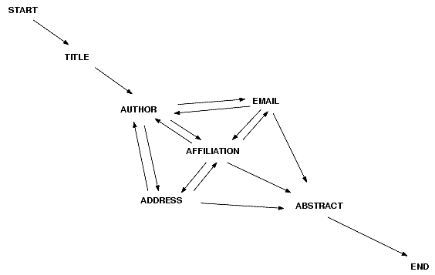
Hidden Markov Models
Example: Classify short segments of text in terms whether they correspond to the title, author names, addresses, affiliations, etc.

Slide 101
Hidden Markov Model
Each state corresponds to one of the fields that we wish to extract
  e.g. paper title, author name, etc.
True Markov state diagram is unknown at parse-time
  can see noisy observations from each state
    the sequence of words from the document
Each state has a characteristic probability distribution over the set of all possible words
  e.g. specific distribution of words from the state ‘title’

Slide 102
Training HMM
Given a sequence of words and HMM
  parse the observed sequence into a corresponding set of inferred states
    Viterbi algorithm
Can be trained
  in supervised manner with manually labeled data
  bootstrapped using a combination of labeled and unlabeled data

