Slide 1
Object Behaviors
(Chapter 4)

Slide 2
Requesting Object Services
One way to think of an object’s methods are as services that can be requested of the object by the application as a whole
In order to request some service of an object ‘x’, we need to know the specific language with which to communicate with x
  Which of x’s methods/services we want it to perform
  Give x some additional information so that x knows exactly how to proceed
  x in turn needs to know how to report outcome

Slide 3
An Example
With respect to household chores, a Person is capable of:
  mowing the lawn
  taking out the trash
  washing the car
Notes:
Re SimPol: Populus is capable of …; Government is capable of …; Issue is capable of …

Slide 4
An Example, cont.
We decide that we want our teenaged sons Larry, Moe, and Curley, to do each of these three chores
How would we ask them to do this?
  "Please* wash the car."
  "Please take out the trash."
  "Please mow the lawn."
  * optional! ;o)

Slide 5
An Example, cont.
How would we ask them to do this?
  "Please wash the car (the Camry)."
  "Please take out the trash."
  "Please mow the lawn, and let me know if you see any crabgrass."
clarification
reporting back

Slide 6
In CSS terms …
Re SimPol: how do Populus, Government, and Issue behave?
  Populus is capable of …;
  Government is capable of …;
  Issue is capable of …

Slide 7
Method Headers
We take care of communicating these 3 aspects of each method by defining a method header
A formal specification of how that method is to be invoked -- it consists of:
  A method’s name;
  An optional list of arguments (names and types of variables) to be passed to the method, enclosed in parentheses; and
  A method’s return type – that is, the data type of the information that is going to be passed back, if any, when the method is finished executing

Slide 8
Method Headers, cont.
Example of a Student method:
boolean registerForCourse(String courseId, int sectionNumber)
(for folks familiar with C/C++, this is nothing more
than a function specification)
return type
(can be void
if no response
is required)
method
name
optional argument list (can be empty ( ))

Slide 9
Method Headers, cont.
Other examples:
boolean isHonorsStudent()
int getAge()
void changeName(String newName)
We declare a return type of void when we don't need any data to be passed back to us
return type
method name
(optional) argument list

Slide 10
Argument Signatures
The term argument signature refers to the order, types, and number of arguments comprising a method header, but not their specific names
Method header:
boolean registerForCourse(String courseId, int sectionNumber)
has argument signature: (String, int)

Slide 11
Methods in the UML
Student
attributeName : type = default
name
studentId : String
majorField : String = “TBD”
methodName (parameterList) : returnType
getAge
assignAdvisor (p : Professor)
isHonorsStudent () : boolean

Slide 12
Method Bodies
We must also program the internal details of how each method should behave when invoked – this represents business logic
    public class Student {
    // Attributes.
    float gpa;
    // other attributes would follow here...
    // Method.
    boolean isHonorsStudent() {
    // All attributes are "in scope" for all methods.
    if (gpa >= 3.5) return true;
    else return false;
    // "return" statement not needed for void methods
    }
    // etc.

Slide 13
Method Bodies
We must also program the internal details of how each method should behave when invoked – this represents business logic
    public class Student {
    // Attributes.
    float gpa;
    // other attributes would follow here...
    // Method.
    boolean isHonorsStudent() {
    // Alternatively:
    return (gpa >= 3.5);
    }
    // etc.

Slide 14
Method Bodies
A SimPol example:
public class Government {
float budget;
// etc.
boolean isSolvent() {
if (budget >= 0) return true;
else return false;
// or simply:
return (budget >= 0);
}
// etc.
Notes:
OK with you or did you have something else in mind?
I forgot how to turn off your footer..

Slide 15
Message Passing and
Dot Notation
To represent in code that a service is being requested of an object, we invoke a method on that object's reference variable using dot notation
  Student x = new Student();
  x.registerForCourse("MATH 101", 10); a "message"
  A period ("dot") separates the object reference variable from the method (function) call
(from C/C++, this is nothing more than a function call … aimed at a particular object!)

Slide 16
Passing Messages
Returning to our example of asking our teenaged sons to do various chores, we need to target each request for a particular son:
  "Larry, please wash the car (the Camry)."
  "Moe, please take out the trash."
  "Curley, please mow the lawn, and let me know if you see any crabgrass."

Slide 17
Passing Messages
Now, let's turn this into Java code:
  Person is a class
  We have defined the following methods for Person:
  void washTheCar(Car c)
  void takeOutTheTrash()
  boolean mowTheLawn()

Slide 18
Passing Messages
  We have three Person objects/instances:
  Person larry = new Person();
  Person moe = new Person();
  Person curley = new Person();
  While we're at it, let's create a Car:
  Car camry = new Car();
  We send a message to each, indicating the service that we wish each of them to perform:
  larry.washTheCar(camry);
  moe.takeOutTheTrash();
  curley.mowTheLawn();

Slide 19
Capturing the Result of a Method Call
In our earlier example, although we declared the registerForCourse() method to have a return type of boolean:
boolean registerForCourse(String courseId, int sectionNumber)
we didn't capture the returned value when we invoked the method:
x.registerForCourse("MATH 101", 10);

Slide 20
Capturing the Result of a Method Call, cont.
We can optionally catch the result of a non-void method when we invoke it:
boolean outcome;
outcome = x.registerForCourse("MATH 101", 10);
We can also react to the result without bothering to capture it in a distinct variable:
// An "if" expression must evaluate to a boolean result.
// Note the use of ! (not).
if (!(x.registerForCourse("MATH 101", 10))) {
action to be taken if registration failed …
}

Slide 21
Client Code
We refer to any body of code that invokes a method on an object ‘X’ as client code relative to ‘X’
  E.g., the main method is considered to be client code relative to Student s in the example below:
  public static void main(String[] args) {
    Student s = new Student();
    // details omitted ...
    // Invoke a method on Student object s.
    double x = s.getGpa();
    }
  because s is performing a service that is of benefit to the main method

Slide 22
A Word About
Argument Names
Names we give to the arguments of a function have no relationship to the names of the variables that are passed into the function from elsewhere in our application
  A C function:
double average(double x, double y) {
  return (x + y) / 2.0;
} // as of this closing brace, x and y go out of scope
  Calling this function from a C program:
double a = 17.3;
double b = 38.7;
double c = average(a, b); // the values of a and b are
// assigned to x and y
Notes:
I _would_ do this.

Slide 23
Passing Arguments
  In the preceding example, the arguments to the average function are said to be passed by value
  When an argument is passed by value, changing its value in a function doesn’t affect the value of the original variable in the main program
void double_it(int x) {
  x = 2 * x;
} // as of this closing brace, the compiler forgets about x
  Using this function from a C program:
int y = 3;
double_it(y);
// y in the main program is still equal to 3!
  To change y’s value:
y = double_it(y);

Slide 24
Passing Arguments, cont.
In Java, simple data types are passed by value
Abstract data types, on the other hand, are passed by reference
  We are, in effect, passing the address of where a given object is located in memory
    boolean registerForCourse(Course c) { … }
    // In the main program:
    Course x = new Course();
    Student s = new Student();
    s.registerForCourse(x);
  If we change the attribute values of Course object ‘c’ inside of the method, the same changes apply to ‘x’, because they are both referring to the same object

Slide 25
Argument Names
When inventing names for the arguments of your methods, there are several schools of thought:
  Choose creative names that make the arguments self-documenting; examples:
boolean registerForCourse(String courseId, int sectionNumber)
boolean registerForCourse(String courseName, int secNo)
  Choose single letter names, but then make sure that the method is well documented; do not use single-letter names for things that persist for a while:
// Arguments: the name of the course and the section number.
boolean registerForCourse(String c, int s)

Slide 26
Argument Names, cont.
  AVOID argument names that duplicate attribute names of the class that the method belongs to:
public class Student {
String name;
// etc.
// BAD IDEA!
void changeName(String name) {
// Here, both references to name are to the
// locally scoped variable -- the attribute
// by this name doesn’t get changed!
name = name;
}
// etc.
}

Slide 27
Argument Names, cont.
public class Student {
String name;
// etc.
void changeName(String name) {
// There is a workaround … but, it is easy
// to forget to do this!
this.name = name;
}
// etc.
}

Slide 28
Accessing Attributes via
Dot Notation
In theory, we can also use dot notation to directly manipulate an object’s internal attributes from client code:
    Student x = new Student();
    x.name = "John Smith";
However, classes often restrict access to some of their features (attributes in particular) -- such restriction is known as information hiding

Slide 29
Information Hiding
In a well designed OO application, a class publicizes
  what it can do – i.e. the services it is capable of providing, or its method signatures
but hides the internal details both of
  how it performs these services (method bodies) and
  the data (attributes) that it maintains in order to support these services
Example: Yellow Pages ad for a dry cleaner

Slide 30
Visibility
We use the term visibility to refer to whether or not a particular feature (attribute/method) can be accessed from client code by applying dot notation to the object’s reference variable
  Public visibility:
  public class Student {
    public String name;
    // etc.
public class MyProgram {
    public static void main(String[] args){
    Student x = new Student();
    x.name = "Fred Schnurd"; // OK!
    // etc.

Slide 31
Visibility, cont.
  Private visibility:
    public class Student {
    public String name;
    private String ssn;
    // etc.
    public class MyProgram {
    public static void main(String[] args){
    Student x = new Student();
    x.ssn = "123-45-6789"; // NOT OK TO MODIFY!
    System.out.println(x.ssn); // NOT OK TO ACCESS!
"Variable ssn in class Student not accessible from class MyProgram"

Slide 32
Visibility, cont.
  The same applies to methods:
    public class Student {
    public String name;
    private String ssn;
    // etc.
    public void someMethod() { … }
    private void anotherMethod() { … }
    public class MyProgram {
    public static void main(String[] args){
    Student x = new Student();
    x.someMethod(); // OK
    x.anotherMethod(); // NOT OK!

Slide 33
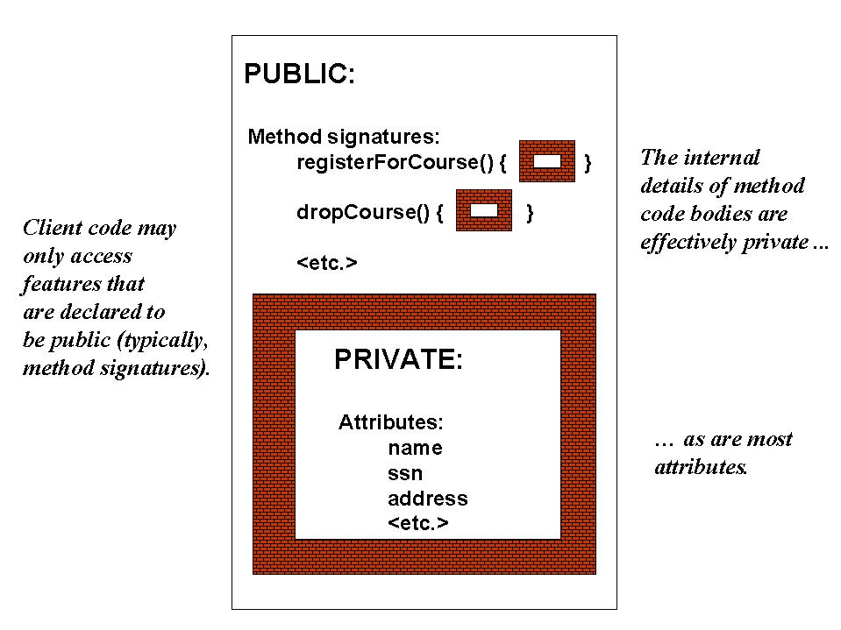
Info. Hiding, cont.
(glass wall)
(brick walls)

Slide 34
Accessor/Modifier Methods
If we make all of the attributes private, how will we ever get or set their values from the main program?

Slide 35
Get/Set Methods
If we make all of the attributes private, how will we ever get or set their values from the main program?
  Via public accessor methods (aka "get" and "set" methods)

Slide 36
Get/Set Methods
If we make all of the attributes private, how will we ever get or set their values from the main program?
  Via public accessor methods (aka "get" and "set" methods)
name:
"Fred"
"set" method passes in a new
value for a given attribute
from client code ...
set

Slide 37
Get/Set Methods, cont.
If we make all of the attributes private, how will we ever get or set their values from the main program?
  Via public accessor methods (aka "get" and "set" methods)
name:
"Fred"
… and the corresponding "get"
method retrieves its value
for use by client code
get

Slide 38
Get/Set Methods, cont.
For an attribute declaration of the form:
visibility attribute-type attributeName;
private String ssn;
  ‘get’ method syntax:
public attribute-type getAttributeName()
public String getSsn()
  ‘set’ method syntax:
public void setAttributeName(attribute-type argument-name)
public void setSsn(String newSsn)

Slide 39
Standard Get/Set Methods
'Get' and 'set' method bodies are often simple 'one-liners':
public class Student {
private String name;
private String ssn;
// etc.
public String getSsn() {
return ssn;
}
public void setSsn(String newSsn) {
ssn = newSsn;
}
// etc.

Slide 40
Get/Set Methods
Set methods should perform error checking (if needed or possible):
class Person {
private int age;
private int minAge=0;
private int maxAge=100;
…
public boolean setAge(int a){
if (a > minAge) && (a < maxAge) {
age = a;
return(true);
} else return(false);

Slide 41
Get/Set Methods
We invoke get/set methods from client code via dot notation, just like any other method:
public class MyApp {
public static void main(String[] args) {
    Student s = new Student();
    s.setName("Fred Schnurd");
    s.setSsn("123-45-6789");
    s.setMajor("MATH");
    // etc.
    // or:
    System.out.println(s.getName());
    if (s.getAge() >= 21) { s.drinkBeer(); }
// etc.
}
}

Slide 42
Return Types
Note that a method can only return one result or answer – a simple data type or a single object reference
public int getAge() { … }
public Professor getAdvisor() { … }
This result can be an object of arbitrary complexity, including a special type of object called a collection that can contain multiple other objects - we'll learn about this later

Slide 43
Encapsulation, Revisited
It is useful to think of an object as a “fortress” that “guards” its data
  We cannot directly access the values of an object’s privately-declared attributes without an object’s permission and knowledge, i.e. …
  We must use one of an object’s publicly accessible methods
    Example: wallet access
An object is responsible for ensuring the integrity of its own data

Slide 44
Info. Hiding Helps to Ensure Data Integrity
As an example, let’s say that we wish to store a Student's birthdate as a String attribute:
    private String birthdate;
  Our intention is to record birthdates in the format "mm/dd/yyyy"
  We provide a Student method with header:
    boolean updateBirthdate(String d)
  The single argument to the updateBirthdate() method as we've declared it is a String which can be of literally any format
  How will we ensure that dates conform to our desired format?

Slide 45
Info. Hiding, cont.
    We'll provide logic within the method which verifies and, if necessary, rejects the request
    public class Student {
    private String birthdate;
    // etc.
    public boolean updateBirthdate(String d) {
    boolean updated = true; // assume the best!
    if (date not in the format mm/dd/yyyy) updated = false;
    else (if mm not in the range 01 to 12) updated = false;
    // etc. for other validation tests
    else birthdate = d; // all is well!
    return updated; // report outcome
    }

Slide 46
Info. Hiding, cont.
    We'll provide logic within the method which verifies and, if necessary, rejects the request
    public class Student {
    private String birthdate;
    // etc.
    public boolean updateBirthdate(String d) {
    boolean updated = true;
    if (date not in the format mm/dd/yyyy) updated = false;
    else (if mm not in the range 01 to 12) updated = false;
    // etc. for other validation tests
    else birthdate = d; // all is well!
    return updated; // report outcome
    }

Slide 47
Info. Hiding, cont.
    We'll provide logic within the method which verifies and, if necessary, rejects the request
    public class Student {
    private String birthdate;
    // etc.
    public boolean updateBirthdate(String d) {
    boolean updated = true;
    if (date not in the format mm/dd/yyyy) updated = false;
    else (if mm not in the range 01 to 12) updated = false;
    // etc. for other validation tests
    else birthdate = d; // all is well!
    return updated; // report outcome
    }

Slide 48
Info. Hiding Simplifies Code Maintenance
Info. hiding insulates our application from changes to the hidden implementation details of a class
  As an example, let’s say that we design our Student class to have an attribute:
    private int age;
  and a method as follows:
    public int getAge() {
    return age;
    }

Slide 49
Info. Hiding, cont.
  We test and deploy our Student class, and it is used in dozens of applications throughout the University
  Later on, we decide that it was a silly idea to implement an age attribute -- we should have instead implemented a birthdate attribute, and compute the age whenever it is needed
  We change our class design as follows (see next slide):

Slide 50
Info. Hiding, cont.
BEFORE:
AFTER:
  public class Student { public class Student {
  // Explicit age attribute. // NO age attribute!
  private int age; private String birthDate;
  public int getAge() { public int getAge() {
  return age; return systemDate -
  birthDate;
  } }
  // etc. // etc.
  The beauty is that, because all we've changed are private details of the class, we don’t care which of these approaches is used! (cont.)

Slide 51
Info. Hiding, cont.
  With EITHER version of the Student class, the public method signature for getAge() is the same, and so client code won't have to change:
    Student s = new Student();
    // details omitted ...
    int i = s.getAge();
  This method call worked before, when "age" was an explicit attribute; and it works now, when age is computed from the birthdate attribute
  Code changes made only to the private aspects of a class are said to be encapsulated

Slide 52
Info. Hiding, cont.
  Of course, all bets are off if the developer of a class changes one of its public method signatures
  For example, if we decided to change
  int getAge()
  to: float getAge()
  then the client code
  int i = s.getAge();
  would no longer compile, and we would have a "ripple effect" throughout our application(s)

Slide 53
Info. Hiding, cont.
  Of course, all bets are off if the developer of a class changes one of its public method signatures
  For example, if we decided to change
  int getAge()
  to: float getAge()
  then the client code
  int i = (int) s.getAge(); // a cast is needed
  would no longer compile, and we would have a "ripple effect" throughout our application(s)

Slide 54
Accessing One's Own Features
Whether public or private, a class's features are visible/accessible within all of its own methods
  This is because the attributes are "in scope" at the class level
public class Student {
  private String name;
  public void printInfo() {
    System.out.println(name);
    // etc.
    }
    // etc.

Slide 55
Accessing One's Own Features, cont.
We can also invoke one method of a class from inside another method of the same class without using dot notation
  The object receiving the message is implied to be the object whose method is being executed
  public class Student {
  public void methodA(int i) {
    do something ...
    }
  public void methodB() {
    methodA(12);
    do some other stuff ...
    }

Slide 56
Accessing One's Own Features, cont.
We can optionally add this. as a prefix to mean “invoke method xxx on this object”, but it isn’t necessary to do so
  public class Student {
  public void methodA(int i) {
    do something ...
    }
  public void methodB() {
  // The this. prefix is optional …
    this.methodA(12);
    do some other stuff ...
    }

Slide 57
Initialization, Revisited
We learned earlier that when simple (i.e., non-object) variables are declared, their values are not automatically initialized
Trying to access such variables without explicitly initializing them will result in a compilation error
      public static void main(String[] args) {
      // Declare several local variables.
      int i; // not automatically initialized
      int j; // ditto
      j = i; // compilation error!
      Variable i might not have been initialized.

Slide 58
Initialization, cont.
However, with attributes, which are declared at the class scope level:
      public class Student {
      int age;
      boolean isHonorsStudent;
      Professor advisor;
      // etc.
they are automatically initialized to the appropriate zero-equivalent values in Java:
  booleans are initialized to false
  numerics are initialized to either 0 or 0.0,
  object references are initialized to null
  and so forth

Slide 59
Exceptions to the Public/Private Rule
Even though it is generally true that:
  Attributes are declared to be private,
  Method signatures are declared to be public, and
  Private attributes are teamed up with public get/set methods,
there are numerous exceptions to this rule

Slide 60
Exceptions to the Public/Private Rule, cont.
Exception #1: If we provide only a ‘get’ method for an attribute, then that attribute is effectively read-only
How are these attributes' values ever set?
  When we first create the object, through use of a special type of function called a constructor
  As a side effect of calling some other method
    Assign a grade to a Student => gpa is recalculated

Slide 61
Exceptions to the Public/Private Rule, cont.
Exception #2: An attribute may be used strictly for internal housekeeping purposes --> neither a ‘get’ nor a ‘set’ method is provided
public class Student {
  private int countDsAndFs;
  public boolean onAcademicProbation() {
    if (countDsAndFs > 1) return true;
    else return false;
  }
  // etc.

Slide 62
Exceptions to the Public/Private Rule, cont.
Exception #4: Some methods may require ugly parameters; use hiding to “prettify” the API (= “syntactic sugar”)
public class Student {
private UglyStructure uglyStruct;
  private int navigateStruct(recursionDepth, parameter) {
  return result();
  }
  public int navigateStruct(parameter) {
  // Pseudocode.
  return navigateStruct(0, parameter);
  }
  }

Slide 63
Exceptions to the Public/Private Rule, cont.
Exception #3: Some methods may be used strictly for internal housekeeping, as well, in which case these may also be declared private
public class Student {
private Date birthdate;
  public boolean over21() {
    if (computeAge() > 21) return true;
    else return false;
  }
  public int getAge() {
  return computeAge();
  }
  private int computeAge() {
  // Pseudocode.
  return system date - birthdate;
  }
  }

Slide 64
Exceptions to the Public/Private Rule, cont.
Exception #4: Classes may occasionally declare public attributes as a convenience when such attributes are going to be accessed frequently (e.g., the Point class)
Point p = new Point();
p.x = 7.3;
p.y = 3.0;

Slide 65
Speaking of…
Recursion is a function calling itself, with different parameters
Exercise:
  How can we do Exercise 2A without a single for loop?

Slide 66
Why is it useful?
Browse or create self-similar structures
Trees
Graphs
“mung” algorithms
  “mung” = “mung until no good”

Slide 67
Why is it useful?

Slide 68
Exercise
Let’s see in how many ways we can navigate this tree
  Write pseudo-code to navigate it

Slide 69
Exercise #4
(handout #B-10)
Begin in class; complete as homework assignment prior to next week’s class meeting
Notes:
JJB: Replaced this slide

Slide 70
SimPol vs. SRS
Beginning Java Objects was written to address “classic” software applications
  SRS is an example of such an application
  Objects (Students, Professors, Courses, etc.) are “passive”
  The human user drives their behaviors by interacting with the SRS user interface (see next slide)
Notes:
JJB: a new slide

Slide 71
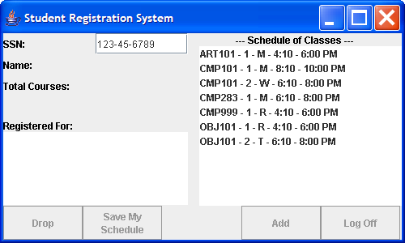
Sample SRS GUI
Type an SSN and press the Enter key, and a
Student object representing the student user is
instantiated in memory …

Slide 72
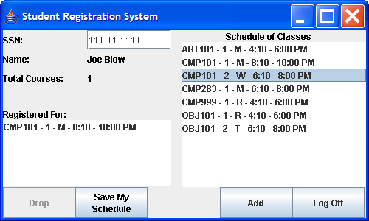
Sample SRS GUI
Click here, and the Student’s course load is modified
(change in state), etc. …

Slide 73
SimPol vs. SRS, cont.
When modeling a social sciences problem, on the other hand, there is no “user” per se (at least in the classic, interactive sense)
  The environment must serve as the driver for the objects’ behaviors
    E.g., MASON
  As creators of the model, you must configure the environment
    Perhaps writing a script of sorts to drive a particular simulation scenario, and/or
    Setting attribute values on built-in objects
Notes:
JJB: a new slide

Slide 74
SimPol vs. SRS, cont.
We can’t cover enough ground in one semester to expect you to build such an environment from scratch
  I’ll be providing the SimPol simulation environment
  You’ll be focused on designing and programming the objects/classes that work within such an enviroment: Government, Populus, Issue, etc.
  Those whose Java skills are more advanced can attempt to extend the environment
Notes:
JJB: a new slide

