Slide 1
The OO Building Blocks: Objects and Classes
(Chapter 3)
Notes:
Very cool!
This is a great chapter with a ton of content. Good thing we have a whole session for it. Will need to pace carefully to make sure all is covered, or it will spill over into next week…
JJB: I believe that we can accomplish it all in a single evening.

Slide 2
Software at its Simplest
Every software application consists of:
  Data
  Functions that operate on the data
The pre-OO way of designing software was known as "(top-down) functional decomposition"

Slide 3
Functional Decomposition
With F.D., we started with a statement of the overall function that a system was expected to perform
  E.g., “Student Registration"
We then broke that function down into subfunctions
  “Enroll Student"
  “Establish Plan of Study”
  “Register for Courses”
  “Print Class Schedule”
  “Print Student Roster”
Notes:
CC: for the examples in “quotations” consider functions pertinent to the SRS, such as “Register Student”, “Compute Grade”, “Assign Advisor” or others as you see fit, but tied to the SRS running example.
JJB: Done!

Slide 4
Functional Decomposition, cont.
We kept subdividing functions into smaller and smaller pieces
We then assigned modules to different programmers to implement, assembling them from the bottom up
Student
Registration
Enroll
Student
Establish
Plan of Study
Register for
Courses
Etc.
Display Course
Catalog
Add Course
Remove Course
Etc.

Slide 5
Functional Decomposition, cont.
With this approach, data was an "afterthought”
  Was passed around from one function to the next, like a car on an assembly line
  Data structure had to be understood in MANY places throughout an application
  If the data structure changed, there were major "ripple effects" (example: Y2K)
  If data became corrupted after an application had been deployed, it was hard to pinpoint where (i.e., in what function) this had occurred

Slide 6
Compared to the OO Approach
  We consider the data aspects of a model first, functional aspects later
  Data is encapsulated inside of objects
  Data structure only has to be understood by the object it belongs to
  If the data structure changes, there are virtually NO "ripple effects"
  An object is responsible for ensuring the integrity of its own data
  If data becomes corrupted, we can pretty much assume it was the object itself that did the corrupting!
Notes:
CC: can you say, “Data come before functions” ? This is because “Objects come first”, no? See if the next one (duplicate edited version of this one) works for you.
JJB: well, but objects consist of data AND functions, so to say “objects come first” doesn’t quite capture what I wish to say – see modification above.

Slide 7
What is an Object?
Before we talk about software objects, let's talk about real world objects in general
  According to Merriam Webster's dictionary:
    “(1) Something material that may be perceived by the senses; (2) something mental or physical toward which thought, feeling, or action is directed.”
  The first part of this definition refers to objects as we typically think of them: as physical ‘things’ that we can see and touch, and which occupy space

Slide 8
What is an Object?, cont.
Let's think of some examples of physical objects that make sense in the general context of an academic setting:
  The students who attend classes;
  The professors who teach them;
  The classrooms in which class meetings take place;
  The buildings in which the classrooms are located;
  The textbooks students use
etc.

Slide 9
What is an Object?, cont.
There are also great many conceptual objects that play important roles in an academic setting; some of these are:
  The courses that students attend;
  The departments that faculty work for;
  The degrees that students receive;
etc.

Slide 10
In CSS terms …
Computational “Objects” (entities) are ubiquitous in the social universe, although we may not always label them as such…
  Actors, “agents”, decision-makers, groups
  Institutions, value systems, belief systems
  Systems of actors, alliances, federations
  Relations (called “association classes” in OOM)
These are (of course!) the subject of social science theories and research in all domains: anthropology, economics, politics, linguistics, sociology, …

Slide 11
What is a Software Object?
A software object is a computational construct (module) that bundles together
  data and
  functions
necessary to model the
  structure and
  behavior
  of a 'real-world' (physical or conceptual) object
A building block of an object-oriented software system
Notes:
I added “computational” in line 1

Slide 12
Data/Attributes
If we wish to record information about a student, what data might we require?
  Name
  Student ID no.
  Address
  Major field of study, if they have declared one yet.
  Grade point average (GPA)
  Current course load
  Transcript
The data elements used to describe an object are referred to as the object’s attributes
A given attribute may be simple (GPA) or complex (transcript)
Notes:
The parallel example is an issue in SimPol

Slide 13
Simple and Complex
Simple attributes:
  Built-in data types
Complex attributes:
  Objects
  Collections of objects (are also objects)
  Data structures

Slide 14
Exercise
Let’s take a database model and turn it into a simple object model

Slide 15
State
An object’s attribute values, when taken collectively, are said to define the state, or condition, of the object
  Is a student ‘eligible to graduate’ (a state)?
  Look at a combination of:
    The student’s transcript (an attribute), and
    The list of courses they are currently enrolled in (a second attribute)
Notes:
State of Populus, state of Issue, state of Government, state of…. Polity

Slide 16
Functions/Behavior
A student’s behaviors might include:
  Enrolling in a course;
  Dropping a course;
  Choosing a major field of study;
  Selecting a faculty advisor;
  Telling you his or her GPA when asked;
  Telling you whether or not he or she has taken a particular course
Notes:
There is no user in SimPol. So behaviors are the different.

Slide 17
Functions/Behavior, cont.
It is a bit harder to think of an inanimate, conceptual object as having behaviors
  Computational social scientists are definitely supposed to be GOOD at this! ;o)
A course's behaviors might include:
  Allowing a student to enroll;
  Providing a list of all attending students;
  Telling you which professor is teaching the course;
  Telling you the classroom location in which it is being taught
  and so forth
Notes:
CC: consider adding to the first bullet: --this is something that computational social scientists are definitely supposed to be good at!
JJB: Done!

Slide 18
Methods
When we talk about software objects, we refer to an object’s behaviors generically as operations and, when rendered in an OOPL, as its methods
  A method is nothing more than a function -- one that is performed by a specific object, however
In performing a method, an object typically accesses -- and optionally modifies -- its data (attribute values)
  Telling you his or her GPA involves accessing the value of a student’s ‘GPA’ attribute
  Enrolling in a course updates the value of a student’s ‘course load’ attribute
Notes:
CC: Just a minor point for background: Method is the Java name for operation. In CSS 600 they learned that an object is defined in terms of its attributes and operations, and that in Java an operation is called “method”.
JJB: Done.

Slide 19
What is a Class?
A class is the programmatic way that we define the data structure and methods of all members in a group of similar objects
Class is a template for recreating many copies (instances) of an object
  Attribute names and data types
  The methods that each object belonging to the class is capable of performing
    method names,
    how to formally request them,
    what ‘behind the scenes’ things an object has to do in accomplishing each one
Instances are not perfect copies - they contain different data
Notes:
CC: Sometimes they will ask: what is the difference between an object and a class?
JJB: I can deal with that! We cover it on slides 125-129.
CC: those who took 600 know that an object is a class instance, or what mathematicians call a set element.

Slide 20
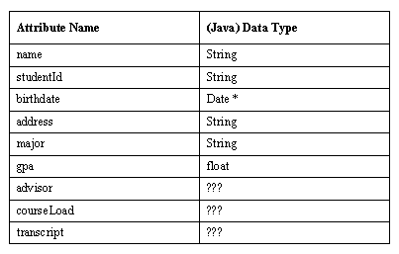
Example
The Student class may declare:
  9 attributes
* Date is another built-in Java data type

Slide 21
Example, cont.
  5 methods
    registerForCourse
    dropCourse
    chooseMajor
    changeAdvisor
    printTranscript
We use the term feature to refer collectively to attributes and methods
  9 attributes + 5 methods = 14 features

Slide 22
Naming Conventions
Name classes starting with an upper case letter
Use mixed case to construct "readable" names from multiple word phrases
Examples:
  Student
  Course
  ScheduleOfClasses
Name attributes and methods starting with a lower case letter: studentIdNo, chooseMajor()

Slide 23
Classes as UML Constructs
ClassName
ClassName
ClassName
attributes
attributes
operations
ClassName
uncommon:
operations

Slide 24
Attributes in the UML
Student
attributeName : type = default
name
studentId : String
majorField : String = “TBD”

Slide 25
Classes as Java Code
// File: Student.java
public class Student {
// Attributes.
String name;
String studentID;
String major;
float gpa;
String birthdate;
String address;
// ??? advisor;
// ??? courseLoad;
// ??? transcript;
// Methods will go here … details to follow!
public boolean registerForCourse(…) { … }
}
Student
name : String
studentID : String
major : String
gpa : float
etc.
Attributes are variable
declarations at the
class level of scope

Slide 26
Instantiation
A class definition may be thought of as a template for creating software objects
  Like a cookie cutter or a rubber stamp
The term instantiation is used to refer to the process by which an object is constructed based upon a class definition
  Allocate a prescribed data structure in memory to house the attributes of a new object, and
  Associate a certain set of behaviors with that object
Another way to refer to an object, then, is as an instance of a particular class

Slide 27
Classes vs. Objects
An object's data structure is fixed based on the class it belongs to
  The object fills in the data structure by providing values for its attributes
An object can only do those things for which methods have been defined by the object’s class
  In this respect, an object is like an appliance
Classes limit your access to the internal data structure - on purpose!
  If you find that you need to access internals of a class - the class has been designed incorrectly!

Slide 28
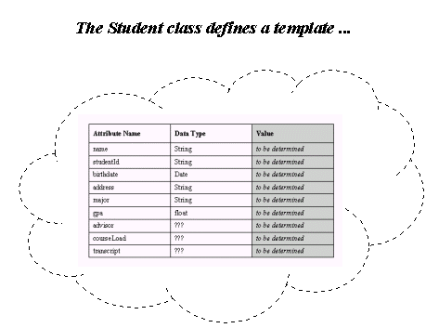
Classes vs. Objects

Slide 29
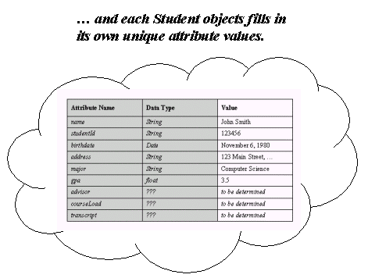
Classes vs. Objects
… which gets stamped out in memory when a new object is instantiated.

Slide 30
Classes vs. Objects
Each student object then fills in its own unique
attribute values.

Slide 31
Variable Declarations and
“Built-In” Data Types
In a non-OOPL, the statement int x;
is a declaration that variable “x” is an int(eger), one of Java's simple, “built-in” data types
What does this really mean?
  “x” is a symbolic name that represents an integer value which is stored as a 32 bit integer somewhere in memory -- we don’t care where ...
  The “thing” named “x” understands how to respond to a number of different arithmetic and logical operations as defined for the int data type
  When we want to operate on this particular int. value, we refer to “x” instead: if (x < 3) x = x + 1;

Slide 32
Behind the Scenes
With any compiled program -- object oriented or otherwise -- we declare variables to represent data values
int x;
The compiler automatically maps our variable to a memory address/location via a symbol table
Notes:
JJB: Slides 134 – 141 are newly added – shall we keep them or eliminate them?
CC: let’s keep them now and see how they work, with an open mind for the future.

Slide 33
Behind the Scenes, cont.
Program Memory:
Symbol Table:
...
x
int
18024
18023
18024
18025
18026
18027
int x;
...

Slide 34
Behind the Scenes, cont.
Program Memory:
Symbol Table:
...
x
int
18024
18023
18024
3
18025
18026
18027
x = 3;
...

Slide 35
Behind the Scenes, cont.
Program Memory:
Symbol Table:
...
x
int
18024
18023
18024
4
18025
18026
18027
x = x + 1;
...

Slide 36
Classes as
Abstract Data Types
In an OOPL, we can define a class such as Student and then declare a variable such as: Student y;
What does this really mean?
  “y” is a symbolic name that refers to a Student object that is stored as a “chunk” of data somewhere in memory -- we don’t care where ...
  The “thing” that we have named “y” understands how to respond to a number of different service requests that have been defined by the Student class
  Whenever we want to operate on this particular object, we refer to “y” instead:
    if (y.getAge() >= 21) y.drinkBeer(); // ;o)

Slide 37
Abstract Data Types, cont.
Just as int is referred to as a simple, or built-in, data type, we can refer to a class such as Student as an abstract data type (ADT): that is, a user-defined data type that specifies structure as well as behavior
  It is called “abstract” because a class is an abstraction of real-word objects that reflects only relevant details
  And, because “y” is a variable that refers to an instance (object) of the class Student, “y” may be alternatively referred to as a reference

Slide 38
Instantiating Objects:
A Closer Look
Different OO languages differ in terms of when an object is actually conceived
In Java, when we declare a variable to be of a user-defined type – e.g., Person p; -- we haven't actually created an object in memory yet
  Reference variable “p” merely has the potential to be a reference to a Person object
  Until we initialize y by assigning it a specific object to refer to, p is said to have the value null

Slide 39
Instantiating Objects, cont.
We must take the distinct step of using the new operator to actually carve out a brand new object in memory:
p = new Person();
  Its data structure in memory is mandated by the Student class definition
We can combine the two steps – declaring a reference variable and actually instantiating an object for that variable to refer to – into a single line of code:
Person p = new Person();

Slide 40
Object References
Think of a newly created object as a helium balloon, and a reference variable as holding onto a string that is tied to the balloon
  We refer to the object in our application code with the variable name “p”
  We often use the slang term “handle”, as in “p maintains a ‘handle’ on a Person object”
  For those of you who know C/C++, a reference is a thinly veiled pointer ...
a Person
object
p

Slide 41
Behind the Scenes, cont.
Program Memory:
Symbol Table:
...
x
int
18024
18023
p
Person
18025
18024
18025
18026
18027
...
Person p;

Slide 42
Behind the Scenes, cont.
Program Memory:
Symbol Table:
...
x
int
18024
18023
p
Person
18025
18024
18025
26053
...
26053
attribute
values for
Person
object
...
p = new Person();

Slide 43
Behind the Scenes, cont.
Program Memory:
Symbol Table:
...
x
int
18024
18023
p
Person
18025
18024
18025
26053
...
26053
...
a Person
object
Copyright 2005 Jacquie Barker – All rights reserved

Slide 44
Pointers and References
Program Memory:
Symbol Table:
...
x
String
18024
18023
18024
foo
18025
18026
String y = x
18027
...

Slide 45
Instantiating Objects, cont.
Another way to initialize a reference variable is to hand it a preexisting object: that is, an object (“helium balloon”) whose handle (“string”) is already being held by some other reference variable
Let's look at an example involving Student objects ...

Slide 46
Instantiating Objects, cont.
public static void main(String[] args) {
// We instantiate our first Student object.
Student x = new Student();
// We declare a second reference, but do not
// instantiate a second object.
Student y;

Slide 47
Instantiating Objects, cont.
public static void main(String[] args) {
// We instantiate our first Student object.
Student x = new Student();
// We declare a second reference, but do not
// instantiate a second object.
Student y;
// We pass y a 'handle' on the same object
// that x is holding (x continues to hold
// onto it, too).
y = x;

Slide 48
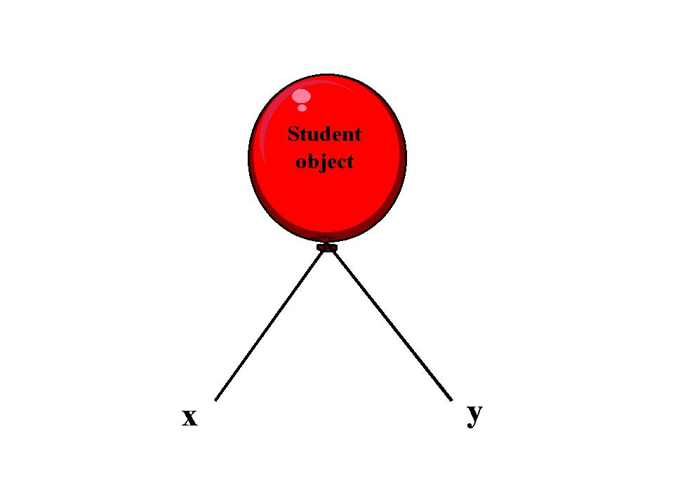
Instantiating Objects, cont.
// We instantiate our first Student object.
Student x = new Student();
// We declare a second reference, but do not
// instantiate a second object.
Student y;
// We pass y a 'handle' on the same object
// that x is holding (x continues to hold
// onto it, too).
y = x;
The conceptual outcome: two ‘strings’ tied to the same ‘balloon’ – that is, two reference variables referencing the same object in memory

Slide 49
Behind the Scenes
Program Memory:
Symbol Table:
...
x
Student
18025
18023
y
Student
18025
18024
18025
26053
...
26053
...
a Student
object
Copyright 2005 Jacquie Barker – All rights reserved

Slide 50
'Handles' on Objects
We therefore see that the same object can have many reference variables holding onto it
Conversely, any one reference variable can only hold onto one object at a time
  To grab onto a new object ‘handle’ means that a reference variable must let go of any previous object ‘handle’ it was holding onto

Slide 51
'Handles' on Objects, cont.
We therefore see that the same object can have many reference variables holding onto it
Conversely, any one reference variable can only hold onto one object at a time
  To grab onto a new object ‘handle’ means that a reference variable must let go of any previous object ‘handle’ it was holding onto
  If there comes a time when all
  references holding onto a particular
  object have released the object’s
  handle, then the object is no longer
  accessible to the program

Slide 52
'Handles' on Objects, cont.
    // We instantiate our first Student object.
    Student x = new Student();
    // We declare a second reference, but do not
    // instantiate a second object.
    Student y;
    // We pass y a 'handle' on the same object
    // that x is holding.
    y = x;
    // We now declare a third reference and instantiate
    // a second Student object.
    Student z = new Student();

Slide 53
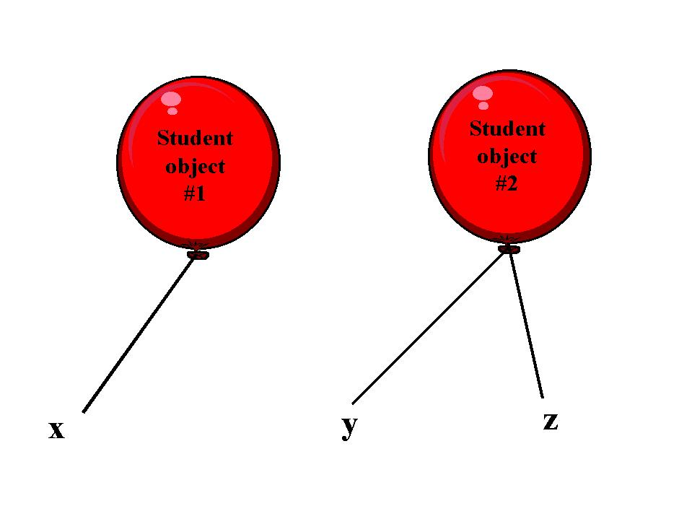
'Handles' on Objects, cont.
    // We instantiate our first Student object.
    Student x = new Student();
    // We declare a second reference, but do not
    // instantiate a second object.
    Student y;
    // We pass y a 'handle' on the same object
    // that x is holding.
    y = x;
    // We now declare a third reference and instantiate
    // a second Student object.
    Student z = new Student();

Slide 54
'Handles' on Objects, cont.
    // y now lets go of the first Student object
    // and grabs onto the second.
    y = z;

Slide 55
'Handles' on Objects, cont.
    // y now lets go of the first Student object
    // and grabs onto the second.
    y = z;

Slide 56
'Handles' on Objects, cont.
    // y now lets go of the first Student object
    // and grabs onto the second.
    y = z;
    // Finally, x lets go of the first Student
    // object, and grabs onto the second, as well.
    x = z;

Slide 57
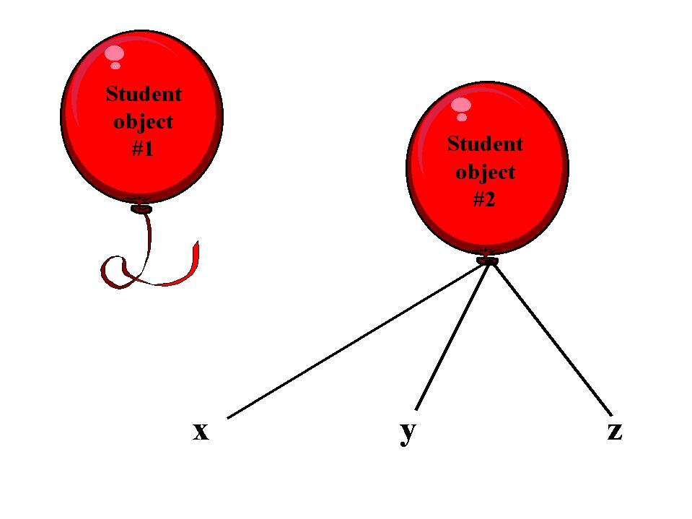
'Handles' on Objects, cont.
    // y now lets go of the first Student object
    // and grabs onto the second.
    y = z;
    // Finally, x lets go of the first Student
    // object, and grabs onto the second, as well.
    x = z;
    // The first Student object is now lost to
    // the program.

Slide 58
What happens to runaway objects?
In C and C++, runaway objects sit around and waste memory
  C++ is compiled into a binary file, and there is nobody around to take care of lost memory references
  Thus, programmers must release memory every time they free an object - or risk memory leaks
Java has garbage collection - so you don’t have to worry about it!

Slide 59
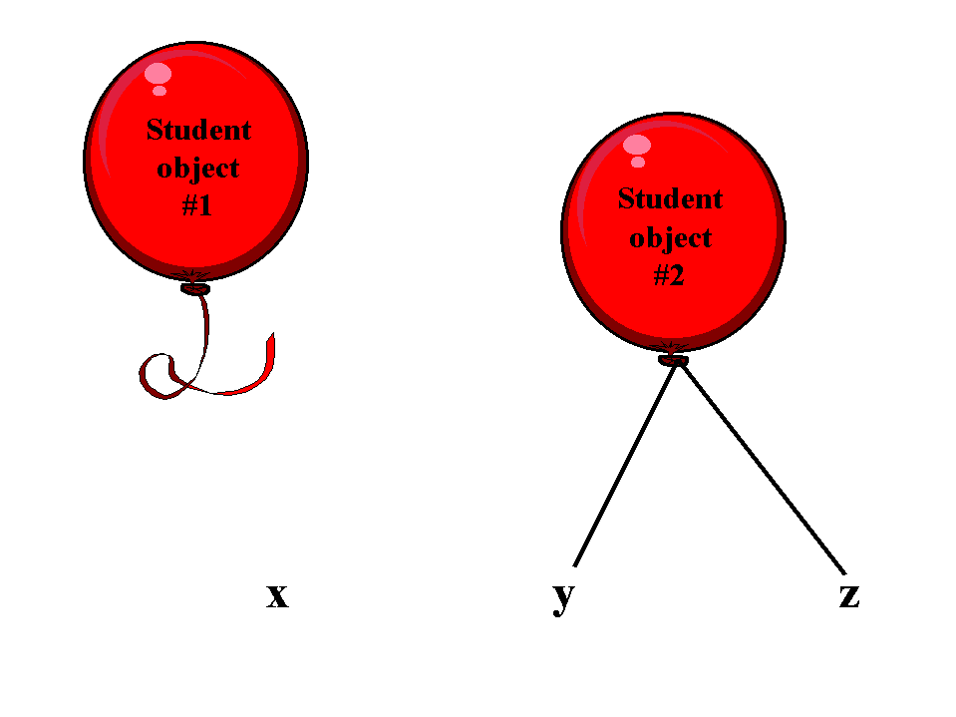
'Handles' on Objects, cont.
    // Another way to get a reference to let go of an object:
    x = null;

Slide 60
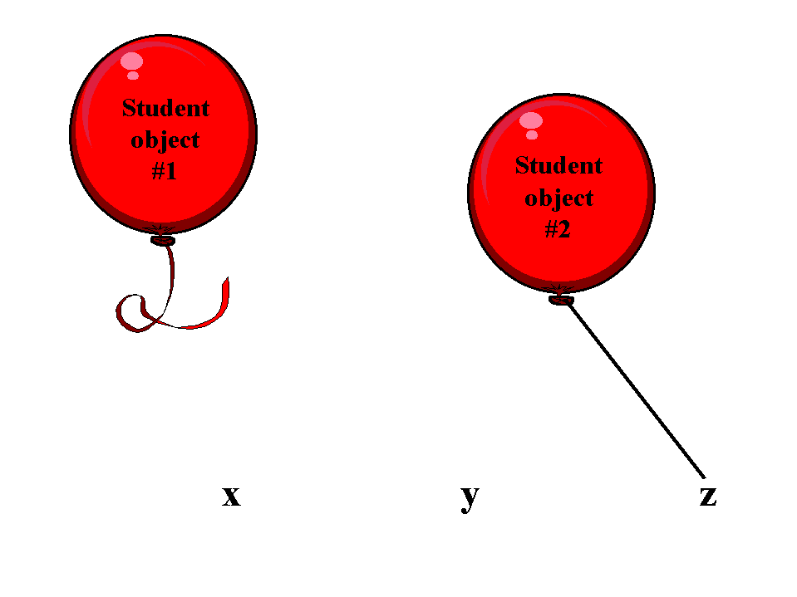
'Handles' on Objects, cont.
    // Another way to get a reference to let go of an object:
    x = null;
    y = null;

Slide 61
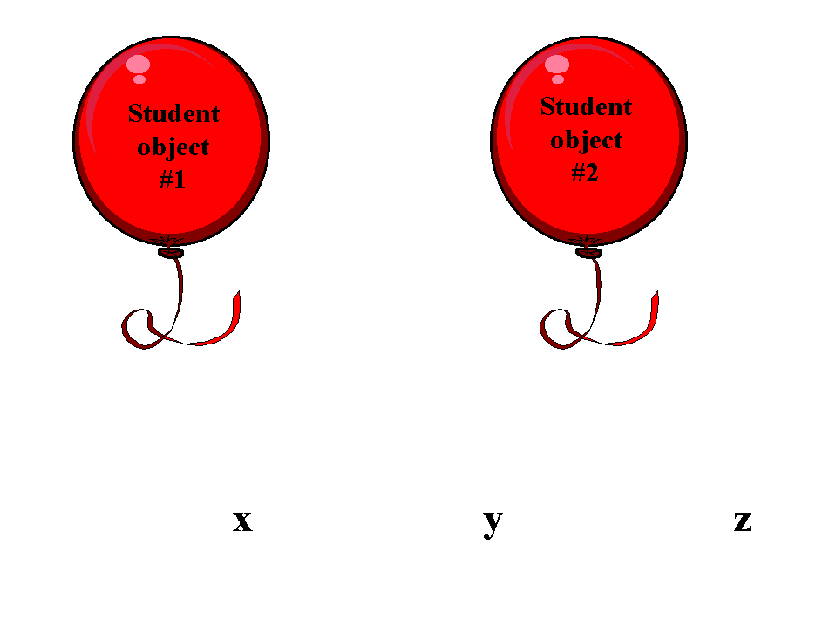
'Handles' on Objects, cont.
    // Another way to get a reference to let go of an object:
    x = null;
    y = null;
    z = null;

Slide 62
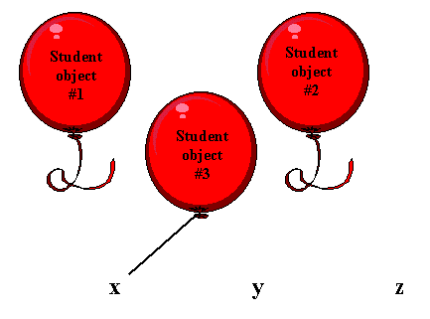
'Handles' on Objects, cont.
    x = null;
    y = null;
    z = null;
    // Whenever we see the "new" operator, we know that a
    // brand new object has been created.
    x = new Student();

Slide 63
Garbage Collection
If all of an object’s handles are dropped, it might seem as though the memory that the object occupies is permanently ‘wasted’
  In a language like C++, this is indeed the case, unless programmers explicitly ‘recycle’ the memory of an object before all of its handles are dropped
In Java, on the other hand, there is a utility called the garbage collector built into the JVM which automatically recycles ‘lost’ objects’ memory for us

Slide 64
Naming Conventions, Revisited
Name object references starting with a lower case letter
Use mixed case to construct "readable" names from multiple word phrases
Examples:
  Student aStudent;
  Professor departmentChair;

Slide 65
Objects as Attributes
When we first discussed the Student class, we stated that some of the attributes could be represented by built-in data types, whereas the types of a few others (advisor, courseLoad, and transcript) were left undefined
Let’s now put what we've learned about abstract data types to good use:
  Rather than declaring the advisor attribute as simply a String representing the advisor’s name …
  We'll declare it to be of an abstract data type – namely, type Professor, another user-defined type

Slide 66
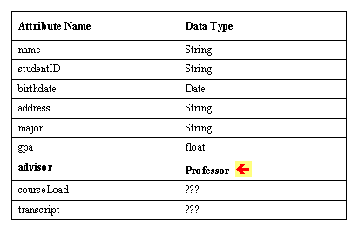
Objects as Attributes, cont.
Student attributes:
(we'll leave the others undefined for the time being)
String

Slide 67
Objects as Attributes, cont.
// File: Student.java
public class Student {
// Attributes.
String name;
String studentID;
String birthdate;
String address;
String major;
float gpa;
Professor advisor;
// ??? courseLoad;
// ??? transcript;
// Methods go here ... stay tuned! :o)
}

Slide 68
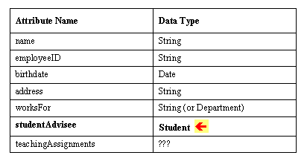
Objects as Attributes, cont.
Professor attributes:
String

Slide 69
Abstraction, Revisited
    Remember: decisions of inclusion vs. elimination must be made within the context of the overall domain of the future system
      When representing a person, is his/her eye color important? How about his/her genetic profile? Salary? Hobbies?
      Any of these features may be relevant or irrelevant, depending on the system to be developed

Slide 70
Nested Objects?
It might seem as though implementing objects as attributes would mean that a Student object has a Professor object “nested” inside, and vice versa ...
(a Student)
(a Professor)
String name ...
String studentId ...
Professor advisor
String name ...
String employeeId ...
Student advisee
(a Professor)
(a Student)

Slide 71


Object References
But in reality, each object only exists once in memory; objects store references to one another, so that they can find (refer to) one another as needed (memory sketch)
String name ...
String studentId ...
Professor advisor
String name ...
String employeeId ...
Student advisee
(a Student)
(a Professor)

Slide 72
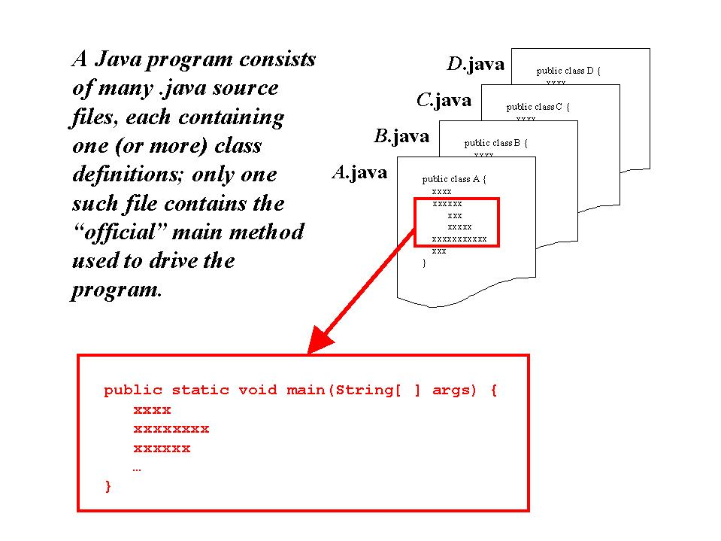
Anatomy of an Application

Slide 73
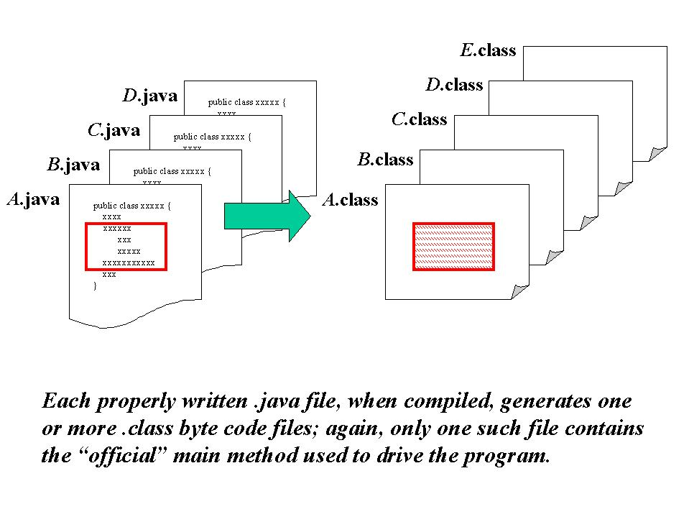
Anatomy, cont.

Slide 74
Assigning Attribute Types
Noteworthy points about the Professor class:
  Having an attribute like studentAdvisee that can only track a single Student object may be limiting
  We'll discuss techniques for handling this when we talk about collections, which will also be relevant to:
    the teachingAssignments attribute of Professor
    the courseLoad and transcript attributes of Student
  The worksFor attribute can be declared as either:
    A simple String representing the department name ("MATH")
    A reference to a Department object

Slide 75
Attribute Types, cont.
  The decision of whether or not we need to invent an abstract data type to represent a particular real-world concept is not always clear-cut
  Pose these questions:
    Is the concept central to our model overall?
    Does the concept warrant attributes and behaviors of its own?
  If the answer to either or both is "yes", then it most likely warrants its own class

