Slide 1
Constructors & Collections

Slide 2
Constructors
When we talked about instantiating objects, you may have been curious about the interesting syntax involved with the ‘new’ operator:
    Student x = new Student();
Why are there parentheses tacked onto the end of the statement? We are actually invoking a special type of method called a constructor
A constructor literally constructs (instantiates) a brand new object by allocating enough program memory to house the object’s attributes

Slide 3
Constructors, cont.
The syntax of a constructor signature is a bit different from other methods:
public Student(String id, String name)
NO
return type!
(implied)
method name
MATCHES the
class name
optional argument list (may be empty ( ))

Slide 4
Constructors, cont.
The argument list of a constructor may be used to specify which attributes you want to initialize, if any, at the time that an object is being instantiated
    // Instead of:
    Student s = new Student();
    s.setName("Fred Schnurd");
    s.setSsn("123-45-6789");
    s.setMajor("MATH");
    // etc.
    // We have:
  Student s = new Student("Fred Schnurd",
  "123-45-6789", "MATH");

Slide 5
Constructors, cont.
The body of the constructor would then look as follows:
    class Student {
    // Attributes.
    String name;
    String ssn;
    String major;
    // etc.
    public Student(String n, String s, String m){
    name = n; // or: name = new String(n);
    ssn = s;
    major = m;
  }
  // etc.

Slide 6
Constructors, cont.
We may actually write many different constructors for the same class which take differing numbers of arguments:
public class Student {
    // Attributes.
    String name;
    String ssn;
    String major;
    // etc.
    public Student(String n, String s, String m) {…}
    public Student(String n, String s) {…}
    public Student(String s) {…}
  Another example of overloading

Slide 7
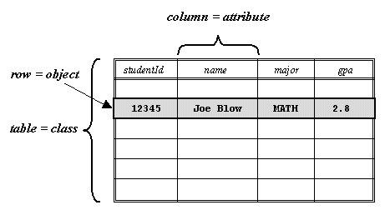
Objects and Databases
There is a tendency to relate the concept of an object to that of a record in a database

Slide 8
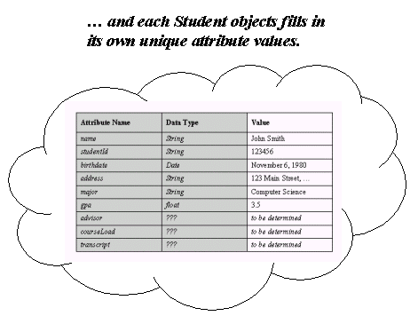
Objects and Databases, cont.
We often persist/restore the state of an object with a database

Slide 9
Constructors and Databases
Instead of passing arguments into a constructor to initialize the attributes for an object, we may have the constructor fetch data from a database
public class Student {
// Attribute details omitted.
  // Constructor.
  public Student(String ssn) {
    use ssn as a primary key to look up this student's record in the database's Student table;
    if (record found) {
    retrieve record and initialize all attributes
    based on this record;
    }
  }
  // etc.

Slide 10

Objects and Databases, cont.
Each in-memory object houses one record’s worth of data

Slide 11
Constructors, cont.
One other ‘oddity’ with respect to constructors, as compared with other methods, is that invoking them does not involve dot notation:
    Professor p = new Professor();
This is because we are not requesting a service of a particular object, but rather are requesting that a new object be crafted from ‘thin air’ by the programming environment
can be THOUGHT OF as: Professor p = Professor.Professor();

Slide 12
Default Constructor
If we don't explicitly declare any constructor for a class, Java provides a default "no args" constructor for us:
Student s = new Student();
If we need to do something special when an object is created, we may override this method signature explicitly:
public class Student {
  // Explicitly override the default constructor.
  public Student() {
    do whatever special processing that we deem
    necessary to construct a Student
  }
  }

Slide 13
Default Constructor, cont.
If we invent any constructors of our own, we lose the default "no args" constructor
    public class Person {
    protected String name;
    // Constructor.
    public Person(String n) {
    name = n;
    }
    // Default constructor is LOST!
    }
  In this case, we can no longer do the following in client code:
  Person p = new Person();

Slide 14
Default Constructor, cont.
If we want a "no args" constructor, we must explicitly add one back:
    public class Person {
    protected String name;
    public Person(String n) {
    name = n;
    }
    public Person() {
    name = "?";
    }
    }
This is generally a good practice, for reasons that we'll see in a moment

Slide 15
Reusing Constructor Code
We can reuse the code of one constructor from within another constructor in the same class via this(...) to avoid code duplication
  public class Student {
    // Attributes omitted - see earlier example.
    // Constructor #1.
    public Student() {
    name = "?";
    ssn = "?";
    major = "TBD";
    }

Slide 16
Reusing Constructor Code, cont.
We can reuse the code of one constructor from within another constructor in the same class via this(...) to avoid code duplication
  public class Student {
    // Attributes omitted - see earlier example.
    // Constructor #1.
    public Student() {
    name = "?";
    ssn = "?";
    major = "TBD";
    }
    // Constructor #2.
    public Student(String s) {
    this(); // perform code of Student()
    ssn = s; // whatever extra logic makes sense
    }

Slide 17
Reusing Constructor Code, cont.
    // (Repeated from previous slide.)
    // Constructor #2.
    public Student(String s) {
    this();
    ssn = s;
    }
    // Constructor #3.
    public Student(String n, String s) {
    this(s); // perform code of Student(String s)
    name = n;
    perhaps some extra steps …
    }
    // etc.

Slide 18
Reusing Constructor Code, cont.
    // (Repeated from previous slide.)
    // Constructor #2.
    public Student(String s) {
    this();
    ssn = s;
    }
    // Constructor #3.
    public Student(String n, String x) {
    this(x); // perform code of Student(String s)
    name = n;
    perhaps some extra steps …
    }
    // etc.

Slide 19
Constructors and Inheritance
There are number of complicating factors that we need to be aware of with respect to constructors whenever we are working with an inheritance hierarchy

Slide 20
Constructors and Inheritance
Factor #1: Constructors are not inherited as other methods are
  If we write a constructor for Person that takes a single String argument:
  public class Person {
    protected String name;
    // Constructor.
    public Person(String n) {
    name = n;
    }
    }
    // Client code:
    Person p = new Person("Joe");

Slide 21
Constructors and Inheritance
  It is not true that the same constructor signature will automatically be available for a subclass of Person
  public class Student extends Person { … }
    // Client code:
    Person p = new Person("Joe");
    Student s = new Student("Fred"); // NOT AUTOMATIC!

Slide 22
Constructors and Inheritance
  We'd have to explicitly program a constructor with that same signature in the subclass if we wanted such a constructor signature available to the subclass
    public class Person {
    protected String name;
    public Person(String n) {
    name = n;
    }
    }
    public class Student extends Person {
    public Student(String n) {
    name = n;
    }
    }

Slide 23
Constructors and Inheritance
  If we want to reuse a parent's constructor within a subclass constructor, we employ the same "super" keyword that we learned about earlier, but with a different syntax:
    public class Person {
    protected String name;
    public Person(String n) {
    name = n;
    }
    }
    public class Student extends Person {
    public Student(String x) {
    super(x); // reusing parent constructor
    } // with same arg. signature
    }
(match argument signatures)

Slide 24
Constructors and Inheritance
  Another example:
    public class Person {
    protected String name;
    protected String address;
    public Person(String n, String a) {
    address = a;
    name = n;
    }
    public Person(String n) {
    name = n;
    }
    }
    public class Student extends Person {
    String studentId;
    public Student(String x, String i) {
    super(x);
    studentId = i;
    }
    }
(match argument signatures)

Slide 25
Constructors and Inheritance
  One final example:
    public class Person {
    protected String name;
    protected String address;
    public Person(String n, String a) {
    address = a;
    name = n;
    }
    public Person(String n) {
    name = n;
    }
    }
    public class Student extends Person {
    String studentId;
    public Student(String x) {
    super(x, "?");
    studentId = "?";
    }
    }

Slide 26
Constructors and Inheritance
Factor #2: whenever a constructor for a subclass is called, constructor(s) for all of its ancestor class(es) are also called -- either explicitly, or by default -- in top-to-bottom order
  This is in keeping with the "is a" nature of inheritance
  For example, if Student is a subclass of Person, then whenever we call the constructor for a Student, the constructor for a Person also comes into play, because a Student is both

Slide 27
Constructors and Inheritance
Case #1: We've written no explicit constructors for either the Person or the Student class, and call the default Student constructor
  Student s = new Student();
In this case, the default Student constructor automatically calls the default Person constructor as its first step

Slide 28
Constructors and Inheritance
Case #2: we've written an explicit constructor for Student
  public class Student extends Person {
    String major;
    public Student(String n, String m) {
    // Although we don't see it in the code,
    // the first thing that happens in this
    // constructor is an implied call to the
    // default Person constructor
    name = n;
    major = m;
    }
    }

Slide 29
Constructors and Inheritance
Case #2: we've written an explicit constructor for Student
  public class Student extends Person {
    String major;
    public Student(String n, String m) {
    // Although it would be unnecessary to
    // do so, we could explicitly insert the
    // following line of code to accomplish
    // the same step:
    super();
    name = n;
    major = m;
    }
    }

Slide 30
Constructors and Inheritance
The default constructor for a superclass will always be implicitly called as the first line of a subclass's constructor …
    public Student(String n, String m) {
    super(); <-- automatically implied
    name = n;
    major = m;
    }
… unless we explicity call a different version of the parent's constructor to accomplish code reuse (must be the first line of code)
    public Student(String n, String u) {
    super(n); // assume Person(String n) in Person
    undergraduateMajor = u;
    }

Slide 31
Constructors and Inheritance
Either way, a Person constructor will always be called as the first step in constructing a Student
  There is no getting around this, nor should we want to circumvent this language feature
  This phenomenon can nonetheless cause us some problems

Slide 32
Constructors and Inheritance
Assume we have written the following code:
    public class Person {
    protected String name;
    // Constructor.
    public Person(String n) {
    name = n;
    }
    // THE "NO-ARGS" CONSTRUCTOR IS LOST.
    }
    public class Student extends Person {
    String id;
    // NO EXPLICIT CONSTRUCTOR PROVIDED.
    }

Slide 33
Constructors and Inheritance
We'll have a problem when we try to construct a Student:
Student s = new Student();
  The Student class's "no args" constructor will automatically try to invoke the "no args" constructor for a Person first, which doesn't exist in this case
  We'll get the following (somewhat cryptic) compilation error:
  Cannot resolve symbol: constructor Person()
  location: class Person
  class Student extends Person
  ^

Slide 34
Constructors and Inheritance
How can we get around this problem?
When creating an inheritance hierarchy, either:
  As recommended earlier, ensure that a "no-args" constructor is available for every class in the hierarchy
    This is the preferred approach, unless it is impossible to initialize a “meaningful” object when no arguments are passed in
  Provide explicit constructors for all classes in the hierarchy, and use only those -- never rely on the default "no-args" constructor

Slide 35
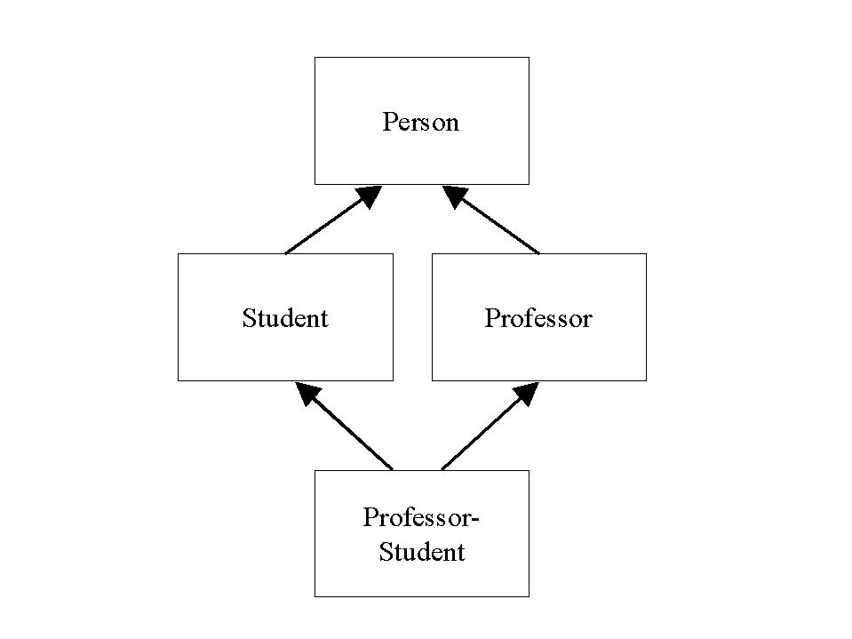
Multiple Inheritance
Multiple inheritance involves more than one parent for a given subclass

Slide 36
Multiple Inheritance, cont.
Deemed problematic
  Ambiguity with respect to inheriting conflicting features of multiple parents
Prohibited in Java
Java interfaces provide a work-around

Slide 37
Three Features of an OOPL
✓(Programmer creation of) Abstract Data Types (ADTs)
✓ Inheritance
Polymorphism

Slide 38
Object Collections
(Chapter 6)

Slide 39
What are Collections?
A collection is a special type of object used to gather up references to other objects as they are created so that we can manage/operate on them collectively and/or individually
  Implement one-to-many relationships
  A Professor object may wish to step through all Student objects registered for a particular Course to compute their grades
  The Student Registration System may need to step through all of the Course objects to determine which are subject to cancellation

Slide 40

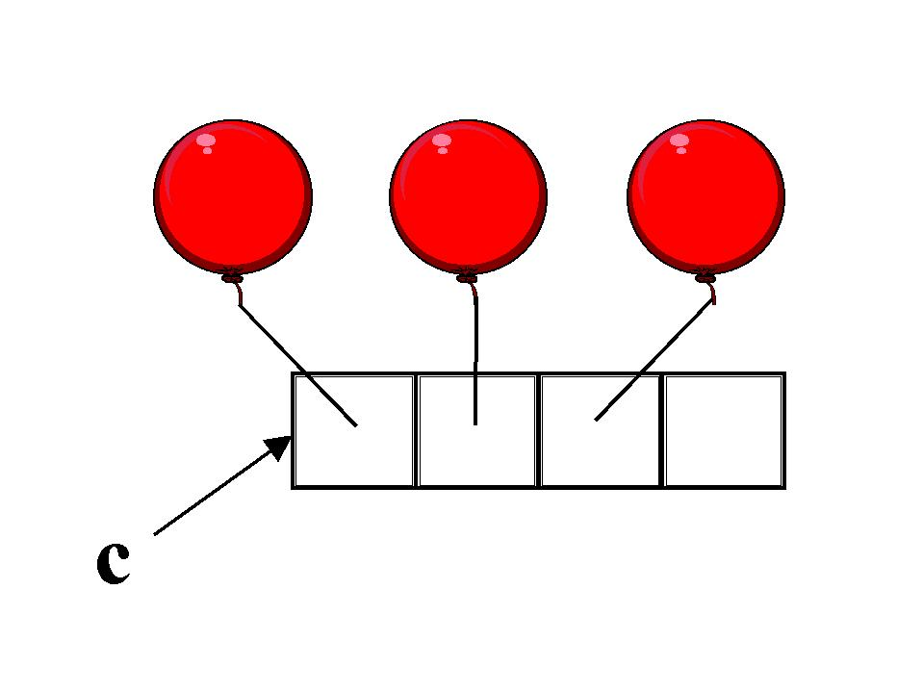
Collections of References
With some languages (e.g., C++), we actually do physically place the objects themselves into a collection
With Java, however, we are in actuality storing object references in the collection

Slide 41
Collections as Objects
Like any other object, a collection must be instantiated before it is used
  Vector v; // insufficient
    v = new Vector(); // empty "egg carton" created!
Collections are defined by classes that specify methods for ‘getting’ and ‘setting’ their contents
    // Create a few Student objects and store them in the
    // collection.
    Student a = new Student();
    v.add(a);
    // or:
    v.add(new Student());
    // Later in the application:
    // Retrieve a handle on the first Student.
    Student someStudent = (Student) v.elementAt(0);

Slide 42
Collections as Objects, cont.
Virtually all collections provide methods for:
  Adding objects*
  Removing objects
  Retrieving specific individual objects
  Iterating through the objects in some predetermined order
  Getting a count of the number of objects in the collection
  Answering true/false questions as to whether a particular object is in the collection or not
  * "objects" throughout is short for "object references"

Slide 43
Arrays as Simple Collections
A container of cells for holding like-typed things (ints, chars, references to Students)
The Java syntax for declaring and using arrays deviates from "typical" object syntax, to make arrays look more like arrays in non-OO languages
Java arrays are declared in one of two ways:
datatype[ ] name; int[] x; Student[] y;
datatype name[ ]; int x[]; Student y[];

Slide 44
Arrays, cont.
Instantiated via the 'new' operator:
Student[] y = new Student[20];
  Although this doesn't look like a typical constructor invocation, we are indeed invoking the Array class constructor
  We determine an array's size when we instantiate it, not when it is declared

Slide 45
Arrays, cont.
The contents of an array are initialized to their zero-equivalent values when the array is instantiated
  int[] filled with zeroes
  Student[] filled with nulls
Stuff the array with references
    Student[] studentBody = new Student[20];
    Student s = new Student();
    studentBody[0] = s;
    // Reuse s!
    s = new Student();
    studentBody[1] = s;

Slide 46
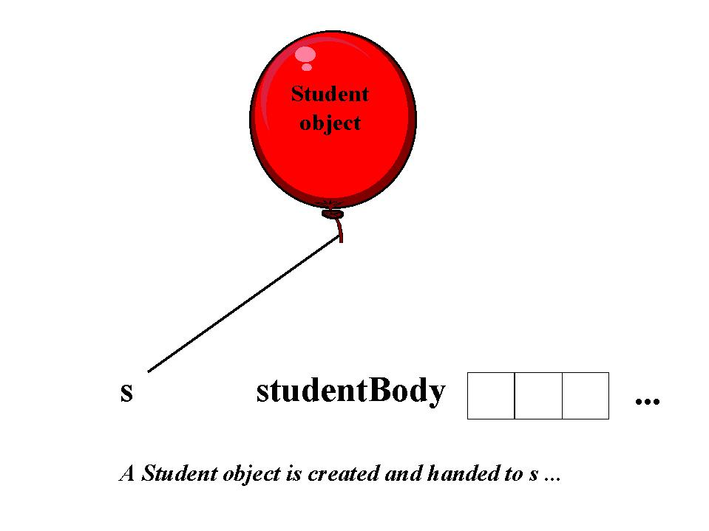
Arrays, cont.
Student s = new Student();

Slide 47
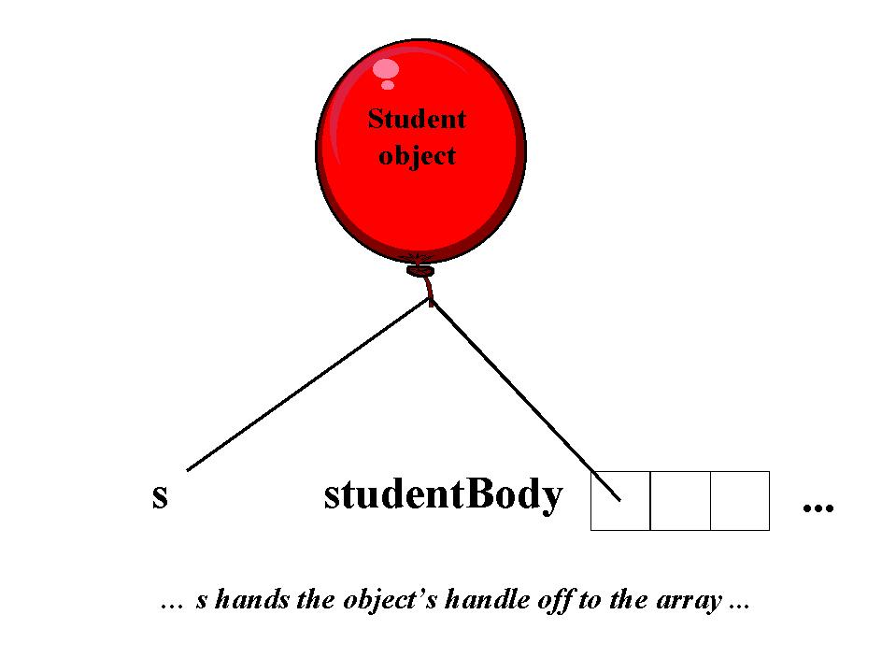
Arrays, cont.
    studentBody[0] = s;

Slide 48
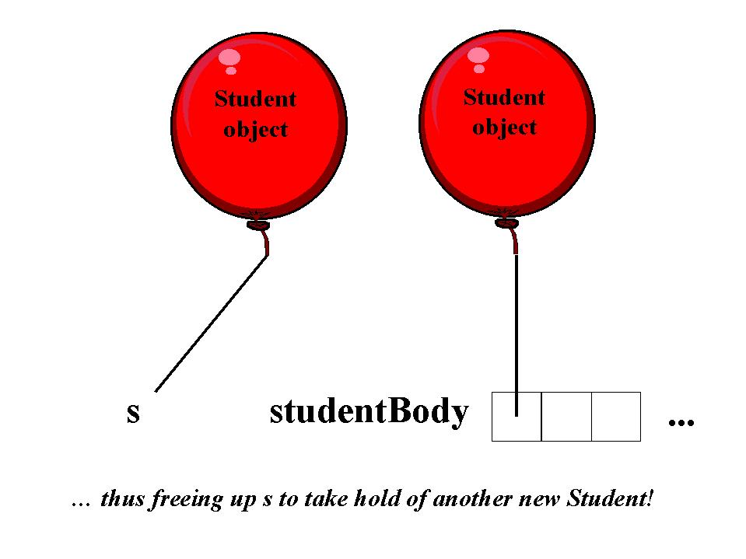
Arrays, cont.
s = new Student();

Slide 49
Arrays, cont.
Iterating through an array also involves somewhat odd-looking syntax:
for (int i = 0; i < studentBody.length; i++) {
    // Access the 'i^{th}' element of the array.
    System.out.println(studentBody[i].getName());
}
  Note length attribute
  length = number of cells, whether empty or not
  Note message passing
  If an array cell is empty (null), a NullPointerException arises ("landmine")
    (we'll see a workaround for this on the next slide)

Slide 50
Array Limitations
There are several problems with using an array to hold a collection of objects:
  Once sized, a ‘classic’ array cannot typically be expanded
  It is often hard to predict in advance the number of objects that a collection will need to hold
  ‘Landmine’ issues if an array isn't full (we can test for these, however:
for (int i = 0; i < studentBody.length; i++) {
    if (studentBody[i] != null)
    System.out.println(studentBody[i].getName());
}

Slide 51
More Sophisticated Collection Types
Ordered List:
  Similar to an array, in that order is preserved
  Size does not have to be specified at the time that the collection object is first created
  Will automatically grow in size as new items are added (true of virtually all collections besides arrays)

Slide 52
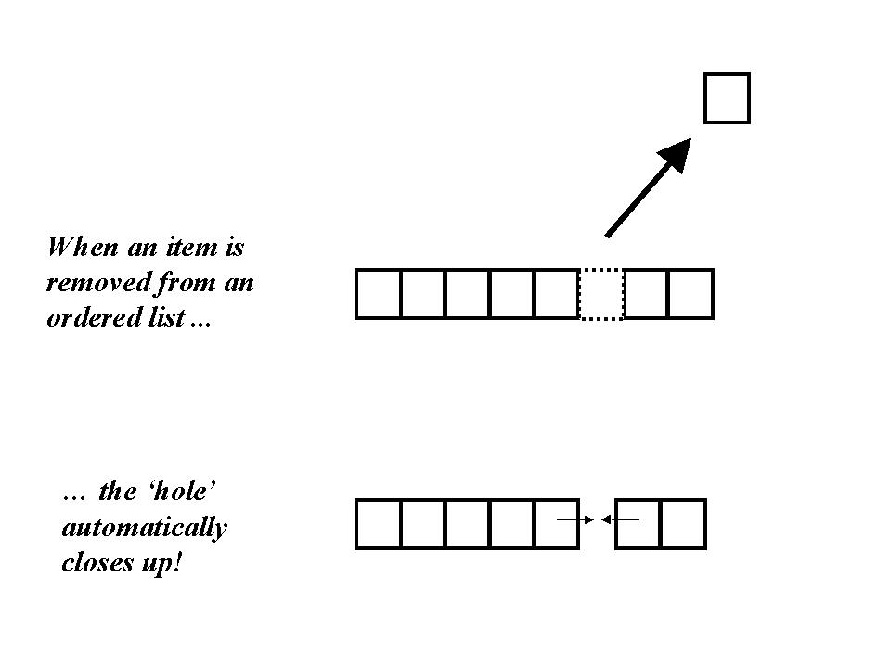
More Types, cont.
  No "landmines" (except when 100% empty)
  SRS example: manage a wait list for a course that has become full
  SimPol examples???

Slide 53
Java-Specific Collections
Java has numerous built in collection classes that represent ordered lists: Vector, ArrayList, LinkedList, Stack
We'll use the Vector class in our SimPol exercises
  We'll talk about this class in a bit more depth shortly

Slide 54
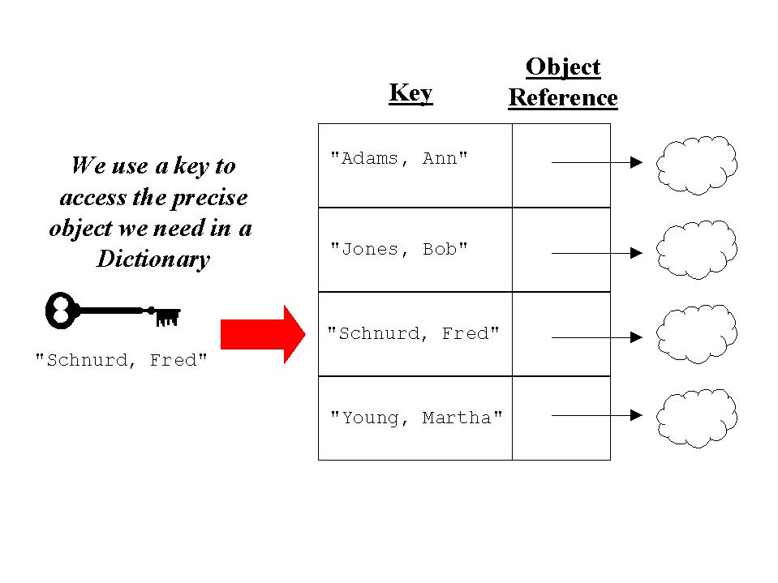
More Types, cont.
Dictionary:
  Store each object reference along with a unique retrieval key (typically based on attribute values)
  Retrieve directly by key, or iterate through in key order

Slide 55
More Types, cont.
  SRS example: a dictionary, indexed on a unique combination of course number plus section number, to manage its semester schedule
  SimPol examples???

Slide 56
Java-Specific Collections, cont.
Java has numerous built in collections that implement dictionaries: Hashtable, TreeMap, Hashmap, etc.
The Hashtable class is used in the SRS code example associated with this book

Slide 57
More Types, cont.
Set:
  An unordered collection (like an assortment of differently colored marbles in a sack)
    We can reach into the sack to pull the marbles out one by one, but the order with which we pull them out is non-deterministic
    We can step through the entire set to perform some operation on each object, but can’t guarantee in what order the objects will be processed
    We can perform tests to determine whether a given specific object has been previously added to a set or not

Slide 58
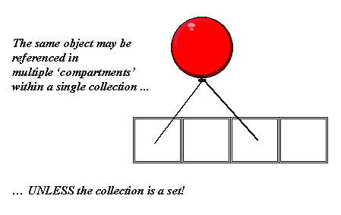
More Types, cont.
A Set doesn't allow duplicates, whereas most other collection types do:
SRS example: Biology Department majors
SimPol examples???

Slide 59
Java-Specific Collections, cont.
Java has several built in collections that implement sets: HashSet, TreeSet, etc.

Slide 60
Choosing a Collection Type
Collections are encapsulated, and hence take full advantage of information hiding
  We don’t need to know the private details of how object references are stored internally to a collection
  We only need to know a collection’s public behaviors in order to choose an appropriate collection type for a particular situation and to use it effectively

Slide 61
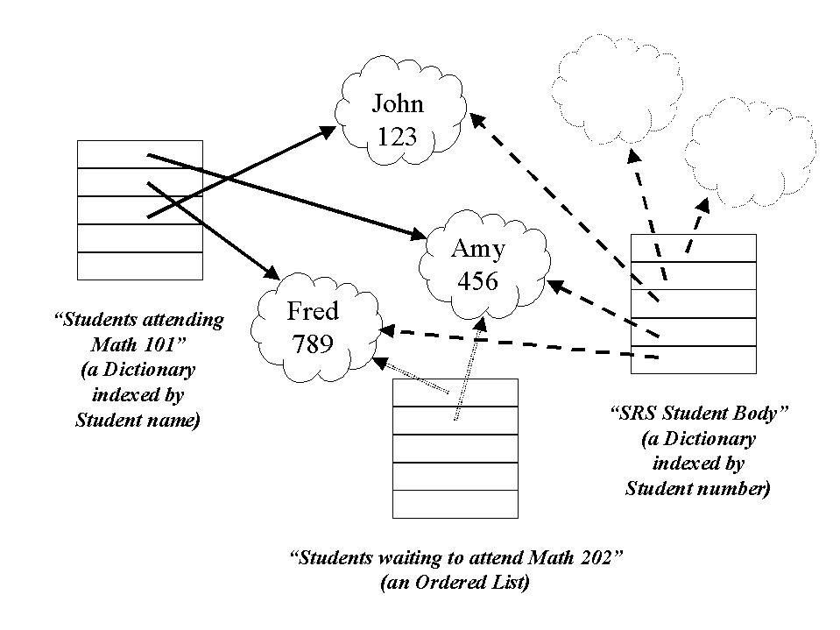
Objects May Coexist in
Multiple Collections
* Each object only instantiated once!!! *

Slide 62
Constraining a Collection's
Content Type
Java collection types other than Arrays don’t allow you to specify what type of object they will hold when you declare them
  Virtually all built-in Java collections are designed to hold objects of type Object, the "mother of all classes"
    // Vectors hold generic Objects.
    Vector v = new Vector(); // No type designated!
    // With arrays, we DO specify a type.
    Student[] s = new Student[100];

Slide 63
Constraining a Collection's
Content Type, cont.
  So, we can pretty much put whatever type of object we wish into a collection, because every Java object is descended from Object!
  It is important that programmer know what the intended (super)type for a collection is going to be, so that only objects of the proper type are inserted in the collection
Vector v = new Vector(); // of Students
  This will be important when you subsequently attempt to iterate through and process all of the objects in a collection

Slide 64
Retrieving Objects from a Java Collection
Objects ‘ remember’ their types when inserted into a collection, but are treated as generic Objects by the collection
We have to assure the compiler of their type when pulling them back out (by casting):
  Vector v = new Vector(); // of Students
  Student s1 = new Student();
  Student s2 = new Student();
  // Insert the Student objects …
  v.add(s1);
  v.add(s2);
  // Iterate through the collection ...
  for (int i = 0; i < v.size() ; i++) {
  Student s = (Student) v.elementAt(i); // cast
  // etc.
(note: size()
METHOD vs.
length ATTRIB.)

Slide 65
Collections of Supertypes
If we create a collection intended to hold objects of a given type – e.g., Person – then it makes perfect sense to insert a mixture of objects of type Person or of any of the subtypes of Person
  This is by virtue of the ‘is a’ nature of inheritance

Slide 66
Collections of Supertypes
    Vector srsUsers = new Vector(); // of Person objects
    Professor p = new Professor();
    UndergraduateStudent s1 = new UndergraduateStudent();
    GraduateStudent s2 = new GraduateStudent();
    // Add a mixture of professors and students; all have
    // Person as a common supertype.
    srsUsers.add(s1);
    srsUsers.add(p);
    srsUsers.add(s2);
    // etc.

Slide 67
Collections of Supertypes
When we iterate through a collection that contains a mixture of object types, we must cast to a common supertype - usually, but not always, the one furthest down on the inheritance hierarchy
  // Iterate through the collection ...
  for (int i = 0; i < srsUsers.size() ; i++) {
  Person p = (Person) srsUsers.elementAt(i); // cast
  do things with p ...
  }
  We’ll revisit the reasons for this when we talk about polymorphism later on

Slide 68
Java-Specific Collections: the Vector Class
Vector defines many interesting behaviors:
  add(Object) – adds an object reference to the end of the Vector, automatically expanding the Vector if need be to accommodate the reference (note that it can be a reference to any type of object, as they are all descended from the Java Object class)
  add(int, Object) – adds the specified object reference to the position in the Vector indicated by the int argument (where counting starts with 0, as in an Array), shifting everything in the Vector over by one location to accommodate the new item

Slide 69
The Vector Class, cont.
  set(int, Object) – replaces the n^{th} object reference with the specified object reference
  elementAt(int) – retrieves the n^{th} object reference as type Object – a cast is needed to ‘restore’ the object reference’s ‘true identity’
  removeElementAt(int) – takes out the n^{th} reference and ‘closes up’/’collapses’ the resultant ‘hole’
  remove(Object) – hunts for existence of the object reference in question and, if found, removes the (first) occurrence of that reference from the Vector, closing up the ‘hole’
  size() - returns a count of the number of Objects

Slide 70
The Vector Class, cont.
  indexOf(Object) – hunts for existence of a specific object reference and, if found, returns an integer indicating what the (first) position is of this reference in the Vector (starting with 0);
  contains(Object) – hunts for existence of the object reference in question and, if found, returns the value true, otherwise false
  isEmpty() – returns true if the Vector is empty, false otherwise
  clear() – empties out the Vector
and there are more!

Slide 71
Import Statements
In order to use the Vector class in one of our own classes, we must include the appropriate import statement at the top of the enclosing class's source file:
// MyClass.java
import java.util.*; // Vector is in the java.util package
// The import statement(s) go ahead of the
// public class … declaration.
public class MyClass {
  private Vector someVector;
  // etc.

Slide 72
Import Statements
Alternative syntax:
// MyClass.java
import java.util.Vector; // just import one class
public class MyClass {
  private Vector someVector;
  // etc.
  We'll discuss the import mechanism in more detail in a later lesson

Slide 73
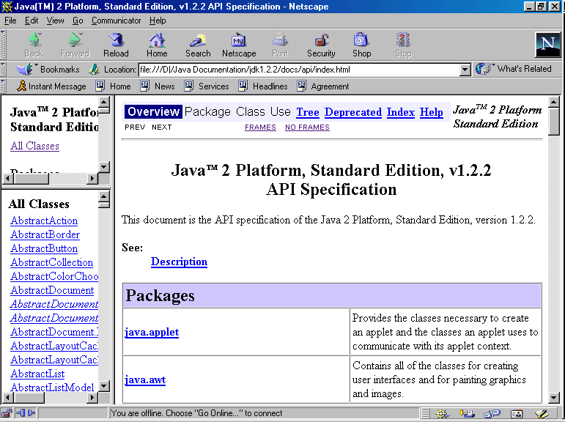
Using On-Line Java Documentation
Sun Microsystems has provided a convenient, on-line way to view Java language documentation from the comfort of your own browser

Slide 74
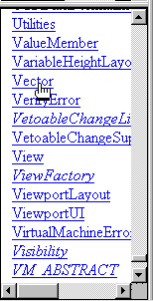
On-Line Documentation, cont.
Scroll to the class of
interest, and click on
its hyperlink ...

Slide 75
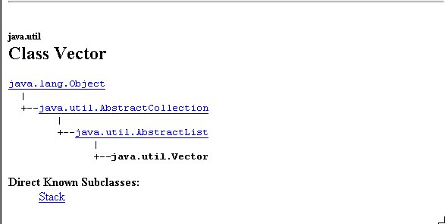
On-Line Documentation, cont.
… and documentation about that class, including its inheritance "lineage", constructors, methods, and attributes, appears in the browser window

Slide 76
Representing Associations
In Code, Revisited
As mentioned earlier, we represent associations in code as attributes
  We use individual reference variables to represent the "one" end of an association
  We use collections to represent the "many" end of an association -- we'll illustrate this now
  We may or may not wish to make these "bidirectional"

Slide 77
Representing Associations
In Code -- An Example
A Student enrolls in many Sections, and a Section has many Students enrolled in it
public class Student { public class Section {
// Attributes. // Attributes.
private String name; private String sectionNo;
private Vector sections; private Vector students;
// of Section objects // of Student objects
// etc. Course courseRepresented;
// etc.

Slide 78
Client Code for this Example
Student s = new Student();
Section sec = new Section();
// Details omitted.
// Create bidirectional link between these two objects.
sec.enroll(s);
s.enroll(sec);
What would the enroll() methods look like?

Slide 79
Representing Associations
In Code -- Example, cont.
public class Student {
// Attributes.
private String name;
private Vector sections;
// etc.
public void enroll(Section x) {
// Call the add() method on the sections Vector.
sections.add(x);
}
// etc.

Slide 80
Representing Associations
In Code -- Example, cont.
public class Section {
// Attributes.
private String sectionNo;
private Vector students;
// etc.
public void enroll(Student x) {
// Call the add() method on the students Vector.
students.add(x);
}
// etc.

Slide 81
Explicit Constructors, cont.
… and vice versa.
public class Section {
// Attributes.
private String sectionNo;
private Vector students;
// etc.
public void enroll(Student x) {
students.add(x);
}
public Section() {
students = new Vector();
}
// etc.

Slide 82
Memory Schematic
Student s = new Student();
(a Student)
sections
s

Slide 83
Memory Schematic, cont.
Student s = new Student(); sections = new Vector();
(a Vector)
(a Student)
sections
s

Slide 84
Memory Schematic, cont.
Student s = new Student();
Section sec = new Section();
(a Vector)
(a Student)
(a Section)
sections
students
s
sec

Slide 85
Memory Schematic, cont.
Student s = new Student();
Section sec = new Section(); students = new Vector();
(a Vector)
(a Student)
(a Section)
sections
students
s
sec
(a Vector)

Slide 86
Memory Schematic, cont.
Student s = new Student();
Section sec = new Section();
sec.enroll(s); students.add(x);
(a Vector)
(a Student)
(a Section)
sections
students
s
sec
(a Vector)

Slide 87
Memory Schematic, cont.
Student s = new Student();
Section sec = new Section();
sec.enroll(s);
s.enroll(sec); sections.add(x);
(a Vector)
(a Student)
(a Section)
sections
students
s
sec
(a Vector)

Slide 88
Memory Schematic, cont.
Student s = new Student();
Section sec = new Section();
sec.enroll(s);
s.enroll(sec);
Student s2 = new Student();
(a Vector)
(a Student)
(a Section)
sections
students
s
sec
(a Student)
(a Vector)
s2
sections
(a Student)

Slide 89
Memory Schematic, cont.
Student s = new Student();
Section sec = new Section();
sec.enroll(s);
s.enroll(sec);
Student s2 = new Student();
(a Vector)
sections = new Vector();
(a Student)
(a Section)
sections
students
s
sec
(a Student)
(a Vector)
s2
sections
(a Vector)
(a Student)

Slide 90
Memory Schematic, cont.
Student s = new Student();
Section sec = new Section();
sec.enroll(s);
s.enroll(sec);
Student s2 = new Student();
sec.enroll(s2);
(a Vector)
students.add(x);
(a Student)
(a Section)
sections
students
s
sec
(a Student)
(a Vector)
s2
sections
(a Vector)

Slide 91
Memory Schematic, cont.
Student s = new Student();
Section sec = new Section();
sec.enroll(s);
s.enroll(sec);
Student s2 = new Student();
sec.enroll(s2);
s2.enroll(sec);
(a Vector)
sections.add(x);
(a Student)
(a Section)
sections
students
s
sec
(a Student)
(a Vector)
s2
sections
(a Vector)

Slide 92
Referential Integrity
Make sure that the references between objects and collections stay current as objects are created and destroyed.

