Slide 1
From Endogenous Firms to Macro-Volatility with 120 million Agents
Rob Axtell
Krasnow Institute for Advanced Study
George Mason

Slide 2
Transition in the Social Sciences
Decision theory
Rational actors:
Utility maximization
Profit maximization
Representative agents
Indirect interactions
Agent-level equilibrium
Ag data + econometrics
OR and optimization
Top down AI
Game theory
Behavioral economics:
Behavioral anomalies
Multi-agent firms
Heterogeneous agents
Direct interactions (nets)
Micro diseq, macro stat.
Micro data + simulation
Institutional realism
Distributed AI -> Agents

Slide 3
Transition in the Social Sciences
Decision theory
Rational actors:
Utility maximization
Profit maximization
Representative agents
Indirect interactions
Agent-level equilibrium
Ag data + econometrics
OR and optimization
Top down AI
Game theory
Behavioral economics:
Behavioral anomalies
Multi-agent firms
Heterogeneous agents
Direct interactions (nets)
Micro diseq, macro stat.
Micro data + simulation
Institutional realism
Distributed AI -> Agents
SIMPLE
ECONOMICS
COMPLEXITY
ECONOMICS?
Santa Fe
Economics?
Agent-based
Economics?

Slide 4
Big Picture
5 strengths of agents: heterogeneity, bounded rationality, direct interactions, non-equilibrium, scale
‘Agentization’: Create computational representation of conventional (neoclassical) model
Many ways to relax neoclassical specifications, leading to multiple model ‘flavors’
Macro: add heterogeneity, add networks, sub-rational behavior, add institutions,...
Need basic research program on macroeconomics: let 100 flowers bloom
Need positive research not tied to policy concerns...
...although policy makers can drive methodology!

Slide 5
A Basic Research Pgm
Back to the foundations of macroeconomics:
Empirically-credible macro-level output
Behaviorally-credible heterogeneous agents
Institutionally-credible details
Macro-dynamics:
Perpetual novelty at agent level, macro-stationarity
Exogenous shocks neither necessary nor sufficient
We don’t know how to accomplish this analytically:
‘Double regress’ of stalled analytics -> numerics
Begin with agents and institutions, ‘grow’ macroeconomy from the bottom up

Slide 6
Origins of Macro Fluctuations
DSGE: Microeconomy is in equilibrium, thus only way to get dynamics is via exogenous shocks
Gabaix [2011]: Skew sizes + exogenous firm shocks lead to lumpy (‘granular’) aggregate fluctuations
Schwartzkopf, Farmer and Axtell: Stochastic firm growth generates aggregate variability
Acemoglu et al. [2012]: Skew production networks lead to realistic levels of aggregate volatility
Today: ‘Normal’ labor dynamics lead to skew sizes, firm-level fluctuations, and aggregate volatility

Slide 7
Transition in Macroeconomics?
Equation-based macro
Representative agents
General equilibrium microfoundations
Rational expectations
Exogenous shocks
Usual central limit th’m
Lucas critique
‘Dead’ (equil) economy
Bottom-up macro
Heterogeneous agents
Adaptive agents whose behavior evolves
Simple agents, learning
Endogenous dynamics
Lévy-type limit th’ms
‘Veil of complexity’
‘Economy under glass’

Slide 8
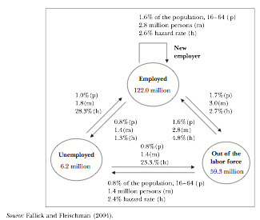
Monthly Labor Flows
Bob Hall, Handbook of Labor Economics,
“...rates of job [separation] are astonishingly high in the US economy...”

Slide 9
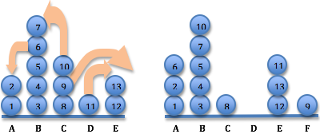
Basic Idea
t
t+1
5 FIRMS
13 AGENTS

Slide 10
Basic Idea
t
t+1
5 FIRMS
13 AGENTS

Slide 11
Basic Idea
t
t+1
5 FIRMS
13 AGENTS
5 DIFFERENT FIRMS
13 AGENTS (CONSERVED)

Slide 12
Specific Results
Microeconomic specification sufficient to yield ‘lifelike’ firms, labor flows, aggregate volatility:
120 million workers
6 million firms (with employees)
3 million job changers each month
100 thousand start-ups each month
20 thousand largest firms employ 1/2 of labor
1 firm with one million employees
Persistent aggregate fluctuations
25+ empirical facts rationalized by the model
Best neoclassical model: 2 facts;
Claim: Usual focus on agent-level equilibrium of limited use for reproducing the data

Slide 13
General Results
Modeling approach: Dynamics are endogenous (i.e. no need for exogenous shocks)
Theory: Microeconomic equilibria exist but are dynamically unstable
Computing: Agent model at full-scale with U.S. private sector (120 million agents)
Org theory: Large firms arise w/o internal structure
Macro: Micro-level shocks propagate to aggregate level

Slide 14
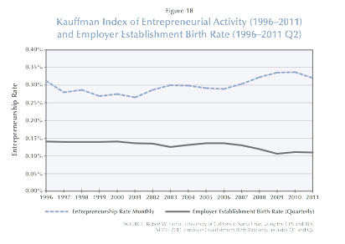
Number of New Firms
1
Source: Kauffman Foundation

Slide 15
Monthly Labor Flows
2

Slide 16
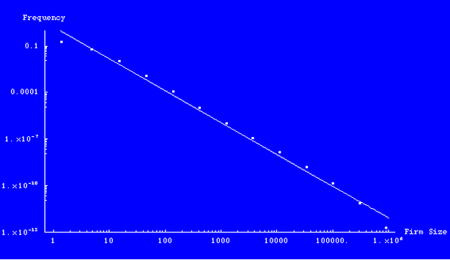
Firm Sizes
3
Pr[S ≥ s_{i}] = 1-F(s_{i}) = s_{i}^{−α}
Average firm size ~ 20
Median ~ 3-4
Mode = 1
“U.S. Firm Sizes are Zipf Distributed,” RL Axtell, Science, 293 (Sept 7, 2001), pp. 1818-20
Source: Census

Slide 17
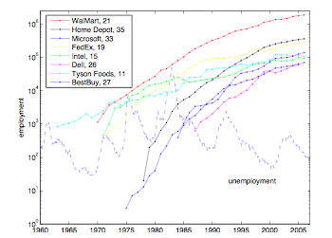
Size of the Largest Firm
4
Source: public data

Slide 18
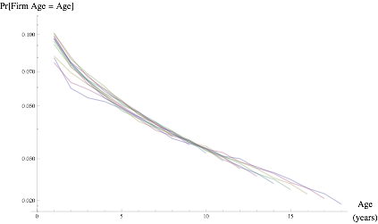
Firm Ages
5
Source: Census

Slide 19
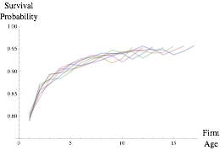
Survival Probability
6
Source: Census

Slide 20
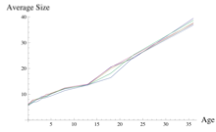
Avg Firm Size vs Age
7
AVERAGE SIZE ∝ AGE
Source: Census

Slide 21
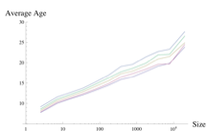
Avg Firm Age vs Size
8
AVERAGE AGE ∝ LOG(SIZE)
Source: Census

Slide 22
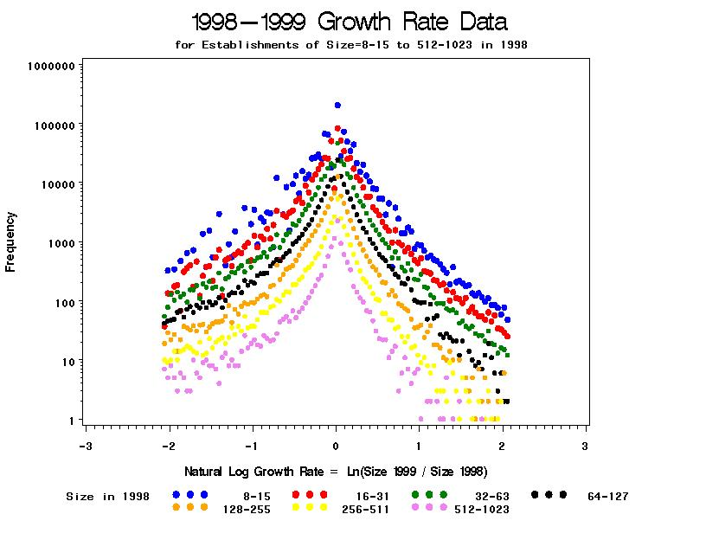
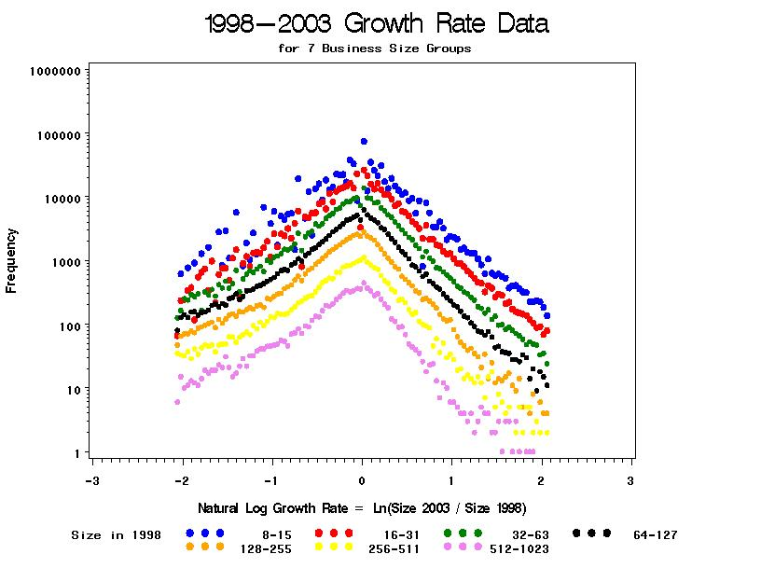
Firm Growth
9, 10
Source: Census and SBA; Perline, Axtell and Teitelbaum [2006]

Slide 23
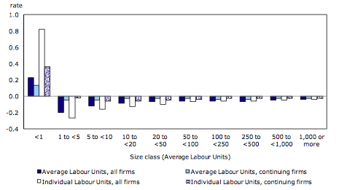
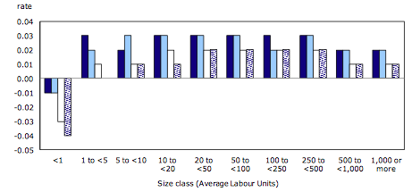
Growth Rate vs Size
11
Source: Dixon and Rollin [2012]

Slide 24
Growth Rate vs Size
11, 12
Source: Dixon and Rollin [2012]

Slide 25
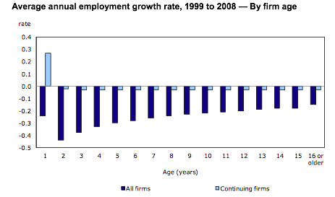
Growth Rate vs Age
13
Source: Dixon and Rollin [2012]

Slide 26
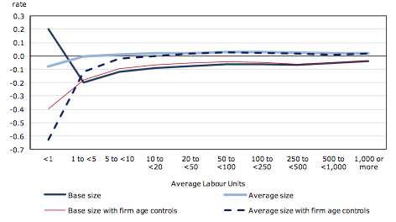
Growth vs Size and Age
14
Source: Dixon and Rollin [2012]

Slide 27
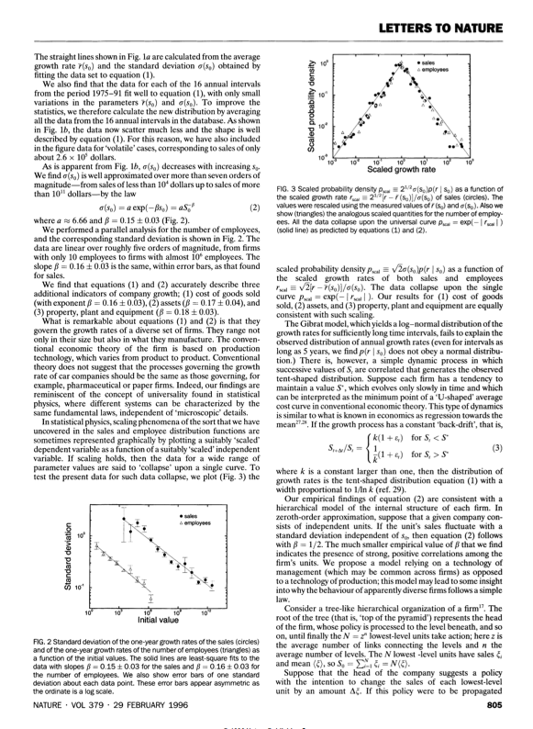
Growth Volatility vs Size
15
Source: Stanley et al. [1996]

Slide 28
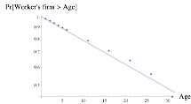
Employment by Firm Age
16
Source: BLS

Slide 29
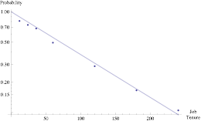
Job Tenure
17
Source: BLS

Slide 30
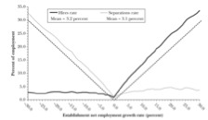
Labor Flow vs Growth
18
Source: Davis, Faber and Haltiwanger [2006]

Slide 31
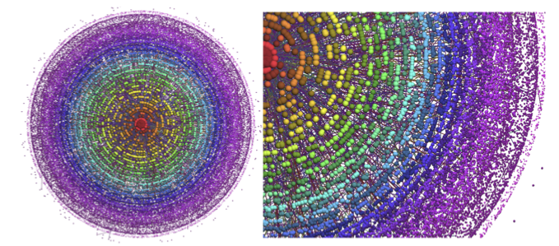
Labor Flow Network (work of Omar Guerrero)
Source: Statistics Finland

Slide 32
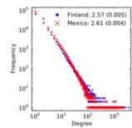
Labor Flow Network: Degree Distribution
19
Source: Statistics Finland and O. Guerrero

Slide 33
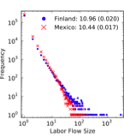
Labor Flow Network: Edge Weights
20
Source: Statistics Finland and O. Guerrero

Slide 34
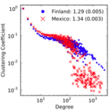
Labor Flow Network: Clustering Coefficient
21
Source: Statistics Finland and O. Guerrero

Slide 35
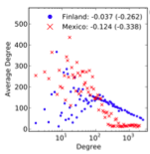
Labor Flow Network: Assortativity
22
Source: Statistics Finland and O. Guerrero

Slide 36
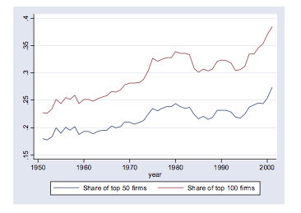
Large Firm Volatility
Source: Gabaix [2011]

Slide 37
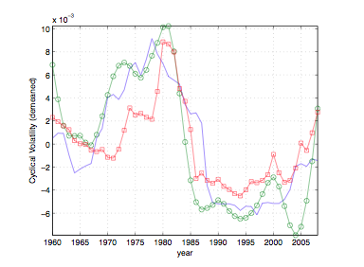
Output Volatility: ‘Great Moderation’
Source: Carvalho and Gabaix [2012]

Slide 38
Other empirical patterns
Constant returns to scale at the macro level
Exponential income distribution
Employment as a function of size
Variance of firm growth rate with age
Firm wage-size effect (larger firms pay more)
Dependence of output volatility on size
...

Slide 39
Team Production

Slide 40
Team Formation Model
Heterogeneous population of agents
Situated in an environment of increasing returns (team production)
Agents are boundedly rational (locally purposive not perfectly rational)
Rules for dividing team output (compensation systems)
Agents have social networks from which they learn about job opportunities

Slide 41
Model
⬥ Consider a group of N agents, each of whom supplies input (‘effort’) e_{i} ∈ [0,1]
⬥ Total effort level: E = Σ_{i∈{1..N}} e_{i}
⬥ Total output: O(E) = aE + bE², a, b≥ 0
⬥ b = 0 means constant returns, b > 0 is
increasing returns
⬥ Agents receive equal shares of output:
S(E) = O(E)/N
⬥ Agents have Cobb-Douglas preferences for
income (output shares) and leisure,
U^{i}(e_{i}) = S(e_{i},E_{~i})^{θi} (1-e_{i})^{1-θi}

Slide 42
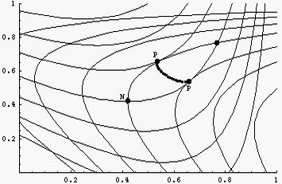
Analytical Results
Nash equilibria always exist and are unique
Agents undersupply effort at Nash equlibrium (Holmström)
Nash equilibrium is dynamically unstable for sufficiently large groups

Slide 43
Agent Model

Slide 44
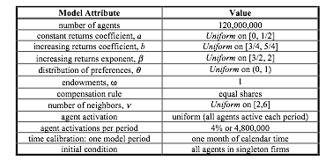
Base Parameterization
Size of the U.S. private sector

Slide 45
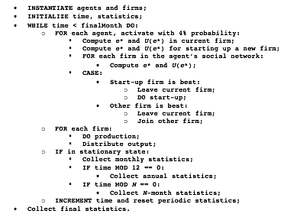
Pseudo-code

Slide 46

Dynamics (in slow motion)

Slide 47
Realizing 10⁸ agents
Needed: 1 KB/agent => 100 GB
What doesn’t work: multiple machines, OpenMP, MPI; Java; conventional threading on a few cores
What is needed:
large ‘flat’ memory space (e.g., 256 GB)
OS to address large memory (Unix)
lots of processors (server architecture motherboard, e.g., 4 Xeon E5-2687W)
lots of cores/processor (2687W = 8, so 32 cores)
time...24-48 hours to remove transient

Slide 48
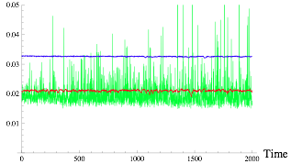
Monthly Job-to-Job Flows
TOTAL
JOB CREATION
JOB DESTRUCTION

Slide 49
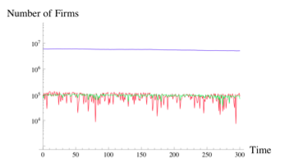

Number of Firms
avg firm size ~ 20 =
TOTAL
ENTRANTS
EXITS

Slide 50
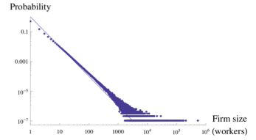
Firm Size Distribution
-2

Slide 51
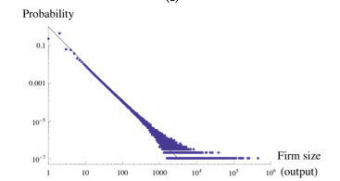
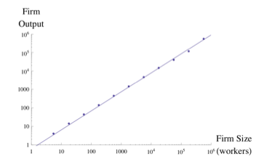
Firm Size Distribution
-2

Slide 52
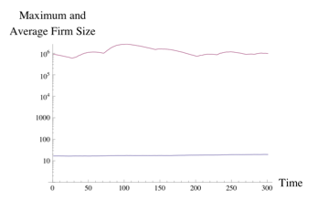
Firm Size Statistics

Slide 53
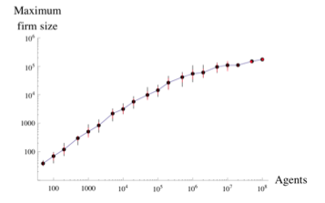
Largest Firms

Slide 54

Digression on Scale

Slide 55
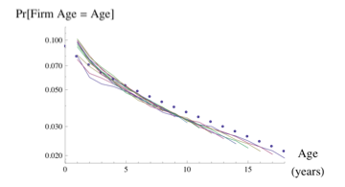
Realized Firm Ages

Slide 56
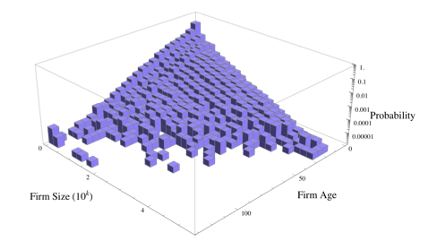
Firms by Size an Age

Slide 57
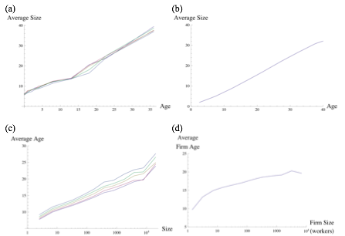
Avg Age and Avg Size
US data
Model output

Slide 58
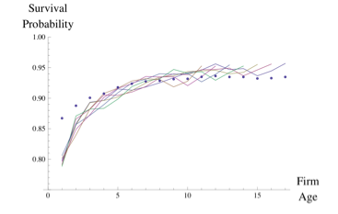
Realized Firm Survival

Slide 59
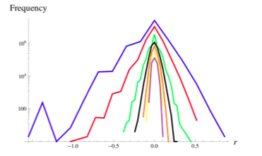
Realized Firm Growth
KEY
8-15
16-31
32-63
64-127
128-255
256-511
512-1023

Slide 60
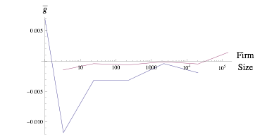
Realized Growth on Size

Slide 61
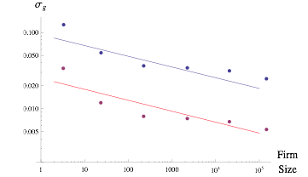
Realized Volatility on Size
-1/6
-1/7

Slide 62
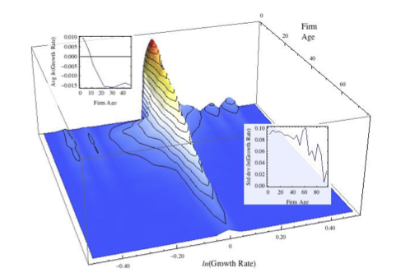
Growth Rate vs Age

Slide 63
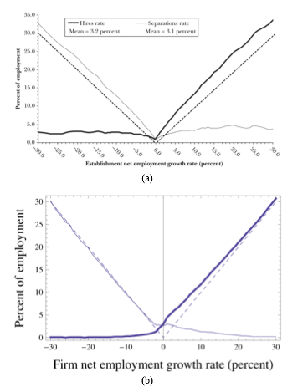
Labor Transitions
SOURCE: Davis, Faberman and
Haltiwanger 2006

Slide 64
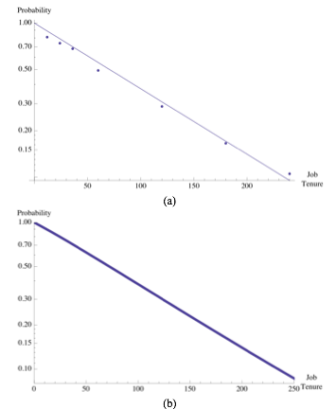
Realized Job Tenure
US data
Model output

Slide 65
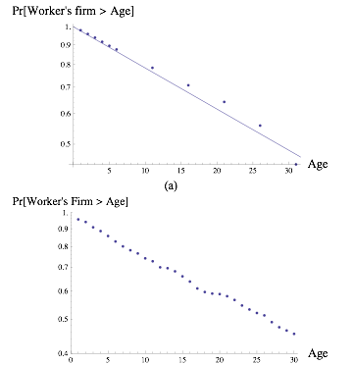
Employment by Firm Age
US data
Model output

Slide 66
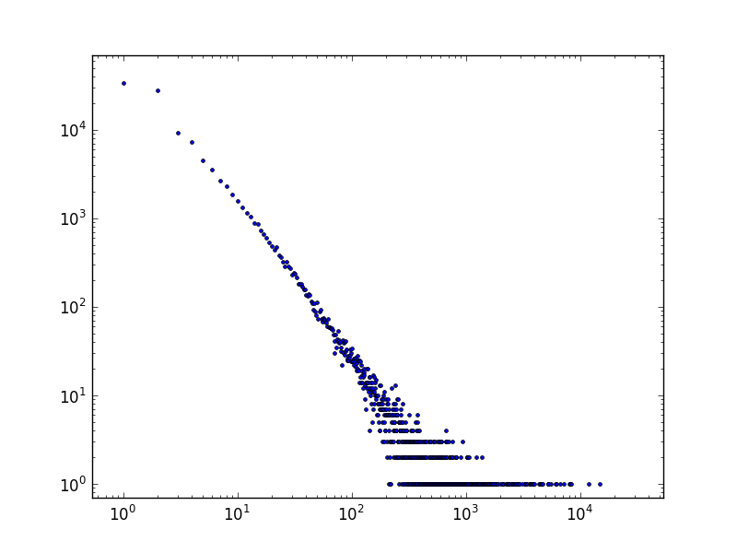
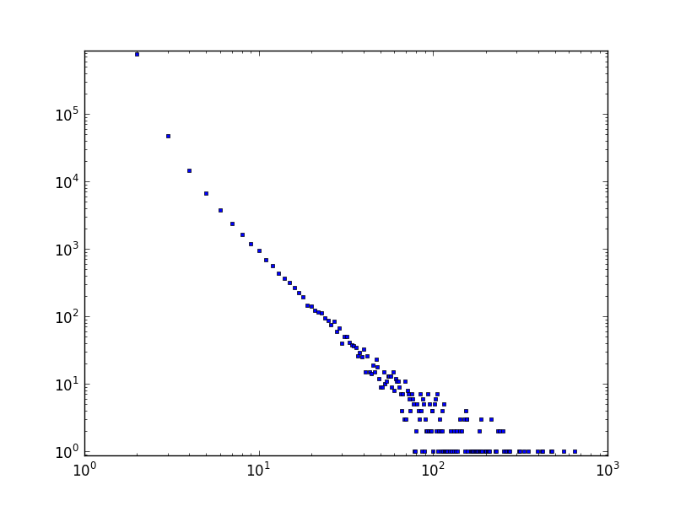
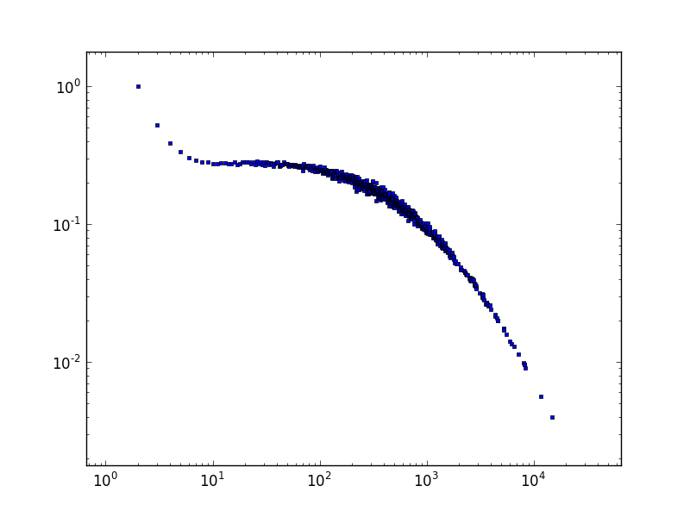

Labor Flow Networks

Slide 67

Realized Welfare

Slide 68


Output Volatility

Slide 69
Summary
Emerging firm micro-data (universe of U.S. firms)
Computational model at 1-to-1 scale with the private sector workforce
Realistic levels of job switching and firm formation
Microeconomic level is not in equilibrium
Macro-level is stationary
Good agreement between many data series and model output

Slide 70
Implications
Large-scale agent models are feasible to build, calibrate, experiment with...
Integration of agent models with micro-data is possible
Models that are nonequilibrium at the agent level seem to be a good way to produce endogenous dynamics at the aggregate level
Agent models relevant to emerging interest among theorists (Gabaix [2011], Acemoglu [2012])

Slide 71
Implications for CRISIS?
Many sources of endogenous dynamics: how to ‘allocate’ variability between them?
Which more important: financial instabilities transmitted to real economy or fluctuations in the real economy transmitted to financial markets?
At what scale can comprehensive models be built? What is the right scale for particular questions?
Are there ‘natural’ measures of ‘too big to fail’ in the real economy? Too connected to fail?

