Slide 1
Emergence of Firms
Agent Based Modeling

Slide 2
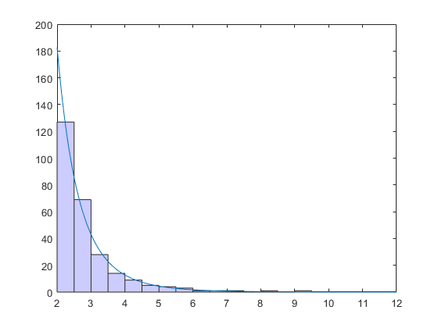
Last time – “asshole model of economy”
“At every move, I will take a dollar from a random person”
Accumulated wealth shows extreme inequality.
Pareto distribution – Power Law

Slide 3
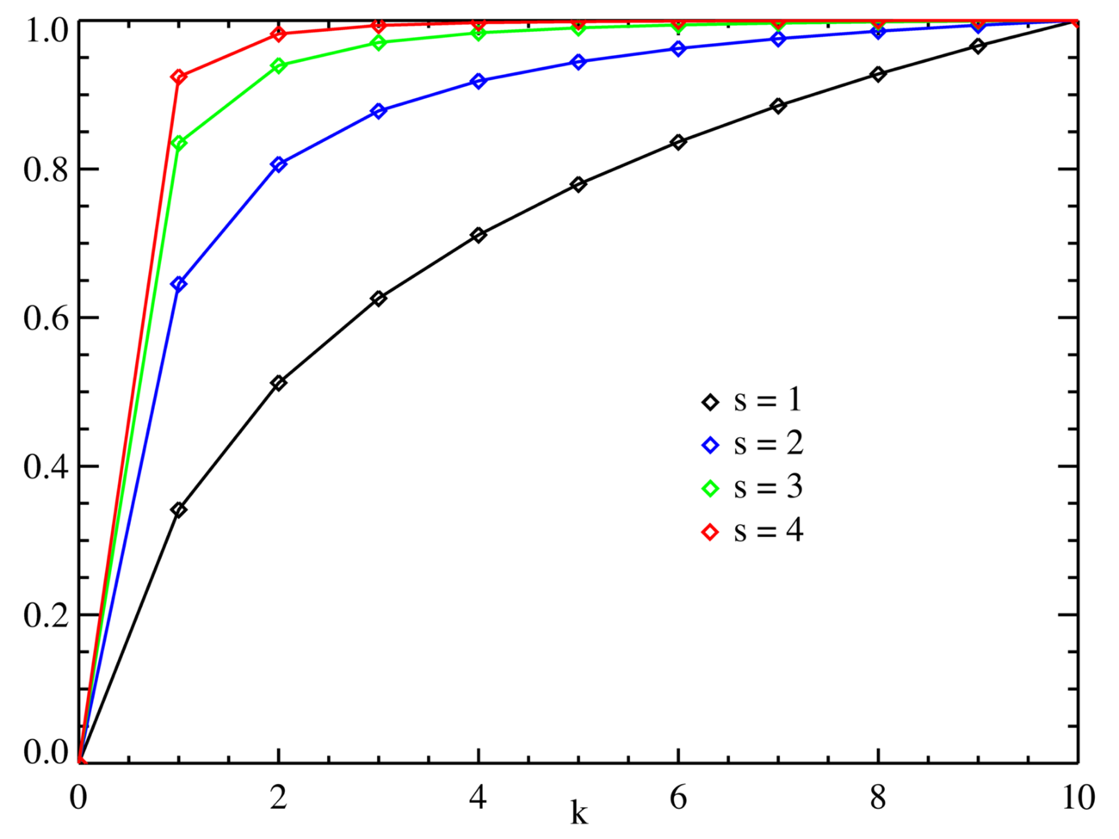
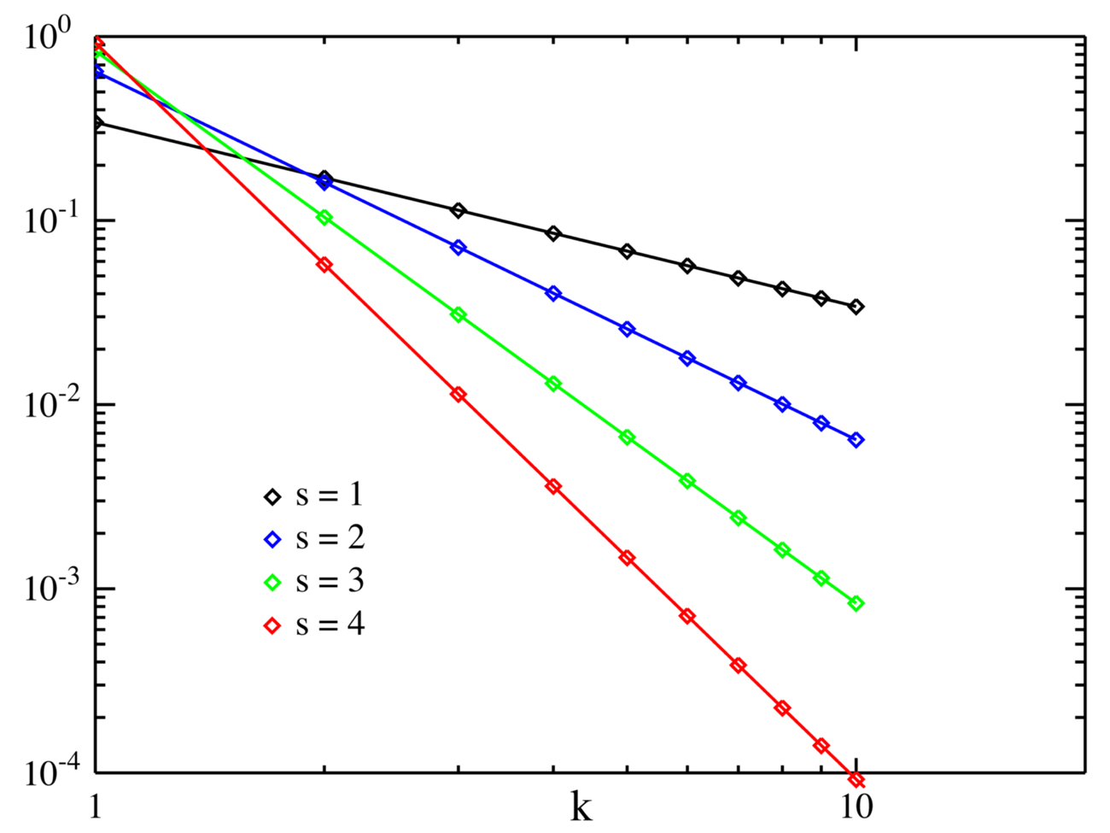
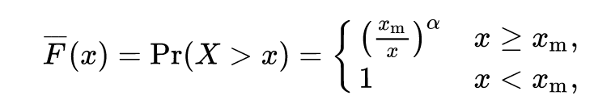
What is a power law distribution
Not one, but a whole family of highly skewed distributions that are usually a hallmark of emergent systems
Bottom plot is in log-log space

Slide 4
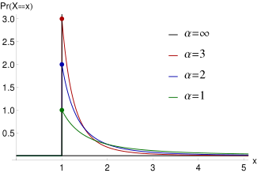
What’s this alpha

Slide 5
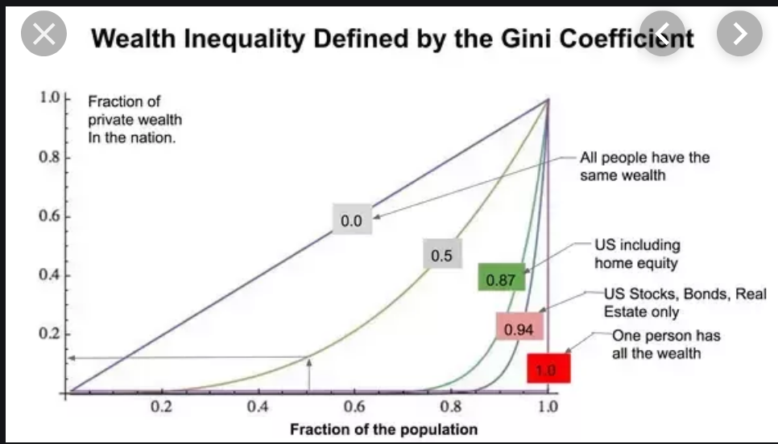
What’s so special about pareto?
Pareto distributions are everywhere – today we’ll look at economics

Slide 6
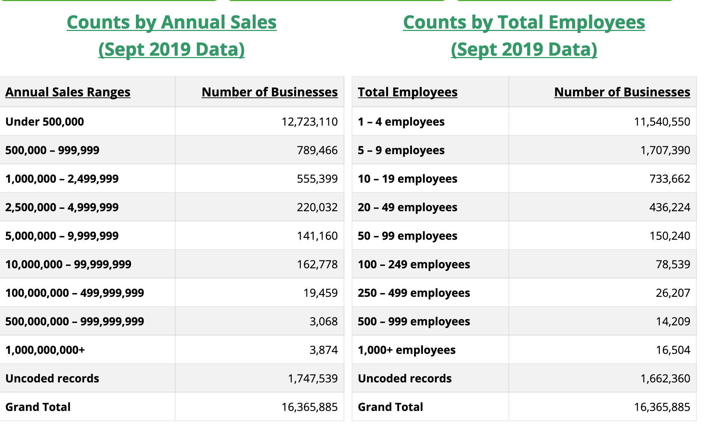
So what generates pareto, besides assholes?

Slide 7
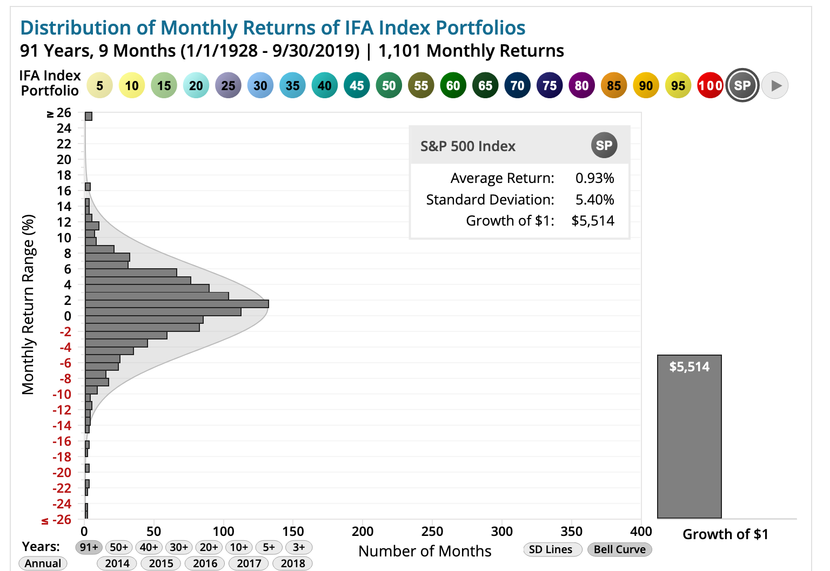
Investments gains / losses (S&P 500)

Slide 8
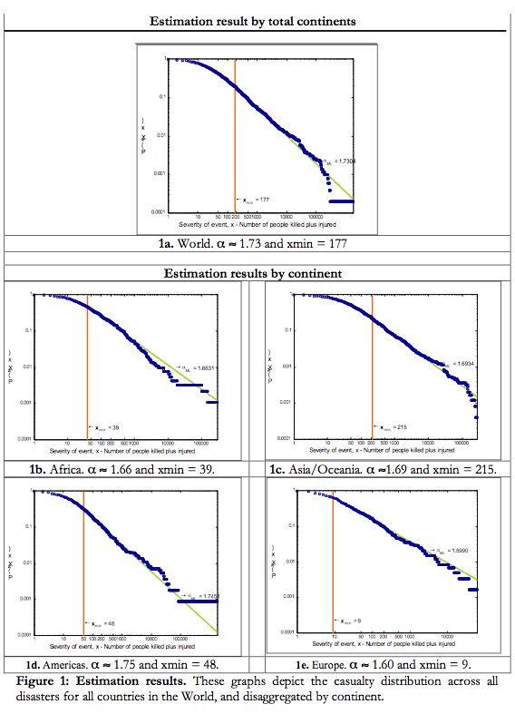
War casualties

Slide 9
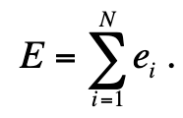

Let’s zero in on firms
What’s a firm?
Collection of people working together on a product / project
((( let’s not talk about firm agency quite yet )))
When people work together, they make something bigger than the sum of total work
Effort for the group:
Result for the group:

Slide 10
Did we forget something?
Yes we did
Coordination cost / management cost eats into the output
Coordination cost is also nonlinear (network)

Slide 11
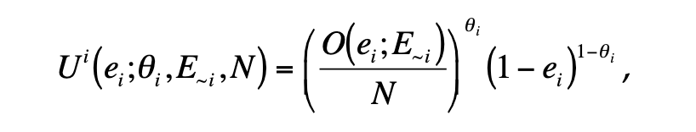
Individual utility
Production function for individual:
Every person has a preference for income vs. leisure
Income is divided equally between members of the firm
Leisure is time you spend not working

Slide 12
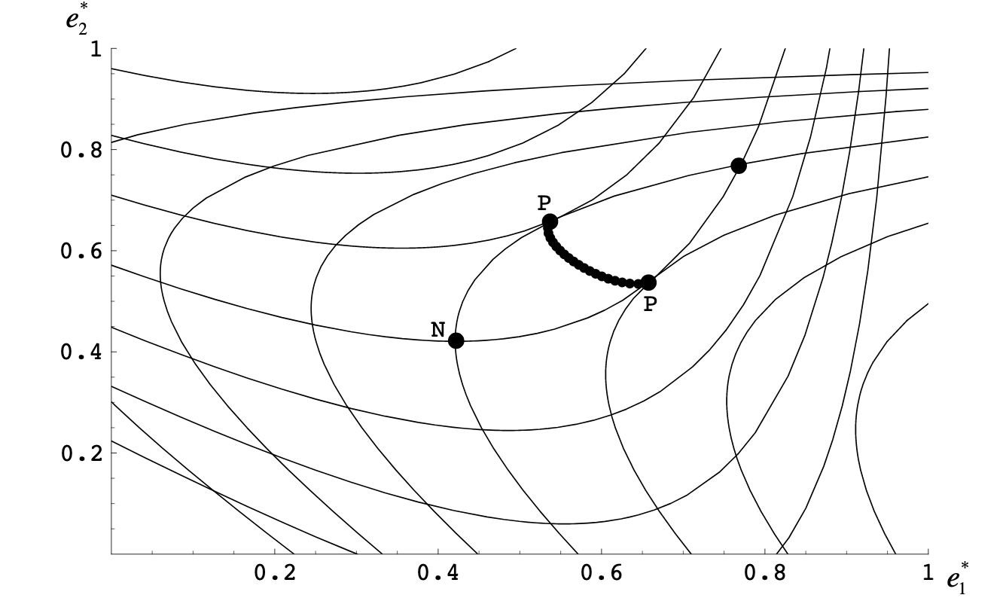
Agents are rational assholes
They maximize utility
If I’m working with you, I can work less and make you work more and still get the same money
Yes, I’m an asshole

Slide 13
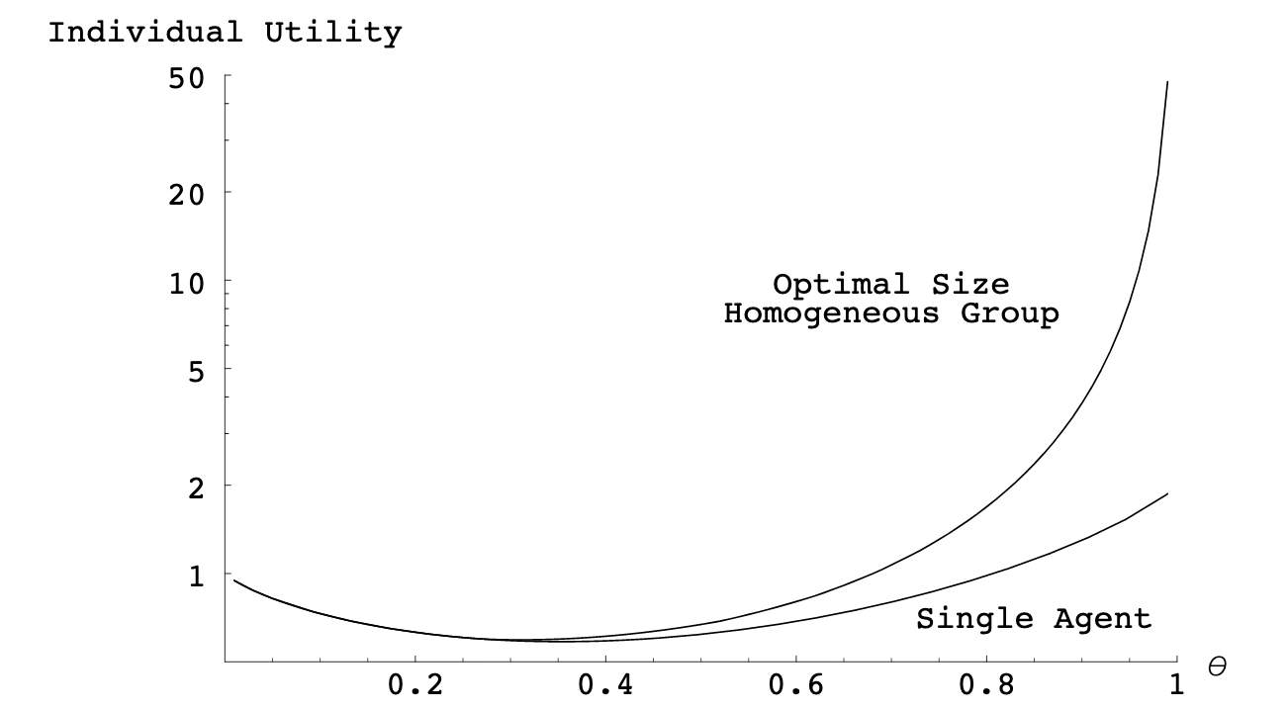

Slide 14
Now let the agents play
Each time…
Agent makes a decision to
Stay in his current job
Change jobs
Start a firm
Evaluates expected utility based on his preference for income vs. leisure
Takes most advantageous outcome

Slide 15
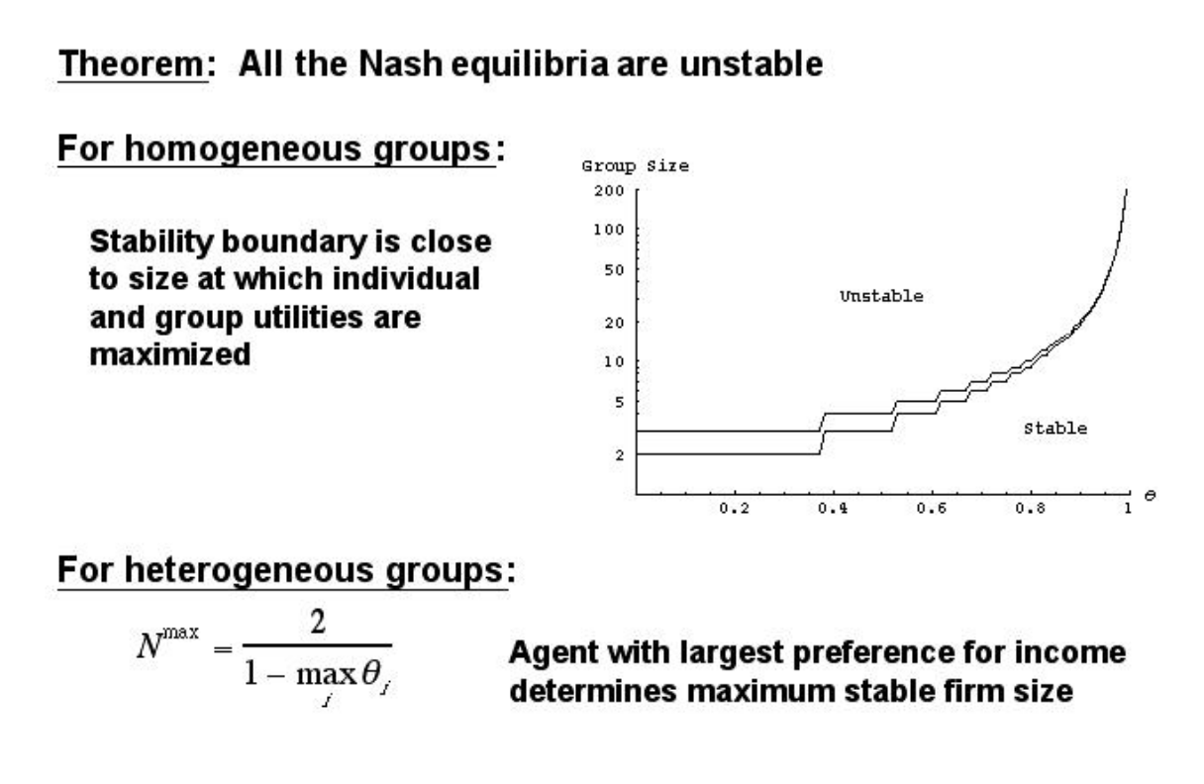

Slide 16
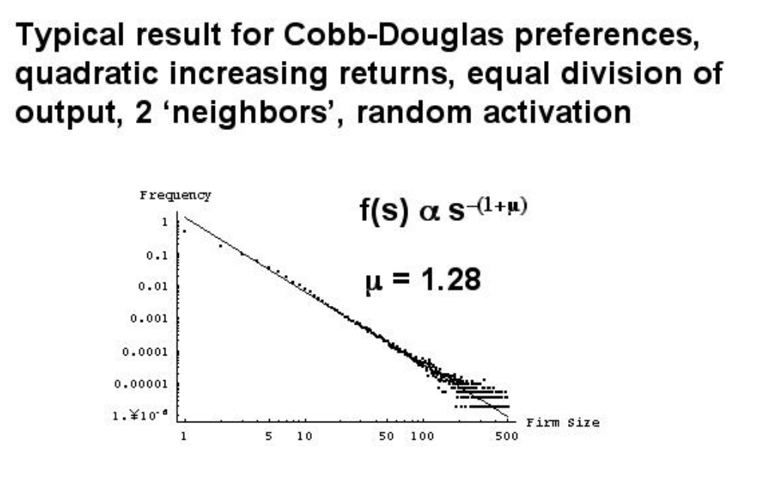

Slide 17
Emergence of free-riders
Tragedy of the commons?
What is free-riding behavior

Slide 18
Free-riders
If you have a high preference for leisure, do not start a business ☺
Instead, join a large firm with a lot of workaholics and show up as little as possible to not get fired
Effect of free-riders:
Workaholics get pissed off and leave
(first rat off a sinking ship goes home dry?)
Firm overall income declines
Eventually only lazy butts are left
Then they leave too because they want more money

Slide 19
