Slide 1
Models of Contagion and Violence

Slide 2
Simple Opinion Contagion – Noah Friedkin
Boundedly rational agents on a grid
Start with a random belief

Slide 3
Epstein Model of Violence
(not THAT Epstein)
Try to explain how civil unrest emerges from individual unhappiness and actions of the regime
Use ABM to explain the ”critical mass” phenomenon that frequently occurs in civil conflicts

Slide 4
Why do people act?
Over-simplified theory:
Hаrdship (H) – how unhappy are you (scaled 0 – 1)
Legitimacy (L) – how much do you trust the government?
Grievance (G) -- how unhappy are you with the government?
G = H*(1-L)
So – if you have a difficult life (H = 1) but trust your government unconditionally (L=1) you will not react; if you have an easy life (H ~ 0.1) but do not trust the government at all (L ~ 0.1) you may be susceptible

Slide 5

But do you actually rebel?
R = risk aversion (scaled 0-1) and fixed for life
P = probability of arrest
OK, need to unpack this:
C/A is the ratio of cops to ”active” agents
(C/A) is the ratio of cops to active agents in my range of vision
K is a constant
If there’s 10 cops and 100 people throwing rocks, you’re unlikely to be punished for throwing a rock, vs. 10 cops and 10 rebels
Net Risk N = R*P ==> my risk aversion times perceived risk

Slide 6
Bounded Rationality
I assess the consequences of my actions locally, within my field of vision
This can produce a “bandwagon effect”
Starts with rebels with a low risk aversion
If there’s enough rebels I can see, and not that many cops, I perceive a low risk and join in
Rebellion spread geographically
BROKEN WINDOW THEORY

Slide 7
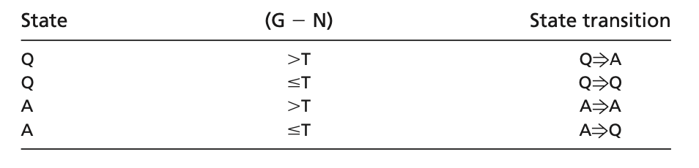
What is in agent’s head?
Agent state:
State Transitions?
If I’m so unhappy that I’m willing to take a risk, I will act
Quiet
Active

Slide 8
Cops
Can inspect agents in their neighborhood
Arrest a random active agent if found
Move to a random spot within your field of vision
Agents can see cops move around, cops can see agents
Agents spend time in jail if caught (”inactive”) but are not removed from the board

Slide 9
Agent State
Quiet
Active
In jail
Released

Slide 10
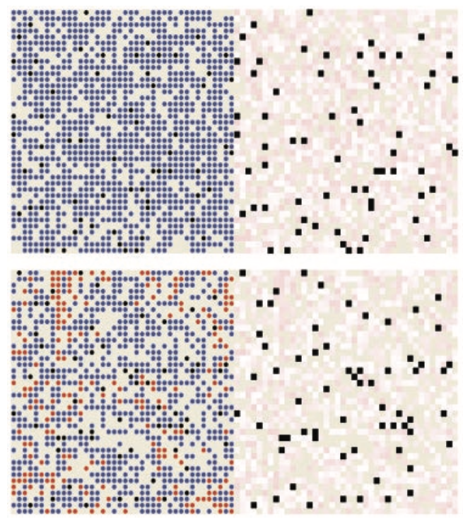
Local Outbursts

Slide 11
Emergent deceptive behavior
If I’m at the edge of rebellion, I will stay quiet if I can see cops
Mechanism:
I can see the cops; this alters my risk perception
If a cop comes nearby, it alters the Actives/Cops ratio
It moves my G-N above threshold, so I go “passive”

Slide 12
