Slide 1
Intro to Content Analysis

Slide 2
Content is difficult
Why?
Because people are inherently not very good communicators.
Things are always up for interpretation; hence the college English classes
People are not even good about discerning sentiment – only 85% agree on sentence being positive or negative.
Human languages are full of exceptions and uncertain rules.
Machines are simply too rule-based to fully make sense of it
That would require “hard AI” – something not even Google can do yet – although they’re pretty damn close. (see Ray Kurzweil’s “Singularity is near” – he’s now running a lab at Google)

Slide 3
So…
We must make human language more palatable for machines (and less interesting for humans)
Pre-processing is necessary.

Slide 4
Prerequisite…
Install TextBlob and NLTK
Pip install textblob
Pip install nltk
NLTK is big. There are entire books written about it. TextBlob is simpler and will suffice for most applications

Slide 5
Pre-processing #1 – Tokenizing
Token == a small unit of information (like a pixel in images); most likely tokens are words and sentences, sans puctuation.
from text.blob import TextBlob
text = “<<cut and paste some text here>>”
TT = TextBlob(text)
words = list(TT.words)
sentences = list(TT.sentences)

Slide 6
Pre-processing #2: Lemmatizing
A word lemma is a canonical form –
Lemma of “octopi” is “octopus”, etc
words = words.lemmatize()
Why do we need to do this? Bringing words into a canonical form lets us recognize them better; a computer does not need to keep track of every irregular verb, etc.
Downside: lemmatization is very language-dependent. TextBlob will not handle non-Enlgish text at all. Also, we lose some accuracy in process.

Slide 7
Pre-processing #3 - Stoplists
Stop-lists are lists of very common words that either carry little meaning by themselves (articles and prepositions) or are too frequently used and become “noise”
Stop-lists are language-specific, dialect-specific, and even source-specifict (Twitter and text-speak have their own stoplists)
I’m providing a useful one here

Slide 8
Applying Stoplist
from english_stopilist import stoplist
stopped_words=[w for w in words if w not in stoplist]

Slide 9
Bag-of-words
A lot of text classification does not require “hard AI” – we can do well just looking at word lists and word counts
Like this..
from collections import Counter
wordcount = Counter(stopped_words)

Slide 10
What can we do with Wordcounts?
Well… start with sentiment

Slide 11
Sentiment Mining, old-schoool
Start with a corpus of words that have sentiment orientation (bad/good):
“awesome” : +1
“horrible”: -1
“donut” : 0 (neutral)
Compute sentiment of a text by averaging all words in text

Slide 12
Sentiment with TextBlob
TT.sentiment
(0.10209790209790211, 0.4291375291375291)
The two numbers represent:
sentiment – between 1 and -1
subjectivity – between 1 and -1
The text in question looks mildly positive and highly subjective

Slide 13
…however…
This doesn’t quite work in the real world (not reliably, at least).
Human emotions are actually quite complex
….. Anyone surprised?

Slide 14
We do things like this:
“This restaurant would deserve highest praise if you were a cockroach” (a real Yelp review ;-)

Slide 15
We do things like this:
“This concert was f**ing awesome!”

Slide 16
We do things like this:
“My car just got rear-ended! F**ing awesome!”

Slide 17
To sum up…
Ambiguity is rampant
Context matters
Homonyms are everywhere
Neutral words become charged as discourse changes, charged words lose their meaning

Slide 18
More Sentiment Analysis
We can parse text using POS (parts-of-speech) identification
This helps with homonyms and some ambiguity

Slide 19
More Sentiment Analysis
Create rules with amplifier words and inverter words:
“This concert (np) was (v) f**ing (AMP) awesome (+1) = +2
“But the opening act (np) was (v) not (INV) great (+1) = -1
“My car (np) got (v) rear-ended (v)! F**ing (AMP) awesome (+1) = +2??

Slide 20
To do this properly…
Valence (good vs. bad)
Relevance (me vs. others)
Immediacy (now/later)
Certainty (definitely/maybe)
…. And about 9 more less-significant dimensions
Samsonovich A., Ascoli G.: Cognitive map dimensions of the human value system extracted from the natural language. In Goertzel B. (Ed.): Advances in Artificial General Intelligence (Proc. 2006 AGIRI Workshop), IOS Press, pp. 111-124 (2007).

Slide 21
Why do we not do it properly?
Sentiment analysis corpora is sourced from places where people express their opinions – movie reviews, restaurant reviews, etc.
While we can ask them a battery of questions about every movie, it is hard to create a reliable corpus of text across 4 dimensions
(heck, 1 dimension is hard enough)

Slide 22
I proposed…
… to do away with the corpora in their entirety.

Slide 23
Hypothesis
Support for a political candidate, party, brand, country, etc. can be detected by observing indirect indicators of sentiment in text
This indicator is that of mirroring -- adopting language and mannerisms of these you identify with.
E.g. use of the word “Obamacare” was a sure telltale of the speaker being Republican
… Until 2012 Obama campaign hijacked the word and started using it in their own campaign ads and diffused the emotional charge

Slide 24
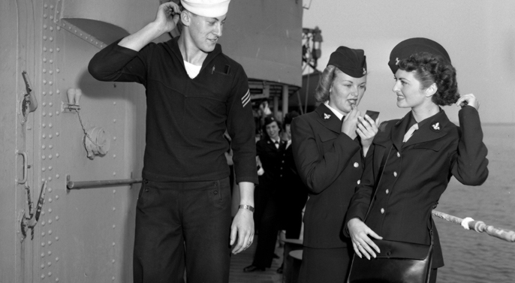
Mirroring – unconscious copying of words or body language
Fay, W. H.; Coleman, R. O. (1977). "A human sound transducer/reproducer: Temporal capabilities of a profoundly echolalic child". Brain and language 4 (3): 396–402

Slide 25
Marker words
All speakers have some words and expressions in common (e.g. conservative, liberal, party designation, etc)
However, everyone has a set of trademark words and expressions that make him unique.

Slide 26
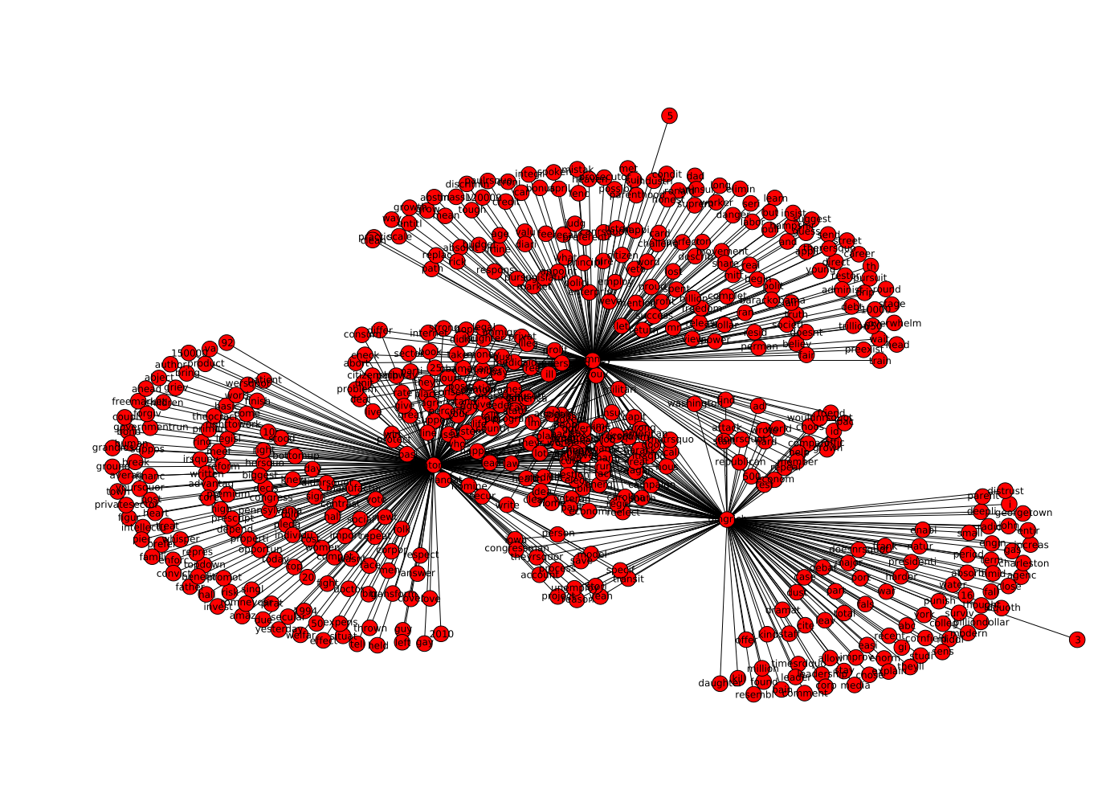
GOP Presidential Candidates
Marker words specific
To a candidate
Identifier words common
To all candidates
e.g. American People
Middle class, etc

Slide 27
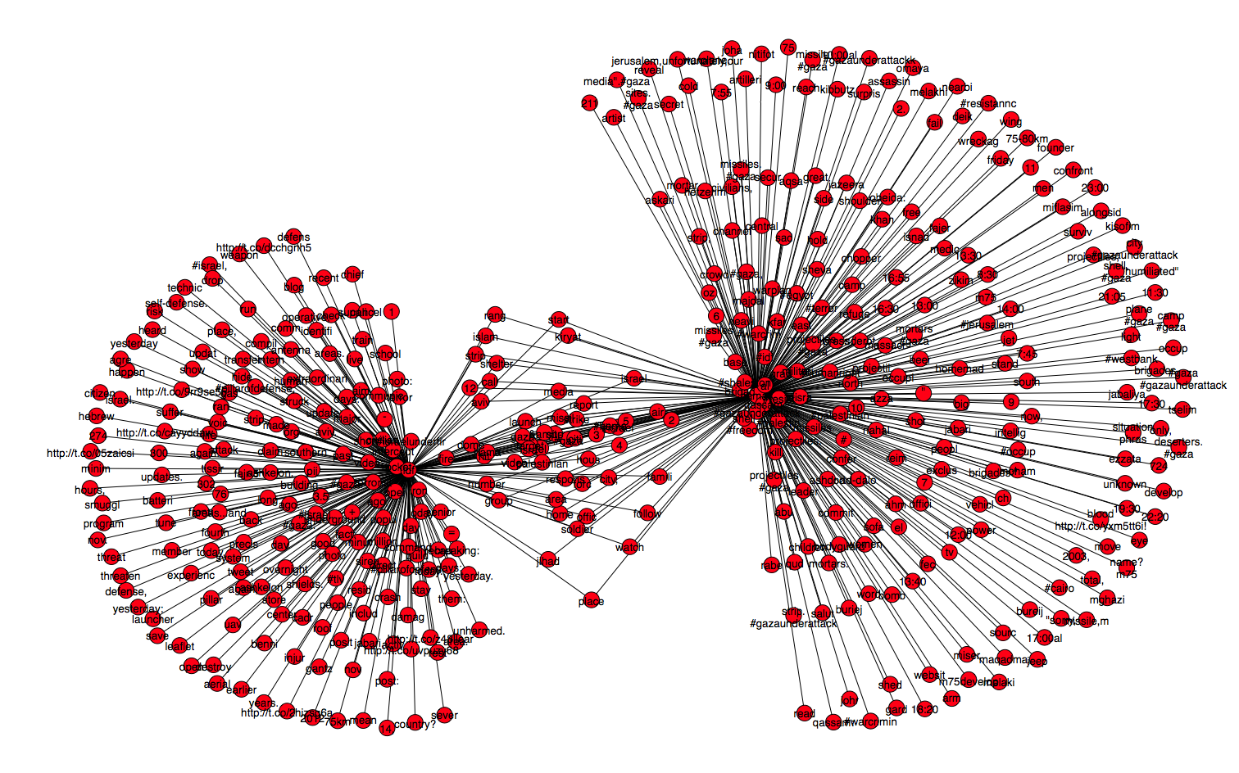
Israel vs. Hamas on Twitter
Israel and Hamas share
Absolutely nothing
Linguistically except place names

Slide 28
Observing Mirroring
We detect marker words and expressions in social media speech and compute sentiment by observing and counting mirrored phrases

Slide 29
Data harvest
Get Twitter feeds for:
@IDFSpokesperson
@AlQuassam
Twitter feeds for CNN, BBC, CNBC, NPR, Al-Jazeera, FOX News – all filtered to only include articles on Israel and Gaza
(more text == more reliable results)

Slide 30
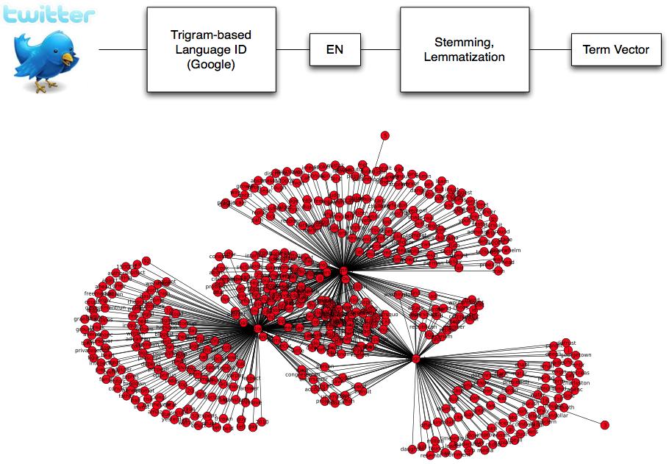
Fast Computational Linguistics

Slide 31
Text Cleaning
Tweet text is dirty
(RT, VIA, #this and @that, ROFL, etc)
Use a stoplist to produce a stripped-down tweet
import string
stoplist_str="""
a
a's
able
About
...
...
z
zero
rt
via
"""
stoplist=[w.strip() for w in stoplist_str.split('\n') if w !='']

Slide 32
Language ID
Language identification is pretty easy…
Every language has a characteristic distribution of tri-grams (3-letter sequences);
E.g. English is heavy on “the” trigram
Use open-source library “guess-language”

Slide 33
Stemming
Stemming identifies root of a word, stripping away:
Suffixes, prefixes, verb tense, etc
“stemmer”, “stemming”, “stemmed” ->> “stem”
“go”,”going”,”gone” ->> “go”

Slide 34
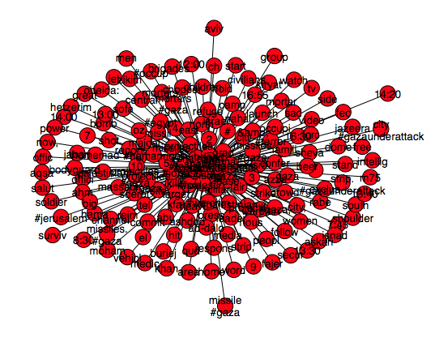
Term Networks
Output of the cleaning step is a term vector
Union of term vectors is a term network
2-mode network linking speakers with bigrams
2-mode network linking locations with bigrams
Edge weight = number of occurrences of edge bigram/location or candidate/location

Slide 35
Build a larger net
Periodically purge single co-occurrences
Edge weights are power-law distributed
Single co-occurrences account for ~ 90% of data
Periodically discount and purge old co-occurrences
Discourse changes, data should reflect it.

Slide 36
Israel vs. Hamas on Twitter

Slide 37
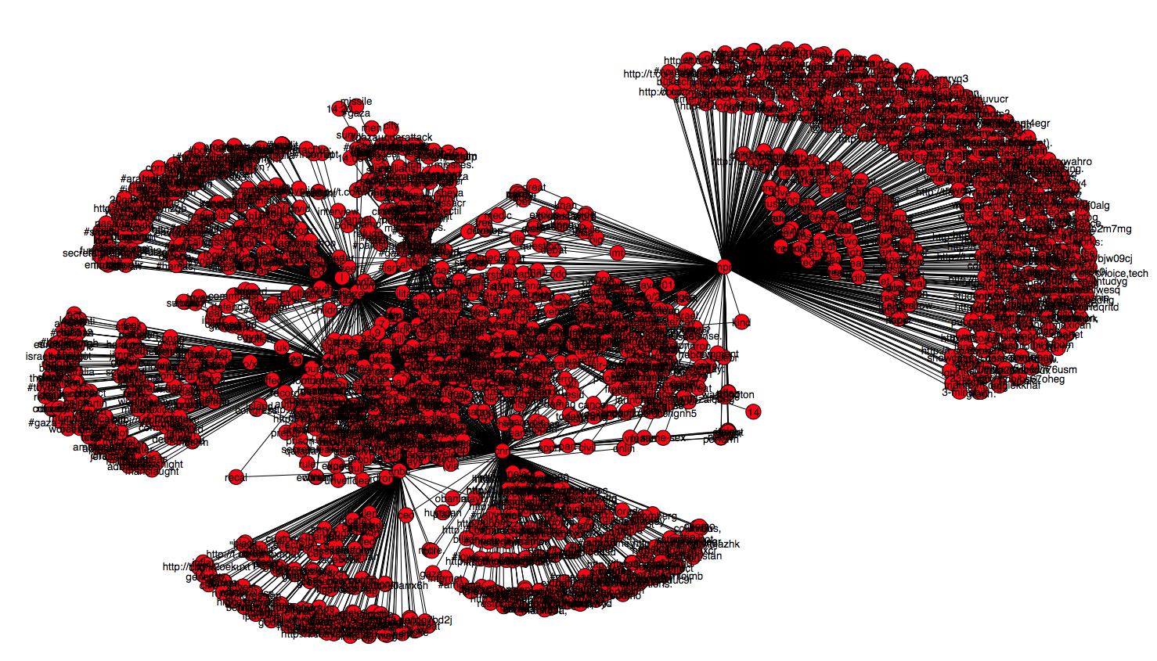
Israel, Hamas and Media

Slide 38
Metrics computation
Extract ego-networks for IDF and HAMAS
Extract ego-networks for media organizations
Compute hamming distance H(c,l)
Cardinality of an intersection set between two networks
Or… how much does CNN mirror Hamas? What about FOX?
Normalize to percentage of support

Slide 39
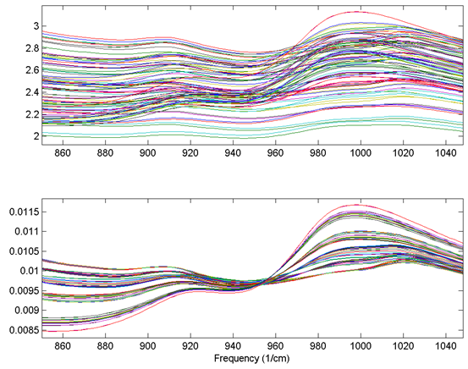
Aggregate & Normalize
Aggregate speech differences and similarities by media source
Normalize values

Slide 40
Media Sources, Hamas and IDF

Slide 41
Ron Paul, Romney, Gingrich, Santorum March 2012 (based on Twitter Support)

Slide 42
Affinity Graph An implied network of “X mirrors Y” Weighted Graph, weight == amount of mirroring

Slide 43
This was a fun toy…
So I released it as a Python library, called Snowwhite
Why Snowwhite… it’s about mirrors… on the wall? ;)
Install snowwhite
Pip install snowhite

Slide 44
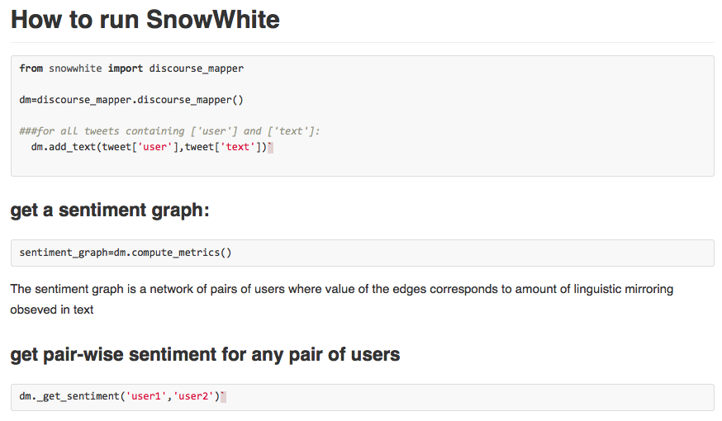

Slide 45
Get the Code
https://www.github.com/maksim2042/snowwhite
A Python library
Implements implicit sentiment analysis
Extension of NetworkX

Slide 46
Text Classification
Follow tutorial in “Teaching a computer to read”
Code is provided in NLP-Tutorial page

Slide 47
Homework
Can you use this method to classify political tweets, and then compute sentiment towards and against Democrats and Republicans?
Putting it all together
Geocode the tweets that made it past the classifier
Create a retweet network, cluster it using community detection
Does positive and negative sentiment coexist inside the same cluster or do people of opposite views hang out with people similar to themselves only?

