Slide 1
For your viewing pleasur e…
Network visualization: more then pretty pictures

Slide 2
Visualization is Hard
Goal:
  Present maximum amount of information in a cognitively accessible form

Slide 3
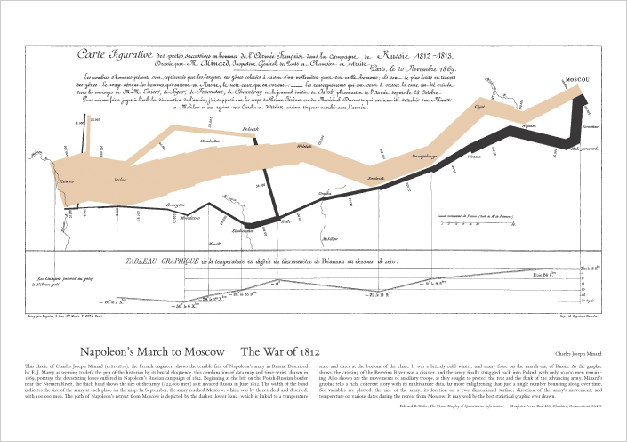
The Holy Grail

Slide 4
Visualizing networks
Clearly show:
  Components
  Density
  Cohesive subgroups
  Recognizable patterns
    (hierarchy, core-periphery, small world)
  Structural roles
  Similarities/Differences
    Visual distance/connectedness should correspond to these in data

Slide 5
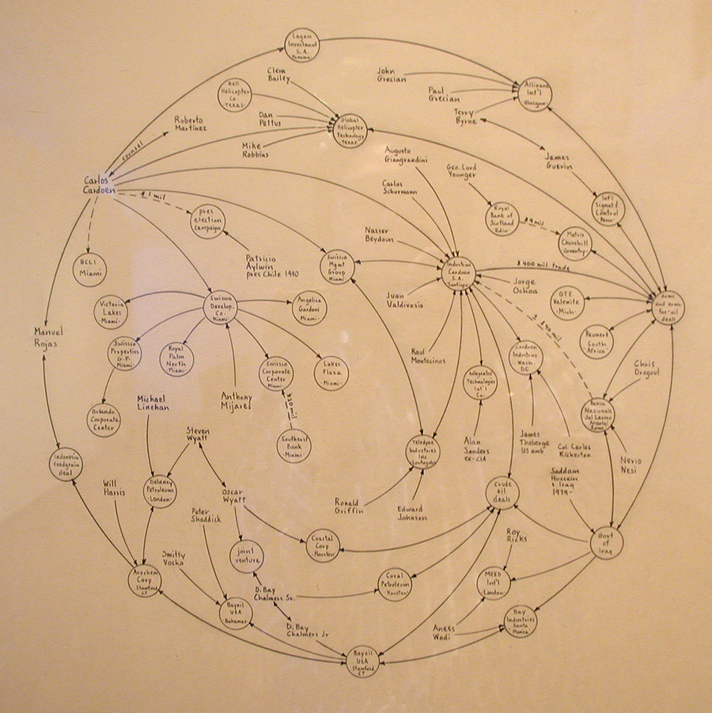
Lombardi

Slide 6
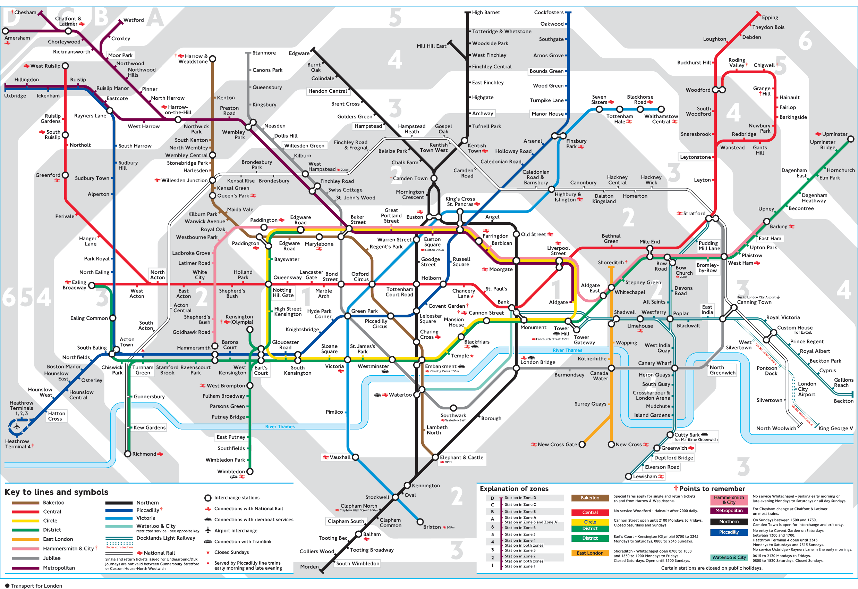
London Tube

Slide 7
What’s in common?
Lombardi networks and London Tube are both fairly complex graphs
What makes these visualizations successful?

Slide 8
Why?
Clean layout
Common visual elements
  Parallel lines (Tube)
  Circle arcs (Lombardi)
  Makes for an “orderly” display
Consistent markup
  Major, minor and transfer stations (Tube)
  Relative importance of people (Lombardi)

Slide 9
Visualizing with computers
Problem:
  Produce the most readable layout (in least possible time)
Further problem
  How do you quantify “readable” or “aesthetically pleasing”?
  Most real graphs are not planar
    Cannot be laid out on a plane without intersecting lines

Slide 10
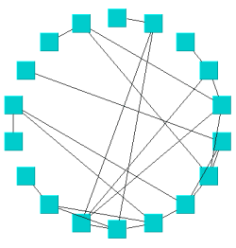
History - Circle Layout

Slide 11
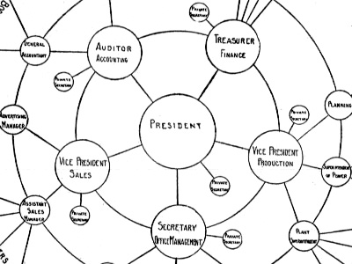
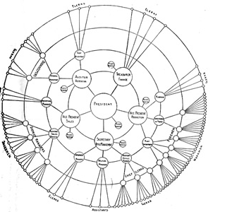

Slide 12
Multi-Dimensional Scaling
CONCOR and Hi-clustering are discrete models
  Partition nodes into exhaustive non-overlapping subsets
  World is not so black-n-white
The purpose of multidimensional scaling (MDS) is to provide a spatial representation of the pattern of similarities
  More similar nodes will appear closer together
Finds non-intuitive equivalences in networks

Slide 13
Input to MDS
Measure of pairwise similarity among nodes
  Attribute-based
  Euclidean distances
  Graph distances
  CONCOR similarities
Output:
  A set of coordinates in 2D or 3D space such that
    Similar nodes are closer together then dissimilar nodes

Slide 14
Algorithm
MDS finds a set of vectors in p-dimensional space such that the matrix of euclidean distances among them corresponds as closely as possible to a function of the input matrix according to a fitness function called stress.
1. Assign points to arbitrary coordinates in p-dimensional space.
2. Compute euclidean distances among all pairs of points, to form the D’ matrix.
3. Compare the D’ matrix with the input D matrix by evaluating the stress function. The smaller the value, the greater the correspondance between the two.
4. Adjust coordinates of each point in the direction of the stress vector
5. Repeat steps 2 through 4 until stress won't get any lower

Slide 17
Interpretation of MDS Map
Axes are meaningless
  We are looking at cohesiveness and proximity of clusters, not their locations
  Infinite number of possible permutations
If stress > 0 , there is distortion
  Larger distances less distorted then smaller

Slide 18
What to look for
Clusters
  groups of items that are closer to each other than to other items.
  When really tight, highly separated clusters occur in perceptual data, it may suggest that each cluster is a domain or subdomain which should be analyzed individually.
  Extract clusters and re-run MDS on them for further separation

Slide 19
What to look for…
Dimensions
  Item attributes that seem to order the items in the map along a continuum.
    For example, an MDS of perceived similarities among breeds of dogs may show a distinct ordering of dogs by size.
    At the same time, an independent ordering of dogs according to viciousness might be observed.
    Orderings may not follow the axes or be orthogonal to each other
  The underlying dimensions are thought to "explain" the perceived similarity between items.
  May “discover” non-obvious continuums

Slide 20
Stress function
The degree of correspondence between the distances among points on MDS map and the matrix input
d_{ij} = euclidean distance, across all dimensions, between points i and j on the map,
f(x_{ij}) is some function of the input data,
scale = a constant scaling factor, used to keep stress values between 0 and 1.
When the MDS map perfectly reproduces the input data,
  f(x_{ij}) = d_{ij} is for all i and j, so stress is zero.
  Thus, the smaller the stress, the better the representation.

Slide 21
Non-zero stress
Caused by measurement error or insufficient dimensionality
  Stress levels of
    < 0.15 = acceptable
    < 0.1 = excellent
Any MDS map with stress > 0 is distorted

Slide 22
Dimensionality
Normally, MDS is used in 2D space for optimal visual impact
  May be a very poor, highly distorted, representation of your data.
  High stress value.
  Increase the number of dimensions.

Slide 23

Increasing dimensionality
As number of dimensions increases, stress decreases:

Slide 24
High-dimensionality MDS
Difficult to interpret visually, need a mathematical technique
Feed MDS coordinates into another discriminator function
  May be easier to tease apart then original attribute vectors

Slide 25
Spring Embedding
Linked nodes attract
F_{att}
F_{att}
n
n’ = “ideal length”
k=spring constant
Force acting on nodes
F_{att}=k*(n-n’)

Slide 26
Spring Embedding
Non-Linked Nodes Repel
n=current distance
F_{rep}
F_{rep}
n’=ideal distance
k=spring constant
Force acting on nodes
F_{rep}=-k*(n-n’ if n>n’, 0 otherwise)

Slide 27
Spring Embedding
B
C
F_{att}
A
F_{rep}
F_{total}(a)=Vector Sum of all forces on A
Total Stress = Sum(all nodes)(|n-n’|)

Slide 28
Spring Embedding Algorithm
Repeat…
  For n₁ in (all nodes)
    For n₂ in (all nodes)
      If n₁ is connected to n₂
        Compute attractive force
      If n₁ is not connected to n₂
        Compute repulsive force
    End for
    Compute vector sum of all forces
    Compute motion of the node in 1 time step (acceleration = F/m)
  End iteration
Until overall stress is low

Slide 29
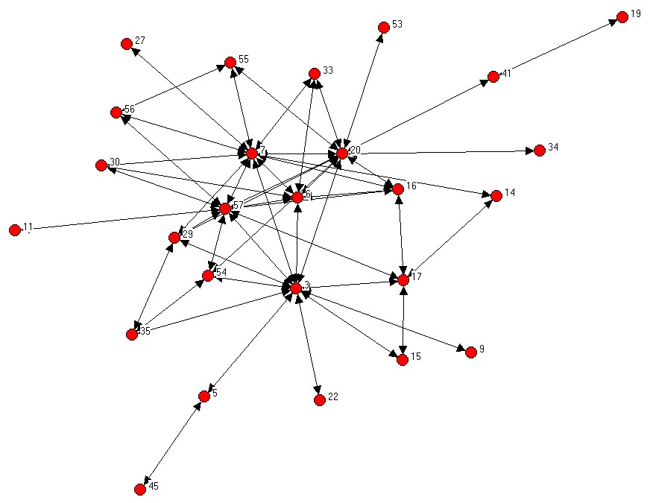
Demo

Slide 30
Problems…
Does not scale up to larger graphs
Cannot minimize line crossings
Shows core-periphery but does not show hierarchies
Produces fuzzballs

Slide 31
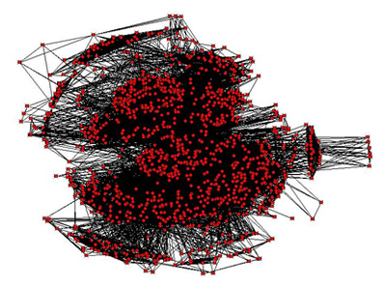

Slide 32
Can we do better?
Better force-directed methods
  Node mass related to centrality?
  Friction?
  Fruchterman-Reingold method
  Kamada-Kawaii method
    (in general… good physics gets better layouts)
  Use brightness to highlight or fade nodes

Slide 33
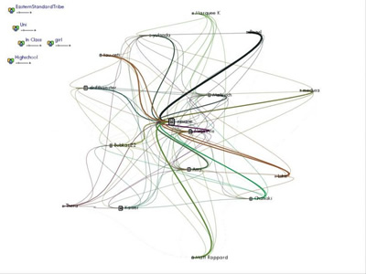
Curved links can help

Slide 34
Rich data
Make important things stand out
Manipulate:
  Node size, shape, color
  Edge color, thickness, curvature
Make un-important things disappear
  Don’t highlight attributes that are not useful
  Make periphery dimmer then core

Slide 35
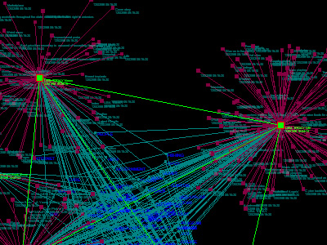

Slide 36
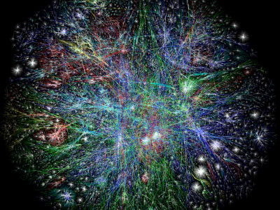
Make things zoomable

Slide 37
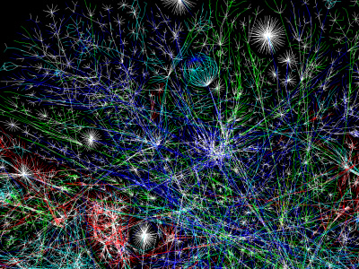

Slide 38
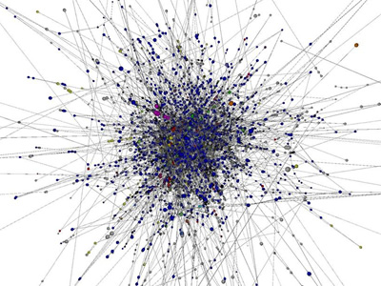
3D Layouts

Slide 39
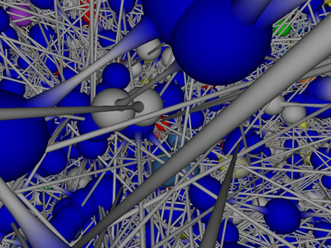

Slide 40
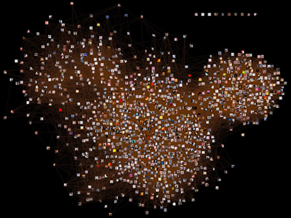
Volume Rendering

Slide 41
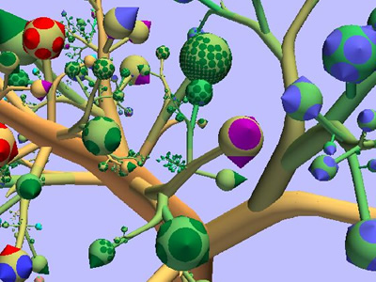
Networks as Fruits

Slide 42
3D not a panacea
3D layouts are actually harder to understand then good 2D layouts
Best layouts are still made by humans
Volume rendering (e.g. clouds) may be useful for very large networks

Slide 43
This was just a taste…
Graph drawing is a big and complex area
  www.graphdrawing.org
  www.touchgraph.org
  www.visualcomplexity.com
  www.insna.org

Slide 44
So… this is it!
Next week:
Guest lecture by Rob Axtell
(same time, same place)

Slide 45
Final Presentations
Monday, December 11
4:30 pm
Research 1, Rm. 163

