Slide 1
Centrality in Social Networks
Lecture 3

Slide 2
Background
At the individual level, one dimension of position in the network can be captured through centrality.
Conceptually, centrality is fairly straight forward: we want to identify which nodes are in the ‘center’ of the network. In practice, identifying exactly what we mean by ‘center’ is somewhat complicated.

Slide 3
Methods
Approaches:
    Degree
    Closeness
    Betweenness
    PageRank
Graph Level measures: Centralization

Slide 4
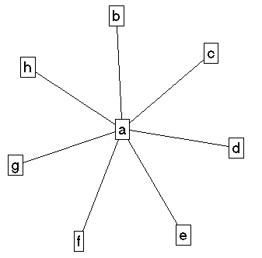
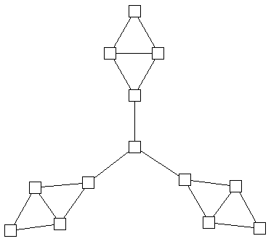
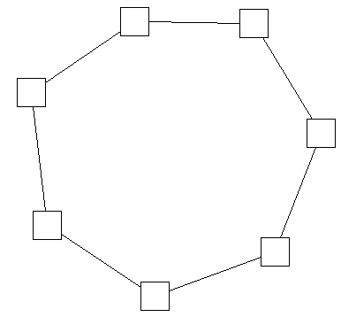
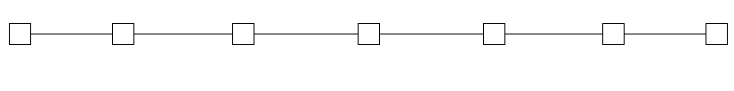
Centrality in Social Networks
Intuitively, we want a method that allows us to distinguish “important” actors. Consider the following graphs:

Slide 5
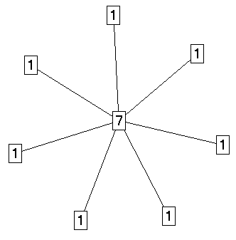
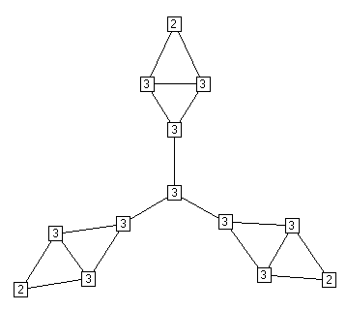
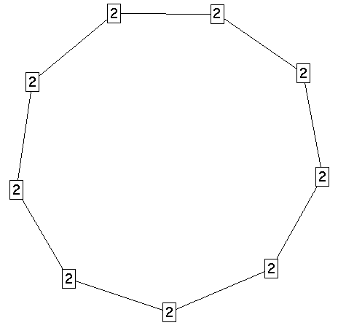

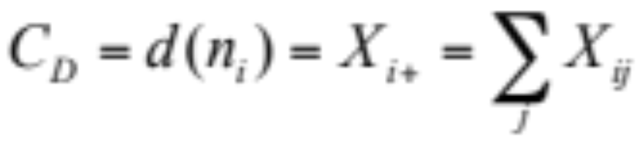
Centrality in Social Networks
Degree
The most intuitive notion of centrality focuses on degree: The actor with the most ties is the most important:

Slide 6
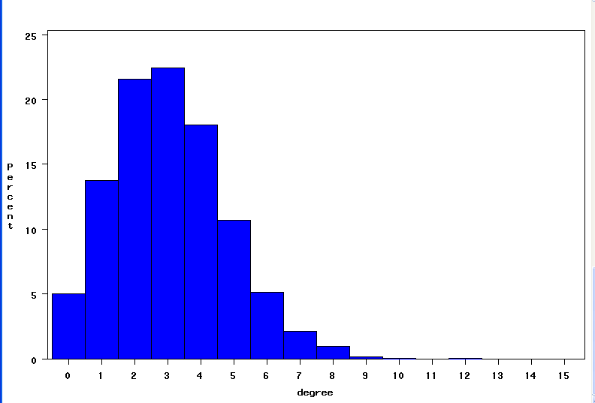
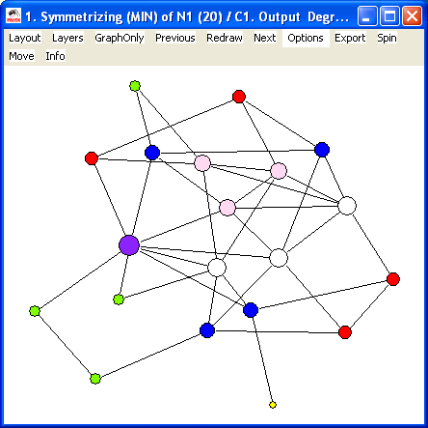
Degree Distribution
In a simple random graph (Gn,p), degree will have a Poisson distribution, and the nodes with high degree are likely to be at the intuitive center. Deviations from a Poisson distribution suggest non-random processes, which is at the heart of current “scale-free” work on networks (see below).

Slide 7
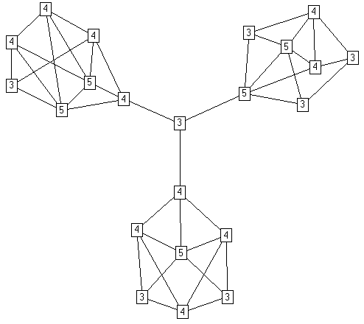
Degree is a local measure

Slide 8
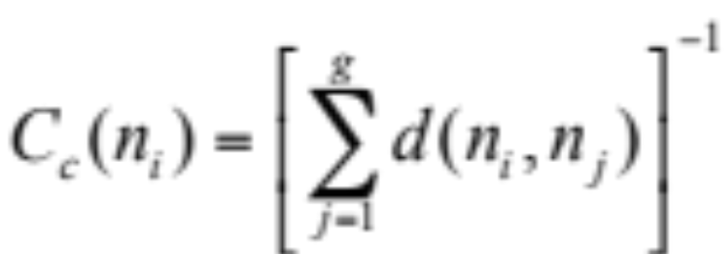
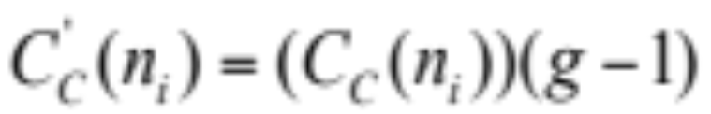
Closeness Centrality
An actor is considered important if he/she is relatively close to all other actors.
Closeness is based on the inverse of the distance of each actor to every other actor in the network.
Closeness Centrality:
Normalized Closeness Centrality

Slide 9
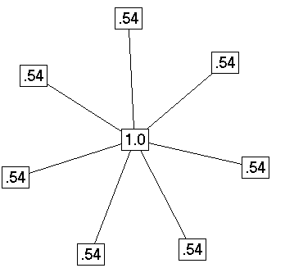
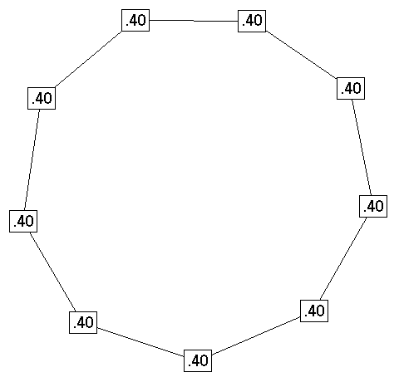
Closeness Centrality in the examples
Distance Closeness normalized
0 1 1 1 1 1 1 1 .143 1.00
1 0 2 2 2 2 2 2 .077 .538
1 2 0 2 2 2 2 2 .077 .538
1 2 2 0 2 2 2 2 .077 .538
1 2 2 2 0 2 2 2 .077 .538
1 2 2 2 2 0 2 2 .077 .538
1 2 2 2 2 2 0 2 .077 .538
1 2 2 2 2 2 2 0 .077 .538
Distance Closeness normalized
0 1 2 3 4 4 3 2 1 .050 .400
1 0 1 2 3 4 4 3 2 .050 .400
2 1 0 1 2 3 4 4 3 .050 .400
3 2 1 0 1 2 3 4 4 .050 .400
4 3 2 1 0 1 2 3 4 .050 .400
4 4 3 2 1 0 1 2 3 .050 .400
3 4 4 3 2 1 0 1 2 .050 .400
2 3 4 4 3 2 1 0 1 .050 .400
1 2 3 4 4 3 2 1 0 .050 .400

Slide 10
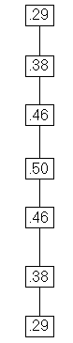
Examples, cont.
Distance Closeness normalized
0 1 2 3 4 5 6 .048 .286
1 0 1 2 3 4 5 .063 .375
2 1 0 1 2 3 4 .077 .462
3 2 1 0 1 2 3 .083 .500
4 3 2 1 0 1 2 .077 .462
5 4 3 2 1 0 1 .063 .375
6 5 4 3 2 1 0 .048 .286

Slide 11
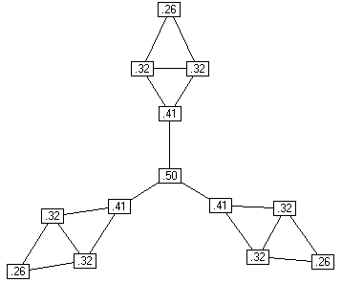
Examples, cont.
Distance Closeness normalized
0 1 1 2 3 4 4 5 5 6 5 5 6 .021 .255
1 0 1 1 2 3 3 4 4 5 4 4 5 .027 .324
1 1 0 1 2 3 3 4 4 5 4 4 5 .027 .324
2 1 1 0 1 2 2 3 3 4 3 3 4 .034 .414
3 2 2 1 0 1 1 2 2 3 2 2 3 .042 .500
4 3 3 2 1 0 2 3 3 4 1 1 2 .034 .414
4 3 3 2 1 2 0 1 1 2 3 3 4 .034 .414
5 4 4 3 2 3 1 0 1 1 4 4 5 .027 .324
5 4 4 3 2 3 1 1 0 1 4 4 5 .027 .324
6 5 5 4 3 4 2 1 1 0 5 5 6 .021 .255
5 4 4 3 2 1 3 4 4 5 0 1 1 .027 .324
5 4 4 3 2 1 3 4 4 5 1 0 1 .027 .324
6 5 5 4 3 2 4 5 5 6 1 1 0 .021 .255

Slide 12
Betweenness
Betweenness Centrality:
Model based on communication flow: A person who lies on communication paths can control communication flow, and is thus important. Betweenness centrality counts the number of shortest paths between i and k that actor j resides on.
b
a
C d e f g h

Slide 13
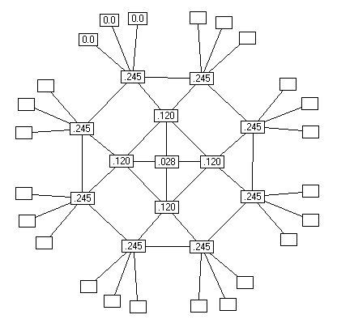
Examples, cont.
Betweenness Centrality:
Centralization: .183

Slide 14
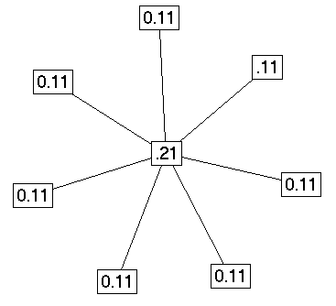
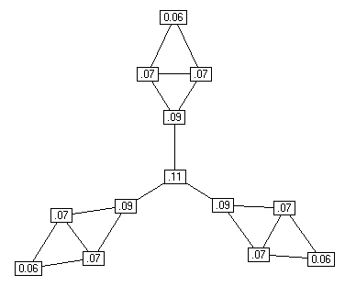
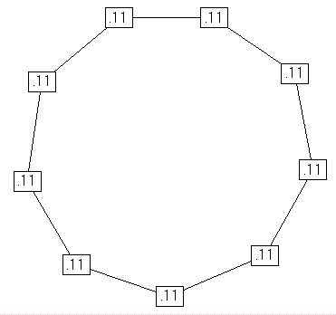
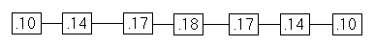
Information Centrality
It is quite likely that information can flow through paths other than the geodesic. The Information Centrality score uses all paths in the network, and weights them based on their length.

Slide 15
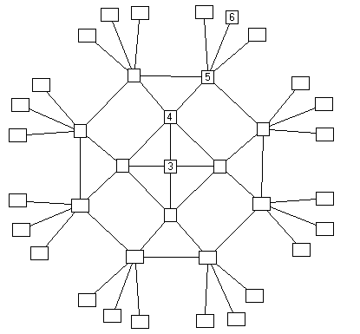
Graph Theoretic Center
Graph Theoretic Center (Barry or Jordan Center). Identify the point(s) with the smallest, maximum distance to all other points.
Value = longest distance to any other node.
The graph theoretic center is ‘3’, but you might also consider a continuous measure as the inverse of the maximum geodesic

Slide 16
Comparison
Comparing across these 3 centrality values
  Generally, the 3 centrality types will be positively correlated
  When they are not (low) correlated, it probably tells you something interesting about the network.
Low
Degree
Low
Closeness
Low
Betweenness
High Degree
Embedded in cluster that is far from the rest of the network
Ego's connections are redundant - communication bypasses him/her
High Closeness
Key player tied to important important/active alters
Probably multiple paths in the network, ego is near many people, but so are many others
High Betweenness
Ego's few ties are crucial for network flow
Very rare cell. Would mean that ego monopolizes the ties from a small number of people to many others.

