Slide 1
How Networks Shape Attitudes and Attitudes Shape Networks
Diffusion and Contagion

Slide 2
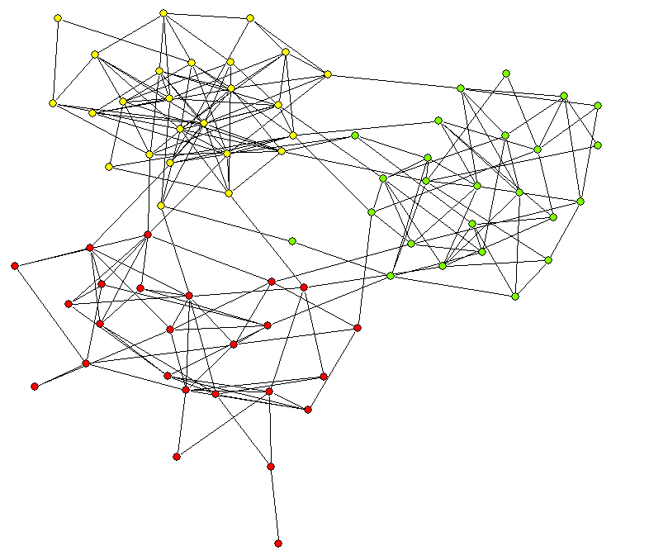
InGroup – OutGroup

Slide 3
Contagion and Diffusion
We choose our friends, and our friends choose us
We learn from them, they learn from us
  Thus…
Formation of networks and formation of attitudes are inextricably linked

Slide 4
Cont…
We shall observe two processes that shape dynamic networks:
Social contagion = diffusion of attributes shaped by network structure
Formation of homophily groups = network structure shaped by attributes

Slide 5
Friedkin Contagion Model
Peer influence models assume that individuals’ opinions are formed in a process of interpersonal negotiation and adjustment of opinions.
Can result in either consensus or disagreement
Looks at interaction among a system of actors
Assumption that a network is static, but individuals change

Slide 6
Basic Peer Influence Model
Attitudes are a function of two sources:
a) Individual characteristics
      Gender, Age, Race, Education, Etc. Standard sociology
b) Interpersonal influences
      Actors negotiate opinions with others

Slide 7
Influenfce Model in English
Every agents’ beliefs are affected by the beliefs of agents he is connected to
At time t+1
  Ego belief= weight *Ego belief at time t +
    Sum(weight * belief of alter)
    For all alters connected to ego

Slide 8
Basic Peer Influence Model
Simple example
1
2
1 2 3 4
1 .33 .33 .33 0
2 .33 .33 .33 0
3 .25 .25 .25 .25
4 0 0 .50 .50
Y
1
3
5
7
3
α = .8
4
T: 0 1 2 3 4 5 6 7
1.00 2.60 2.81 2.93 2.98 3.00 3.01 3.01
3.00 3.00 3.21 3.33 3.38 3.40 3.41 3.41
5.00 4.20 4.20 4.16 4.14 4.14 4.13 4.13
7.00 6.20 5.56 5.30 5.18 5.13 5.11 5.10

Slide 9
Basic Peer Influence Model
Simple example
1
2
1 2 3 4
1 .33 .33 .33 0
2 .33 .33 .33 0
3 .25 .25 .25 .25
4 0 0 .50 .50
Y
1
3
5
7
3
α = 1.0
4
T: 0 1 2 3 4 5 6 7
1.00 3.00 3.33 3.56 3.68 3.74 3.78 3.81
3.00 3.00 3.33 3.56 3.68 3.74 3.78 3.81
5.00 4.00 4.00 3.92 3.88 3.86 3.85 3.84
7.00 6.00 5.00 4.50 4.21 4.05 3.95 3.90

Slide 10
Basic Peer Influence Model
Extended example: building intuition
Consider a network with three cohesive groups, and an initially random distribution of opinions:
(to run this model, use peerinfl1.sas)

Slide 11
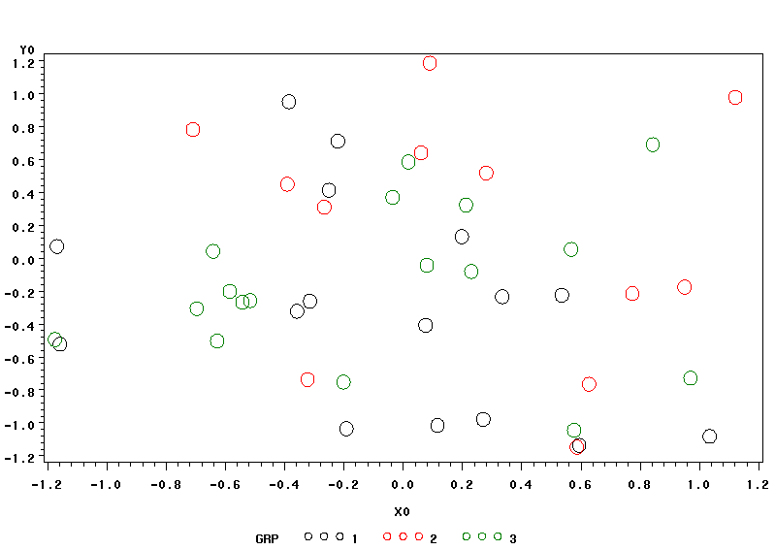
Simulated Peer Influence:
75 actors, 2 initially random opinions, Alpha = .8, 7 iterations

Slide 12
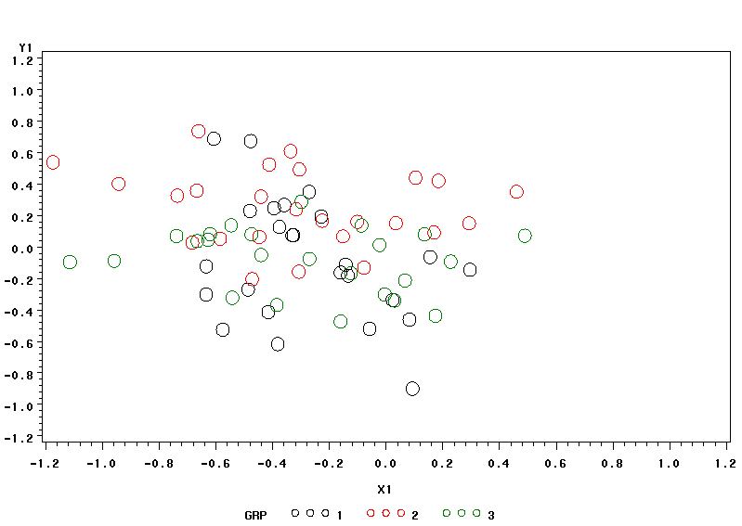
Simulated Peer Influence:
75 actors, 2 initially random opinions, Alpha = .8, 7 iterations

Slide 13
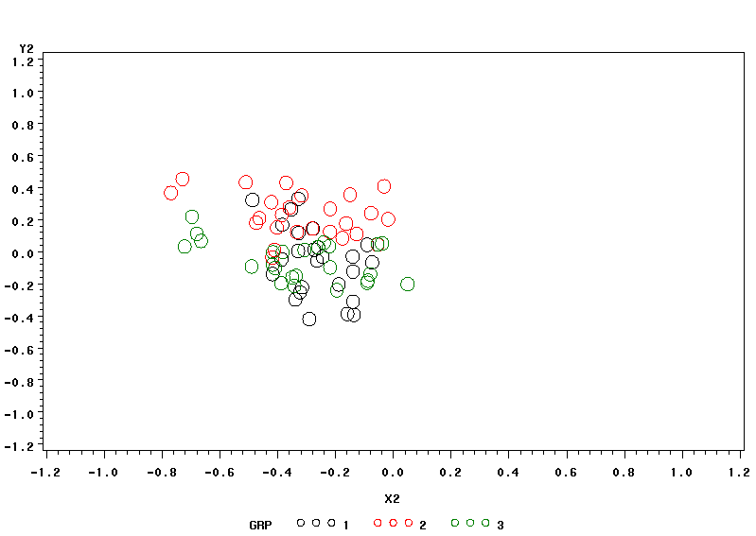
Simulated Peer Influence:
75 actors, 2 initially random opinions, Alpha = .8, 7 iterations

Slide 14
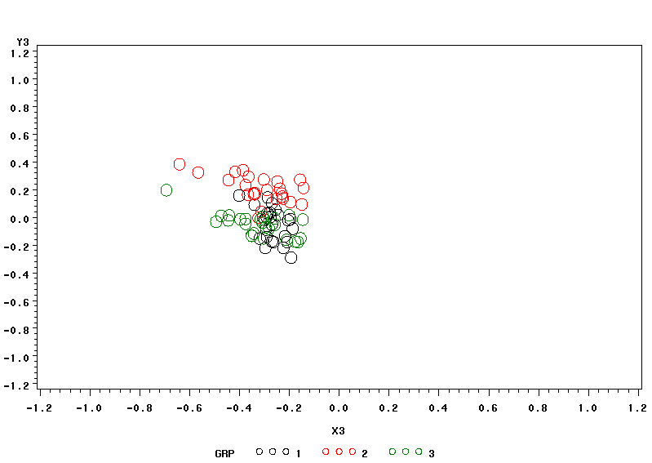
Simulated Peer Influence:
75 actors, 2 initially random opinions, Alpha = .8, 7 iterations

Slide 15
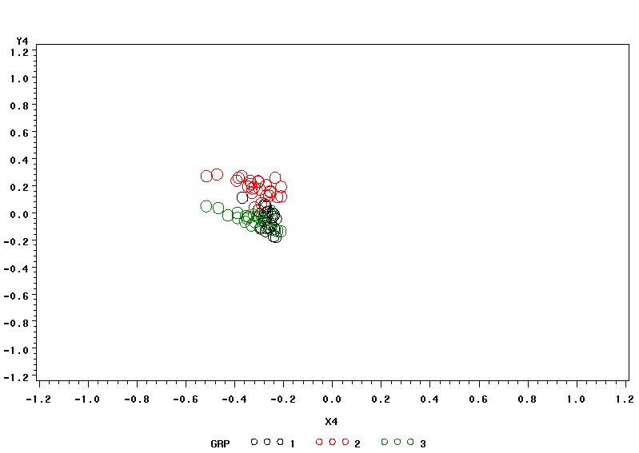
Simulated Peer Influence:
75 actors, 2 initially random opinions, Alpha = .8, 7 iterations

Slide 16
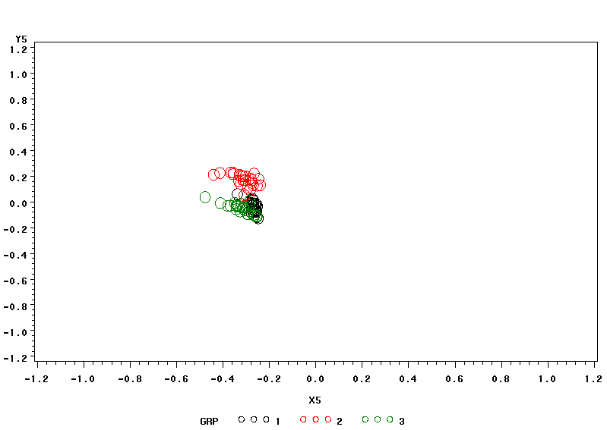
Simulated Peer Influence:
75 actors, 2 initially random opinions, Alpha = .8, 7 iterations

Slide 17
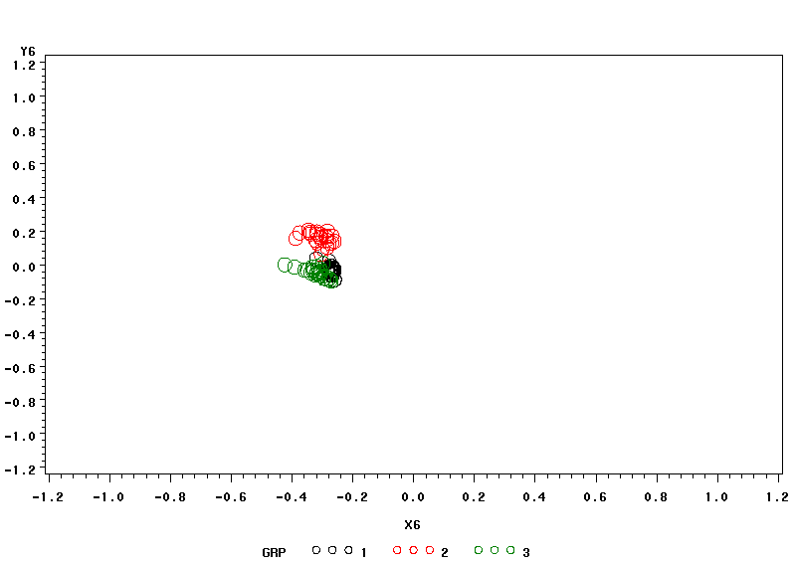
Simulated Peer Influence:
75 actors, 2 initially random opinions, Alpha = .8, 7 iterations

Slide 18
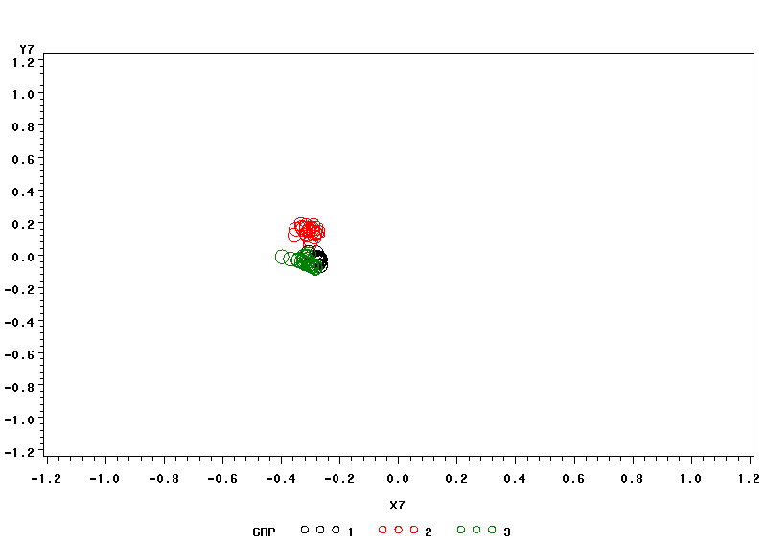
Simulated Peer Influence:
75 actors, 2 initially random opinions, Alpha = .8, 7 iterations

Slide 19
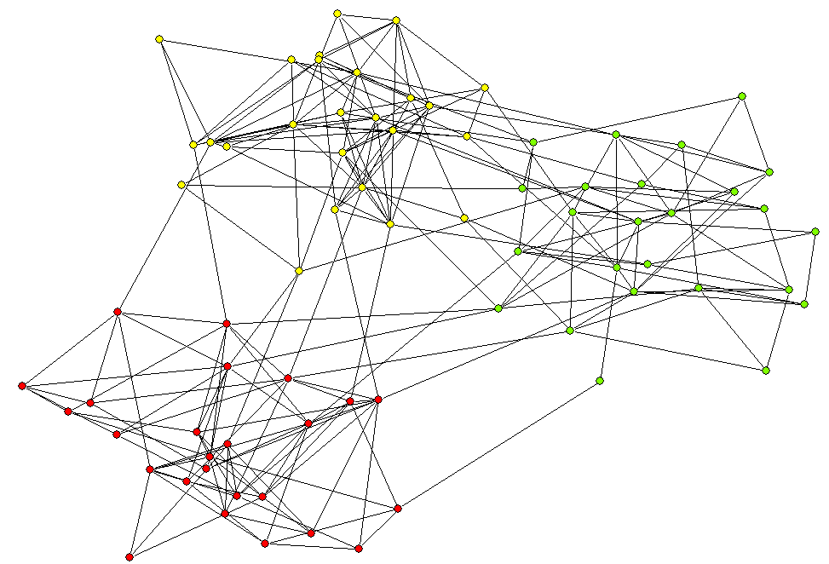
Basic Peer Influence Model
Now weight in-group ties higher than between group ties

Slide 20
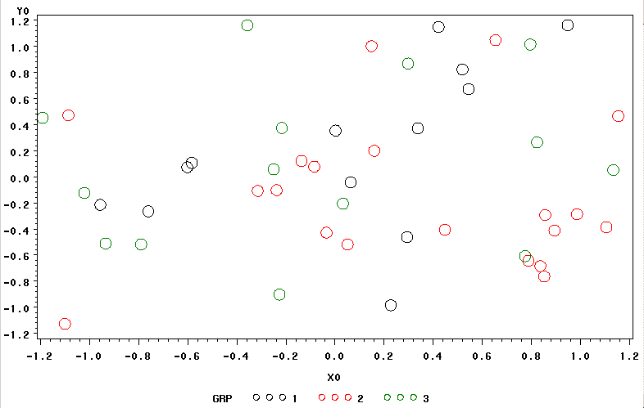
Simulated Peer Influence:
75 actors, 2 initially random opinions, Alpha = .8, 7 iterations, in-group tie: 2

Slide 21
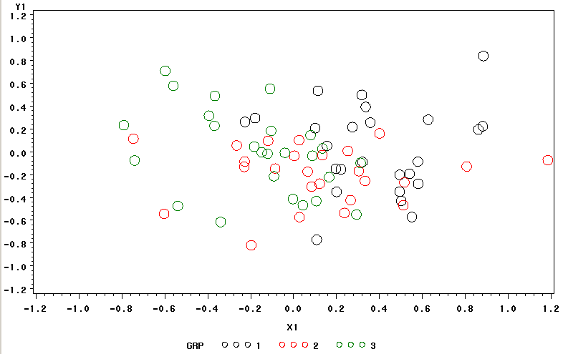

Slide 22
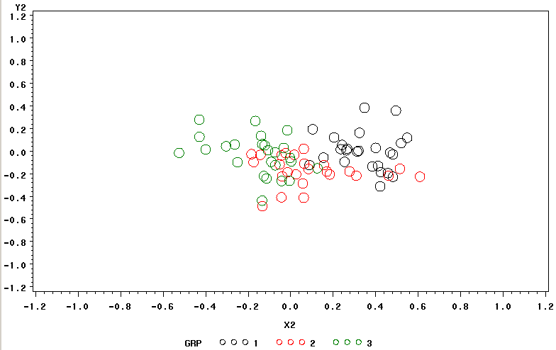

Slide 23
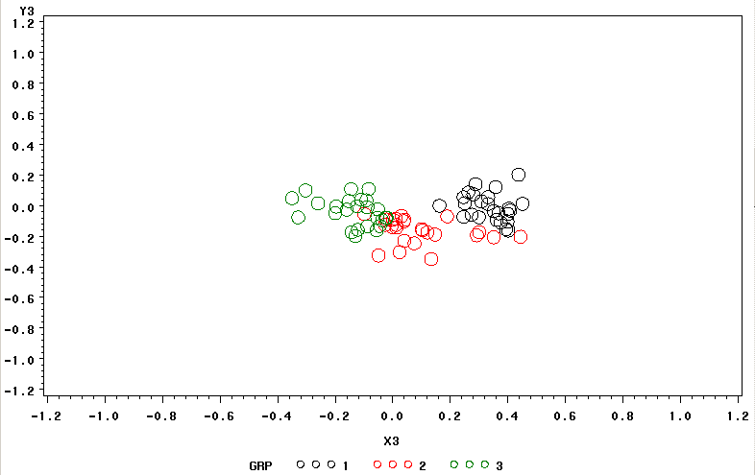

Slide 24
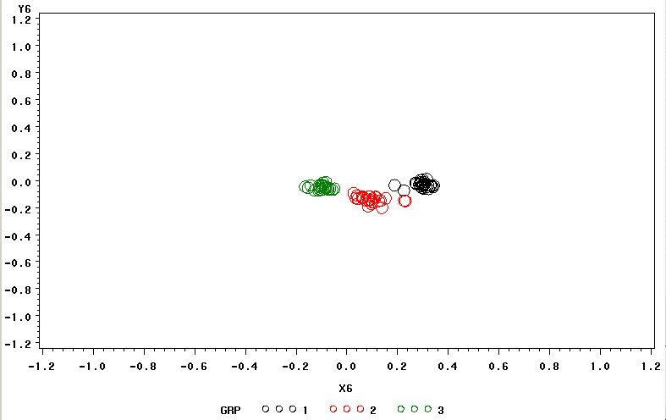

Slide 25
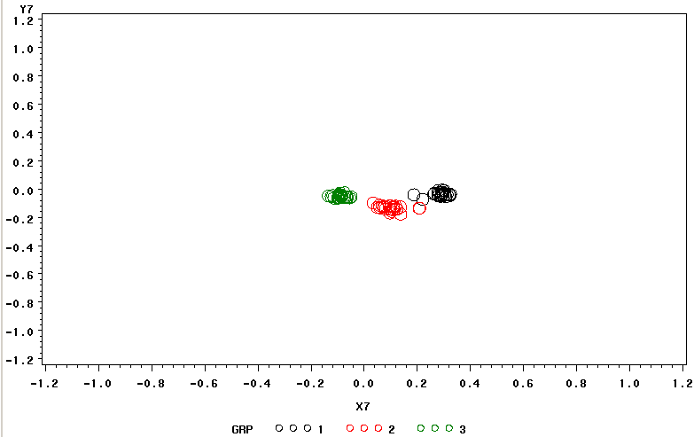

Slide 26
Consider the implications for populations of different structures. For example, we might have two groups, a large orthodox population and a small heterodox population. We can imagine the groups mixing in various levels:
Heterodox: 10 people
Orthodox: 100 People

Slide 27
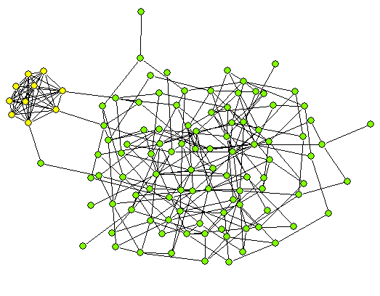
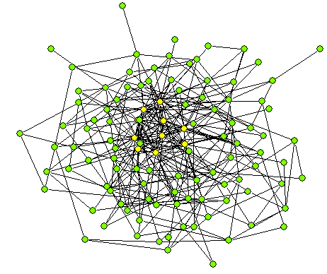
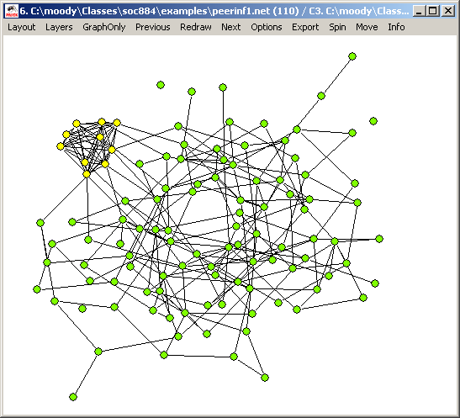
Light
Heavy
Moderate

Slide 28
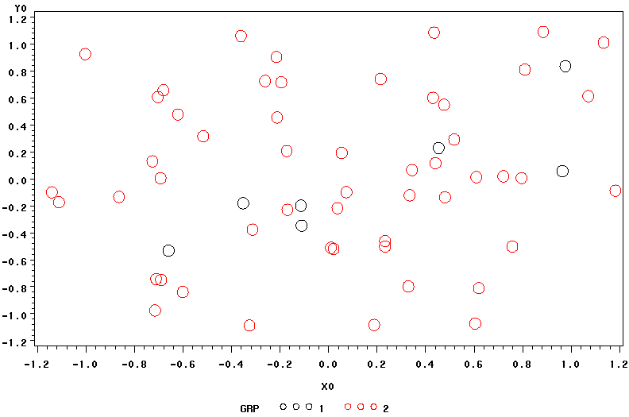
Light mixing

Slide 29
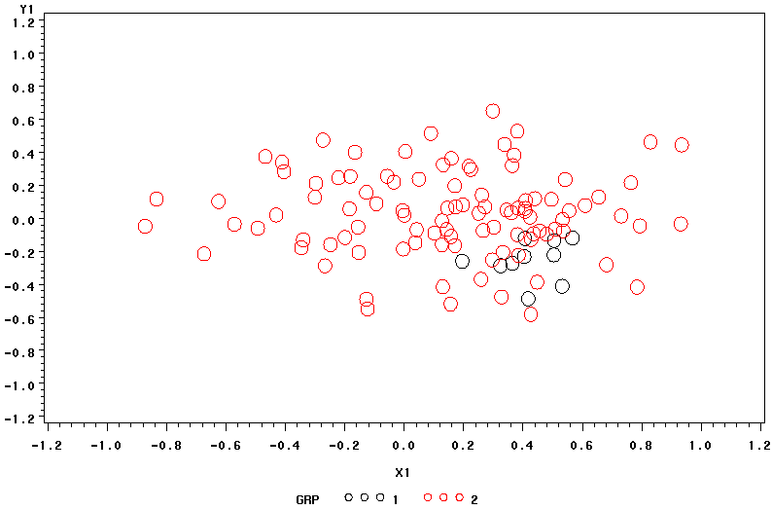
Light mixing

Slide 30
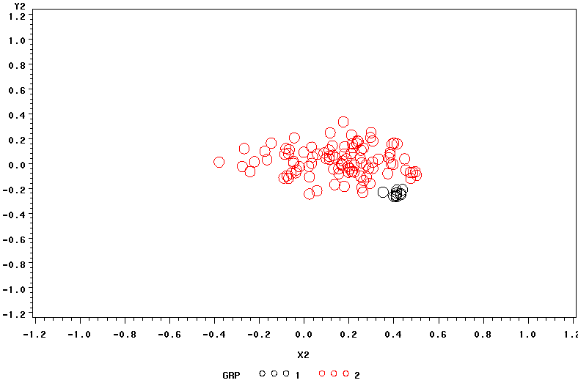
Light mixing

Slide 31
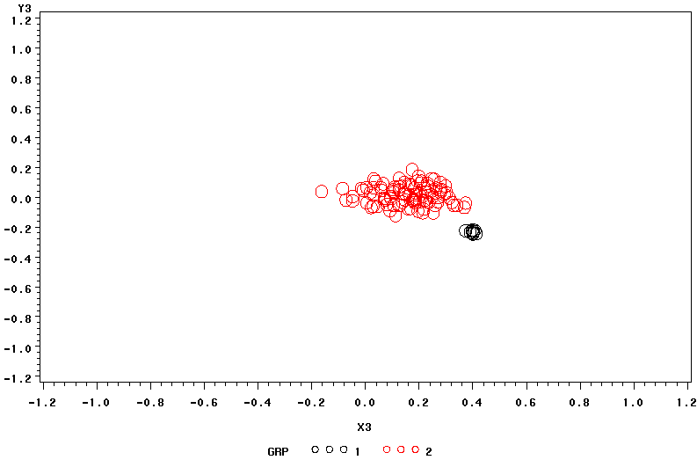
Light mixing

Slide 32
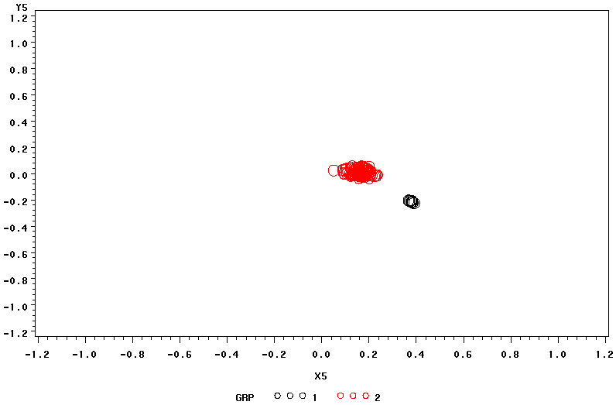
Light mixing

Slide 33
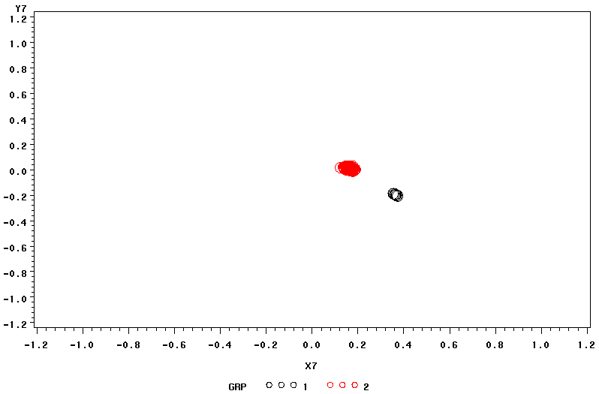
Light mixing

Slide 34
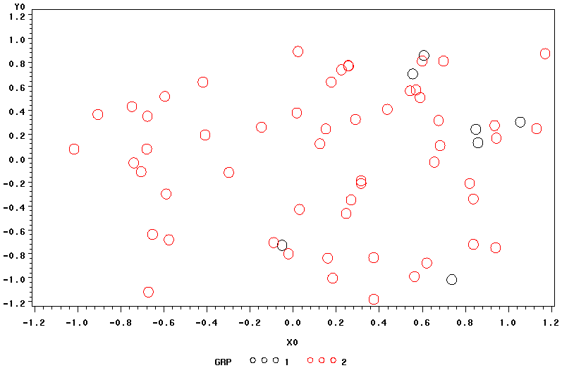
Moderate mixing

Slide 35
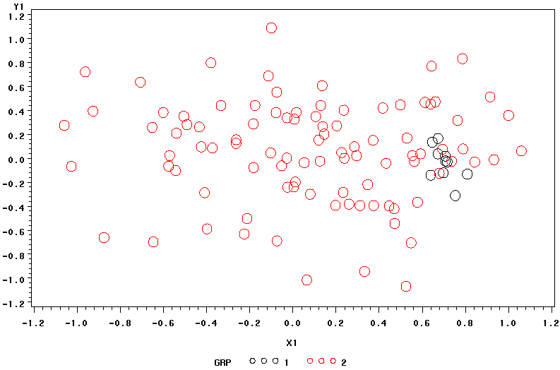
Moderate mixing

Slide 36
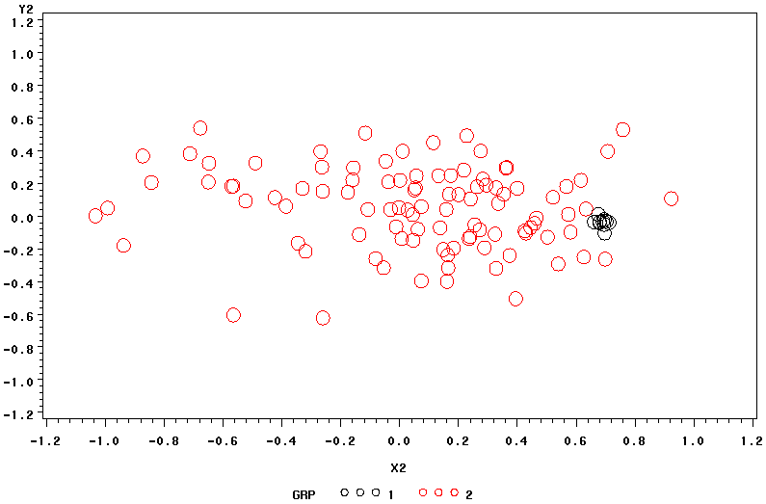
Moderate mixing

Slide 37
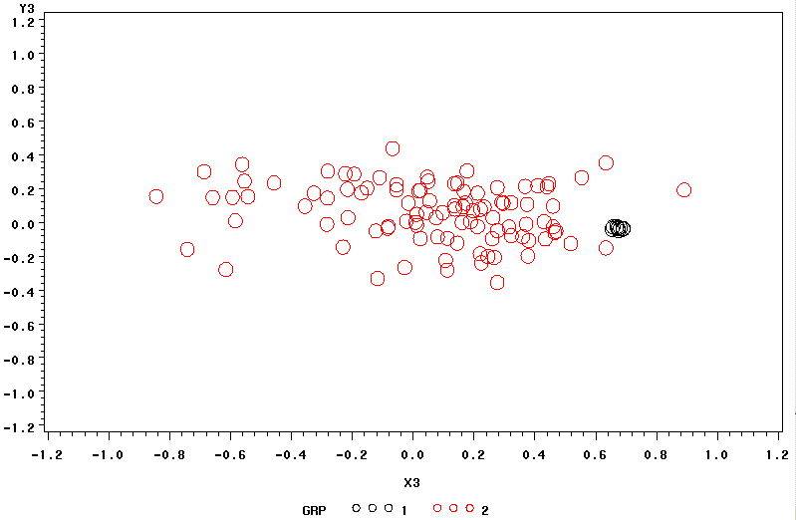
Moderate mixing

Slide 38
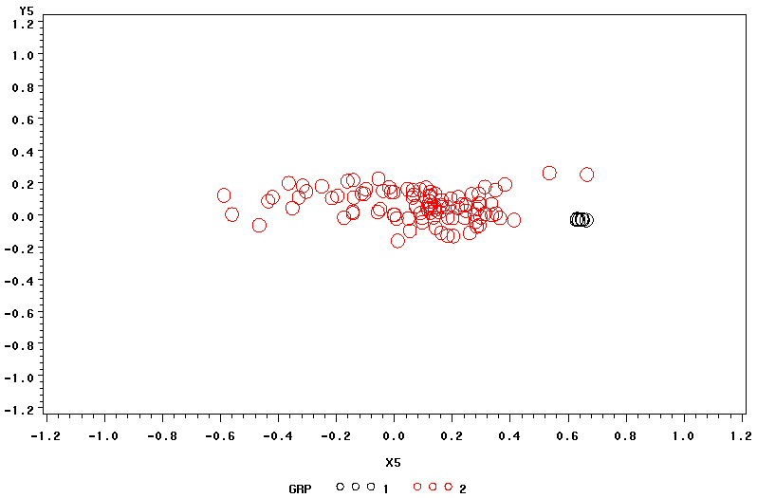
Moderate mixing

Slide 39
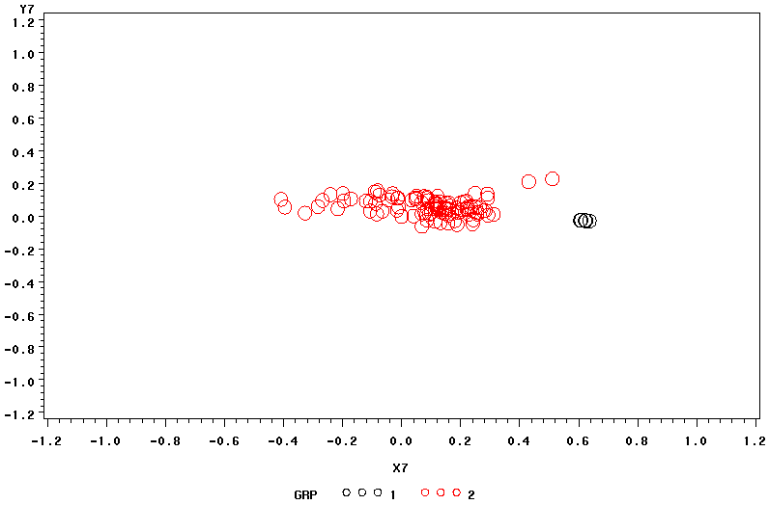
Moderate mixing

Slide 40
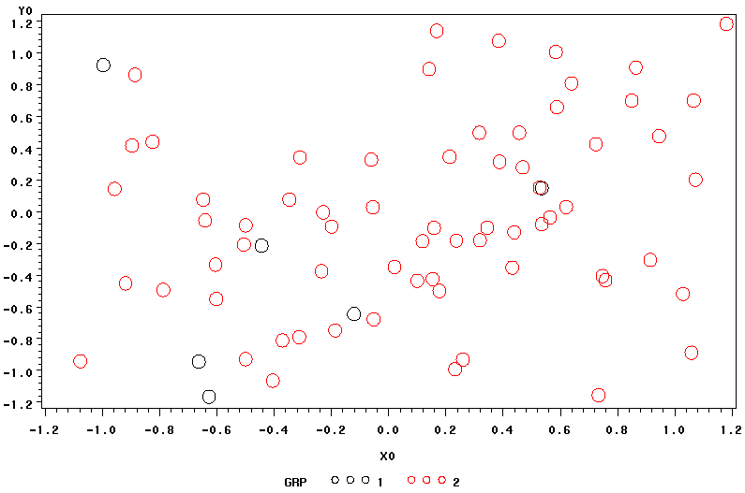
High mixing

Slide 41
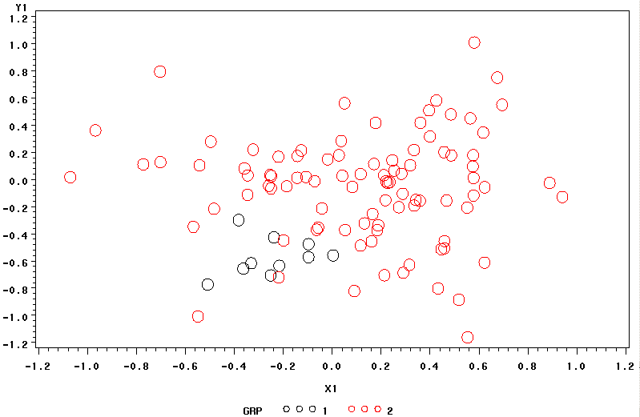
High mixing

Slide 42
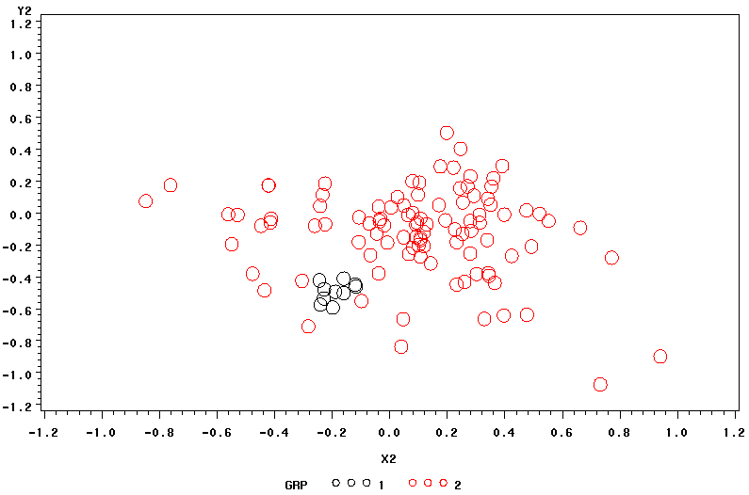
High mixing

Slide 43
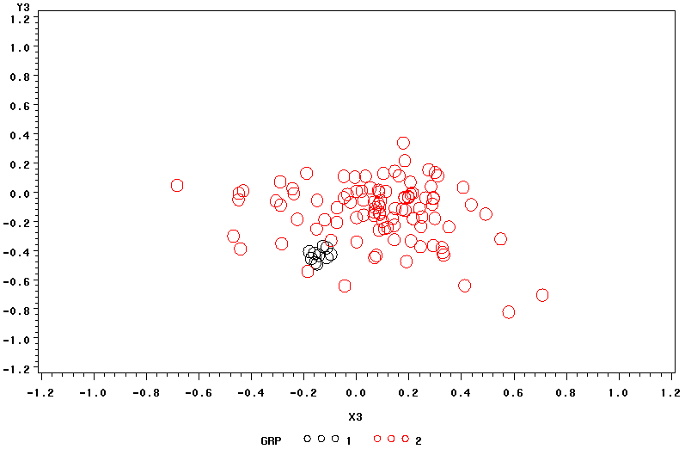
High mixing

Slide 44
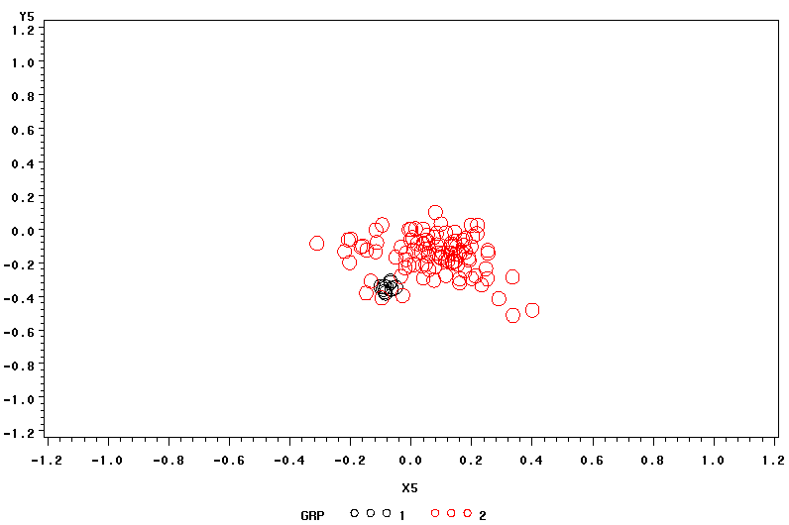
High mixing

Slide 45
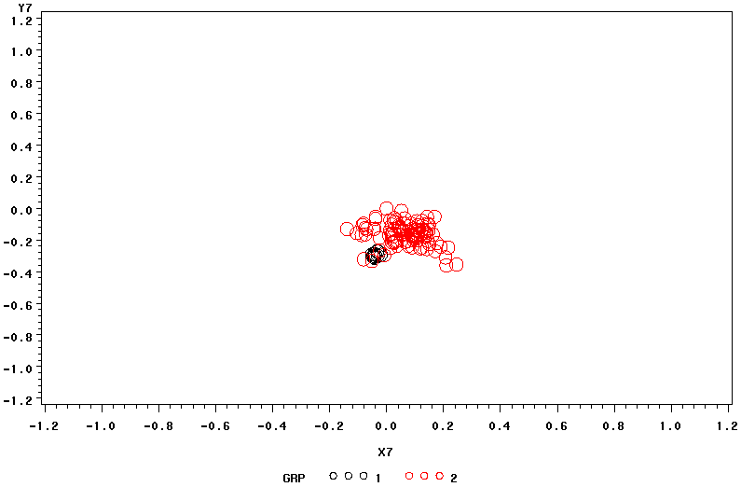
High mixing

Slide 46
So we know…
… Attitudes and knowledge are affected by the network structure
But is the network affected by the attitudes?

Slide 47



Carley’s Construct Model
An agent is…
    A: n x 1 - my neighbors in the network
    B: m x 1 vector of beliefs that ego holds
In matrix form:

Slide 48
Knowledge Network
…or any 2-mode network
“People x Attribute”
“People x Resource”
“People x Organization”
…etc

Slide 49
How networks form
Agents tend to communicated with either:
  People similar to them (I.e. with similar observed beliefs or attributes)
  Or
  People that can provide useful information

Slide 50
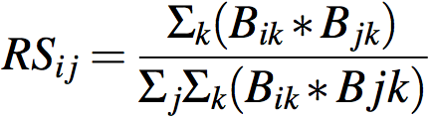
Need for Communicative Ease
Relative similarity RS_{ij} = how much I shares with J divided by how much I shares with all others
B_{ik} is belief network (i knows information k)
Expected interaction based on relative similarity
  “A ratio of what ego shares with alter to what ego shares with everybody else”

Slide 51
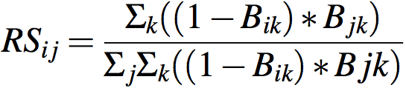
Need to Know
Relative expertise REij = how much I thinks J knows that I does not know divided by how much I thinks all others know that I does not know
Sik is knowledge network I knows information k
Expected interaction based on relative expertise

Slide 52
What do we get from this…
RS and RE are equivalent to probability of interaction
At each time, agents get a chance to interact based on the probabilities
An interaction=creation of a network tie
Ties decay with time if not reactivated

Slide 53
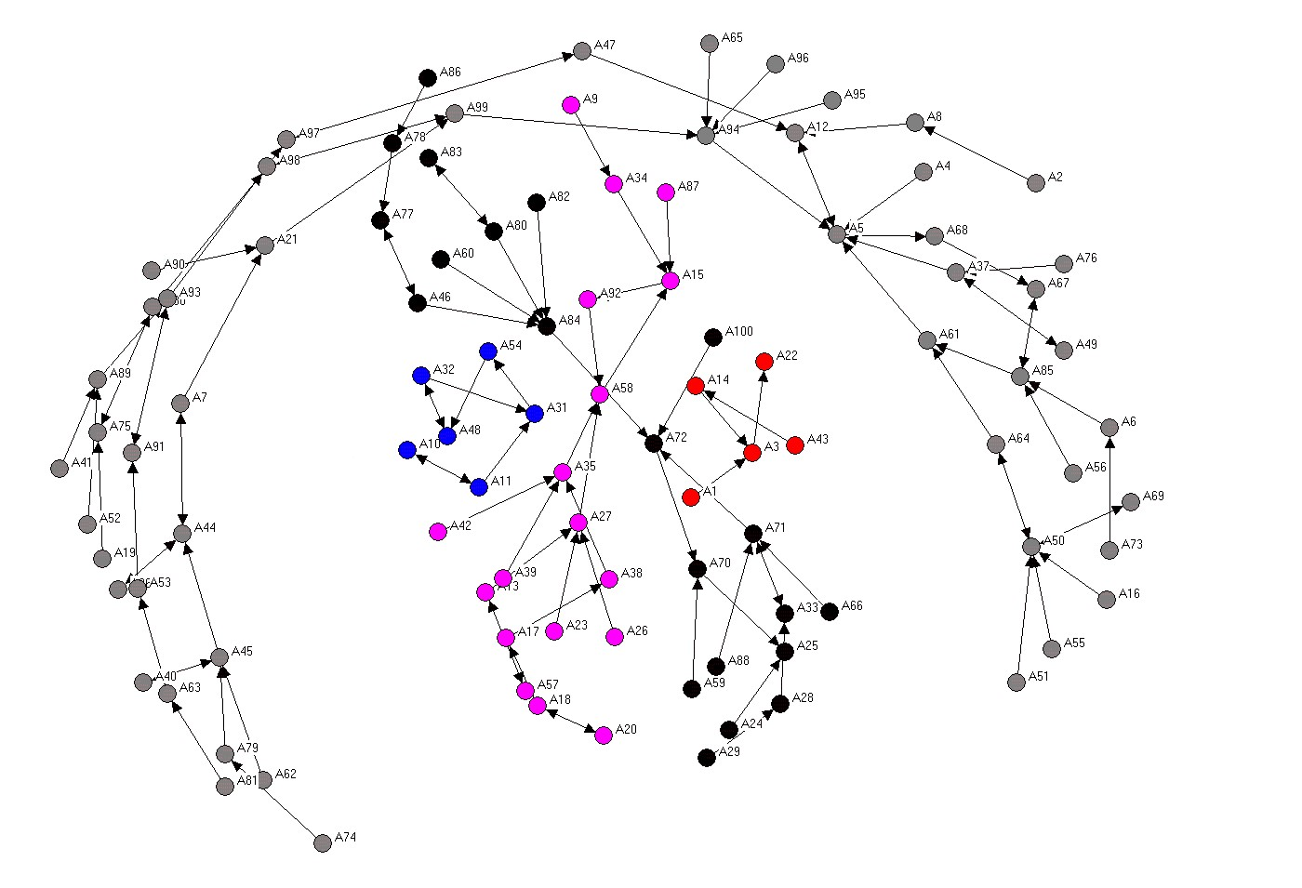
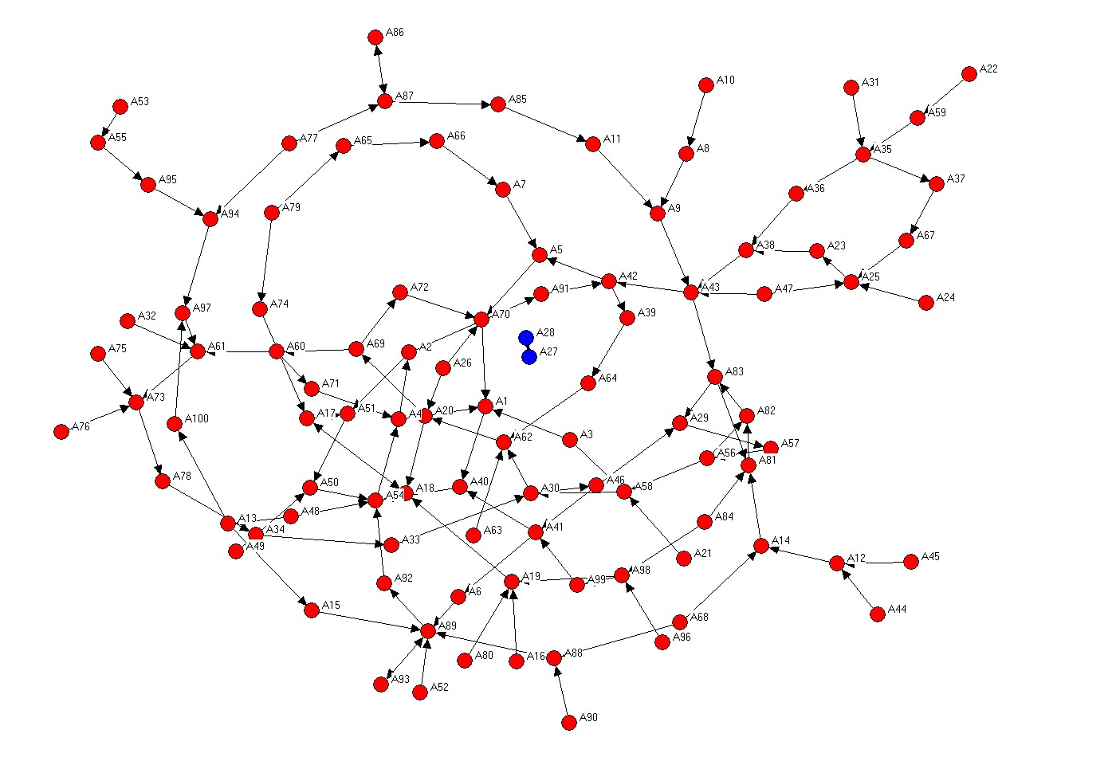
Structural Evolution

Slide 54
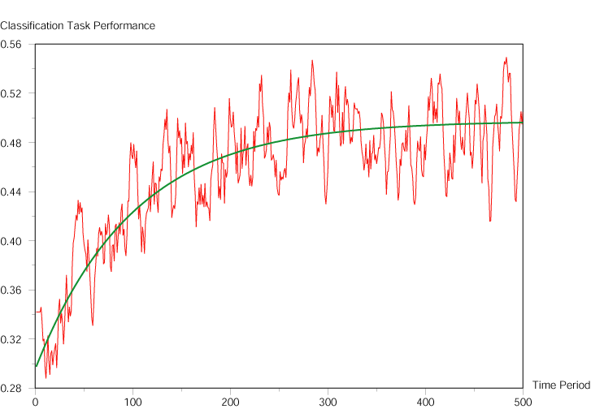
Knowledge Diffusion
Percentage of shared beliefs in the network

Slide 55
Summary
Friedkin’s Contagion Model derives belief structures from network structures
Carley’s Construct Model derives network structures from belief structures
Construct allows simultaneous manipulation of beliefs and network structure

