Slide 1
Community Detection
… in social networks

Slide 2

@maksim2042
Maksim Tsvetovat
Professor of Computational
Social Science at
George Mason University
CTO, DeepMile Networks
Follow me on Twitter!

Slide 3
Prerequisites
Python 2.7
NetworkX, MatplotLib
BioPython (for fetching data)
  pip install biopython
https://www.github.com/webcast_3_5_13

Slide 4
Data
Today, we will look at co-authorship networks in science
  The exact same methods can be applied to Twitter networks, Facebook networks, network of congressmen co-sponsoring bills, etc. etc.

Slide 5
Getting data
First, check out the GitHub repository
> import pubmed
> articles = pubmed.get_articles(‘search terms’)
This gets us a list of articles that match the search terms
Now let’s build a collaboration network

Slide 6
IterTools.Permutations
This is a very useful package in the standard library…
>from itertools import permutations
>l = [1, 2, 3]
>list(permutations(l,2))
>[(1, 2), (1, 3), (2, 1),
(2, 3), (3, 1), (3, 2)]

Slide 7
Building a graph
def make_author_network(articles):
au_net=net.Graph()
for article in articles:
try:
authors=article['AU']
except KeyError:
continue
for a,b in permutations(authors, 2):
add_or_inc_edge(au_net,a,b)
return au_net

Slide 8
Processing…
aunet=pubmed.make_author_network(articles2)
### find the largest component
components=
net.connected_component_subgraphs(trim_edges(aunet,2))
comp=components[0]
net.draw(comp)
plot.show()

Slide 9
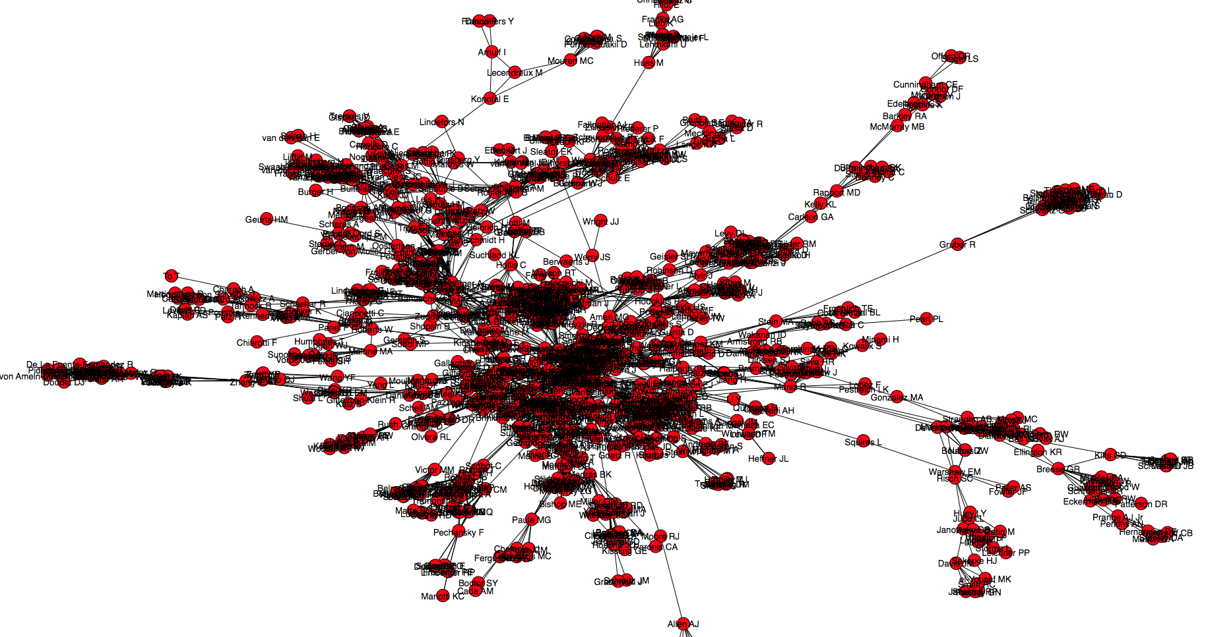

Slide 10
Measuring similarity
Similarity is measured by number of connections that are the same between nodes – Pearson correlations
1.00 -0.20 0.08 0.08 -0.19 -0.19 0.77 0.77 0.77 0.77 -0.26 -0.26 -0.26 -0.26
-0.20 1.00 -0.19 -0.19 0.08 0.08 -0.26 -0.26 -0.26 -0.26 0.77 0.77 0.77 0.77
0.08 -0.19 1.00 1.00 -1.00 -1.00 0.36 0.36 0.36 0.36 -0.45 -0.45 -0.45 -0.45
0.08 -0.19 1.00 1.00 -1.00 -1.00 0.36 0.36 0.36 0.36 -0.45 -0.45 -0.45 -0.45
-0.19 0.08 -1.00 -1.00 1.00 1.00 -0.45 -0.45 -0.45 -0.45 0.36 0.36 0.36 0.36
-0.19 0.08 -1.00 -1.00 1.00 1.00 -0.45 -0.45 -0.45 -0.45 0.36 0.36 0.36 0.36
0.77 -0.26 0.36 0.36 -0.45 -0.45 1.00 1.00 1.00 1.00 -0.20 -0.20 -0.20 -0.20
0.77 -0.26 0.36 0.36 -0.45 -0.45 1.00 1.00 1.00 1.00 -0.20 -0.20 -0.20 -0.20
0.77 -0.26 0.36 0.36 -0.45 -0.45 1.00 1.00 1.00 1.00 -0.20 -0.20 -0.20 -0.20
0.77 -0.26 0.36 0.36 -0.45 -0.45 1.00 1.00 1.00 1.00 -0.20 -0.20 -0.20 -0.20
-0.26 0.77 -0.45 -0.45 0.36 0.36 -0.20 -0.20 -0.20 -0.20 1.00 1.00 1.00 1.00
-0.26 0.77 -0.45 -0.45 0.36 0.36 -0.20 -0.20 -0.20 -0.20 1.00 1.00 1.00 1.00
-0.26 0.77 -0.45 -0.45 0.36 0.36 -0.20 -0.20 -0.20 -0.20 1.00 1.00 1.00 1.00
-0.26 0.77 -0.45 -0.45 0.36 0.36 -0.20 -0.20 -0.20 -0.20 1.00 1.00 1.00 1.00

Slide 11
Hierarchical Clustering
Uses an NxN distance or similarity matrix
Can use multiple distance metrics:
  Graph distance - binary or weighted
  Euclidean distance
    Similarity of relational vectors
  Pearson Correlation matrix

Slide 12
Algorithm
1. Start by assigning each item to its own cluster, so that if you have N items,
  you now have N clusters, each containing just one item.
  Let the initial distances between the clusters equal the distances between the items they contain.
2. Find the closest (most similar) pair of clusters and merge them into a single cluster
3. Compute distances between the new cluster and each of the old clusters.
4. Repeat steps 2 and 3 until all items are clustered into a single cluster of size N.

Slide 13
Distance between clusters
Three ways to compute:
  Single-link
    also called connectedness or minimum method
    shortest distance from any member of one cluster to any member of the other cluster.
  Complete-link
    also called the diameter or maximum method
    longest distance from any member of one cluster to any member of the other cluster.
  Average-link
    mean distance from any member of one cluster to any member of the other cluster.
    Or median distance (D’Andrade 1978)

Slide 14
Preferred methods?
Complete link (maximum length) clustering gives more stable results
Average-link is more inclusive, has better face validity
Other methods may be substituted given domain requirements

Slide 15
Example - US Cities
Using single-link clustering
BOS NY DC MIA CHI SEA SF LA DEN
BOS 0 206 429 1504 963 2976 3095 2979 1949
NY 206 0 233 1308 802 2815 2934 2786 1771
DC 429 233 0 1075 671 2684 2799 2631 1616
MIA 1504 1308 1075 0 1329 3273 3053 2687 2037
CHI 963 802 671 1329 0 2013 2142 2054 996
SEA 2976 2815 2684 3273 2013 0 808 1131 1307
SF 3095 2934 2799 3053 2142 808 0 379 1235
LA 2979 2786 2631 2687 2054 1131 379 0 1059
DEN 1949 1771 1616 2037 996 1307 1235 1059 0

Slide 16
Example - cont.
The nearest pair of cities is BOS and NY, at distance 206. These are merged into a single cluster called "BOS/NY”:
BOS/NY DC MIA CHI SEA SF LA DEN
BOS/NY 0 223 1308 802 2815 2934 2786 1771
DC 223 0 1075 671 2684 2799 2631 1616
MIA 1308 1075 0 1329 3273 3053 2687 2037
CHI 802 671 1329 0 2013 2142 2054 996
SEA 2815 2684 3273 2013 0 808 1131 1307
SF 2934 2799 3053 2142 808 0 379 1235
LA 2786 2631 2687 2054 1131 379 0 1059
DEN 1771 1616 2037 996 1307 1235 1059 0

Slide 17
Example
The nearest pair of objects is BOS/NY and DC, at distance 223. These are merged into a single cluster called "BOS/NY/DC".
BS/NY/DC MIA CHI SEA SF LA DEN
BS/NY/DC 0 1075 671 2684 2799 2631 1616
MIA 1075 0 1329 3273 3053 2687 2037
CHI 671 1329 0 2013 2142 2054 996
SEA 2684 3273 2013 0 808 1131 1307
SF 2799 3053 2142 808 0 379 1235
LA 2631 2687 2054 1131 379 0 1059
DEN 1616 2037 996 1307 1235 1059 0

Slide 18
Example
BOS/NY/DC/CHI MIA SF/LA/SEA DEN
BOS/NY/DC/CHI 0 1075 2013 996
MIA 1075 0 2687 2037
SF/LA/SEA 2054 2687 0 1059
DEN 996 2037 1059 0
BOS/NY/DC/CHI/DEN 0 1075 1059
MIA 1075 0 2687
SF/LA/SEA 1059 2687 0
BOS/NY/DC/CHI/DEN/SF/LA/SEA 0 1075
MIA 1075 0

Slide 19
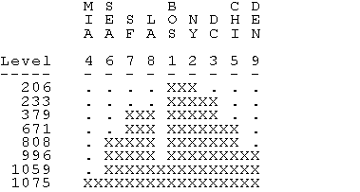
Example: Final Clustering
In the diagram, the columns are associated with the items and the rows are associated with levels (stages) of clustering. An 'X' is placed between two columns in a given row if the corresponding items are merged at that stage in the clustering.

Slide 20
Comments
Useful way to represent positions in social network data
  Discrete, well-defined algorithm
  Produces non-overlapping subsets
Caveats
  Sometimes we need overlapping subsets
  Algorithmically, early groupings cannot be undone

Slide 21
Extensions
Optimization-based clustering
  Algorithm can “add” and “remove” nodes from a cluster
    “add” works similarly to hi-clus
    “remove” takes a node out if it is closer to another cluster then to its own cluster
    Use shortest, mean or median distances
      “remove” will never be invoked with max. distances
    Aim to improve cohesiveness of a cluster
      Mean distance between nodes in each cluster

Slide 22
Multi-Dimensional Scaling
CONCOR and Hi-clustering are discrete models
  Partition nodes into exhaustive non-overlapping subsets
  World is not so black-n-white
The purpose of multidimensional scaling (MDS) is to provide a spatial representation of the pattern of similarities
  More similar nodes will appear closer together
Finds non-intuitive equivalences in networks

Slide 23
Input to MDS
Measure of pairwise similarity among nodes
  Attribute-based
  Euclidean distances
  Graph distances
  CONCOR similarities
Output:
  A set of coordinates in 2D or 3D space such that
    Similar nodes are closer together then dissimilar nodes

Slide 24
Algorithm
MDS finds a set of vectors in p-dimensional space such that the matrix of euclidean distances among them corresponds as closely as possible to a function of the input matrix according to a fitness function called stress.
1. Assign points to arbitrary coordinates in p-dimensional space.
2. Compute euclidean distances among all pairs of points, to form the D’ matrix.
3. Compare the D’ matrix with the input D matrix by evaluating the stress function. The smaller the value, the greater the correspondance between the two.
4. Adjust coordinates of each point in the direction of the stress vector
5. Repeat steps 2 through 4 until stress won't get any lower

Slide 25
Dimensionality
Normally, MDS is used in 2D space for optimal visual impact
  may be a very poor, highly distorted, representation of your data.
  High stress value.
  Increase the number of dimensions.
Difficulties:
  High-dimensional spaces are difficult to represent visually
  With increasing dimensions, you must estimate an increasing number of parameters to obtain a decreasing improvement in stress.

Slide 26

Stress function
The degree of correspondence between the distances among points on MDS map and the matrix input
d_{ij} = euclidean distance, across all dimensions, between points i and j on the map,
f(x_{ij}) is some function of the input data,
scale = a constant scaling factor, used to keep stress values between 0 and 1.
When the MDS map perfectly reproduces the input data,
  f(x_{ij}) = d_{ij} is for all i and j, so stress is zero.
  Thus, the smaller the stress, the better the representation.

Slide 27
Stress Function, cont.
The transformation of the input values f(xij) used depends on whether metric or non-metric scaling.
Metric scaling:
  f(x_{ij}) = x_{ij}.
  raw input data is compared directly to the map distances
  Inverse of map distances for similarities
Non-metric scaling
  f(x_{ij}) is a weakly monotonic transformation of the input data that minimizes the stress function.
  Computed using a regression method

Slide 28
Non-zero stress
Caused by measurement error or insufficient dimensionality
  Stress levels of
    < 0.15 = acceptable
    < 0.1 = excellent
Any MDS map with stress > 0 is distorted

Slide 29

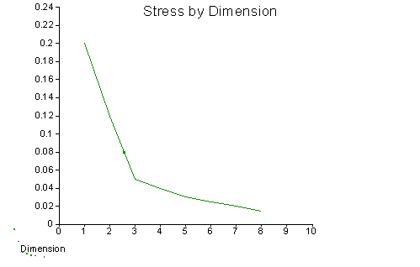
Increasing dimensionality
As number of dimensions increases, stress decreases:

Slide 30
Interpretation of MDS Map
Axes are meaningless
  We are looking at cohesiveness and proximity of clusters, not their locations
  Infinite number of possible permutations
If stress > 0 , there is distortion
  Larger distances less distorted then smaller

Slide 31
What to look for
Clusters
  groups of items that are closer to each other than to other items.
  When really tight, highly separated clusters occur in perceptual data, it may suggest that each cluster is a domain or subdomain which should be analyzed individually.
  Extract clusters and re-run MDS on them for further separation

Slide 32
What to look for…
Dimensions
  Item attributes that seem to order the items in the map along a continuum.
    For example, an MDS of perceived similarities among breeds of dogs may show a distinct ordering of dogs by size.
    At the same time, an independent ordering of dogs according to viciousness might be observed.
    Orderings may not follow the axes or be orthogonal to each other
  The underlying dimensions are thought to "explain" the perceived similarity between items.
  Implicit similarity function is a weighted sum of attributes
  May “discover” non-obvious continuums

Slide 33
High-dimensionality MDS
Difficult to interpret visually, need a mathematical technique
Feed MDS coordinates into another discriminator function
  May be easier to tease apart then original attribute vectorsm

