Slide 1

Social Network Analysis --
Finding communities and influencers

Slide 2
Maksim Tsvetovat www.tsvetovat.org
@maksim2042

Slide 3

My Book
http://shop.oreilly.com/product/0636920020424.do
Use discount
code
SNAFS
(40% off print,
50% off e-book)

Slide 4
First of all...
All materials for this webcast can be found on GitHub:
https://maksim2042@github.com/maksim2042/SNABook.git

Slide 5
Who is influential
Good question :)
It depends

Slide 6
Who’s influential?
Connections matter?
  Number of connections?
  Pattern of connections?
  Structural position?
Content matters?

Slide 7
Yes

Slide 8
Data
Egypt’s Twitter Revolution
Collected ~10,000,000 messages over space of a week
Zeroed in on these relevant to the events in Tahrir Square

Slide 9
Anatomy of Tweet
@alice:
RT @bob VIA @carol : just felt an #earthquake in #Fairfax!
Means:
@alice has retweeted from @bob
@bob metioned @carol
Hashtags #earthquake and #Fairfax are related

Slide 10
...no followers
We do not look at a who-follows-whom relationships?
  Following is “cheap” -- there is no agreement or trust or emotional investment
We want to find out who trusts whom
  Trust is the inverse of influence

Slide 11
Python requirements
Python 2.6 and 2.7 (not yet 3.0)
Tweepy
JSON -- built-in parser
NetworkX
Matplotlib (requires NumPy)

Slide 12
Our data
Retweet network -- in this shape:
Means... person1 has retweeted person2 3 times, and person3 twice.
from | to | weight
person1 | person2 | 3
person1 | person3 | 1

Slide 13
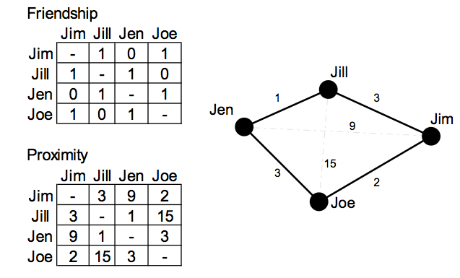
This is a valued graph

Slide 14
Sparse Matrix
Jen Jill 1
Jen Joe 3
Jill Jen 1
Jill Jim 3
Jim Jill 3
Jim Joe 2
Joe Jim 2
Joe Jen 3

Slide 15
Loading the data
import networkx as net
import matplotlib.pyplot as plot
import csv
file="retweets.txt"
g=net.Graph() #create a blank graph
reader=csv.reader(open(file,'rb'),delimiter=' ')
for line in reader:
g.add_edge(line[0],line[1],weight=int(line[2]))
In [17]: len(g)
Out[17]: 129461

Slide 16
This is huge...
120,000 nodes cannot be readily visualized
  It’ll take forever and look like a giant hairball
We have to find groups, communities and influential people -- we have to tease the graph apart

Slide 17
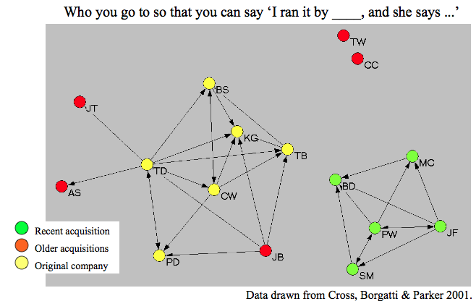
Components

Slide 18
Finding components
A retweet network will most likely be fractured into components
Most of these subgroups will be tiny and can be disregarded
Also, relevance drops significantly outside of the largest main component

Slide 19
Components
components=net.connected_component_subgraphs(g)
"""
In [21]: len(components)
Out[21]: 17202
"""
l=[len(c) for c in components]
"""
In [24]: l[:10]
Out[24]:
[65044,
204,
103,
81,
77,
72,
71,
68,
64,
60]
net.draw(components[1])
"""

Slide 20
Take Component 1
g1=components[0]
Take the first component only
65,000 nodes is still too large to visualize
Let’s take a quick survey of the network
  Edge strength distribution
  Degree distribution
  Network density

Slide 21
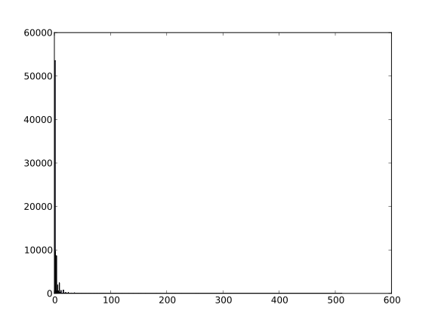
Weight Histogram
weights=[edata['weight'] for f,t,edata in g1.edges(data=True)]
hist=plot.hist(weights,100)

Slide 22
This means....
Value of an edge is the number of times a pair of people communicated
If it’s only once -- there may not be much trust in a relationship
Thus, edges with weight==1 can be dropped

Slide 23
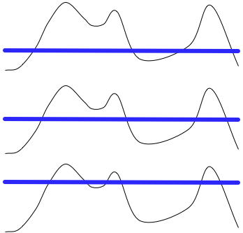
Island Method
Communities consist of strong links; are interconnected with weaker links
Island method lets us find groups of strong links
Raise the “water level” until only peaks emerge

Slide 24
water level = link weight
def trim_edges(g, weight=1):
"""
Remove edges with weights less then a threshold parameter ("weight")
"""
g2=net.Graph()
for f, to, edata in g.edges(data=True):
if edata['weight'] > weight:
g2.add_edge(f,to,edata)
return g2

Slide 25
Raise the water
In [74]: g2=trim_edges(g1)
In [75]: len(g2)
Out[75]: 24657
In [78]: g2=trim_edges(g1, weight=2)
In [79]: len(g2)
Out[79]: 16451
....
In [82]: g2=trim_edges(g1, weight=10)
In [84]: len(g2)
Out[84]: 3357
In [91]: g3=net.connected_component_subgraphs(g2)[0]
In [92]: len(g3)
Out[92]: 1461

Slide 26
Now we have the core
Core of the network consists of 1461 nodes and 1581 edges
But it is not monolythic

Slide 27
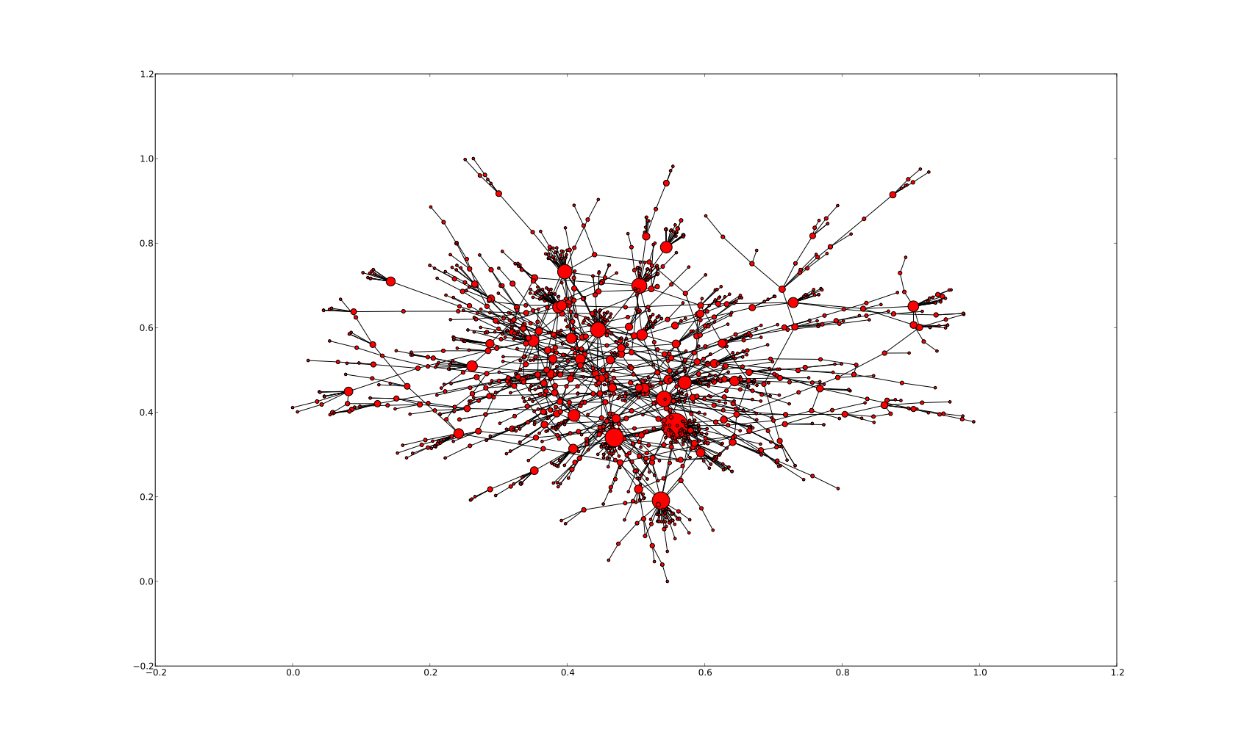

Slide 28
Every one of the large nodes...
has caused a major retweet cascade -- thus holds a position of influence
every edge is a relation of trust, with 10+ mutual retweets
(remember -- we trimmed away 90% of data to get at these core nodes)

Slide 29
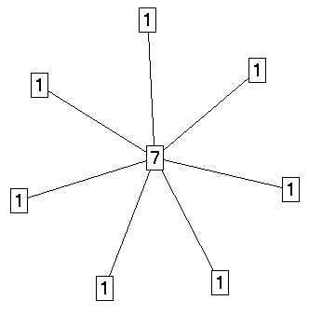
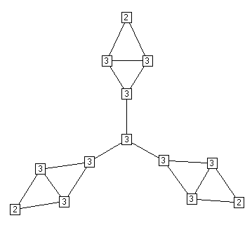
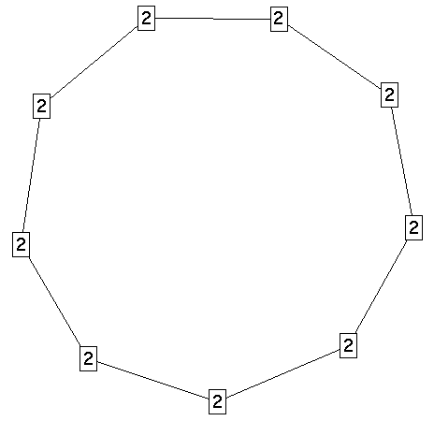
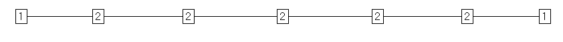
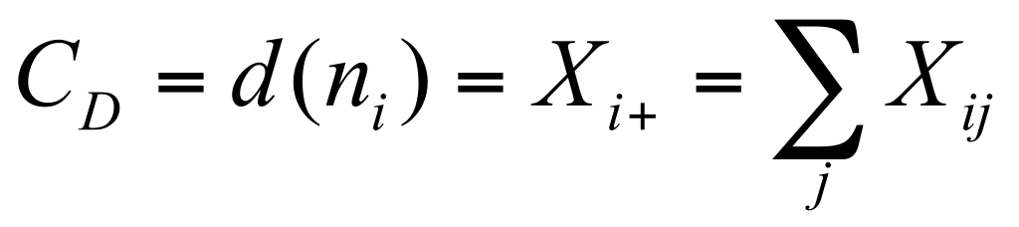
Centrality in Social Networks
Degree
The most intuitive notion of centrality focuses on degree: The actor with the most ties is the most important:

Slide 30
Top Degree
Use this function to sort the degree of nodes:
def sorted_degree(g):
d=net.degree(g)
ds = sorted(d.iteritems(), key=lambda (k,v): (-v,k))
return ds
Returns a map of (node, degree) in sorted order

Slide 31
Top Degree
In [127]: ds=sorted_degree(g3)
In [128]: ds[:10]
Out[128]:
[('alarabiya_ar', 97),
('AJArabic', 50),
('Shorouk_News', 44),
('Ghonim', 35),
('AJEnglish', 34),
('AlArabiya_Eng', 33),
('AymanM', 30),
('monaeltahawy', 26),
('EANewsFeed', 21),
('HGhazaryan', 20)]
Top cascade generators: major media outlets, celebrities (Ghonim), and a couple of bloggers

Slide 32
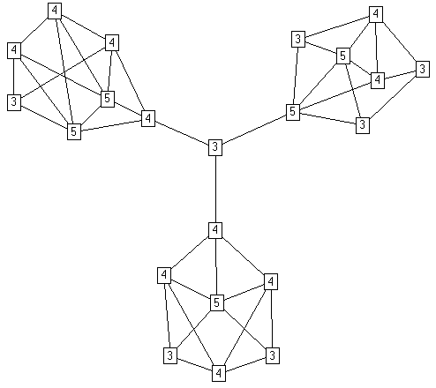
Degree is a local measure

Slide 33
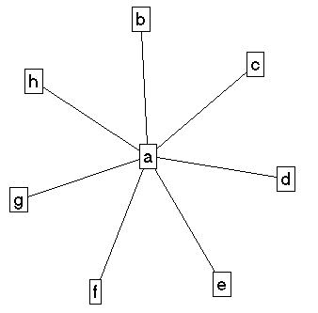
Connectors
Betweenness Centrality:
Model based on communication flow: A person who lies on communication paths can control communication flow, and is thus important. Betweenness centrality counts the number of shortest paths between i and k that actor j resides on.
b
a
C d e f g h

Slide 34
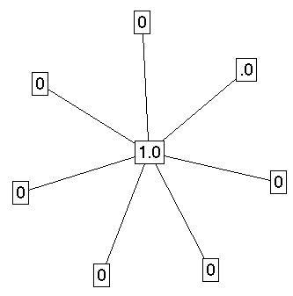
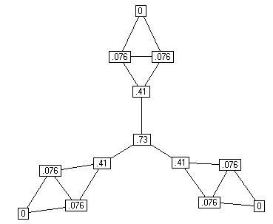
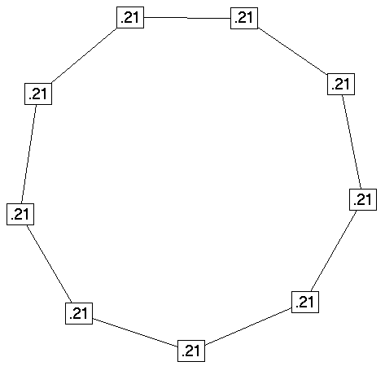
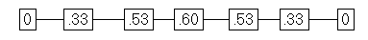
Betweenness Centralization
Betweenness Centrality:
Centralization: 1.0
Centralization: .59
Centralization: 0
Centralization: .31

Slide 35
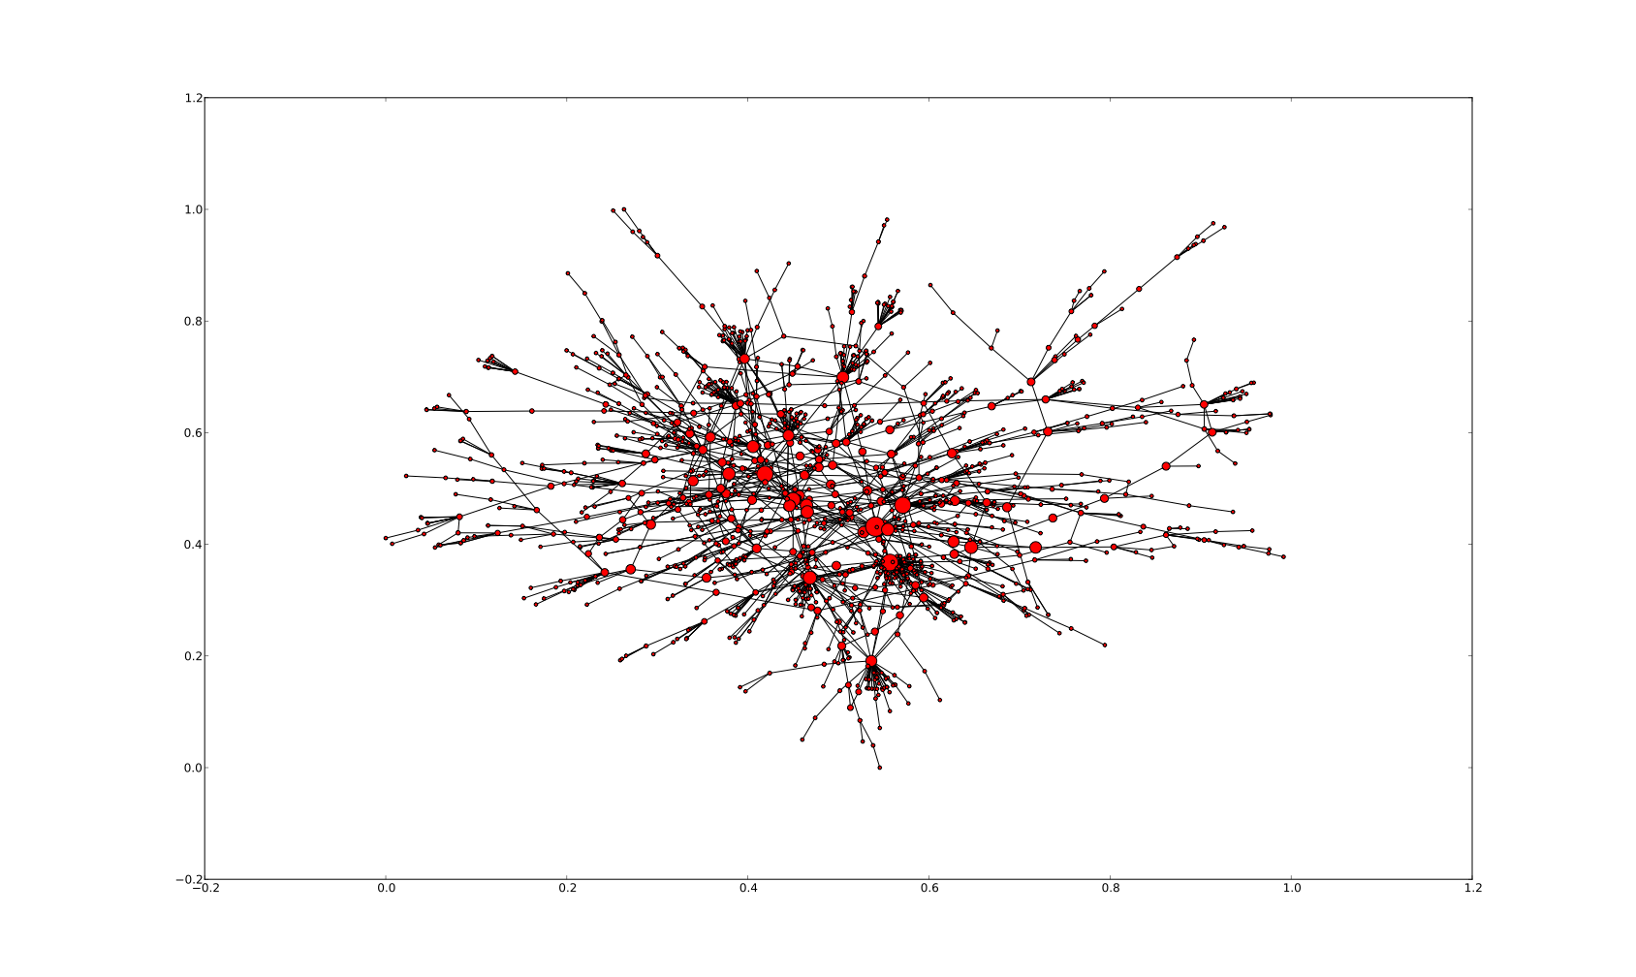
Connectors connect different groups

Slide 36
Top Betweenness
[('Ghonim', 0.30948683318099868),
('alarabiya_ar', 0.22141480094013333),
('monaeltahawy', 0.21103708928780715),
('shary20', 0.21082511576960963),
('dadlani', 0.16175663741677401),
('AJArabic', 0.13889259139494639),
('Reza_Kahlili', 0.12907330369968981),
('CFHeather', 0.12113052931463912),
('WSJ', 0.12103851658308157),
('PERSIA_MAX_NEWS', 0.12016294134886295)]

Slide 37
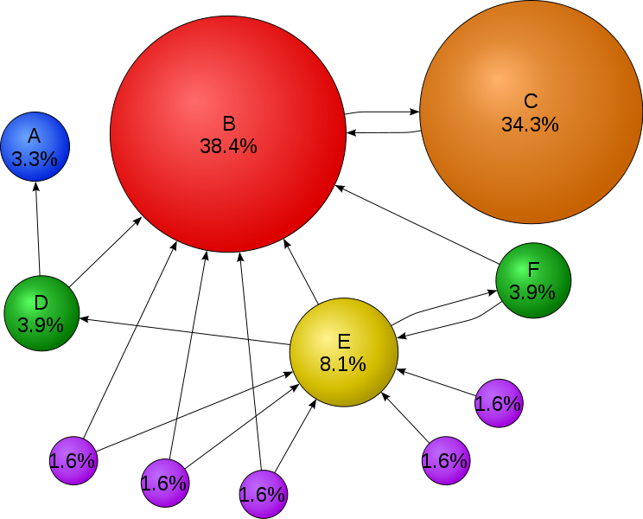
Page Rank

Slide 38
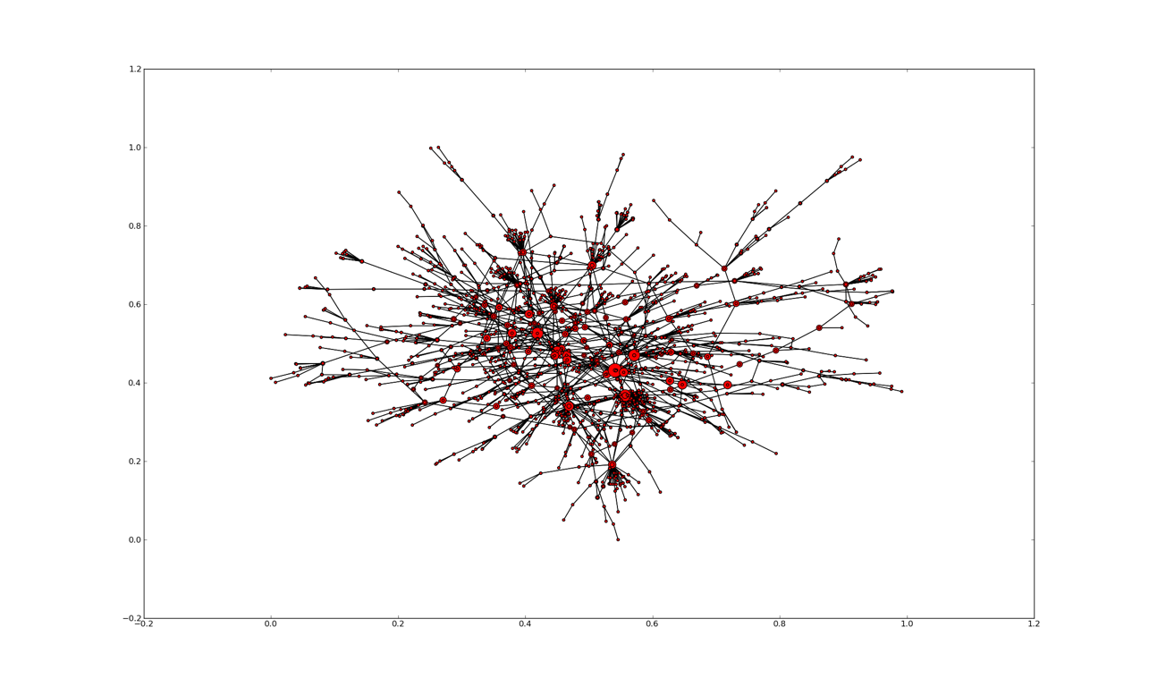
Page Rank on Our Data

Slide 39
Top 10
[('Ghonim', 0.30948683318099868),
('alarabiya_ar', 0.22141480094013333),
('monaeltahawy', 0.21103708928780715),
('shary20', 0.21082511576960963),
('dadlani', 0.16175663741677401),
('AJArabic', 0.13889259139494639),
('Reza_Kahlili', 0.12907330369968981),
('CFHeather', 0.12113052931463912),
('WSJ', 0.12103851658308157),
('PERSIA_MAX_NEWS', 0.12016294134886295)]

