Slide 1
Exploring Social Media and Elections
Max Tsvetovat , @maksim2042
Jackie Kazil, @jackiekazil

Slide 2
Maksim Tsvetovat www.tsvetovat.org
@maksim2042
Jackie Kazil
@jackiekazil

Slide 3

O’Reilly Deal of the Day
http://shop.oreilly.com/product/0636920020424.do
Use discount
code
SNAFS
(40% off print,
50% off e-book)

Slide 4
The Plan
Use network analysis to see what is happening in social media during the electoral campaing
Study social sharing / retweeting
Study linguistic properties of republican tweets
Study geographic distribution of tweeters

Slide 5
Python requirements
Python 2.6 and 2.7 (not yet 3.0)
Tweepy
JSON -- built-in parser
NetworkX
Matplotlib (requires NumPy)

Slide 6
The Data
www.github.com/SNABook/webcast3
Data collected on 2/15/2012
  A tiny snippet of a 2.5 month-long dataset
Tweets containing one of ~500 politics-related terms, geolocated in the US

Slide 7
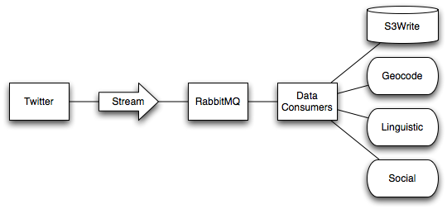
Harvesting Data

Slide 8
Social Sharing
Each candidate wants to make sure that his ideas and his messages go viral. Did they manage to do so?
Let’s explore our data and see who’s doing well

Slide 9
Anatomy of Tweet
@alice:
RT @bob VIA @carol : just felt an #earthquake in #Fairfax!
Means:
@alice has retweeted from @bob
@bob metioned @carol
Hashtags #earthquake and #Fairfax are related

Slide 10
Extracting Retweet Data
Use the JSON structure -- it’s pre-parsed for us
u'entities': {u'hashtags': [],
u'urls': [],
u'user_mentions': [{u'id': 16012783,
u'id_str': u'16012783',
u'indices': [93, 107],
u'name': u'The Daily Beast',
u'screen_name': u'thedailybeast'}]},

Slide 11
Loading the data
import json
import heatmap
import networkx as net
file="data.json"
i = open(file,'rb')
for tweet in i:
js=json.loads(tweet)
### process tweet to extract information

Slide 12
Extracting Retweets
retweets=net.DiGraph()
for tweet in i:
js=json.loads(tweet)
print js
### process tweet to extract information
try:
author=js['user']['screen_name']
entities=js['entities']
mentions=entities['user_mentions']
for rt in mentions:
alter=rt['screen_name']
retweets.add_edge(author,alter)
except KeyError:
print ':-('
continue

Slide 13
If you’re following along...
Clone the GitHub repository
cd to the directory
launch Python
>>> import process_tweets

Slide 14
Now what?
import networkx as net
import process_tweets
retweets=process_tweets.g
len(retweets)
retweets.remove_edges_from(retweets.selfloop_edges())
undir=net.to_networkx_graph(retweets)
core=net.k_core(undir)
len(core)
net.draw(core)

Slide 15
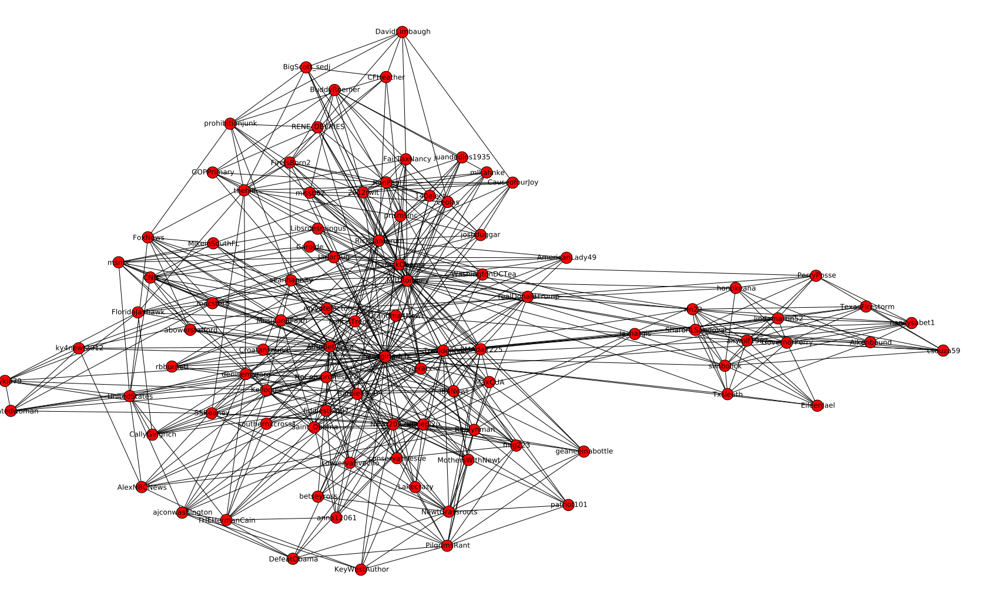
Rick Perry

Slide 16
Ron Paul
Rick Santorum
Barack Obama
Mitt Romney
Newt Gingrich

Slide 17
A couple metrics
 | #Retweets | Cascade PageRank
BarackObama | 7074 | 0.0337
MittRomney | 1367 | 0.00345
newtgingrich | 697 | 0.00195
RonPaul | 672 | 0.00339
RickSantorum | 341 | 0.00276

Slide 18

Linguistic Metrics
Use Google algorithm to identify language, filter out posts not in English

Slide 19
Text cleaning
Tweet text is dirty
  (RT, VIA, #this and @that, ROFL, etc)
Use a stoplist to produce a stripped-down tweet

Slide 20
Stoplist
import sys
import os
import string
stoplist_str="""
a
a's
able
about
above
according
accordingly
...
...
z
zero
rt
via
"""
stoplist=[w.strip() for w in stoplist_str.split('\n') if w !='']

Slide 21
Stemming
Stemming identifies root of a word, stripping away:
  Suffixes, prefixes, verb tense, etc
“stemmer”, “stemming”, “stemmed” ->> “stem”
Use 2 external packages:
  guess_language
  stemming

Slide 22
Cleaning Step
def process(text):
try:
lang=gl.guessLanguageName(text)
#print lang
except:
return []
## only keep the English tweets
if lang != 'English':
return []
else:
tokens=[]
for token in text.lower().split(' '):
try:
token=strip_punctuation(token).lower()
except TypeError:
pass
if (token not in stoplist) and (not token.startswith('@')):
tokens.append(stem.stem(token))
return tokens

Slide 23
Linguistic Networks
Output of the cleaning step -- term vectors.
Union of term vectors = linguistic network
Trim the network -- remove terms only used once or twice (drops 90% of terms)

Slide 24
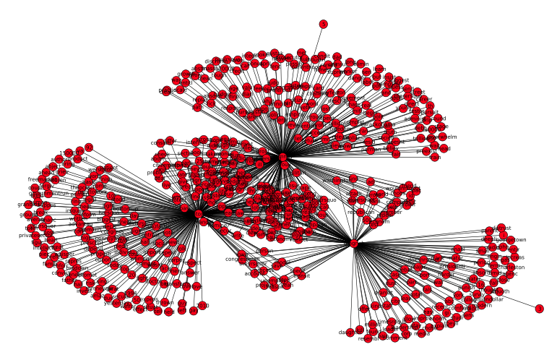

Slide 25
Linguistic Markers
All candidates have something in common -- they are conservative republicans and will speak about topics that resonate with the base
At the same time, each candidate has prominent distinguishing markers
  Frequently used expressions that are unique to the candidate

Slide 26
Identifying Markers
From the overall network of words,
  isolate ego-networks for the candidates
  take intersection of their node-sets to see what they have in common
    .... not that much
  subtract common from total

Slide 27
Identifying Markers
words=net.read_pajek('egauge_wordgraph.net')
for node in words.nodes():
if node in states: words.remove_node(node)
obama=net.ego_graph(words,'obama')
gingrich=net.ego_graph(words,'gingrich')
paul=net.ego_graph(words,'ronpaul')
santorum=net.ego_graph(words,'santorum')
romney=net.ego_graph(words,'romney')
g_vs_p=set(gingrich.nodes()) & set(paul.nodes())
g_vs_s=set(gingrich.nodes()) & set(santorum.nodes())
r_vs_s=set(romney.nodes()) & set(santorum.nodes())

Slide 28
Differences are easy to spot
Gingrich vs. Paul:
'major', 'creat',
'give', 'money',
'tax', 'DC',
'year', 'find',
'cut', 'person',
'young', 'lot',
'citizen','import',
'today', 'peopl',
'pick', 'nation',
'job', 'day'
Gingrich vs. Santorum
societi','dont','creat',
'idea','year','energi',
'make','economi','kid',
'life','regul','peopl','gonna'
'DC','job','understand',
'plan','govern','put',
'america','obama','school'
'made','thing','american',
'time','countri','chang',
'spend','talk'

Slide 29
Mapping the results
Mapping is complicated.GOALS:
Don’t let the consumers of information know that.
Get something published, then pass through another iteration to improve it.

Slide 30
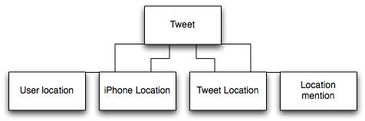
Twitter Location Data is Garbage
We use fuzzy methods for best-guess
estimation of user location
Improve accuracy from 5% to ~40%

Slide 31
User location & Location mentions
Many possible ways of saying the same thing
Many misspellings
Use Levenshtein distance to known locations
If nothing found, use Yahoo geocoder (rate-limited and rather slow, 1s / geocode)

Slide 32
Mobile Location
Provides coordinate in 3 different formats (iPhone, UberTwitter, Android most common)
Parse each format, reverse-geocode to find location name
Cache in the database

Slide 33
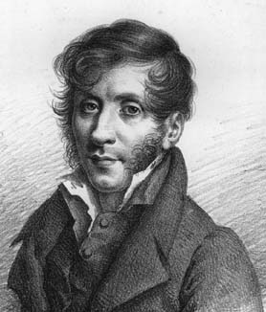
First Iteration
Choropleth - “a thematic map in which areas are shaded or patterned in proportion to the measurement of the statistical variable being displayed.” - wikipedia
Charles Dupin published the first known instance of a choropleth in 1826.

Slide 34
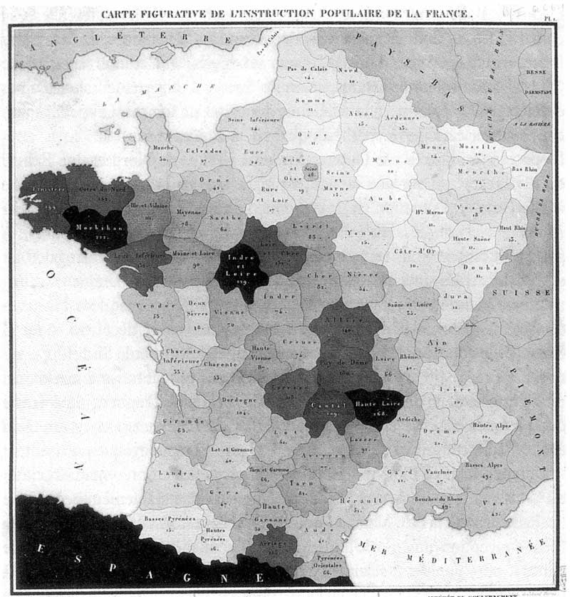
Distribution of Illiteracy in France (1826)

Slide 35
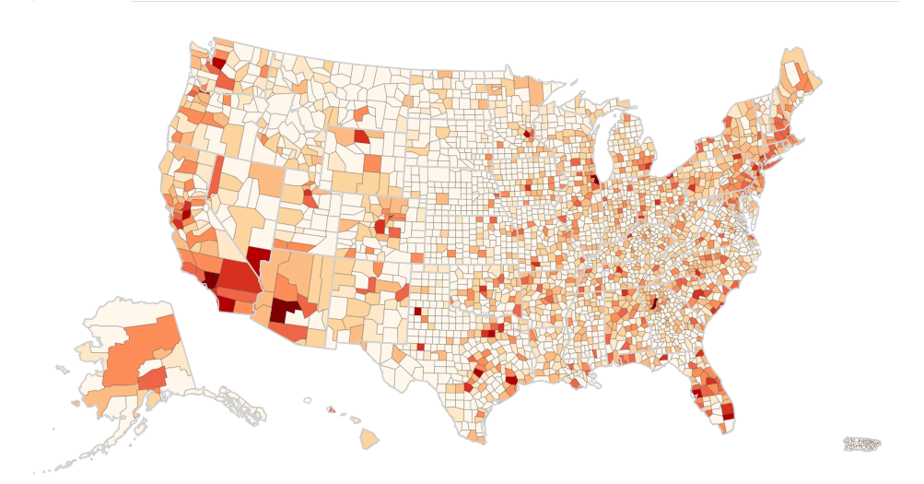
Technique still applies

Slide 36
How to accomplish?
  D3 front-end javascript library: http://mbostock.github.com/d3/ex/choropleth.html
  Understanding of projection, data border files, and processing
  HTML, CSS

Slide 37
Create a map w/ states
// Add svg tag to element with chart id
var svg = d3.select("#chart")
.append("svg");
// Add place holder for counties
var counties = svg.append("g")
.attr("id", "counties")
.attr("class", "OrRd");
// Attach county json & data to counties
d3.json("/static/data/d3/us-counties.json", function(json) {
counties.selectAll("path")
.data(json.features)
.enter().append("path")
.attr("class", data ? quantize : null)
.attr("d", path);
});
For full example code, visit D3 link.

Slide 38
More... map data
D3 website offers states, counties, and countries, but there is so much more.
More shape files @ US census website:
http://www.census.gov/geo/www/tiger/shp.html
For local level, look at local authorities.
  Example: DC neighborhood maps
  http://data.octo.dc.gov/Metadata.aspx?id=163

Slide 39
More... less map data
Problem with shape files: Too much information for simple graphics.
When you displaying 300 miles per pixel, you don’t need to maintain detail by the foot.
Use Map Shaper to simplify the geometry.

Slide 40
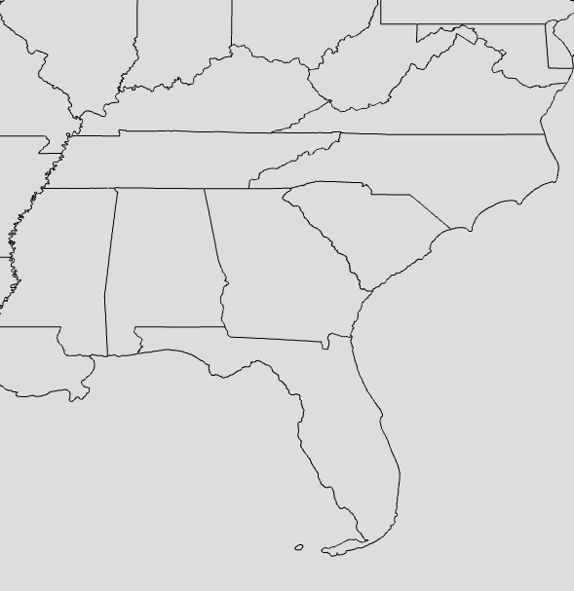
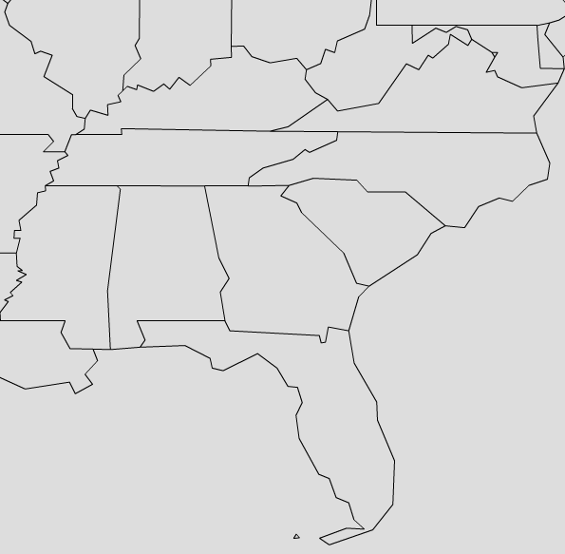
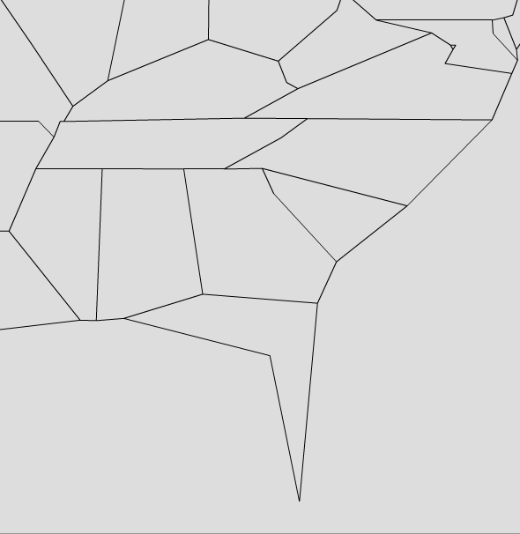
More... less map data

Slide 41
More ... data handling
Export from Map Shaper.
Use ogr2ogr to convert shapefiles to GeoJSON.
$ ogr2ogr -f geoJSON us_states.json us_states.shp

Slide 42
More... projection
One last thing... projection. That is a talk itself. Know the following...
The world is round, your map is probably not.
Areas will be distorted.
Read up on projection & datums.

Slide 43

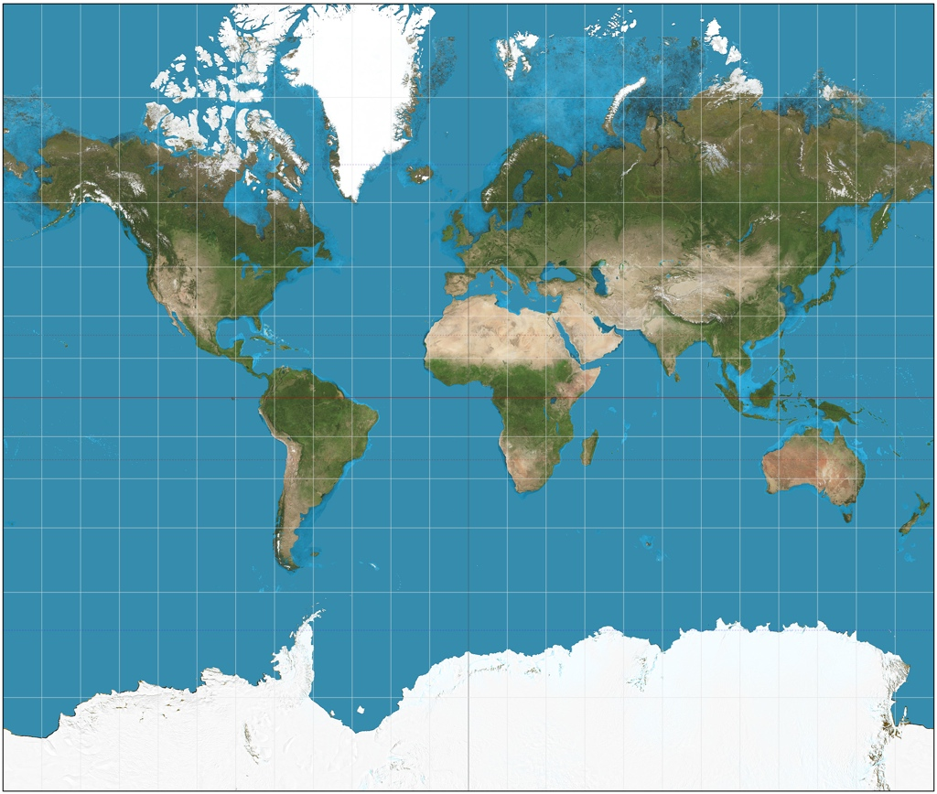
More... projection
This can be handled in using D3.
https://github.com/mbostock/d3/wiki/Geo-Projections
Note: Make sure your your data components are using the same projection.

