Slide 1

Social Network Analysis of Campaign Finance Data
Maksim Tsvetovat
Twitter: @maksim2042

Slide 2
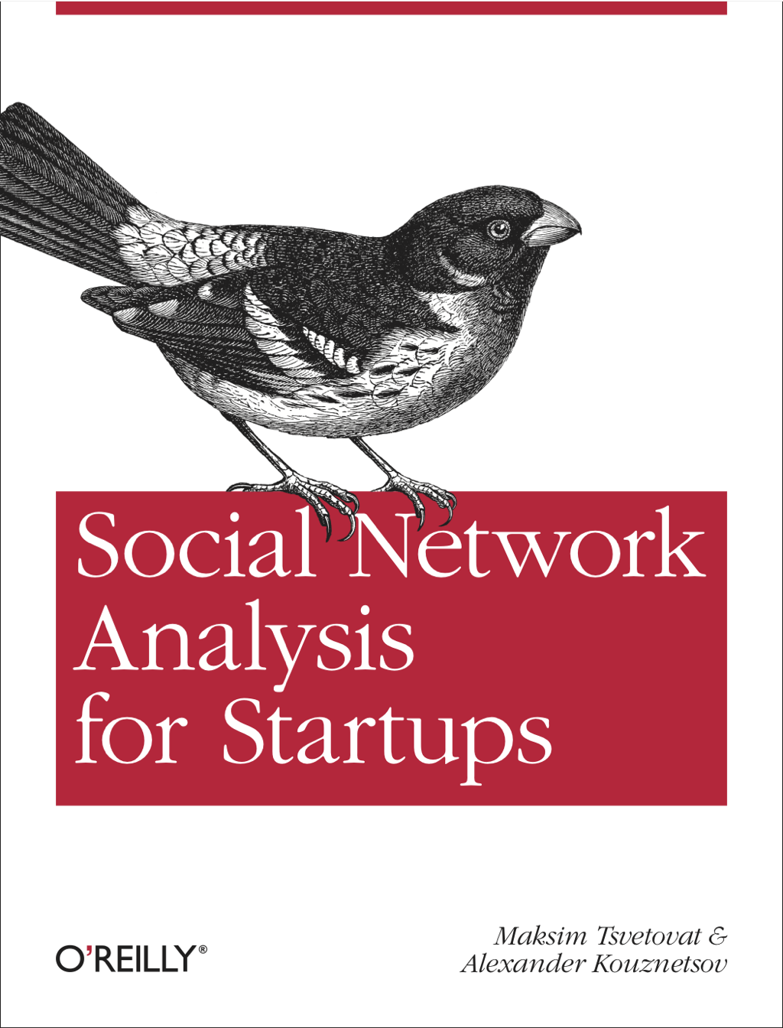
My Book
http://shop.oreilly.com/product/0636920020424.do
Use discount
code
SNAFS
(40% off print,
50% off e-book)

Slide 3
Python requirements
Python 2.7 (not yet 3.0)
JSON -- built-in parser
NetworkX
Matplotlib (requires NumPy)
Demo using iPython Notebook (optional)

Slide 4
GitHub
https://github.com/maksim2042/SNABook

Slide 5
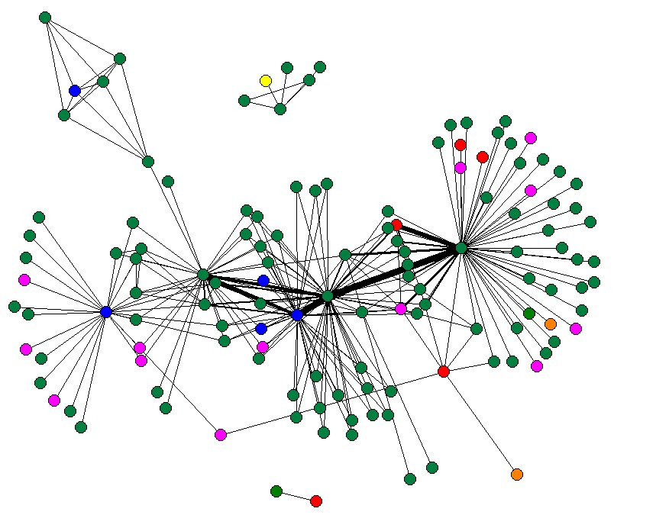

Slide 6
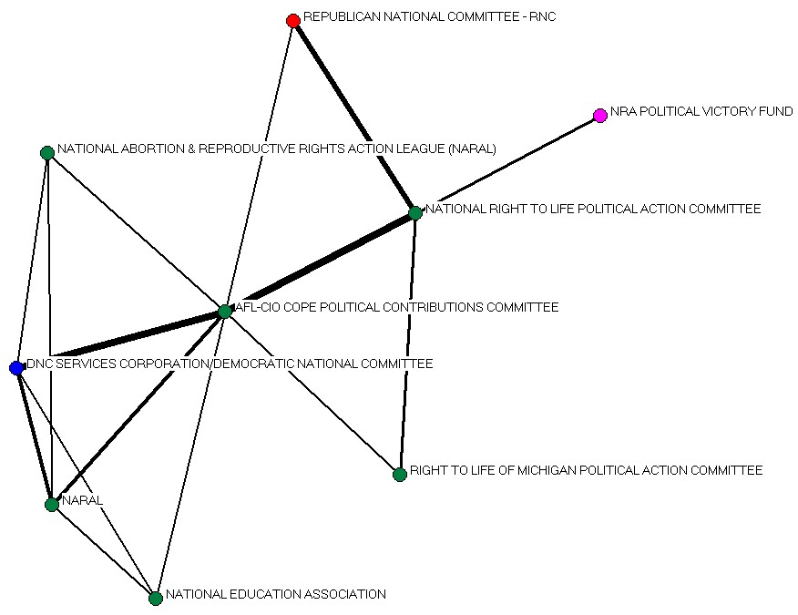

Slide 7
Campaign Finance Records are Public www.fec.gov

Slide 8
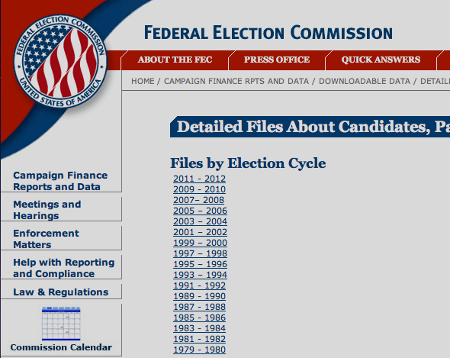
http://fec.gov/finance/disclosure/ftpdet.shtml

Slide 9
... Data in stone age ...
:(

Slide 10
C00000042ILLINOIS TOOL WORKS INC. FOR BETTER GOVERNMENT COMMITTEE WANLESS, BROCK A. 3600 WEST LAKE AVENUE GLENVIEW IL60026BQ QCILLINOIS TOOL WORKS INC. C00000059HALLMARK CARDS PAC GREG SWARENS 2501 MCGEE MD#288 KANSAS CITY MO64108UQUNKMC C00000422AMERICAN MEDICAL ASSOCIATION POLITICAL ACTION COMMITTEE WALKER, KEVIN 25 MASSACHUSETTS AVE, NW SUITE 600 WASHINGTON DC20001BQ MMAMERICAN MEDICAL ASSOCIATION C00000489D R I V E POLITICAL FUND CHAPTER 886 TOM RITTER 3528 W RENO OKLAHOMA CITY OK73107UN QLTEAMSTERS LOCAL UNION 886 C00000547KANSAS MEDICAL SOCIETY POLITICAL ACTION COMMITTEE C. RICHARD BONEBRAKE, M.D. 623 SW 10TH AVE TOPEKA KS66612UQUNKQTMEDICAL ASS'N; KANSAS [AMPAC] C00000638INDIANA STATE MEDICAL ASSOCIATION POLITICAL ACTION COMMITTEE KORA, M.D., VIDYA 322 CANAL WALK, CANAL LEVEL INDIANAPOLIS IN46202UQ QMINDIANA STATE MEDICAL ASSOCIATION

Slide 11
VariableColumns Desc
Committee Identification 1-9 9s
Committee Name 10-99 90s
Treasurer's Name 100-137 38s
Street One 138-171 34s
Street Two 172-205 34s
City or Town 206-223 18s
State 224-225 2s
Zip Code 226-230 5s
Committee Designation 231-231 1s
Committee Type 232-232 1s
Committee Party 233-235 3s
Filing Frequency 236-236 1s
Interest Group Category 237-237 1s
Connected Organiz's Name 238-275 38s
Candidate Identification 276-284 9s

Slide 12
Python to the Rescue
It only takes a few lines to extract from this mess into something more palatablepacs={}
pac_file=open('2012/foiacm.txt','rb')
for line in pac_file:
pid=line[0:9]
ctype=line[0]
name=line[9:99].strip()
party=line[232-235]
ctype=line[231]
zip=line[225:230]
pacs[pid]={'name':name,'party':party,'type':ctype,'zip':zip}

Slide 13
This is much better ;-)
[(k,pacs[k]) for k in pacs.keys()[:3]]
[('C00308403',
{'name': 'MICHELA ALIOTO FOR CONGRESS',
'party': '0',
'type': 'H',
'zip': '91502'}),
('C00488205',
{'name': 'LIAR ALERT POLITICAL ACTION COMMITTEE',
'party': ' ',
'type': 'N',
'zip': '91502'}),
('C00464107',
{'name': 'CORNILLES FOR CONGRESS',
'party': '9',
'type': 'H',
'zip': '75202'})]

Slide 14
Repeat for Candidates
candidates={}
can_file=open('2012/foiacn.txt','rb')
for line in can_file:
cid=line[0:9]
name=line[9:47].strip()
party=line[47:50]
inc=line[56]
zip=line[147:152]
candidates[cid]={'name':name,'party':party,'type':ctype,'inc':inc,'zip':zip}

Slide 15
Contribution Data
C00000042NYE P1295021675624K111820110002500C00496703S2ND000730976232C00000042NYE P1295021675624K111820110002000C00394866H4LA070290976233C00000042NYE P1295021675624K111820110005000C00494930S2OH001700976234C00000042NYE P1295021675724K111820110002000C00418293H6GA041290976235C00000042NYE P1295021675724K112120110002000C00376665H2TN051310976236C00000042NYE P1295021675724K111820110001000C00462374H0AR010830976237C00000042NYE P1295021675824K111820110005000C00347476H0MI100710976238C00000042NYE P1295021675824K112120110001000C00472878H0TN062570976239C00000042NYE P1295021675824K111820110005000C00465971H0IL103020976240C00000042NYE P1295021675924K111820110002500C00252973H0IL160850976241C00000042NYE P1295021675924K112120110002500C00464339H0WI070510976242

Slide 16
Mnemonics
Currently
Used by the Field
Commission Variable Columns Desc.
---------------------------------------------------------------
ITEM-FILER Identification Number 1-9 9s
ITEM-AMEND Amendment Indicator 10 1s
ITEM-REPT Report Type 11-13 3s
ITEM-PGI Primary-General Indicator 14 1s
ITEM-MICRO Microfilm Location (YYOORRRFFFF) 15-25 11s
ITEM-TRANS Transaction Type 26-28 3s
IT-TMN Transaction Date - Month 29-30 2d
IT-TDY Transaction Date - Day 31-32 2d
IT-TCC Transaction Date - Century 33-34 2d
IT-TYY Transaction Date - Year 35-36 2d
ITEM-AMT Amount 37-43 7n
ITEM-OID Other Identification Number 44-52 9s
ITEM-CAND Candidate Identification Number 53-61 9s
ITEM-RN FEC Record Number 62-68 7s

Slide 17
Contributions are a Network
Money come FROM a source TO a candidate
This kind of network is called 2-mode, or bimodal network

Slide 18
Breiger: 1974 - Duality of Persons and Groups
Argument:
Metaphor: people intersect through their associations, which defines (in part) their individuality.
In case of elections, who you accept money from may define your allegiances and behavior in office

Slide 19
An Example:
Construct a candidate to PAC
adjacency matrix:
1 2 3 4 5
A 0 0 0 0 1
B 1 0 0 0 0
C 1 1 0 0 0
D 0 1 1 1 1
E 0 0 1 0 0
F 0 0 1 1 0
Each column is a group, each row a person, and the cell = 1 if the person in that row belongs to that group.
A =

Slide 20
Persons Through Groups
2-mode networks
You can tell how many PACs two candidates have in common by comparing the rows:
Compare candidates A and F
1 2 3 4 5
A 0 0 0 0 1
B 1 0 0 0 0
C 1 1 0 0 0
D 0 1 1 1 1
E 0 0 1 0 0
F 0 0 1 1 0
1 2 3 4 5 Σ
A 0 0 0 0 1 = 1
F 0 0 1 1 0 = 2
AF 0 0 0 0 0 = 0
A =
Or candidates D and F
1 2 3 4 5 Σ
D 0 1 1 1 1 = 4
F 0 0 1 1 0 = 4
DF 0 0 1 1 0 = 2

Slide 21
An Example:
Similarly for PACs:
1 2 3 4 5
A 0 0 0 0 1
B 1 0 0 0 0
C 1 1 0 0 0
D 0 1 1 1 1
E 0 0 1 0 0
F 0 0 1 1 0
1 2 1•2
A 0 0 0
B 1 0 0
C 1 1 1
D 0 1 0
E 0 0 0
F 0 0 0
E 2 2 1
Group 1 has 2 members, group 2 has 2 members and they overlap by 1 members (C).
A =

Slide 22
Interpersonal Network
Intergroup Network
C
E
3
B
D
F
1
2
5
4
A
0 0 0 1 0 0
0 0 1 0 0 0
0 1 0 1 0 0
1 0 1 0 1 2
0 0 0 1 0 1
0 0 0 2 1 0
0 1 0 0 0
1 0 1 1 1
0 1 0 2 1
0 1 2 0 1
0 1 1 1 0

Slide 23
Extract a 2-mode network from Contributions file
and merge with attributes
g=net.Graph()
can_list=[]
pac_list=[]
contrib=open('2012/itpas2.txt','rb')
for line in contrib:
pid=line[0:9]
cid=line[52:61]
#amt=int(line[36:43])
g.add_edge(pid,cid)
if cid not in can_list: can_list.append(cid)
if pid not in pac_list: pac_list.append(pid)
if pid in pacs:
g.node[pid]=pacs[pid]
else:
pacs[pid]={'type':'unknown'}
if cid in candidates:
g.node[cid]=candidates[cid]
else:
candidates[cid]={'type':'unknown'}

Slide 24
Derive a Projected Network
cannet=bi.weighted_projected_graph(g, can_list, ratio=False)
import multimode as mm
cancore=trim_edges(cannet, weight=50)
mm.plot_multimode(cancore,type_string='party')

Slide 25

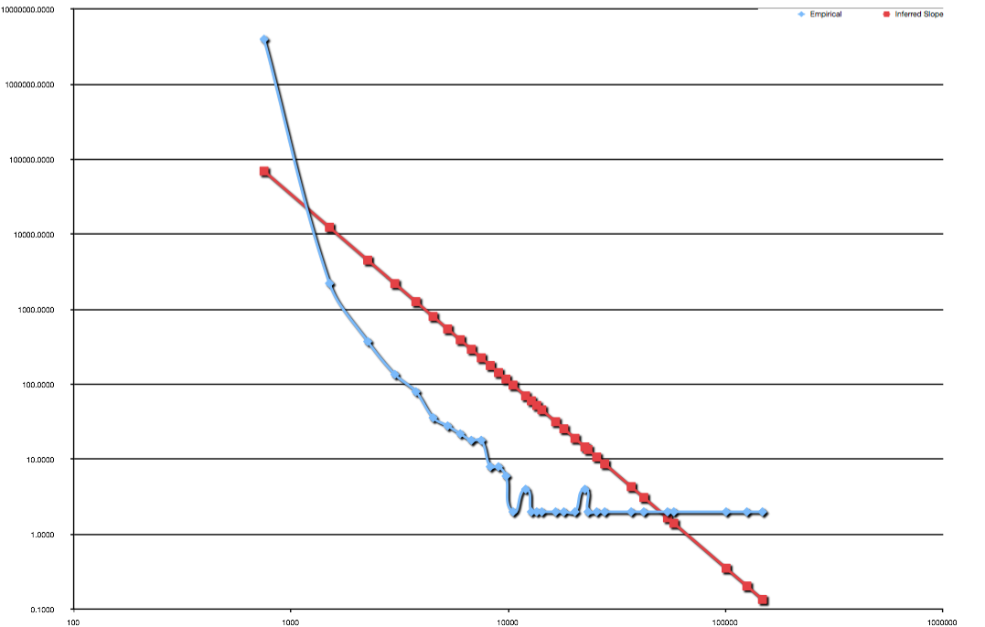
Distribution of Node Degrees

Slide 26
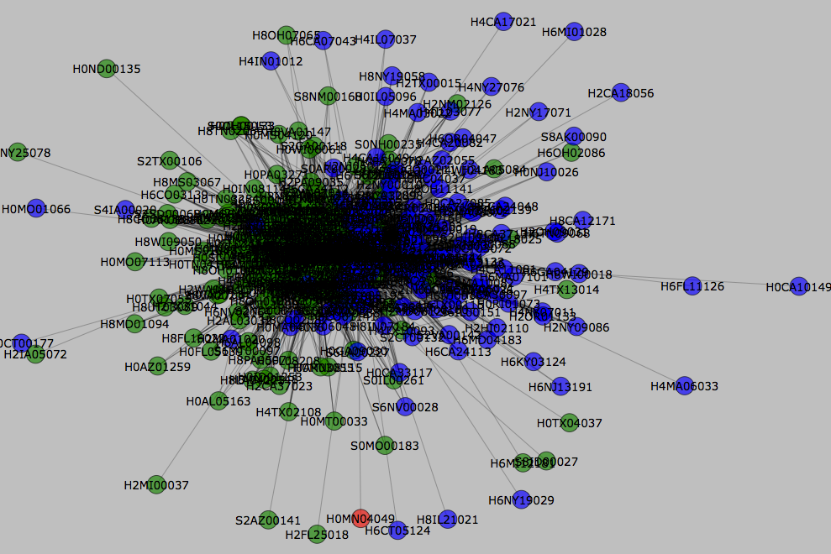

Slide 27
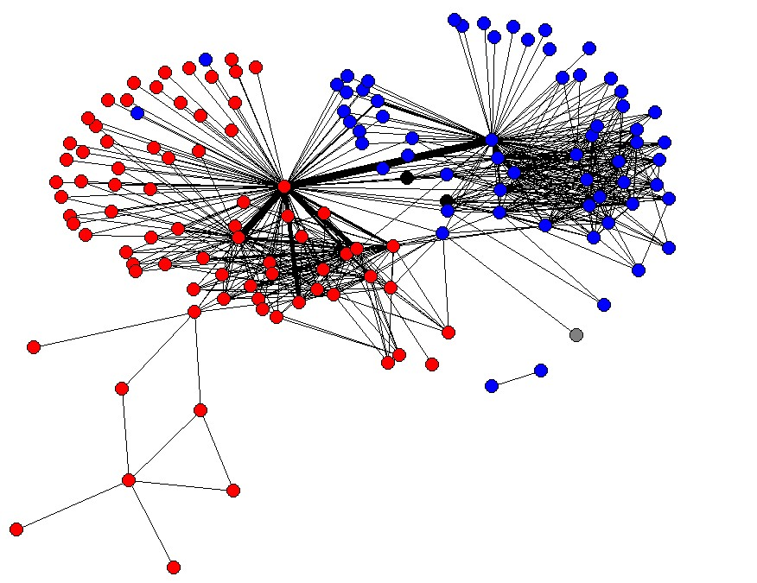
This is very different from 2000

Slide 28
... too early for partisanship
Partisan divisions are clearly there but many Republicans are now funded as Democrats!
Once general election season starts, things will heat up

Slide 29
PAC Net
PAC Net can be computed in similar way:
pacnet=bi.weighted_projected_graph(g, pac_list, ratio=False)
However... will take too long!

Slide 30
Projected networks are hard
Operation is O(n*m*n) where
  n = number of pacs
  m = number of candidates
  (or visa versa)
  O(n^3)

Slide 31
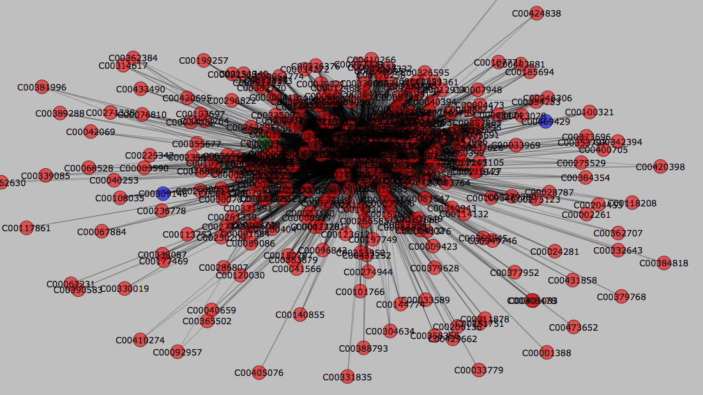

Slide 32
Super - Pacs
NATIONAL ASSOCIATION OF REALTORS POLITICAL ACTION COMMITTEE
AT&T INC. FEDERAL POLITICAL ACTION COMMITTEE
UNITED PARCEL SERVICE INC. PAC
HONEYWELL INTERNATIONAL POLITICAL ACTION COMMITTEE
LOCKHEED MARTIN CORPORATION EMPLOYEES' POLITICAL ACTION COMMITTEE
NATIONAL BEER WHOLESALERS ASSOCIATION POLITICAL ACTION COMMITTEE
GENERAL ELECTRIC COMPANY POLITICAL ACTION COMMITTEE (GEPAC)

Slide 33
Real SuperPacs are Invisible
They are not required to report expenditures on behalf of candidates, and their data does not appear on FEC website
SuperPACs account for ~70% overall funding in 2012 Republican races

Slide 34
... just introduction
The data is rich, but the data is dirty

