Slide 1

Chess analysis
Group members:
Jonas Jansen
Jonathan Meeng
Maksim Kolk
Roshan Baldewsing

Slide 2
Table of contents
Choice of subject
Data collection
Research questions
Hypotheses
Initial analysis
Mean similarities comparison
MDS
Conclusions

Slide 3
Choice of subject
Chess
Openings

Slide 4
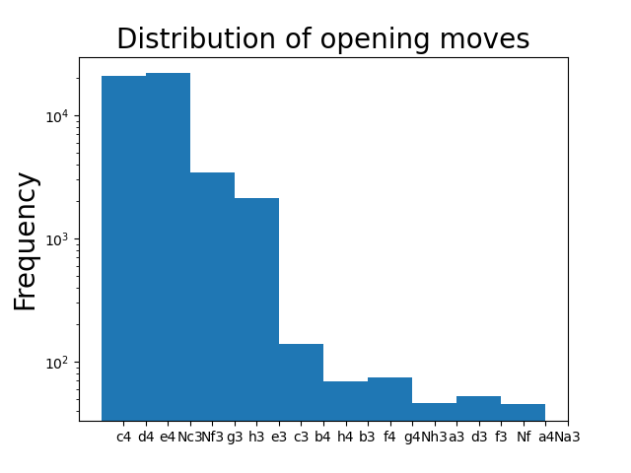
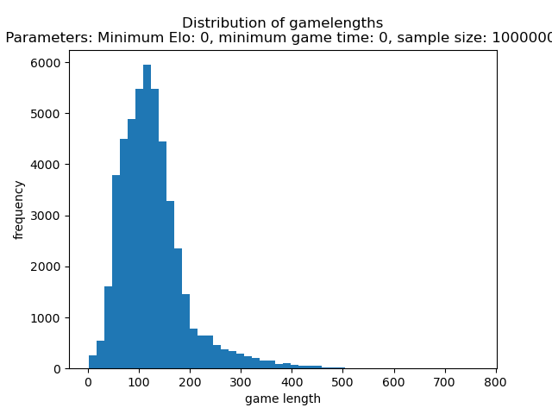
Initial analysis

Slide 5

Initial analysis

Slide 6
Research questions
Main question: can a chess opening be statistically defined?
Sub questions:
Which part of the chess game can be considered the opening (how many moves)?
Is it possible to make accurate clusters of openings on the basis of played moves?
Do factors like player skill affect the similarity of games?

Slide 7
Hypotheses
Openings that are alike will cluster together and be similar statistically

Slide 8
Data collection
Data acquired through Kaggle

Slide 9
Methods
Chess games as vectors where moves are the dimensions
Moves as ngrams
Scrambling moves (random sampling)
Comparing games with cosine similarity
Clustering games using Multi-Dimensional Scaling

Slide 10
What is an opening?
Chess theory: 10-15 moves
Finding statistical proof
Defining different stages using data
Checking by shuffling move order
Does it change for different parameters?

Slide 11
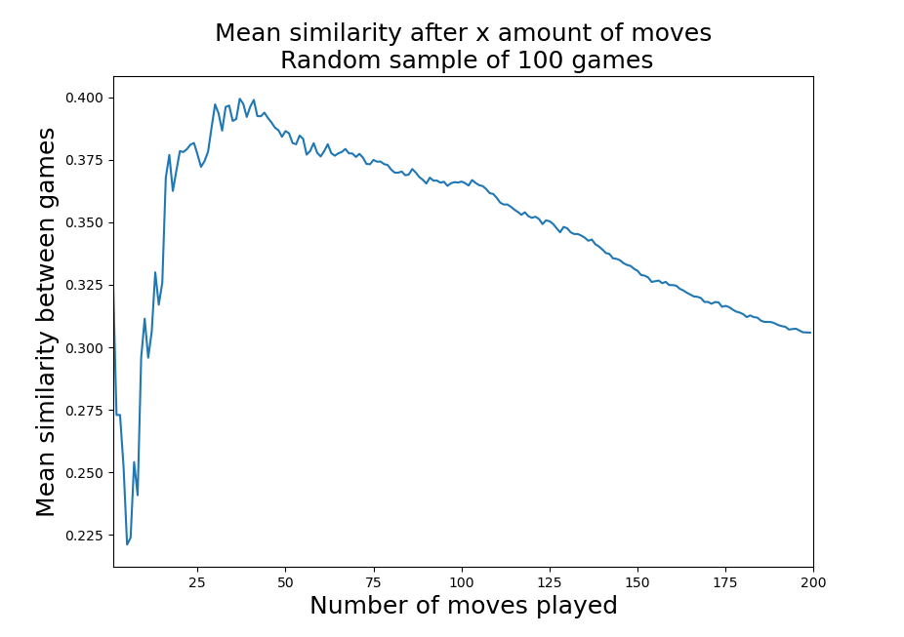
What is an opening?
Chess theory: 10-15 moves
Finding statistical proof
Defining different stages using data
Checking by shuffling move order
Does it change for different parameters?

Slide 12
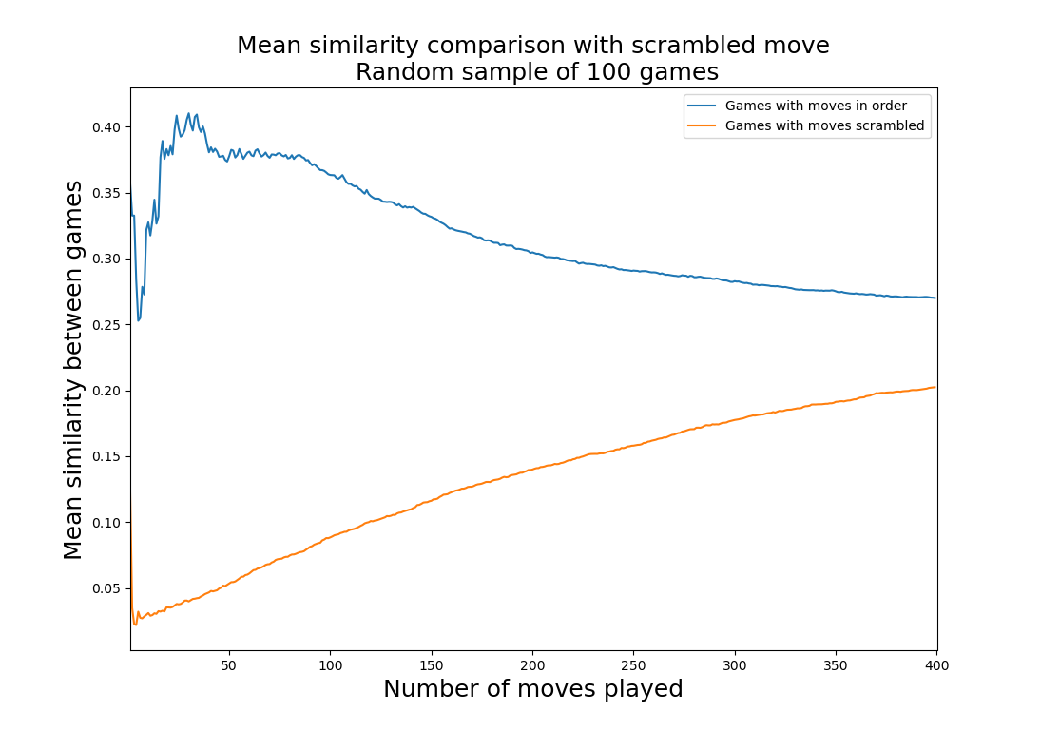
What is an opening?
Chess theory: 10-15 moves
Finding statistical proof
Defining different stages using data
Checking by shuffling move order
Does it change for different parameters?

Slide 13
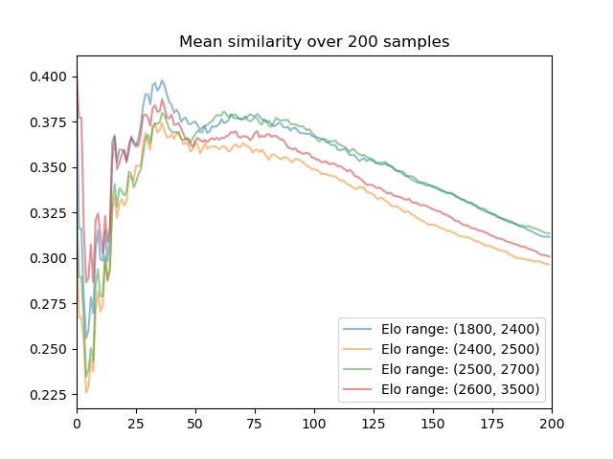
What is an opening?
Chess theory: 10-15 moves
Finding statistical proof
Defining different stages using data
Checking by shuffling move order
Does it change for different parameters?

Slide 14
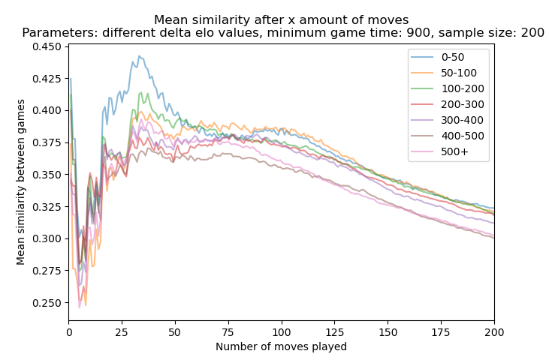
What is an opening?
Chess theory: 10-15 moves
Finding statistical proof
Defining different stages using data
Checking by shuffling move order
Does it change for different parameters?

Slide 15
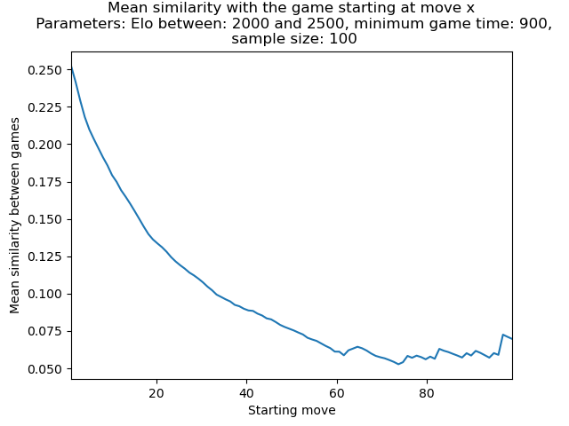
What is an opening?
Chess theory: 10-15 moves
Finding statistical proof
Defining different stages using data
Checking by shuffling move order
Does it change for different parameters?

Slide 16
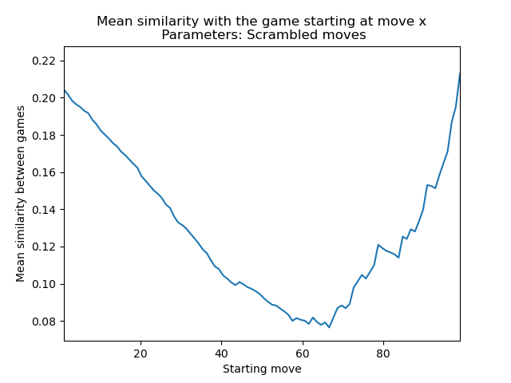
What is an opening?
Chess theory: 10-15 moves
Finding statistical proof
Defining different stages using data
Checking by shuffling move order
Does it change for different parameters?

Slide 17
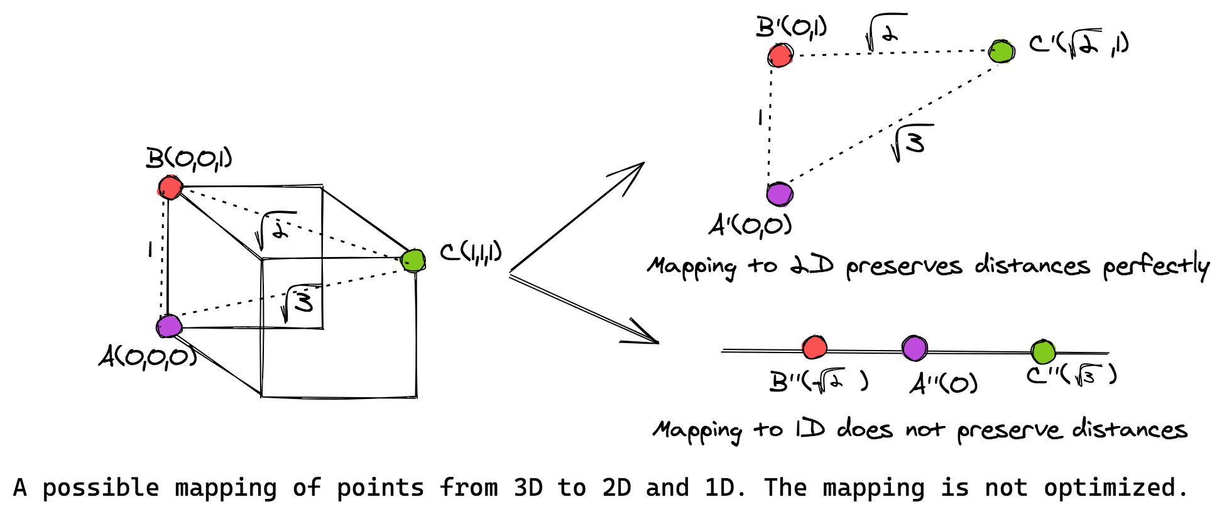
Clustering theory
Multiple Dimensional Scaling (MDS)
From higher to lower dimensions
For example from 3D to 2D
Euclidean distance
Relation to chess openings
Not non-metric data, because it is not ordinal data, but interval scale data.
n-grams from games to cosine similarities sorted by openings
Metric MDS, whereby distance matrix (1/S_{c})

Slide 18
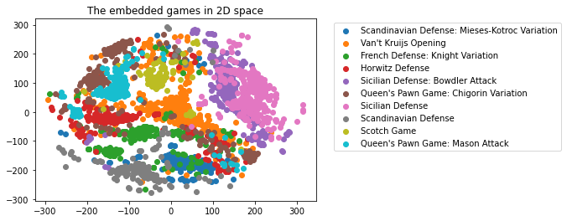
Clustering result
Some openings can be clustered
These openings will have a more specific (and often longer) move sequence

Slide 19
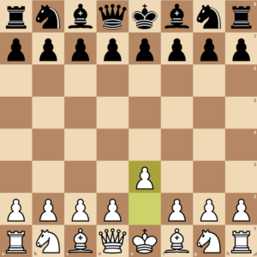
Clustering result
And there are openings which are less clustered
These openings are usually short and reach more
common positions
Example: Van ‘t Kruijs Opening is an opening from which many variations can be played

Slide 20
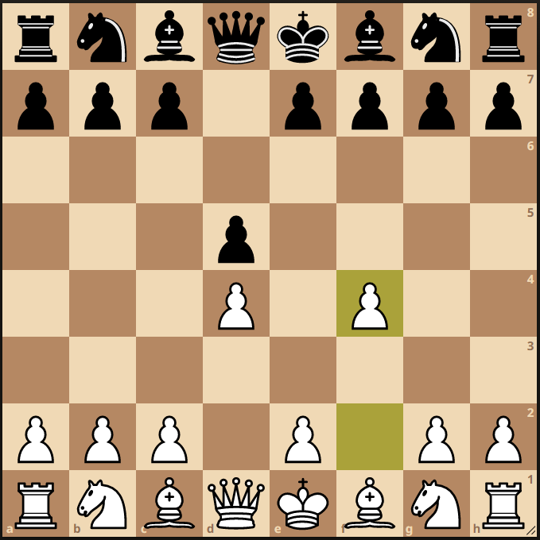
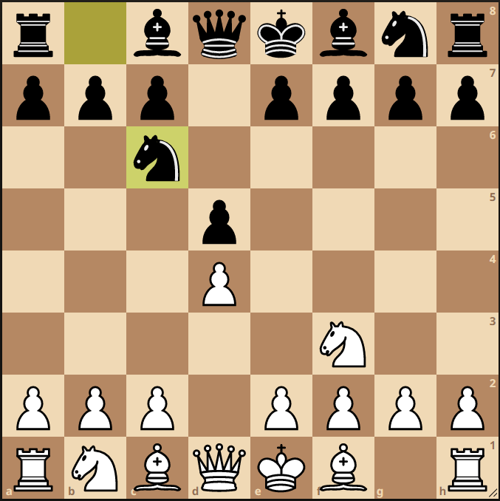
Clustering result
An example of opening variations, both of these positions are variations of the short “Queen’s pawn” opening. They will most likely cluster close to each other.
Examples:
Queen's Pawn Game: Mason Attack
Queen's Pawn Game: Chigorin Variation

Slide 21
Conclusion
The first ±10 moves can be considered as an opening
Clustering with small sample sizes show overlap for different openings which decreases cluster accuracy
Skill factors have no drastic impact on the similarity level of games
Thus chess openings can be statistically defined

