Slide 1

Easy Way website feedback

Slide 2
Table of Content
Home Page
Listings
Categories
Blogs
Contact Us
Additional Content

Slide 3

Home Page
The top should have : Home, Listings, Categories, Blog and Contact visible and not hidden. Done
The first poster should be an Easy Way banner detailing the categories of listings offered. e.g Real Estate Done
The Read More and Purchase now tabs should read “Sell now” and “Purchase now” respectively . Done

Slide 4

Home Page
The middle display picture should be Easy Way banner. Done
The left one should indicate “The Best BUY & SELL Martketplace” Done

Slide 5

Home Page
This should include a picture of any kind of real estate Done
It should also state “Sell now” and “Purchase now” Done
Below this, we need a demo video of how to use Easy Way. Pending

Slide 6
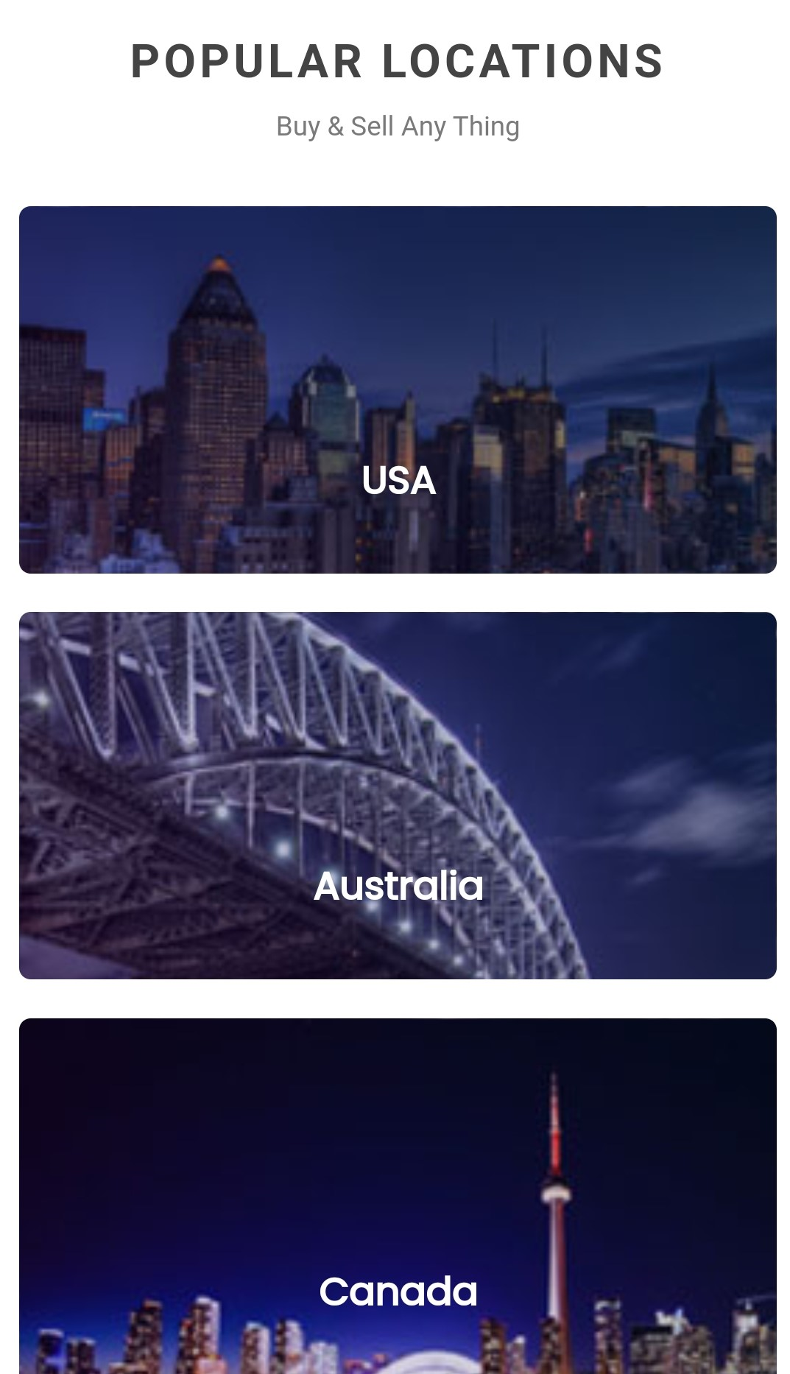
Home Page
This section should include the provinces of Zambia namely: Done
i) Copperbelt
ii) Lusaka
iii) North Western
iv) Northern
v) Southern, e.t.c
(I will provide the pictures for areas on seperate work sheet)

Slide 7
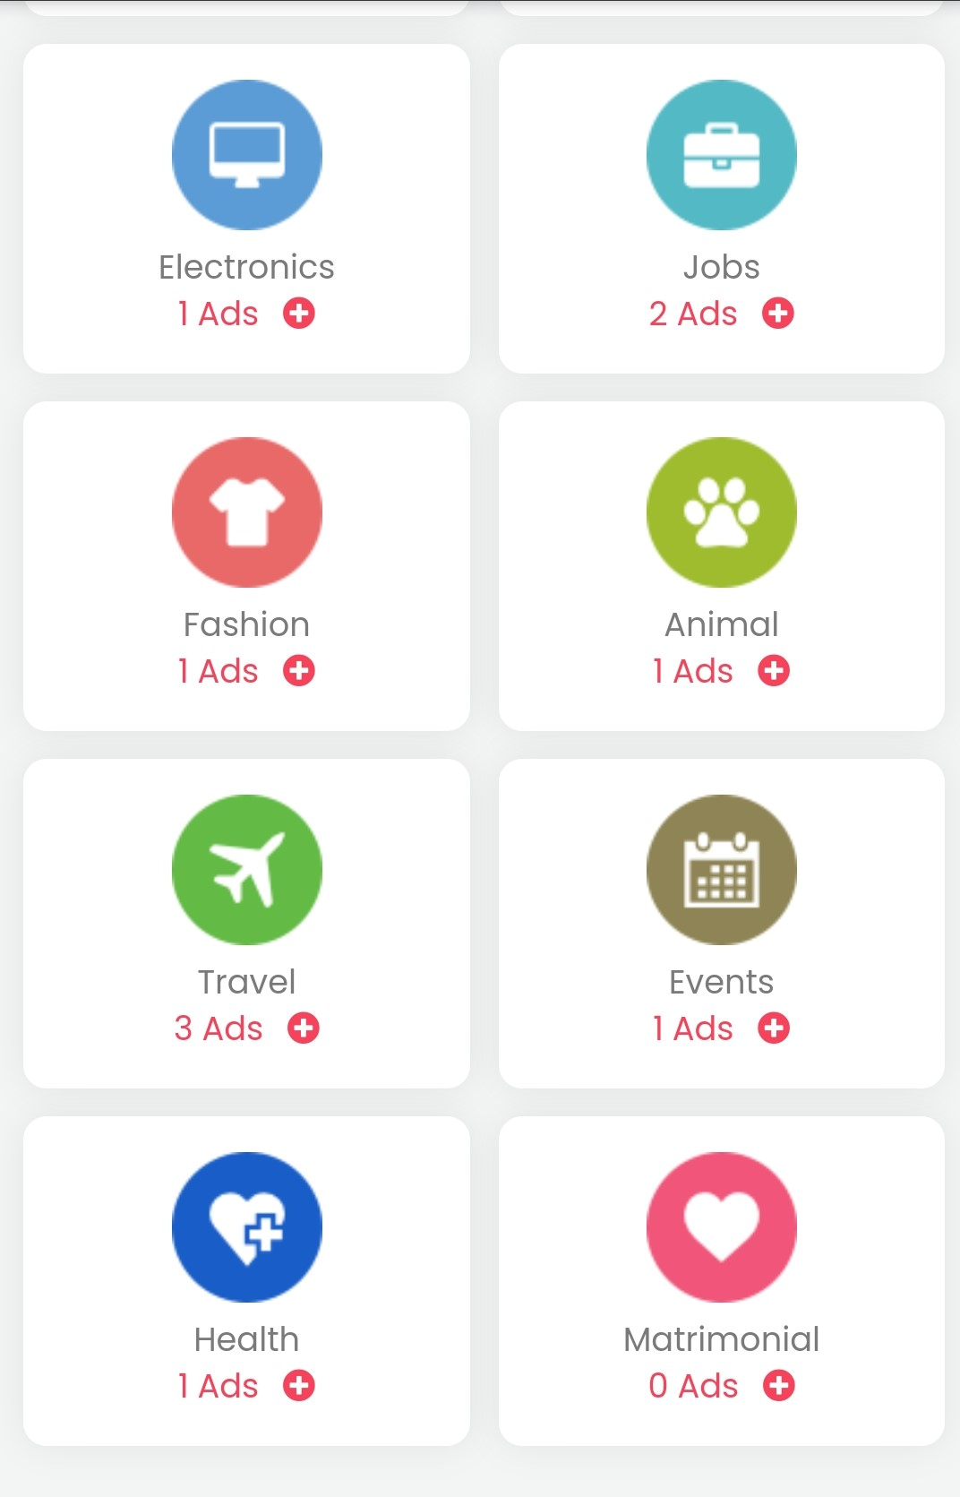
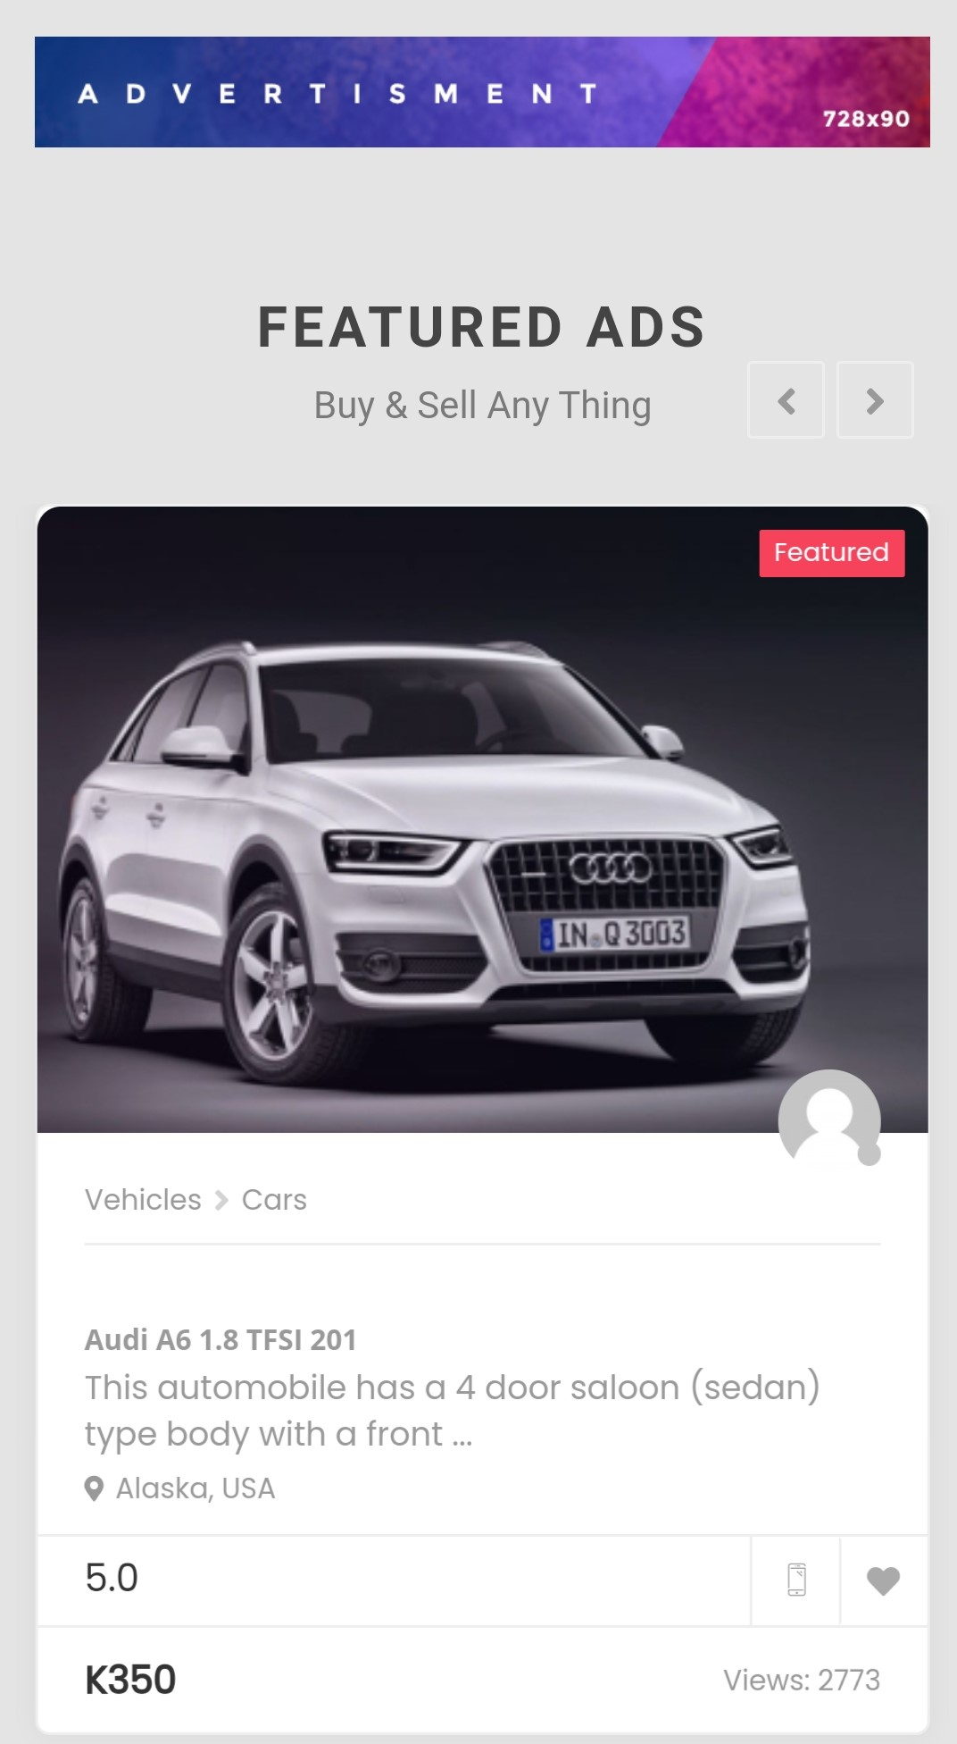
Home Page
We can leave these two
sections as they are, the content
will be provided later. As same as

Slide 8
Home Page: Bottom Section
The final sentence should state : “ copyright 2022 All Rights Reserved, Easy Way. and after should include the Terms and conditions. Done
The “About Us” section at the bottom of the page should read : Easy way is a dedicated site for the sale of second-hand products, ranging from furniture, jewelry, vehicles, apartments, etc., as well as independent advertising of the liberal professions. Done

Slide 9
Listings
Payment Options should include : Need To credentials
i) Credit Card
ii) MTN Mobile
iii) Airtel
iv) Zamtel

Slide 10
Categories
The categories page should include an Easy Way banner or a space to add feature ads Done https://easyway.aistechnolabs.xyz/categories/

Slide 11
Blogs
This will include blogs that will be used to either advertise a business or to educate the users on various sectors of the public. Therefore, content will be uploaded at a later stage Done

Slide 12
Contact us
Phone number
+260 211 222 799
Email Address
office.ifa.invest@gmail.com
Website
www.ifa-invest.com
Office Address
Plot 3269/M, Ibex Hill, Lusaka, Zambia Done

Slide 13
Additional Content
Include Chat Bot Need To credentials
Link needed service/product on Easy Way to appropriate Easy Product, e.g When someone clicks on jobs it takes them to Easy Job

