Slide 1
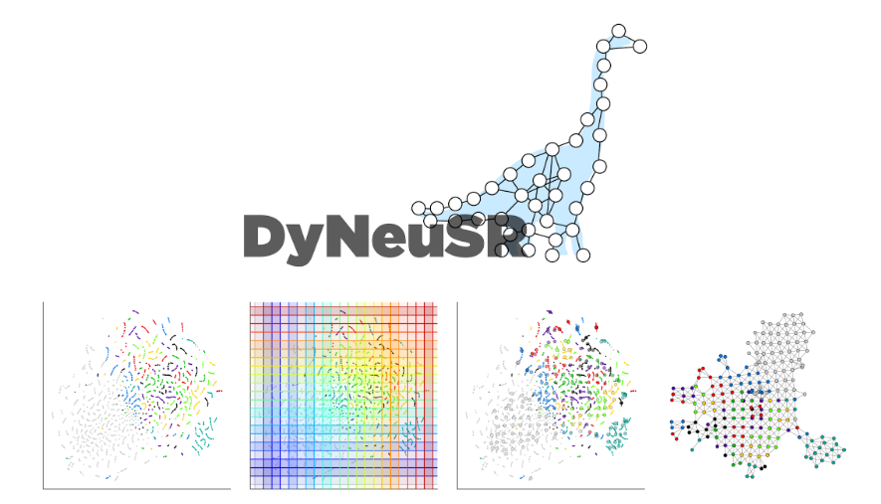
https://braindynamicslab.github.io/dyneusr/
Kanatov Nikolay 18IAD

Slide 2


Dynamical Neuroimaging Spatiotemporal Representations
DyNeuSR is a Python visualization library for topological representations of neuroimaging data.
DyNeuSR was designed specifically for working with shape graphs produced by the Mapper algorithm from topological data analysis (TDA)

Slide 3
Developed with neuroimaging data analysis in mind, DyNeuSR connects existing implementations of Mapper (e.g. KeplerMapper) with network analysis tools (e.g. NetworkX) and other neuroimaging data visualization libraries (e.g. Nilearn) and provides a high-level interface for interacting with and manipulating shape graph representations of neuroimaging data and relating these representations back to neurophysiology.

Slide 4
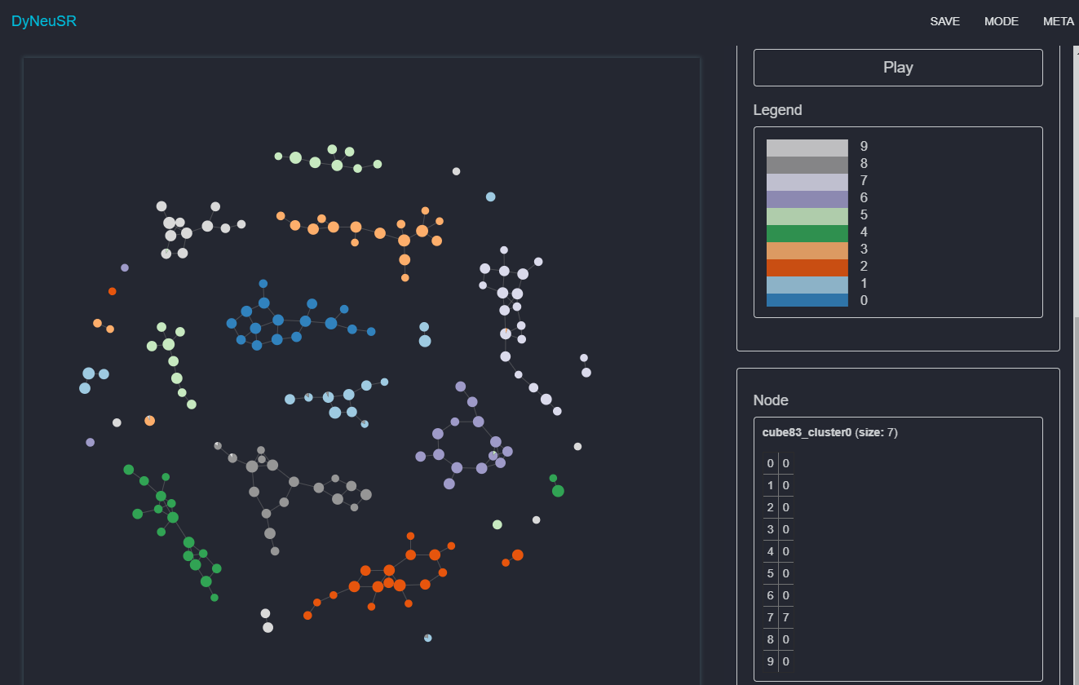
Digits data
More useful topological representations, where each color of node is class of label

Slide 5
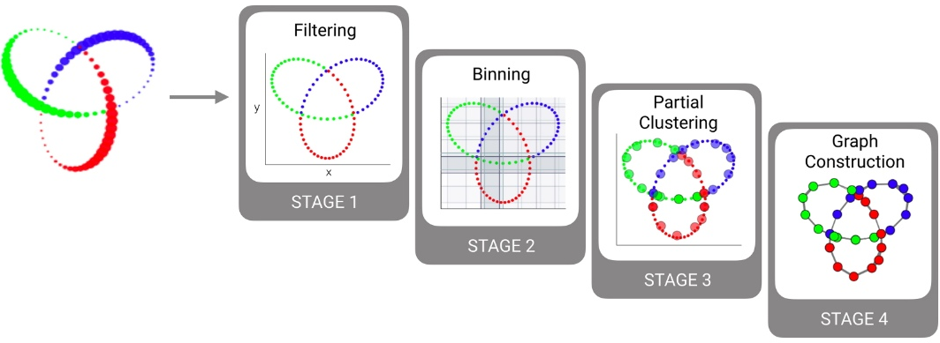
4 stages of mapper visualization

Slide 6
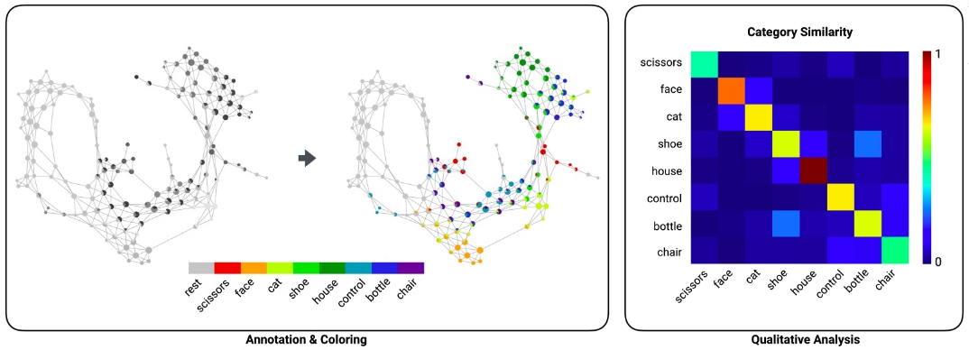

Slide 7
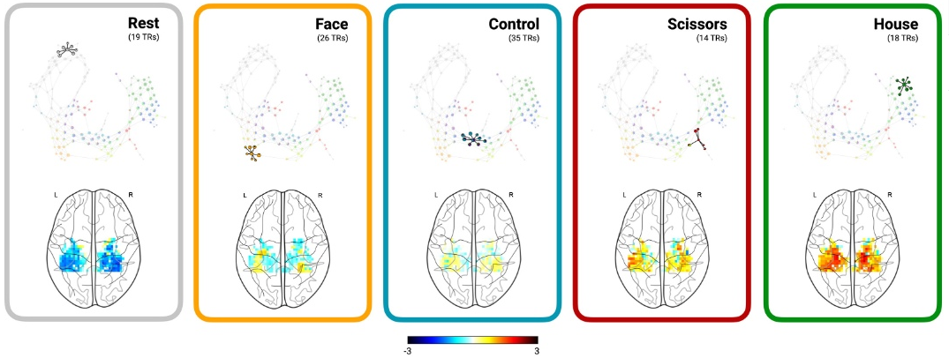

Slide 8
