Slide 1

scikit-tda
Молчанов Кирилл

Slide 2
scikit-tda
Meta-library that aggregate a bunch of other tools for topological analysis
Documentation:
No documentation
Installation:
pip install scikit-tda

Slide 3
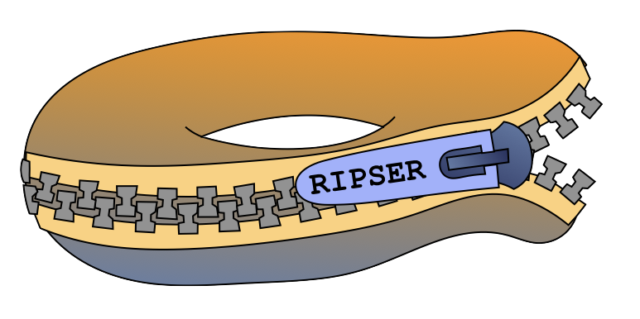
Ripser.py (yes, really .py)
Lean persistent homology package for python
Based on C++ core computational engine
Provide:
computing persistence cohomology of sparse and dense data sets,
visualizing persistence diagrams,
computing lowerstar filtrations on images, and
computing representative cochains.

Slide 4
Ripser.py
Documentation:
https://ripser.scikit-tda.org/
Installation:
pip install Cython
pip install Ripser

Slide 5
Ripser.py
Documentation - 2/2
Tutorials - 5/5
Usage - 5/5

Slide 6

Persim
Library for comparing persistence diagrams
Provides:
Persistence Images
Diagram distances (Bottleneck distance, Sliced Wasserstein Kernel, Heat Kernel)
Diagram visualization

Slide 7
Persim
Documentation:
https://persim.scikit-tda.org/
Installation:
pip install persim

Slide 8
Persim
Documentation - 5/5
Tutorials - 2/5
Usage - 4/5

Slide 9

CechMate
Provides easy to use constructors for custom filtrations that are suitable for use with Phat. Phat currently provides a clean interface for persistence reduction algorithms for boundary matrices. This tool helps bridge the gap between data and boundary matrices.
Provide:
Alpha filtrations
Rips filtrations
Cech filtrations
provide an easy interface for Phat.

Slide 10
CeckMate
Documentation:
https://cechmate.scikit-tda.org/
Installation:
pip install cechmate

Slide 11
CechMate
Documentation - 1/4
Tutorials - 0/5
Usage - 0/5

Slide 12

TaDAsets
Utilities for creating and loading data sets that are useful for Topological Data Analysis.
Provide:
n-spheres
torus
swiss rolls
figure 8s

Slide 13
TaDAsets
Documentation:
https://tadasets.scikit-tda.org/
Installation:
pip install tadasets

Slide 14
TaDAsets
Documentation - 2/5
Tutorials - 3/5
Usage 5/5

Slide 15
Examples

