Slide 1
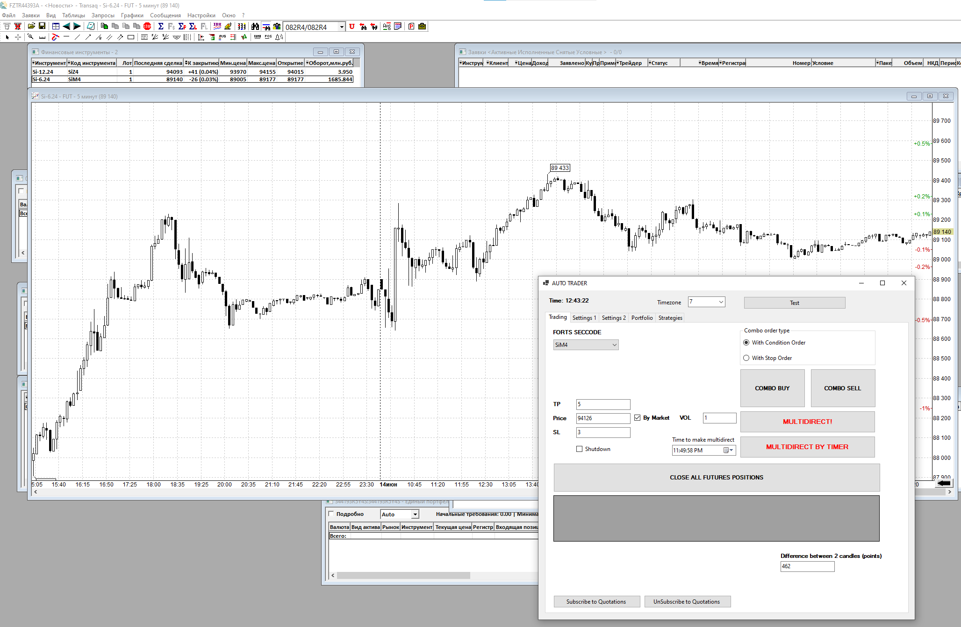
1. Open Transaq
2. Open Security Chart
5. Observe prices
7. Buy or Sell with preconfigured SL/TP
4. Preconfigure order
3. Open Auto Trader
8. Or Buy AND Sell at once

