Slide 1
Multiple relaxation times and fast dynamics in the mixed field Ising chain

Slide 2
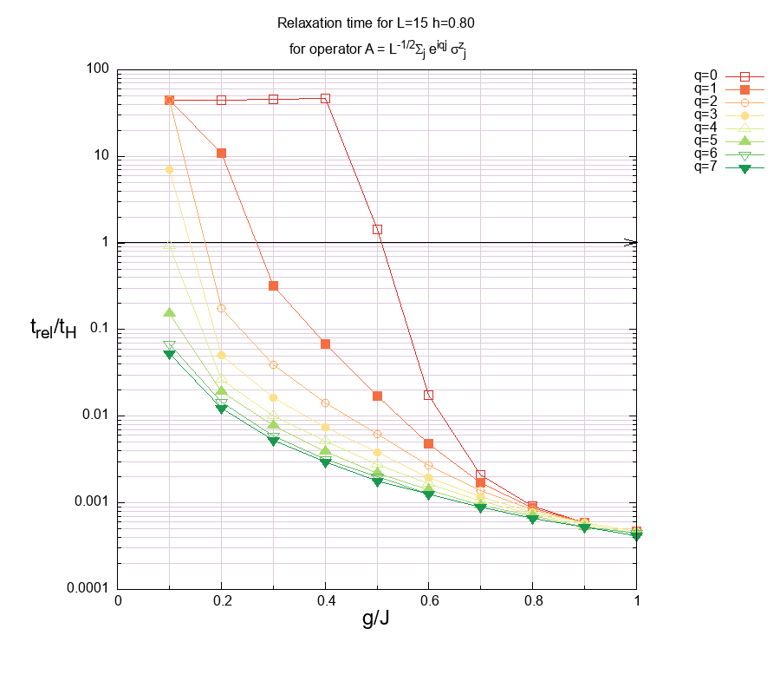
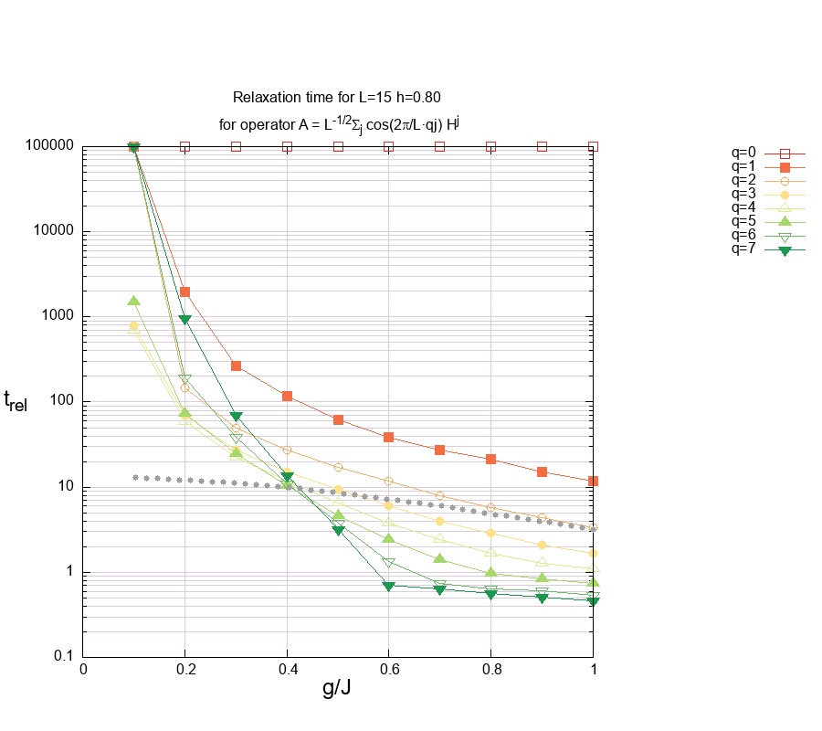
RELAXATION TIMES
Broad distribution of relaxation times at g~0.3-0.5 for sigmaZ_q and for Hq at large g (at even larger g it becomes narrow again?)

Slide 3
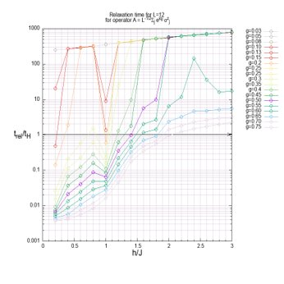
Side story

Slide 4
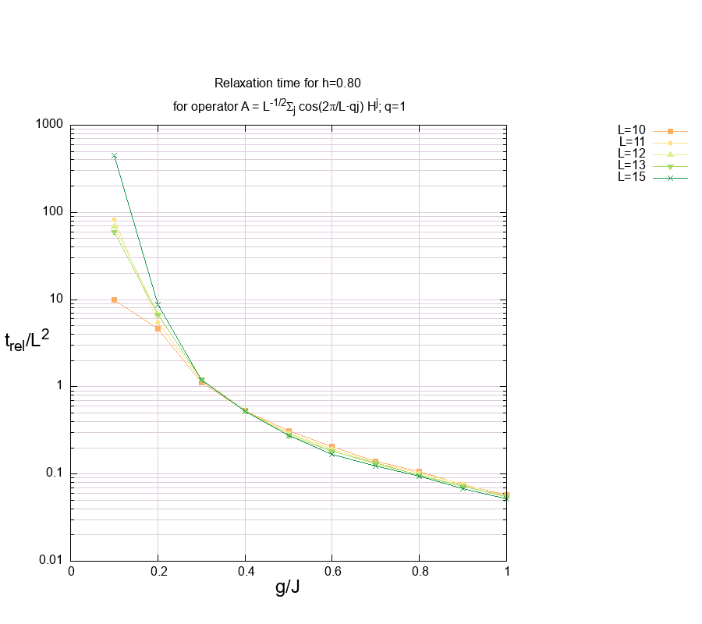
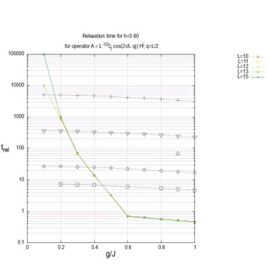
Fast vs slow dynamics

Slide 5
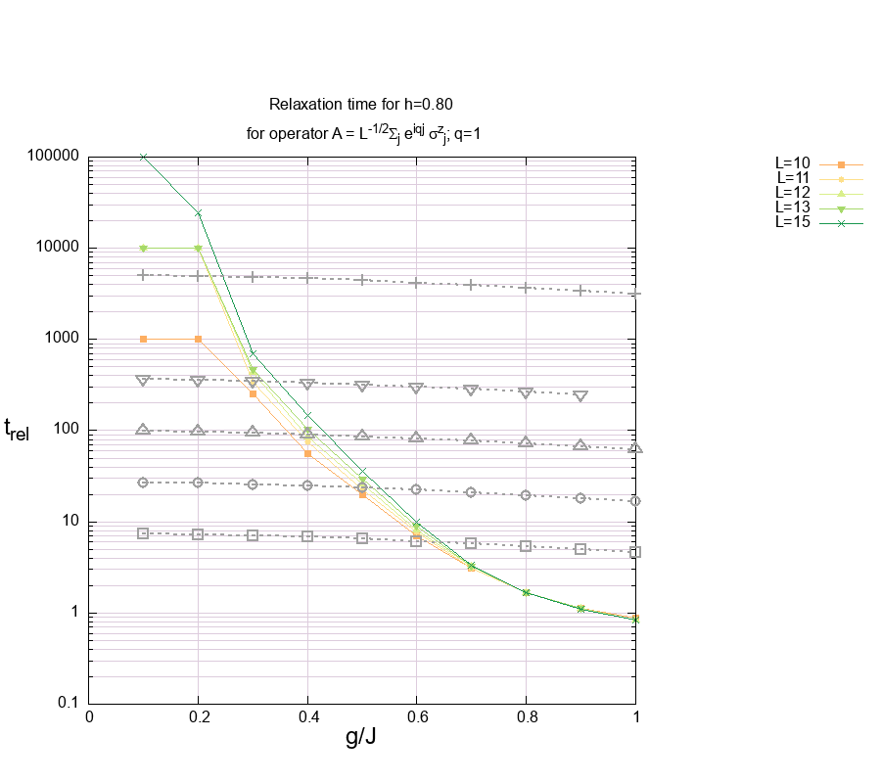
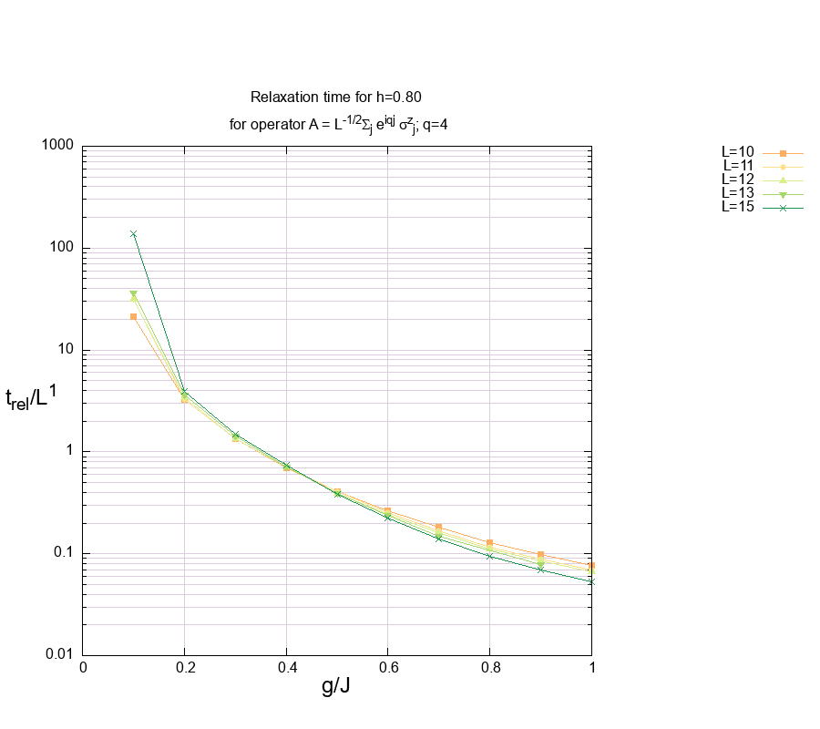
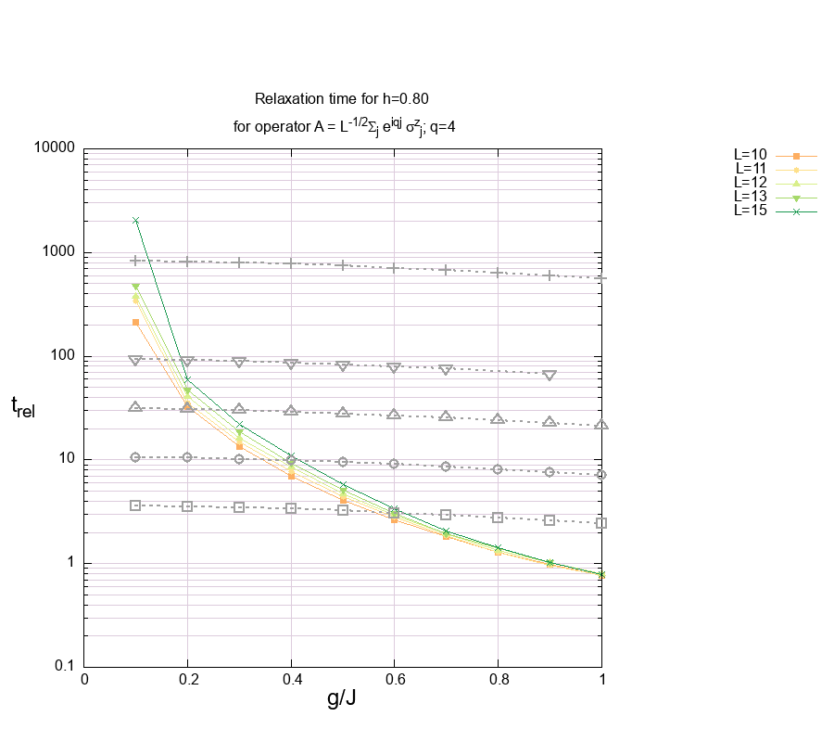
Collapse relaxation times:
Fast dynamics at large g (O(1) in system size)
sub-diffusive dynamics at g with broad distribution
Dashed grey lines are heisenberg times (point symbol matches the relaxation times data)

Slide 6
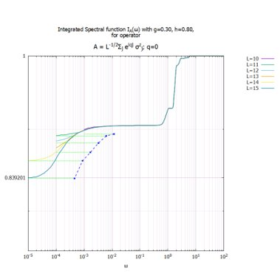
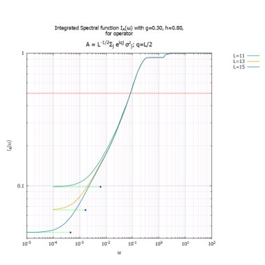
Fast dynamics of integrated spectral function –SigmaZ_q

Slide 7
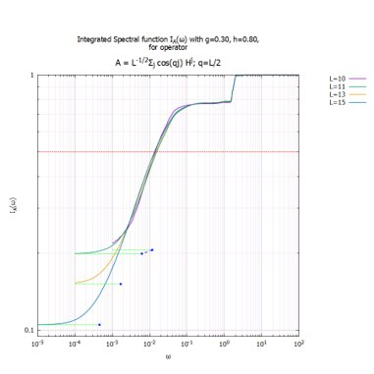
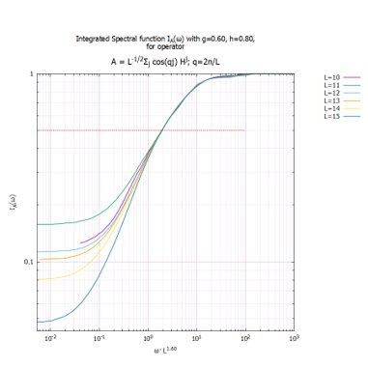
Fast vs slow dynamics integrated spectral function -Hq
O(1) scaling with system size for q->pi and q->0 ~L^2 (diffusive)

Slide 8
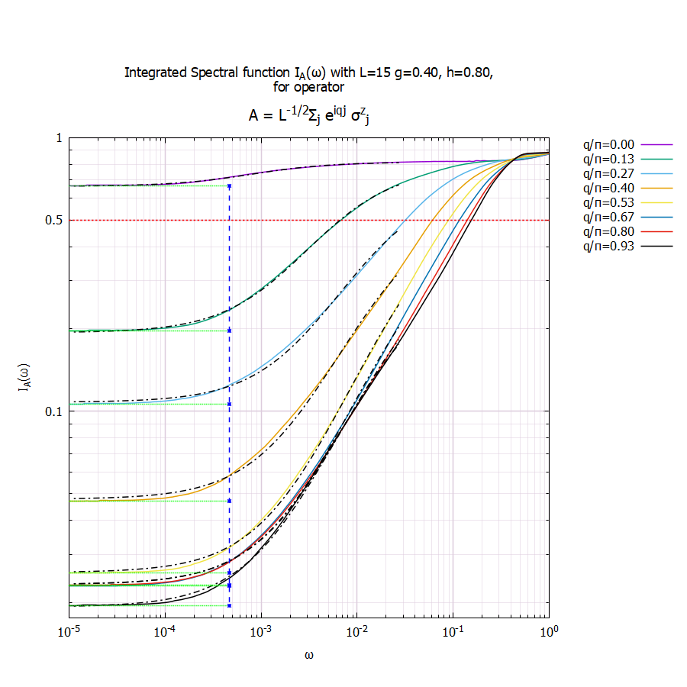
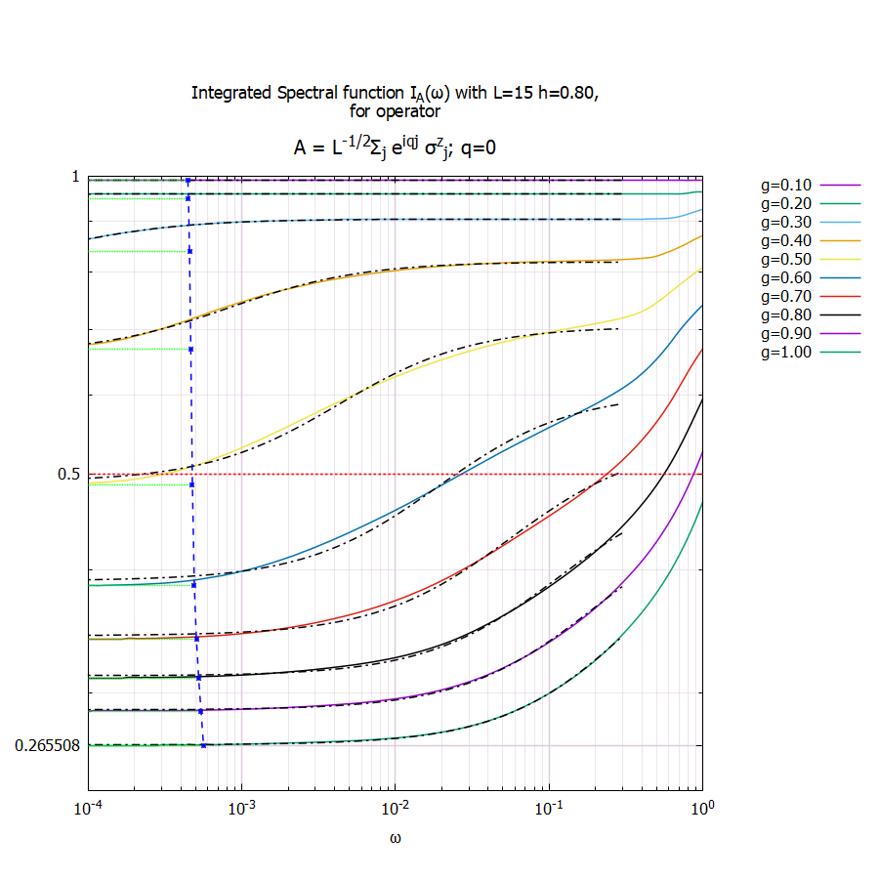
Lorentzian spectral function Sq^Z
Arcus tangens fit – good
->sectral function is lorentzian
At I=½ relaxation times show broad distribution
O(1) scaling with system size

Slide 9
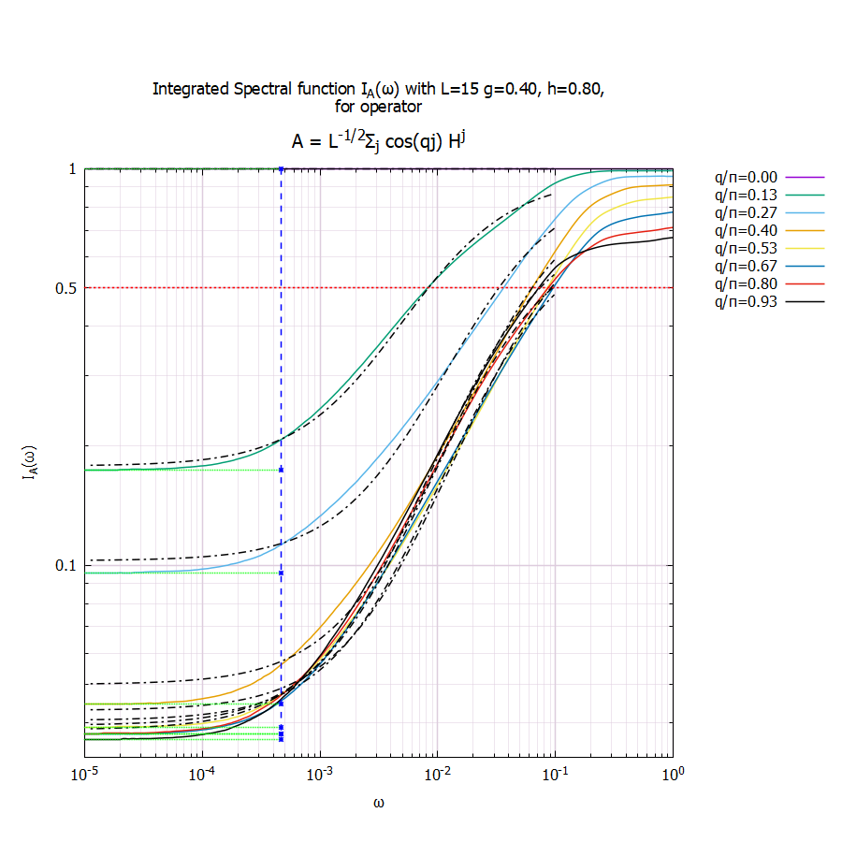
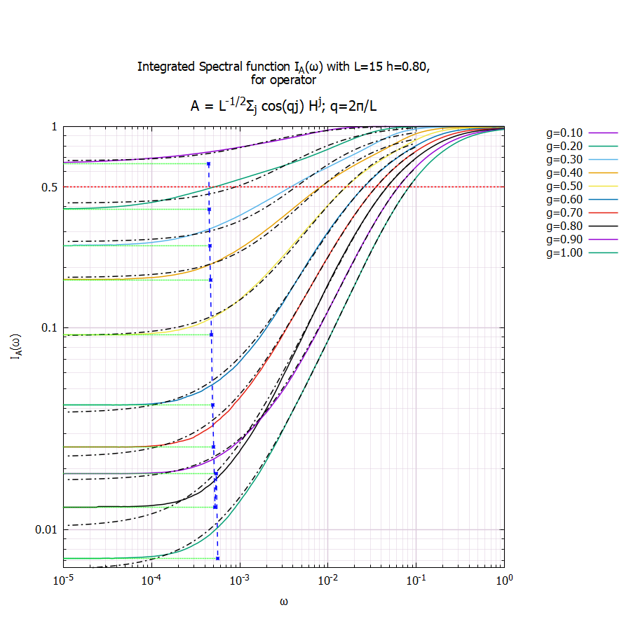
Lorentzian spectral function Hq
Arcus tangens fit is more or less accurate – for q=pi is not very good (atanh better?)
-> sectral function is lorentzian for q->0 limit

Slide 10
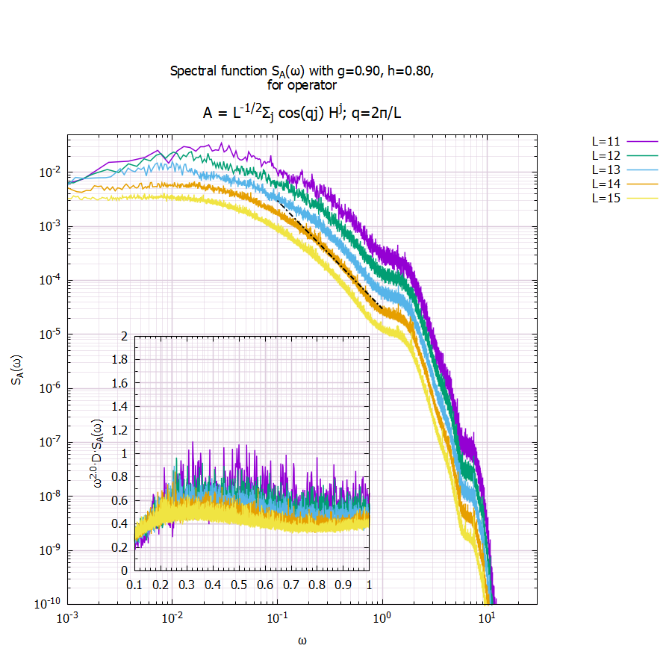
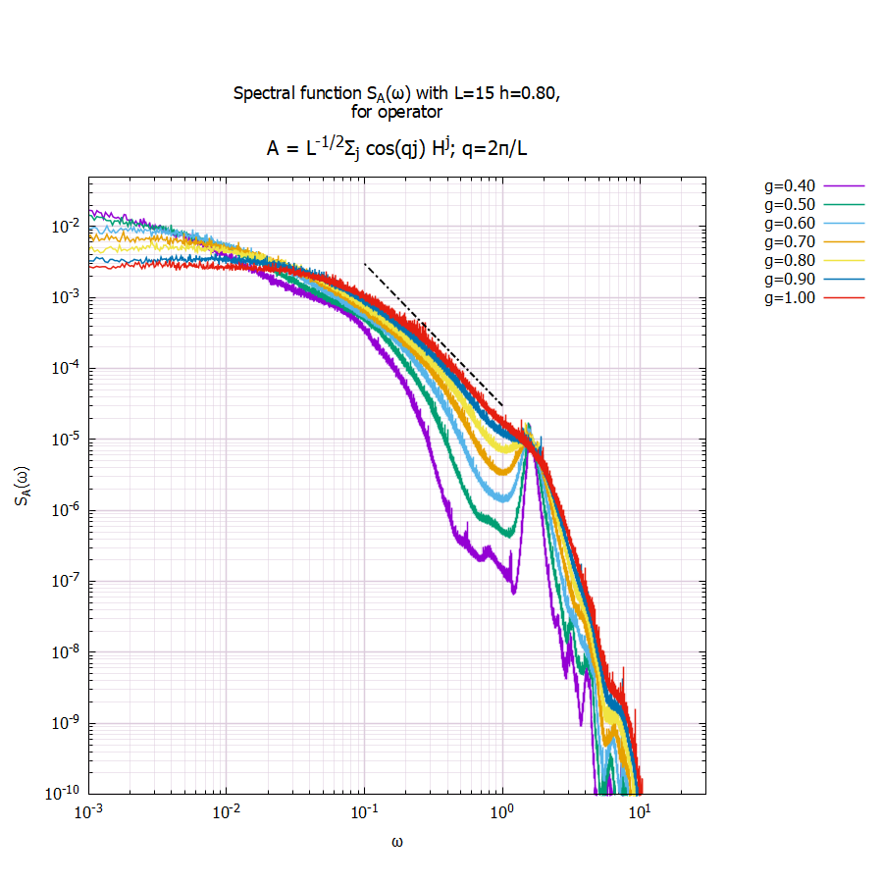
Response functions -Hq
Lorentzian shape at larger g
Dashed line is 1/w^2

Slide 11
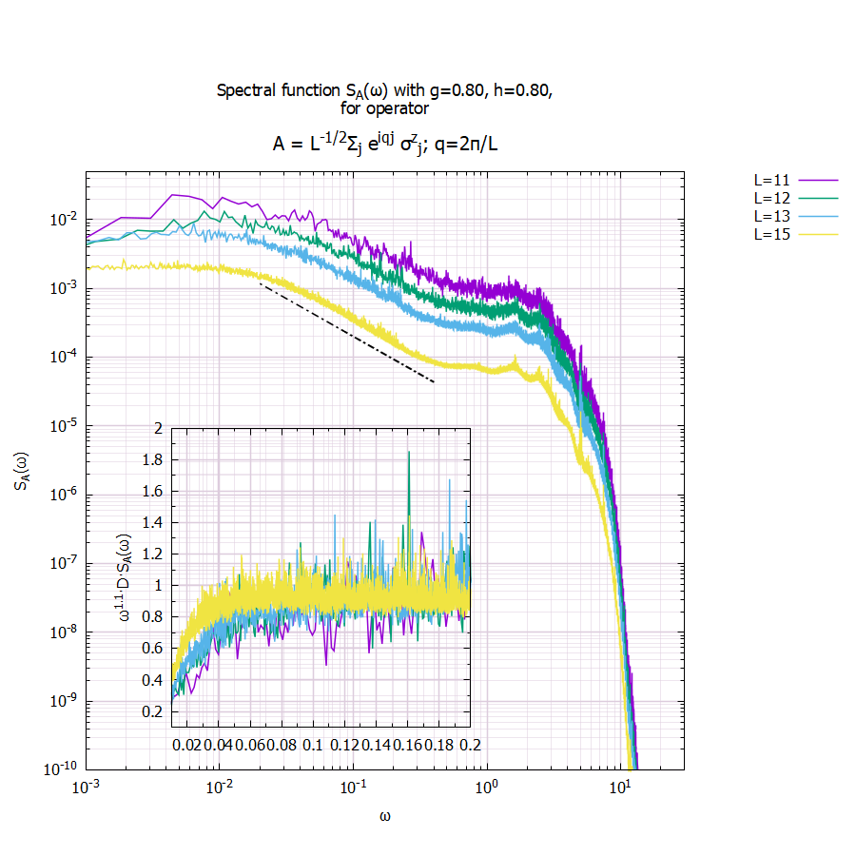
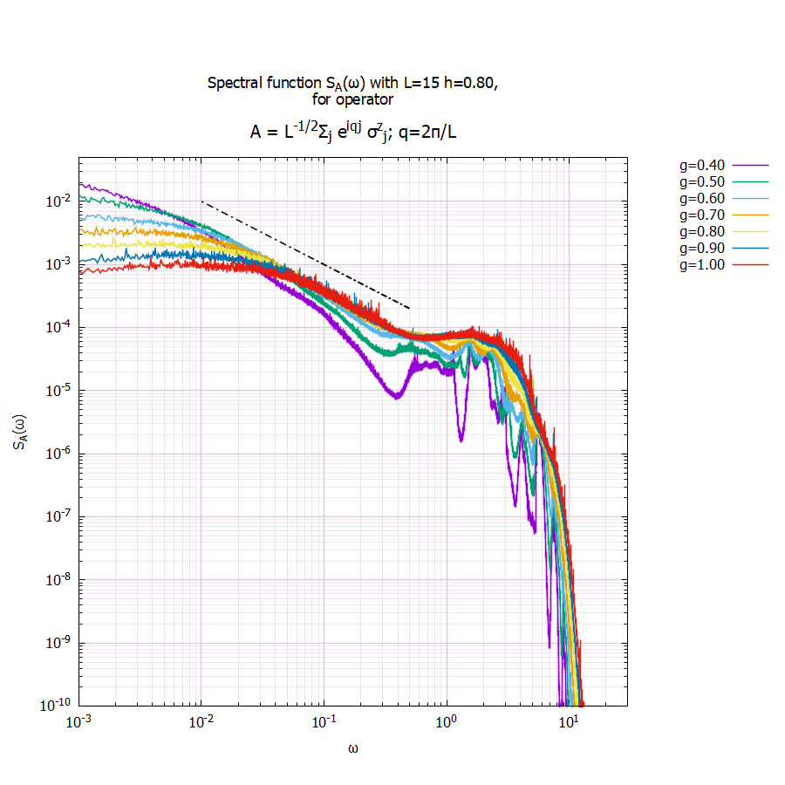
Non-orentzian: 1/w scaling
Integrated spectral function is atanh(w)?
Dashed line is 1/w (left is 1/w^1.1 but its almost the same)

