Slide 1
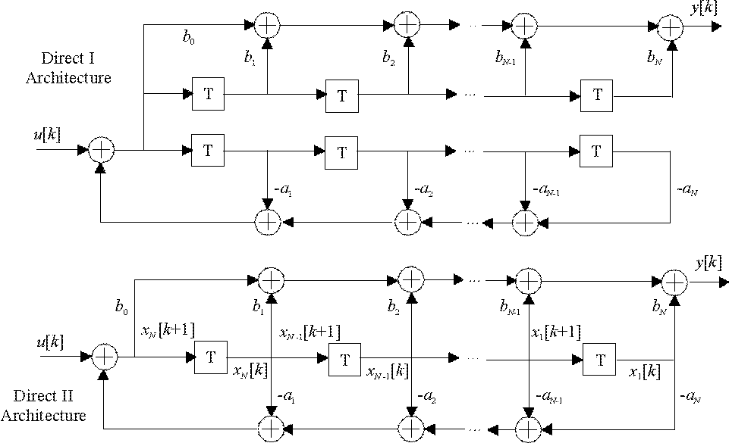
Direct I
Non-canonic Direct I
; (a₀=1)
N(z)
Ku[k]
feedback coefficients.
Lesson 18

Slide 2
Canonic Direct II
N(z).
Ku[k]
feedback coefficients.
Traditionally state ordering
N 1
Lesson 18

Slide 3
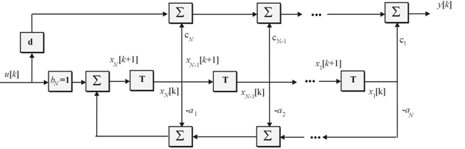
What are their differences?
Alternative Direct II Form.
Lesson 18

Slide 4
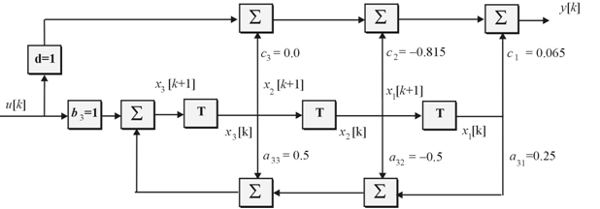
(Super diagonal)
x₃
x₂
x₁
(Traditional ordering)
Lesson 18

Slide 5

Alternative Direct II with MATLAB ordering
x₁
x₂
x₃
State ordering has changed?
Lesson 18

Slide 6
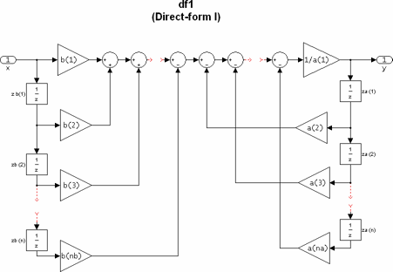
Non-canonic
Lesson 18

Slide 7
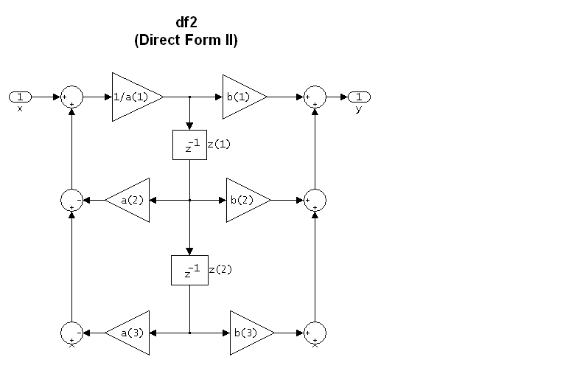
Canonic
Lesson 18

Slide 8
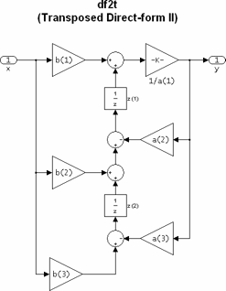
Canonic
Lesson 18

Slide 9
Step 3: State Assignment.
negate
⊕
⊕
y[k]
1
2
-1
x₂[k+1]
x₂[k]
x₁[k]
u[k]
⊕
T
x₁[k+1]
T
1
2
-1
⊕
Lesson 19

Slide 10
Final alternative form with
traditional ordered Direct II.
Check

Lesson 19

Slide 11
Direct II – traditional order
Lesson 19

Slide 12
Direct II alternative form with traditional ordering.
Lesson 19

Slide 13
The cascaded transfer functions of the 3rd order filter are given by:
2 cascaded Direct II sections of order 1 and 2.
How do I build this filter?
Lesson 19

Slide 14
⊕
⊕
y[k]
H₁(z)
H₂(z)
0.3813
-0.479
x₁[k]
x₂[k]
x₃[k]
⊕
T
⊕
⊕
-0.8813
T
T
u[k]
0.5
-0.5
Lesson 19

Slide 15
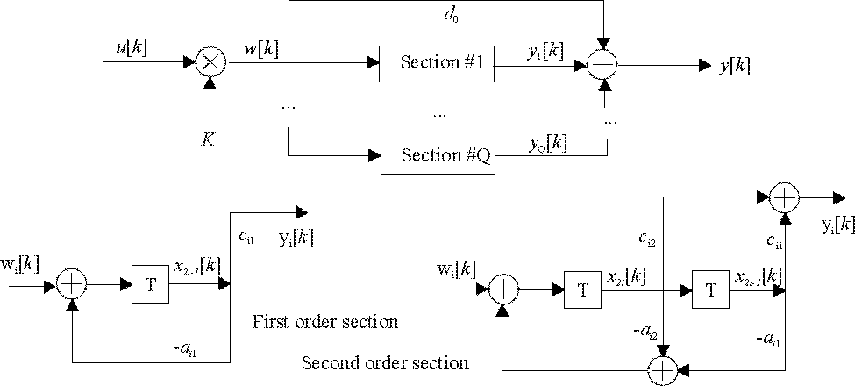
Parallel
Of less importance, the parallel form
Lesson 19

Slide 16
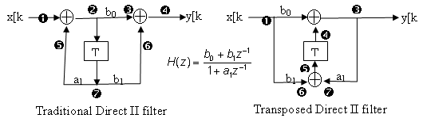
Transposed Architecture
Re-engineer a given architecture
Reverse the direction of flow in all branches.
Reverse the input and output ports.
All nodes become summers, and all summers become nodes.
Result is called a transposed architecture.
Lesson 17

Slide 17
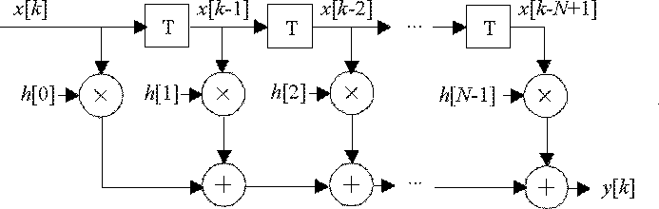
Direct
Direct impulse response?
Lesson 20

Slide 18
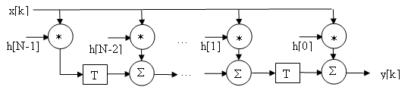
Direct Transpose
Impulse response?
Lesson 20

