Slide 1
Definitions
The consensus problem
Mechanism design problem
Non-linear protocols for optimal distributed consensus in networks of dynamic agents
March 15, 2021

Slide 2
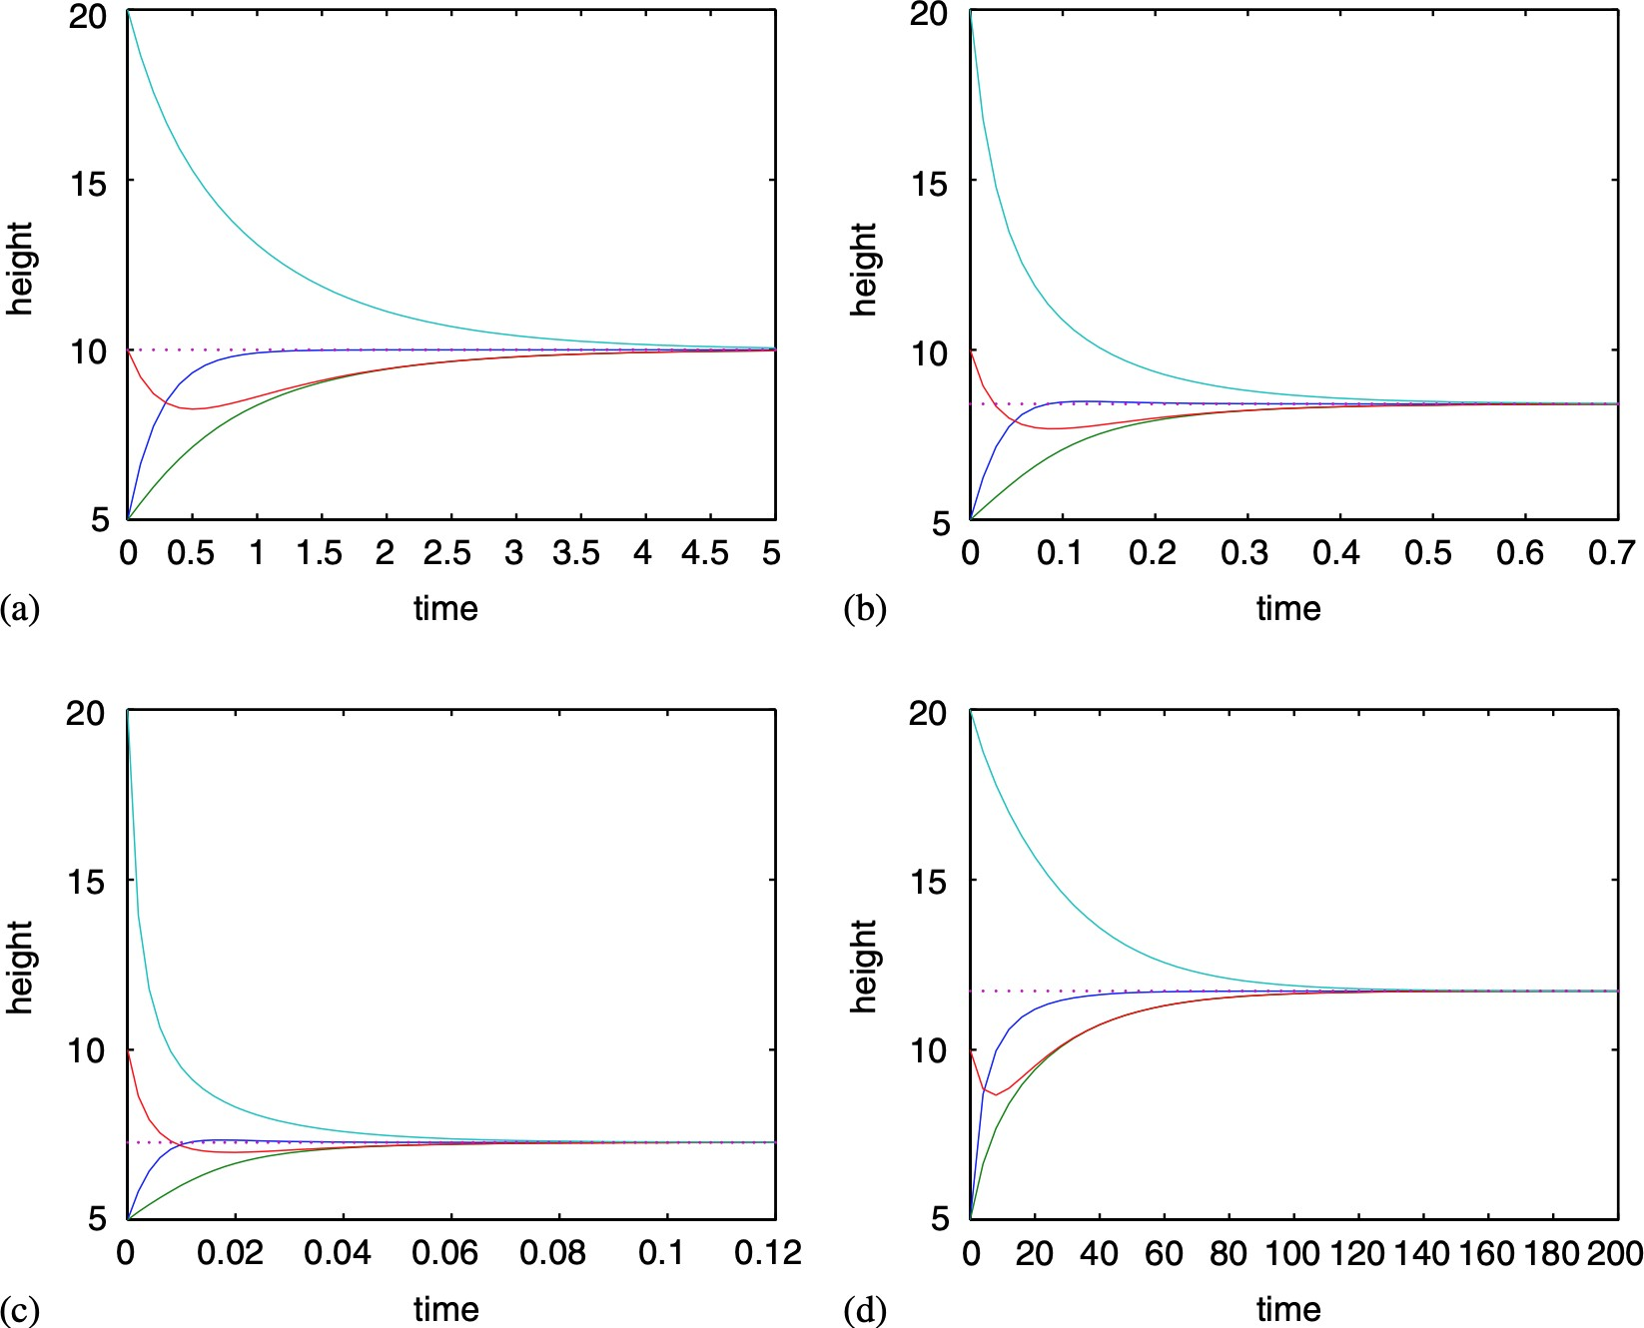
Definitions
The consensus problem
Mechanism design problem
TLDR...

Slide 3

Definitions
The consensus problem
Mechanism design problem
Outline
1
Definitions
2
The consensus problem Time-invariance of χ Convergence of χ
3 Mechanism design problem

Slide 4
Definitions
The consensus problem
Mechanism design problem
Definitions

Slide 5
Definitions
The consensus problem
Mechanism design problem
Definition 1 (Agents)
Γ = 1, . . . , n is a set of agents/players/nodes/vertices and
G = (Γ, E ) is a fixed (in time) undirected, connected, network describing the connections between vertices i ∈ Γ, where
E ⊂ Γ × Γ is the edge set.
Definition 2 (Neighborhood)
A neighborhood of a vertex i is the set of all vertices j for which there is a single edge connecting i , j, that is to say
N_{i} := {j | (i , j ) ∈ E}.

Slide 6
Definitions
The consensus problem
Mechanism design problem
Definition 1 (Agents)
Γ = 1, . . . , n is a set of agents/players/nodes/vertices and
G = (Γ, E ) is a fixed (in time) undirected, connected, network describing the connections between vertices i ∈ Γ, where
E ⊂ Γ × Γ is the edge set.
Definition 2 (Neighborhood)
A neighborhood of a vertex i is the set of all vertices j for which there is a single edge connecting i , j, that is to say
N_{i} := {j | (i , j ) ∈ E}.

Slide 7
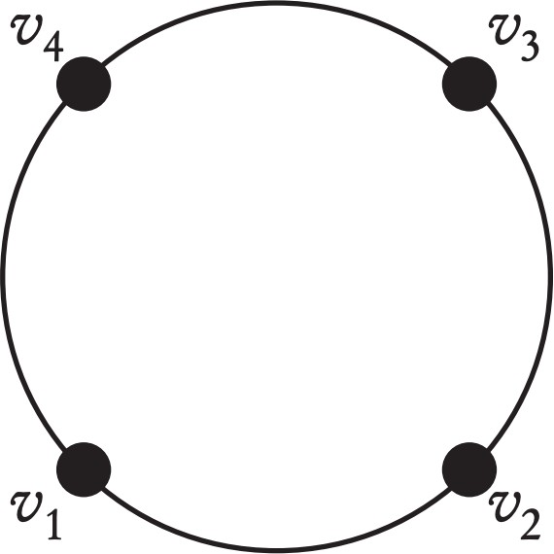
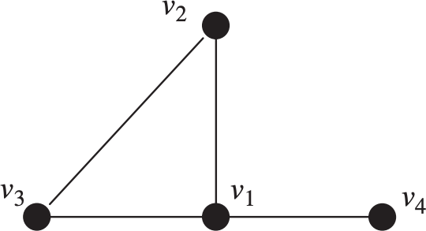
Definitions
The consensus problem
Mechanism design problem
Figure: Neighborhoods

Slide 8
Definitions
The consensus problem
Mechanism design problem
Definition 3 (Control policy)
Let x_{i} (t ) be the state of the agent i at time t, then x_{i} evolves according to a distributed and stationary control policy u_{i} , if x˙_{i} = u_{i} (x_{i} , x_{Ni} ), where x_{Ni} are the states of x_{i} ’s neighbors.
Definition 4 (Protocol)
The protocol of the network is the collection of controls
_u(_x ) := (u_{i} (x_{i} , x_{Ni} )) for all i ∈ Γ.

Slide 9
Definitions
The consensus problem
Mechanism design problem
Definition 3 (Control policy)
Let x_{i} (t ) be the state of the agent i at time t, then x_{i} evolves according to a distributed and stationary control policy u_{i} , if x˙_{i} = u_{i} (x_{i} , x_{Ni} ), where x_{Ni} are the states of x_{i} ’s neighbors.
Definition 4 (Protocol)
The protocol of the network is the collection of controls
_u(_x ) := (u_{i} (x_{i} , x_{Ni} )) for all i ∈ Γ.

Slide 10
Definitions
The consensus problem
Mechanism design problem
Definition 5 (Agreement function)
The agreement function χ : R^{n} → R is any continuous, differentiable function which is permutation invariant, i.e.
χ(x₁, . . . , x_{n} ) = χ(x_{σ(1)}, . . . , x_{σ(n)})
Definition 6 (Consensus)
To reach consensus on consensus value χ(x(0)) means
lim x(t ) = χ(x(0))1
t→∞
where 1 := (1, 1, . . . , 1).

Slide 11
Definitions
The consensus problem
Mechanism design problem
Definition 5 (Agreement function)
The agreement function χ : R^{n} → R is any continuous, differentiable function which is permutation invariant, i.e.
χ(x₁, . . . , x_{n} ) = χ(x_{σ(1)}, . . . , x_{σ(n)})
Definition 6 (Consensus)
To reach consensus on consensus value χ(x(0)) means
lim x(t ) = χ(x(0))1
t→∞
where 1 := (1, 1, . . . , 1).

Slide 12
Definitions
The consensus problem
Mechanism design problem
The consensus problem

Slide 13
Definitions
The consensus problem
Mechanism design problem
Consensus problem
Given a network G of agents and agreement function χ, the consensus problem is to design a protocol u such that consensus is reached for any consensus value χ(x(0)).
Definition 7 (Consensus protocol)
A protocol is a consensus protocol if it is the solution to a consensus problem.

Slide 14
Definitions
The consensus problem
Mechanism design problem
Consensus problem
Given a network G of agents and agreement function χ, the consensus problem is to design a protocol u such that consensus is reached for any consensus value χ(x(0)).
Definition 7 (Consensus protocol)
A protocol is a consensus protocol if it is the solution to a consensus problem.

Slide 15
Definitions
Time-invariance of χ
The consensus problem
Mechanism design problem
Time-invariance of χ

Slide 16
Definitions
Time-invariance of χ
The consensus problem
Mechanism design problem
Lemma 8 (Time invariancy)
Let u be a stationary consensus protocol. Then χ(x(t )) is stationary, i.e. χ(x(t )) = χ(x(0)) for all t > 0.
Proof.
By assumption x(t ) → χ(x(0))1. Stationary u is equivalent to autonomous and therefore, if x(t ) is a solution, then
y_{s} (t ) := x(t + s ) (with y_{s} (0) := x(s )) is also a solution. For such
y_{s} we also have y_{s} (t ) → χ(y_{s} (0))1 i.e.
lim y_{s} (t ) = χ(y_{s} (0)1) = χ(x(s ))
t→∞
But since both y_{s} , x converge to the same limit we must have
χ(x(s )) = χ(x(0)) for all s.

Slide 17
Definitions
Time-invariance of χ
The consensus problem
Mechanism design problem
Lemma 8 (Time invariancy)
Let u be a stationary consensus protocol. Then χ(x(t )) is stationary, i.e. χ(x(t )) = χ(x(0)) for all t > 0.
Proof.
By assumption x(t ) → χ(x(0))1. Stationary u is equivalent to autonomous and therefore, if x(t ) is a solution, then
y_{s} (t ) := x(t + s ) (with y_{s} (0) := x(s )) is also a solution. For such
y_{s} we also have y_{s} (t ) → χ(y_{s} (0))1 i.e.
lim y_{s} (t ) = χ(y_{s} (0)1) = χ(x(s ))
t→∞
But since both y_{s} , x converge to the same limit we must have
χ(x(s )) = χ(x(0)) for all s.

Slide 18
Definitions
Time-invariance of χ
The consensus problem
Mechanism design problem
Note
_{= ∑} ∂χ _{xi} ∂χ
_{i ∂xi} ˙ = ∑ _{∂xi} u_{i} = 0
∈Γ i∈Γ
dχ(x(t )) dt
Thus, a consensus protocol must satisfy ∇χ · u = 0.
Example 9
For χ(x) = min_{i∈Γ} (x_{i} ), a suitable u is
(
u = h x , min x
i i
j∈Ni
j
where h(x , y ) = 0 when x = y .

Slide 19
Definitions
Time-invariance of χ
The consensus problem
Mechanism design problem
Henceforth, we assume further structure for the agreement function:
χ(x) := f ∑ g (x_{i} )'
(1)
i∈Γ
with f , g : R → R and g^{t} /= 0.
Fact 10
Means of order psatisfy the assumptions
Mean χ(x)
Arithmetic
f (y )
g (z ) z
1
∑
x
y
|Γ|
i∈Γ
i
|Γ|
Geometric Harmonic
p−mean
1/|Γ|
_{e} /|Γ|
⁽∏i∈Γ ^{x}i ⁾
y
log (z )
|Γ|
|Γ|
1
y
z
_{z}p
(
∑i∈Γ ^{x}i⁻¹
) ( )
1
|Γ|
p
1/p
y
1/p
∑ x
i∈Γ i
|Γ|

Slide 20
Definitions
Time-invariance of χ
The consensus problem
Mechanism design problem
Theorem 11 (Protocol design rule)
The following protocol
1
∑
u (x , x ) :=
φ(x_{j} , x_{i} ) (2)
i i N
i
^{gt} j∈Ni
with g^{t} /= 0, induces time-invariance in χ if φ is antisymmetric, i.e.
φ(x_{j} , x_{i} ) = −φ(x_{i} , x_{j} )

Slide 21
Definitions
Time-invariance of χ
The consensus problem
Mechanism design problem
Proof.
χ is time-invariant iff
d _{∑ g (xi ) = ∑} dg (x_{i} (t )) _{= ∑} dg (x_{i} ) _{x˙i = ∑ gtui = 0}
^{dt} i∈Γ
i∈Γ ^{dt} i∈Γ ^{dxi} i∈Γ
Finally, since φ is antisymmetric and the graph defining the network is undirected, we have that
∑ g^{t}u_{i} = ¹ ∑ g^{t} ∑ φ(x_{j} , x_{i} ) = 0
i∈Γ
^{gt} i∈Γ j∈Ni

Slide 22
Definitions
Time-invariance of χ
The consensus problem
Mechanism design problem
Example 12
Consider φ(x_{j} , x_{i} ) := α · (x_{j} − x_{i} ). Then the p−mean is time invariant under protocol
_{x} 1−p _{x} 1−p
i
p
∑ φ(x_{j} , x_{i} ) = α · ∑ (x_{j} − x_{i} )
u_{i} (x_{i} , x_{Ni} ) :=
i
p
j∈Ni j∈Ni

Slide 23
Definitions
Convergence of χ
The consensus problem
Mechanism design problem
Convergence of χ

Slide 24
Definitions
Convergence of χ
The consensus problem
Mechanism design problem
Owing to time-invariance of χ, if the system converges, it will converge to χ(x(0))1. But it does not necessarily converge. when g is strictly increasing and the function φ is defined
φ(x_{j} , x_{i} ) := αφ(θ(x_{j} ) − θ(x_{i} ))
where α > 0 and φ is continuous, locally Lipschitz, odd and strictly increasing, and θ : R → R is differentiable with θ^{t} locally Lipschitz and strictly positive. Thus, the protocol (2) becomes
∑
u_{i} (x_{i} , x_{N} ) := ^{α} φ (θ(x ) − θ(x ))
(3)
i
j i
^{gt} j∈Ni
First we study the equilibria of the system.

Slide 25
Definitions
Convergence of χ
The consensus problem
Mechanism design problem
Lemma 13
Let G be a network and u be a protocol with components defined by eqn. (3). Then all equilibria x∗ of the network have the following properties:
x∗ = λ1 for some λ
if x(t ) converges to the equilibrium λ₀1, then λ₀ = χ (x (0)), for any initial state x(0)
1
2
Proof (sketch).
Sufficiency 1 x_{i} = λ, then φ (θ(λ) − θ(λ)) = 0 since φ is odd and continuous.
Necessity 1 x∗ /= λ, then there exists u_{i} < 0 (contradicts equilibrium).
Convergence if λ /= χ (x (0)) then χ is not time-invariant.

Slide 26
Definitions
Convergence of χ
The consensus problem
Mechanism design problem
Lemma 13
Let G be a network and u be a protocol with components defined by eqn. (3). Then all equilibria x∗ of the network have the following properties:
x∗ = λ1 for some λ
if x(t ) converges to the equilibrium λ₀1, then λ₀ = χ (x (0)), for any initial state x(0)
1
2
Proof (sketch).
Sufficiency 1 x_{i} = λ, then φ (θ(λ) − θ(λ)) = 0 since φ is odd and continuous.
Necessity 1 x∗ /= λ, then there exists u_{i} < 0 (contradicts equilibrium).
Convergence if λ /= χ (x (0)) then χ is not time-invariant.

Slide 27
Definitions
Convergence of χ
The consensus problem
Mechanism design problem
Theorem 14
Let G be a network of agents that implement a distributed and stationary protocol
∑
u_{i} (x_{i} , x_{N} ) := ^{α} φ (θ(x ) − θ(x ))
i
j i
^{gt} j∈Ni
against agreement function of the form (1) with g ^{t} > 0. Then the agents asymptotically reach consensus on χ (x (0)) for any initial state x(0).

Slide 28
Definitions
Convergence of χ
The consensus problem
Mechanism design problem
Proof (idea).
Define
η_{i} := g (x_{i} ) − g (χ (x (0)))
and note that, since η is strictly increasing (since g is ) and η = 0 iff x = χ (x (0)), consensus corresponds to asymptotic stability of η around 0. Introduce a candidate Lyapunov function
1 ∑ 2
i
V (η) :=
η
² i∈Γ
Then V (η) = 0 iff η = 0, V (η) > 0 if η /= 0, and V˙ (η) < 0 if
η /= 0 proves stability.

Slide 29
Definitions
The consensus problem
Mechanism design problem
Mechanism design problem

Slide 30
Definitions
The consensus problem
Mechanism design problem
Definition 15 (Individual objective function)
Define an individual objective function for an agent i
T
)
J (x , x , u ) := lim
2
i i Ni i
F (x , x ) + ρu_{i}
dt
T→∞
i Ni
0
where ρ > 0 and F : R × R^{n} → R is a non-negative penalty function that measures the deviation of agent i ’s state x_{i} from its neighbors’ states. A protocol is optimal if each u_{i} optimizes an agent’s corresponding individual objective.
Mechanism design problem
Consider a network of agents. The mechanism design problem is, for any agreement function χ, determine a penalty F such that there exists an optimal consensus protocol u with respect to χ(x(0)) for any initial state x (0).

Slide 31
Definitions
The consensus problem
Mechanism design problem
Definition 15 (Individual objective function)
Define an individual objective function for an agent i
T
)
J (x , x , u ) := lim
2
i i Ni i
F (x , x ) + ρu_{i}
dt
T→∞
i Ni
0
where ρ > 0 and F : R × R^{n} → R is a non-negative penalty function that measures the deviation of agent i ’s state x_{i} from its neighbors’ states. A protocol is optimal if each u_{i} optimizes an agent’s corresponding individual objective.
Mechanism design problem
Consider a network of agents. The mechanism design problem is, for any agreement function χ, determine a penalty F such that there exists an optimal consensus protocol u with respect to χ(x(0)) for any initial state x (0).

Slide 32
Appendix
For Further Reading
A. Author.
Handbook of Everything. Some Press, 1990.
S. Someone.
On this and that.
Journal on This and That. 2(1):50–100, 2000.

