Slide 1
Software Development
Planning & Prototyping
Md. Abdul Munim Dibosh

Slide 2
What we will learn today?
What’s this?
What tools should I make ready before starting?
Is it really important?
Inspirations/Examples?
Who are following this procedure?
Enough talk! Now show me something practical…

Slide 3
Prototyping
A solid start up for your software development project.
Clearer idea of your goals and motivations.
Less development time & complexity.

Slide 4
Tools you should have ;)
Paper & Pencil
Your computer
Favorite music playing on
A cup of coffee/tea
A peaceful mind with a clear vision

Slide 5
Your software should be
Intuitive :: don’t make me think!
Fluid :: huh, it’s hanged!
Pluggable :: whoa, I can’t update it?
Scalable :: so , you say your system will fail to handle this load?
Modern :: Duh, didn’t you hear about the technology they used?

Slide 6
Your software shouldn’t be
A box of irrelevant colors :: everything has a limit!
Complex :: better you said me to solve that puzzle.
Static :: you need this to push it inside, but you don’t have any doors!
Unmanageable :: humm, I think you can’t even understand your code.

Slide 7
Getting started
Paper & Pen/Pencil
List target users
List features
Filter out all but the features for initial build
Plan the scenarios
Create wireframes in paper
Develop mockups and flows

Slide 8
Architectures & Frameworks
Frameworks help you to maintain manageable codes.
Decoupled development.
Common patterns should be applied.
Think simple, do it simply.
Never dive into development without a concrete plan.

Slide 9
Start prototyping
Basic sketch of the idea
Flow/Sitemap plan
Wire-framing
Mockup design

Slide 10
Confused?
Basic sketch : Give your ideas pictorial meaning(Tools: Pen & Paper)
Flow/Sitemap : Flow chart of linked screens/pages(Tools: Pen & Paper/Software)
Wire-framing : Add some more details to your initial sketch, label specific parts, make more understandable(Tools: Pen & Paper/Software)
Mockups : More detailed, actually the look that will be developed in your app(Tools: Software)

Slide 11
Inspirations/Case studies?
http://www.f-i.com/nickelodeon/kids-choice-awards/
http://www.f-i.com/google/ramayana/

Slide 12
Let’s do something
Title: PhotoShop
Concept: Love to see photos from professional photographers? Want to buy some for purpose? Then don’t forget to check PhotoShop.
Target users: Developers, Teachers, Doctors etc.
Main features: Submit/Buy photos
Can be a huge thing to complete, let’s focus on first 2 pages.

Slide 13
Sitemap
Home
Gallery
Let’s keep it simple for now…

Slide 14
Drawn wireframes

Slide 15
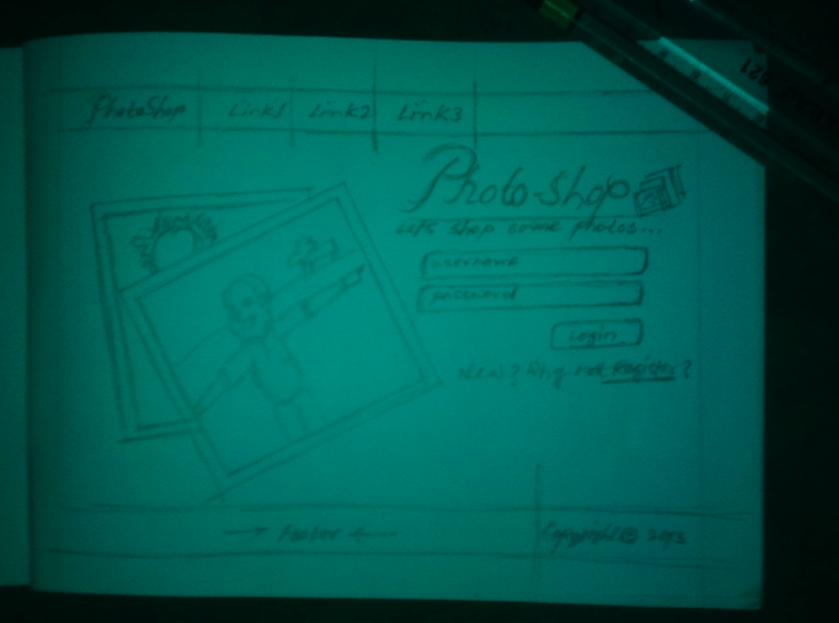
Wireframes-1

Slide 16
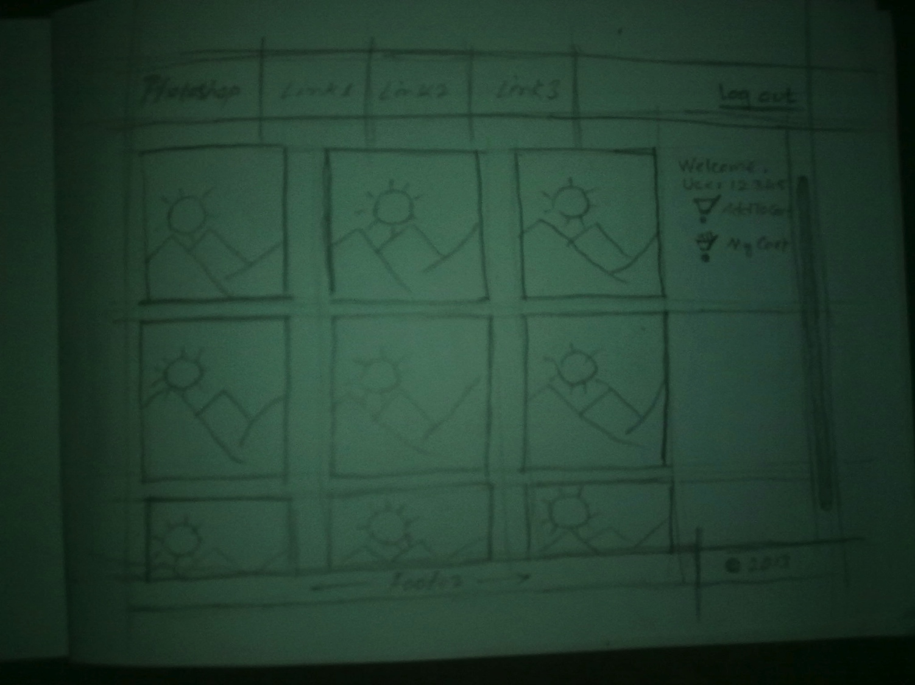
Wireframes-2

Slide 17
Tools for final Mockup
http://moqups.com
Pencil (http://pencil.evolus.vn/)

Slide 18
Final Mockups

Slide 19
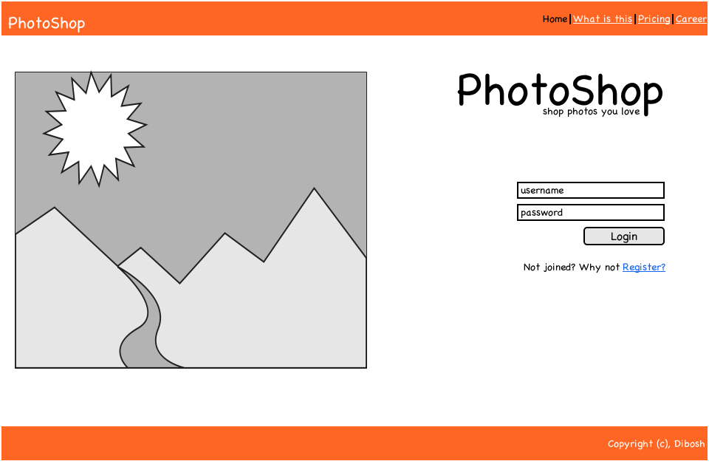
PhotoShop-Home

Slide 20
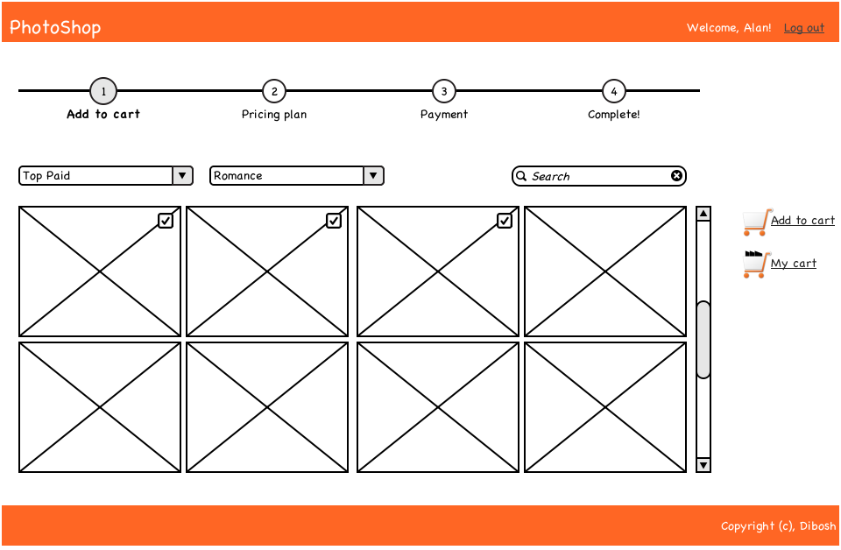
PhotoShop-Gallery

Slide 21
Interactive Prototyping
Prototypes with event triggers.
With commenting/annotations feature.
Best for Professionals.
http://invisionapp.com (Free for 1 project)

Slide 22
Feedback
Your design might not be the best one.
Designing is always iterative. You need continuous feedback before finalizing.
For easy & simple feedback mechanism: http://www.useapollo.com/

Slide 23
Who are used to this?
Microsoft
Apple
Google
facebook
Etc.
Don’t just believe whatever I say ☺
Check their mobile dev sites on your own!
They share thousands of best practices
regarding this.

Slide 24
Got something to ask?
Wait! I don’t guarantee I know everything! So ask on your own risk! ☺

