Slide 1
Node.js Express
By Strus Maksym

Slide 2

Express
Fast, unopinionated, minimalist web framework for Node.

Slide 3
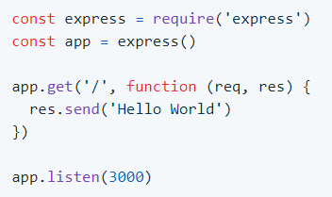
Example of Express app

Slide 4

Request & Response
Express application uses a callback function whose parameters are request and response objects.

Slide 5
Basic Routing
We have seen a basic application which serves HTTP request for the homepage. Routing refers to determining how an application responds to a client request to a particular endpoint, which is a URI (or path) and a specific HTTP request method (GET, POST, and so on).

Slide 6
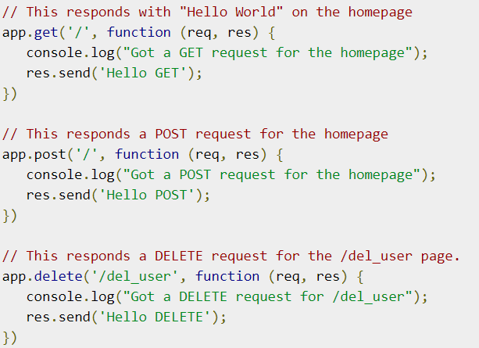
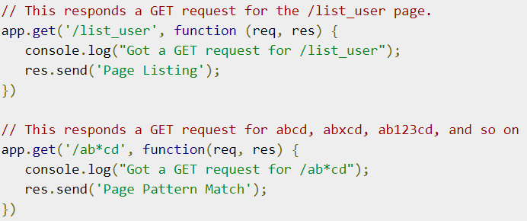
Example of routing

Slide 7
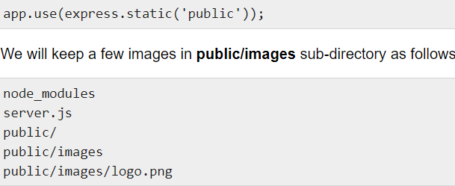
Serving Static Files
Express provides a built-in middleware express.static to serve static files, such as images, CSS, JavaScript, etc.
You simply need to pass the name of the directory where you keep your static assets, to the express.static middleware to start serving the files directly. For example, if you keep your images, CSS, and JavaScript files in a directory named public

Slide 8
Middleware
Middleware functions are functions that have access to the request object (req), the response object (res), and the next middleware function in the application’s request-response cycle. The next middleware function is commonly denoted by a variable named next.
Middleware functions can perform the following tasks:
Execute any code.
Make changes to the request and the response objects.
End the request-response cycle.
Call the next middleware in the stack.

Slide 9
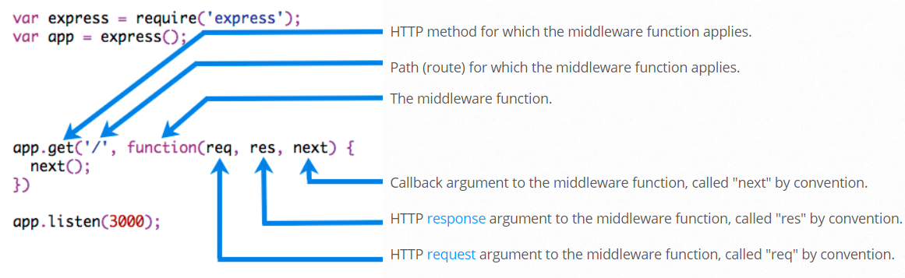
Middleware’s workflow

Slide 10
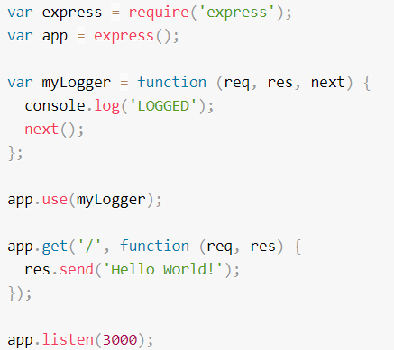
Middleware’s example

Slide 11
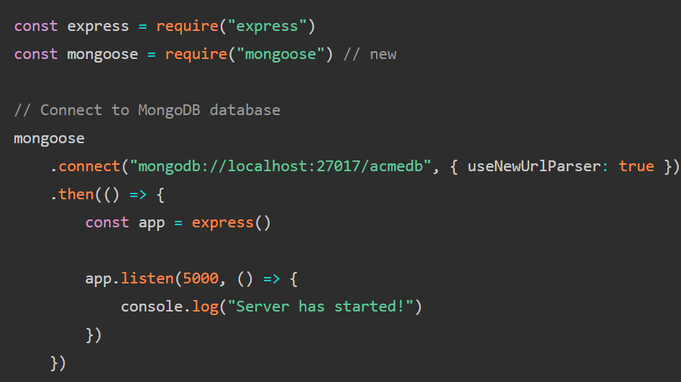
Mongoose with express
Mongoose is the most preferred MongoDB wrapper for Node.js. It allows us to interact with MongoDB database with ease. We can start connecting our server into our MongoDB database.

Slide 12


