Slide 1
F.prototype, prototypal inheritance
By Strus Maksym

Slide 2
Description of prototypical programming
Prototype-based programming is a style of object-oriented programming in which behaviour reuse (known as inheritance) is performed via a process of reusing existing objects that serve as prototypes. This model can also be known as prototypal, prototype-oriented, classless, or instance-based programming.
Prototype-based programming uses generalized objects, which can then be cloned and extended. Using fruit as an example, a "fruit" object would represent the properties and functionality of fruit in general. A "banana" object would be cloned from the "fruit" object and general properties specific to bananas would be appended. Each individual "banana" object would be cloned from the generic "banana" object. Compare to the class-based paradigm, where a "fruit" class would be extended by a "banana" class.

Slide 3
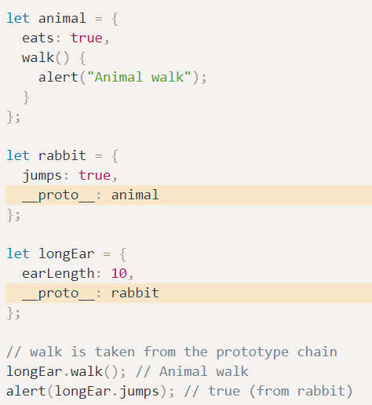
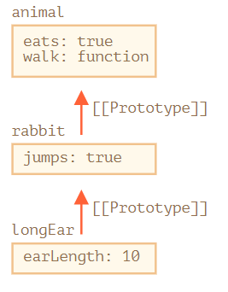
Example of using __proto__

Slide 4
Limitations for __proto__

Slide 5

The value of “this”

Slide 6
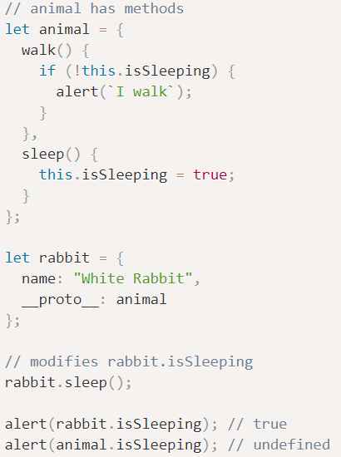
Example of using this with prototypes

Slide 7
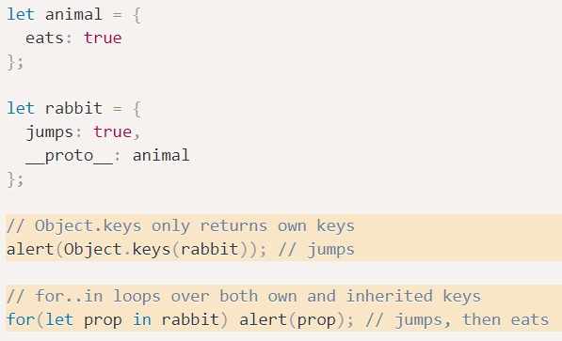
For…in loops with prototypes

Slide 8

F.prototype

Slide 9
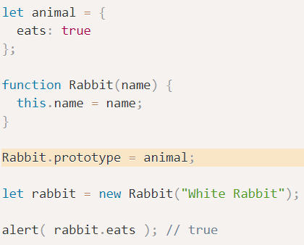
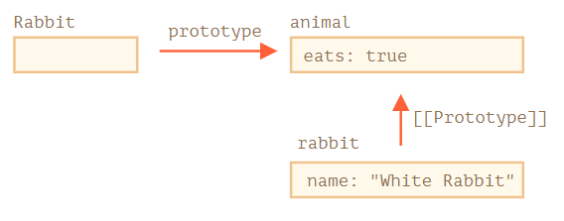
Prototype property example

Slide 10
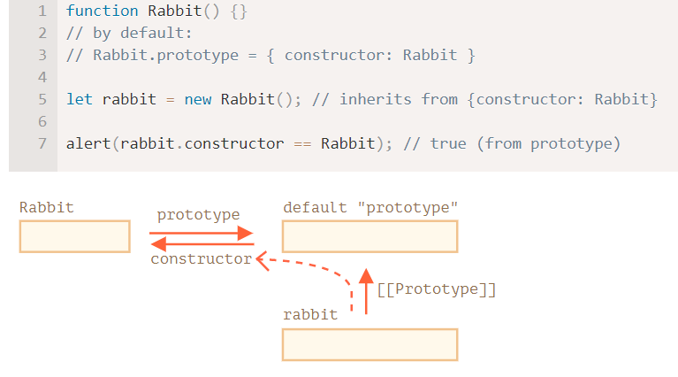
Prototype constructor example

Slide 11


