Slide 1
Rendering
By Strus Maksym

Slide 2

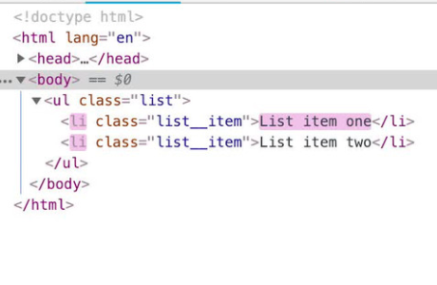
Process of React rendering
We can easily render and add an element to ours page. It`s possible with ReactDOM.render method. We can easily re-render current web page using VDOM

Slide 3
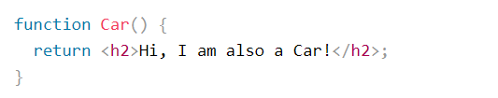
Function Rendering
We just must return a value for rendering an items in the functional element

Slide 4
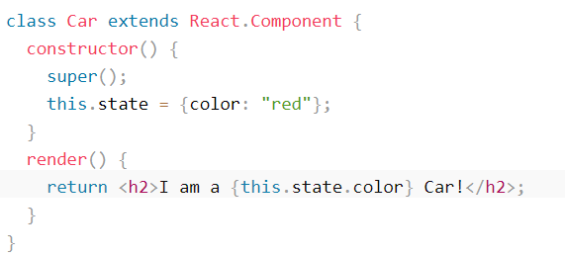
Class Rendering
For rendering the class component we must use render method

Slide 5
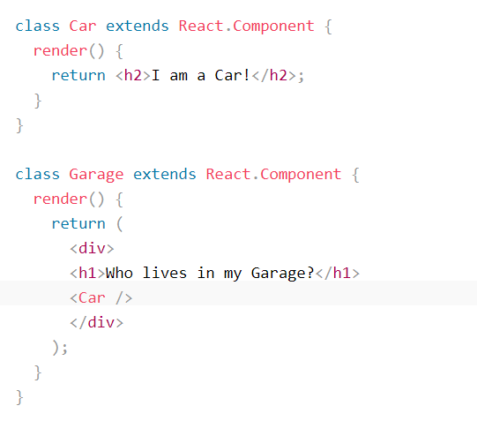
Components in components
We can use nesting for rendering components in components

Slide 6
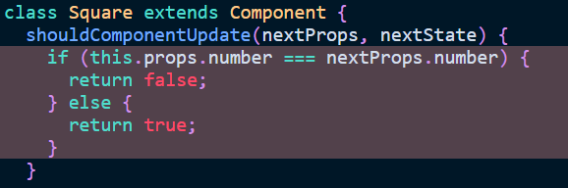
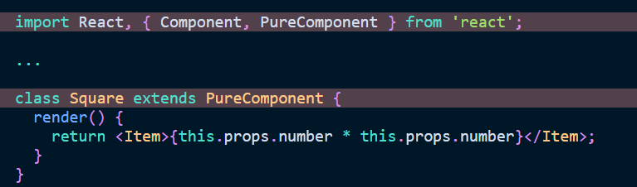
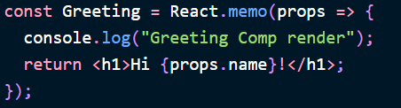
Restriction
We can use shouldComponentUpdate and PureComponents to restrict rendering ratio in classes and React.memo in functions

Slide 7
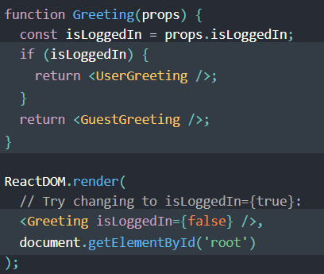
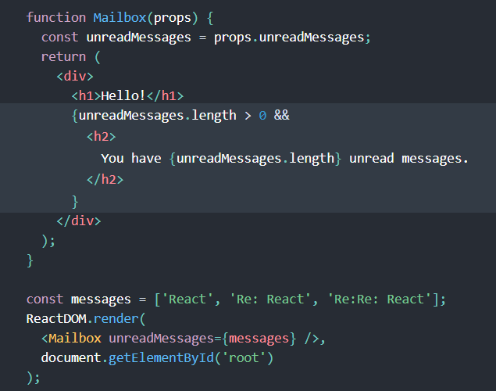
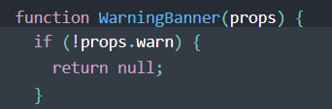
Conditional rendering

Slide 8


